Slide 1
Project Update and Summary of
Project Priority List (PPL) Activity
March 8, 2018

Slide 2
Project Update Agenda
Project Portfolio Update p. 3-8
  Recent / Upcoming Project Implementations
  2018 Release Targets
  Planned Project Starts
  2018 Project Spending Forecast
  Revision Request Funding Placeholder Status
  Priority/Rank Options for Revision Requests with Impacts
Appendix
  Project Portfolio Gantt Chart p. 9-15
Location of Project Priority List (PPL): http://www.ercot.com/services/projects/index

Slide 3
Recent / Upcoming Project Implementations
2018 February Release – 2/6/2018 – 2/8/2018 Complete
  NPRR659 – Discontinue RMR Cost Data Deviation Requests/Responses Rpt
  NPRR683 – Revision to Available Credit Limit Calculation
  NPRR743 – Revision to MCE to Have a Floor For Load Exposure
  NPRR760 – Calculation of Exposure Variables For Days With No Activity
  NPRR800 – Revisions to Credit Exposure Calculations to Use Electricity Futures Market Prices
  NPRR810 – Applicability of RMR Incentive Factor on Reservation and Transportation Costs Associated with Firm Fuel Supplies
2018 April Release – 4/3/2018 – 4/5/2018 In Flight
  NPRR562(b) – Subsynchronous Resonance
    MIS link for posting of annual SSR topology-check report
  NPRR776 – Voltage Set Point Communication
  SCR792 – Enhance Communications of BAAL Exceedances
CMM Release 1a
Note: Projected Go-Live dates are subject to change.
Please watch for market notices as the effective dates approach.

Slide 4
2018 Release Targets – Board Approved NPRRs / SCRs / xGRRs
February 2/6 – 2/8 | April 4/3 – 4/5 | May 5/29 – 5/31 | August 8/7 – 8/9 | October 10/23 – 10/25 | December 12/11 – 12/13
NPRR659 NPRR683 NPRR743 NPRR760 NPRR800 NPRR810 PGRR042 NPRR846 | NPRR562(b) NPRR776 SCR792 | NPRR768 NPRR809(b) NPRR815 SCR791 |  | NPRR817 NPRR843 | NPRR519 NPRR620 NPRR741 NPRR755 PGRR057 SCR789
8 | 3 | 4 | 0 | 2 | 6
ü
ü
ü
ü
ü
ü
ü
ü
E
E
E
P
E
P
I
NS
NS
E
E
E
E
E
I
CMM Release 1a
CMM Release 1b
1/1 & 2/1
4/7 – 4/8
(Retail)
6/2 – 6/3
(Retail)
8/11 – 8/12
(Retail)
10/27 – 10/28
(Retail)
12/15 – 12/16
(Retail)
1/1
2/1
TBD Items (and point at which they became “TBD”)
2014 | 2015 | 2016 | 2017
NPRR664 | None | SCR781 P | NPRR702 P, SCR777, NPRR831(b), NPRR749 E, NPRR833 E, NPRR819, NPRR842, NPRR844, SCR794
Go-live dates can differ from Protocol effective dates – Please refer to market notices for more details
APPENDIX
Red Text: New additions and target release changes
Strike-Through Text: Previous target release changes
(a), (b), etc. indicates multiple phases
Project Status Codes
NS = Not Started
I = Initiation
P = Planning
E = Execution
H = On Hold
Release targets are subject to change
NPRR562(b) – Reporting/posting system changes
NPRR809(b) – Reporting/posting system changes
NPRR831(b) – CRR system changes

Slide 5
Approved Revision Requests “Not Started” – Planned to Start in Future Months
Revision Request | Target Start Date | Release Target | Cost Estimate | Author
NPRR817 – Create a Panhandle Hub | Mar 2018 | 2018-R5 | $150k-$200k | DC Energy
NPRR843 – Short-Term System Adequacy and AS Offer Disclosure Reports Additions | May 2018 | 2018-R5 | $70k-$90k | ERCOT
NPRR821 – Elimination of the CRR Deration Process for Resource Node to Hub or Load Zone CRRs | Jan 2019 | 2019-R3 | $30k-$50k | DC Energy
NPRR829 – Incorporate Real-Time Non-Modeled Telemetered Net Generation by Load Zone into the Estimate of RTL | Aug 2019 | 2020-R1 | $200k-$300k | Enchanted Rock
NPRR825 – Require ERCOT to Issue a DC Tie Curtailment Notice Prior to Curtailing any DC Tie Load | TBD | TBD | $200k-$300k | Rainbow Energy
NPRR841 – Real-Time Adjustments to Day-Ahead Make Whole Payments due to Ancillary Services Infeasibility Charges | TBD | TBD | $60k-$80k | ERCOT
Regulatory
2019 Priority
2019 Priority
Dependent on internal ERCOT project
2019 Priority
Aging Items Report | Last Action | Status
NPRR664 – Fuel Index Price for Resource Definition and Real-Time Make-Whole Payments for Exceptional Fuel Cost Events | Board approved on 12/9/2014 | Pending submission / approval of alternate approach

Slide 6
2018 Project Spending
2018 PPL Budget = $20.0M
“Potential Demand” represents internal ERCOT projects that have not been fully approved

Slide 7
Revision Request Funding Placeholder Status
In 2018 and 2019, ERCOT forecasted $4.0M for Revision Request work
Yearly Revision Request Spending Forecast Summary
Project Status | 2018 | 2019
YTD Actuals | $0.24M
Approved – In-Flight / Complete | $1.60M | $0.00M
Approved – On Hold | $0.00M | $0.00M
Approved – Not Started | $0.19M | $0.12M
Remaining Funding | $2.21M | $3.88M
Total Allocation | $4.00M | $4.00M
As of 1/31/2018

Slide 8
Priority / Rank Options for Revision Requests with Impacts
Options for…
Revision Request | Description | Priority | Rank | Comments
NPRR853 | Availability of ERCOT Estimated Interval Meter Data | – | – | More time requested for IA so ERCOT comments can be considered
NPRR858 | Provide Complete Current Operating Plan (COP) Data | TBD | TBD | Market input requested $25k-$45k, 3-5 months, DAIP
NPRR864 | RUC Modifications to Consider Market-Based Solutions | TBD | TBD | Market input requested $150k-$200k, 5-8 months, MMS
NPRR865 | Publish RTM Shift Factors for Hubs, Load Zones, & DC Ties | TBD | TBD | Market input requested $30k-$40k, 3-5 months, MMS/DAIP
SCR793 | SSR Related Telemetry for Cross Texas Transmission | – | – | IA still pending as of 3/5/2018 Expected to be available at PRS
SCR795 | Addition of Intra-Hour Wind Forecast to GTBD Calculation | 2018 | 2170 | Work into the 2018 project plan without disrupting in-flight projects $30k-$40k, 3-4 months, MMS
PPL Rank Information
Next available Rank in Business Strategy = 2170
Next available Rank in Regulatory = 200

Slide 9
Appendix
  3/1/2018 Project Gantt
    In-flight items sorted by Project End Date
    “On Hold” projects listed separately
      None at this time
    “Not Started” items sorted by Project Start Date

Slide 10
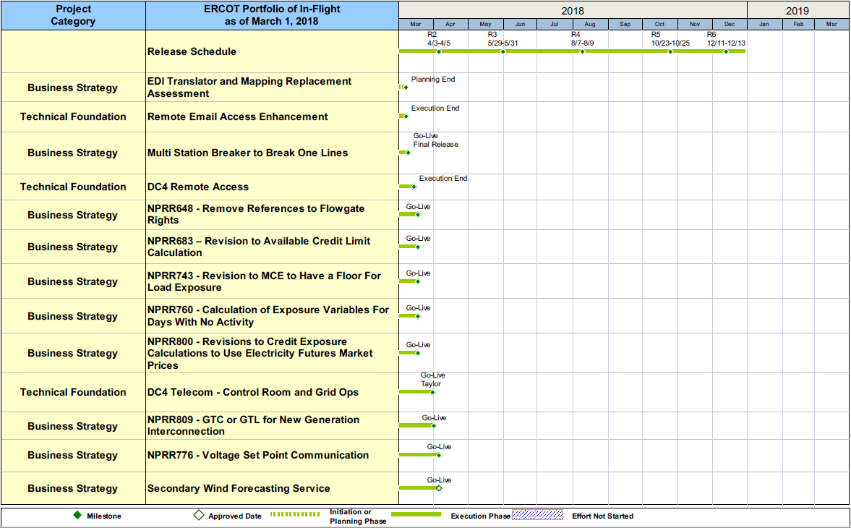
Project Portfolio Status – as of 3/1/2018

Slide 11
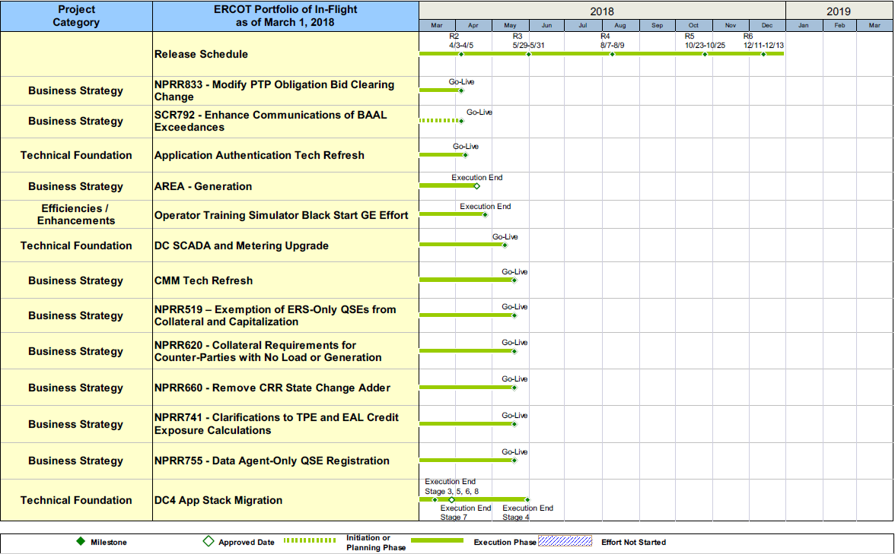
Project Portfolio Status – as of 3/1/2018

Slide 12
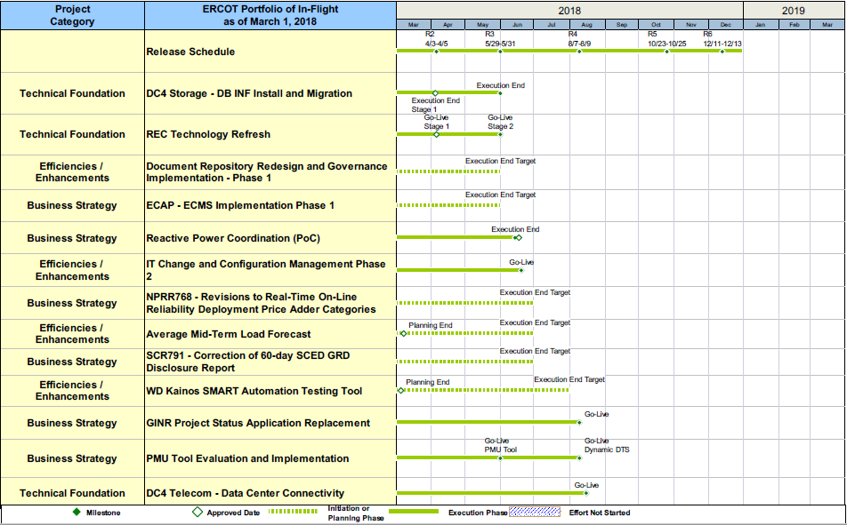
Project Portfolio Status – as of 3/1/2018

Slide 13
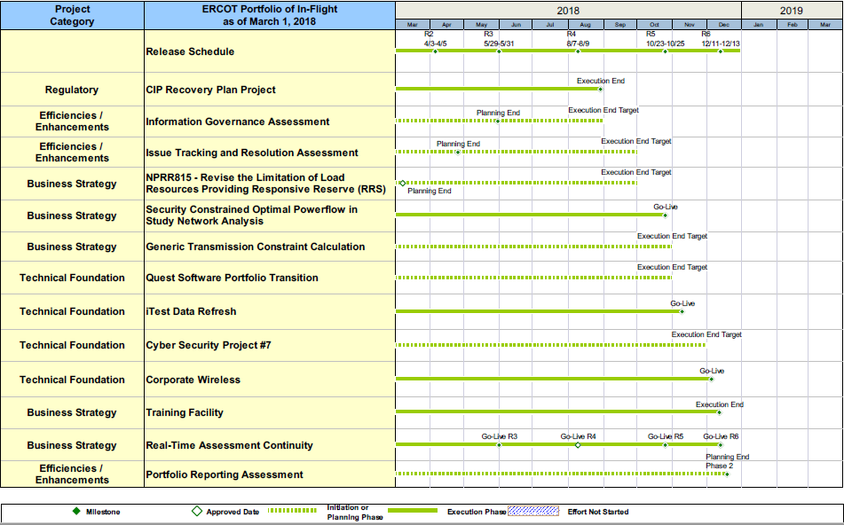
Project Portfolio Status – as of 3/1/2018

Slide 14
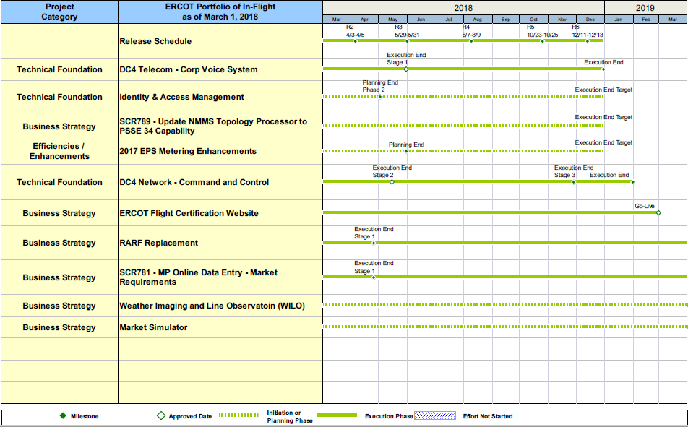
Project Portfolio Status – as of 3/1/2018

Slide 15
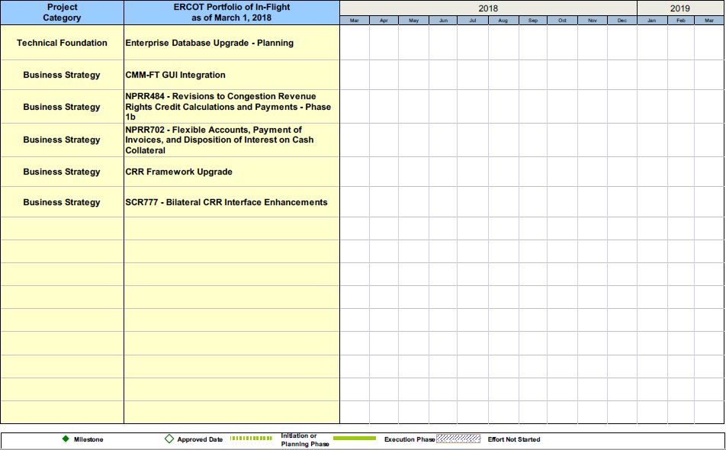
Project Portfolio Status – as of 3/1/2018

Slide 16
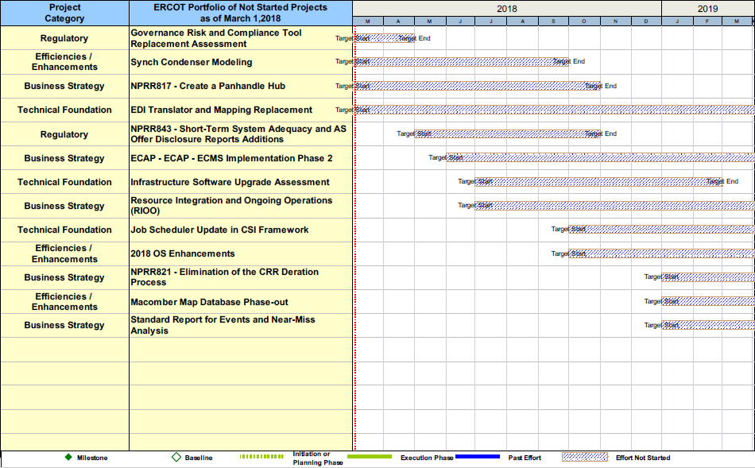
Project Portfolio Status – as of 3/1/2018

