Slide 1
Monthly COP Error Analysis
Alex Lee
Lead Operations Planning Engineer
Alex.Lee@ercot.com
ROS Meeting
ERCOT Public
March 1, 2018

Slide 2
Overview
COP Error Definition
COP Error Scope
COP Error Analysis
Monthly Trends
Observation and Impact

Slide 3
COP Error Definition
COP Error = COP Capacity – SCED Capacity
Negative Error means Under-Scheduling in COP
Positive Error means Over-Scheduling in COP
Example 1: Generator A
COP: ON with HSL equals to 200 MW
SCED: ON with HSL equals to 150 MW
COP Error = 200 – 150 = 50 MW (Over-Scheduling)
Example 2: Generator B
COP: OFF with HSL equals to 100 MW
SCED: ON with HSL equals to 100 MW
COP Error = 0 – 100 = -100 MW (Under-Scheduling)

Slide 4
COP Error Scope
Only generator resources (excludes load resources).
Excludes Renewables and Batteries.
Excludes startup and shutdown Hours.

Slide 5
COP Error Analysis
COP Error for Operating Day $x$ Hour Ending $y$:
Monthly COP Error for Hour Ending $y$ consists of:
$$COP_Error_{xy}=\sum_{i=1}^{all resources}{COP_Error}i$$
$$COP_Error1y, COP_Error2y, …, COP_Error_{ny}$$
where n is the number of days in given month

Slide 6
COP Error Analysis (continued)
Box Chart of n samples:
Monthly Mean Absolute Error (MAE):
Maximum
$$\frac{\sum_{x=1}^{n}{\sum_{y=1}^{24}{|COP_Error_{xy}|}}}{24n}$$
75th Percentile
Median
25th Percentile
Minimum

Slide 7
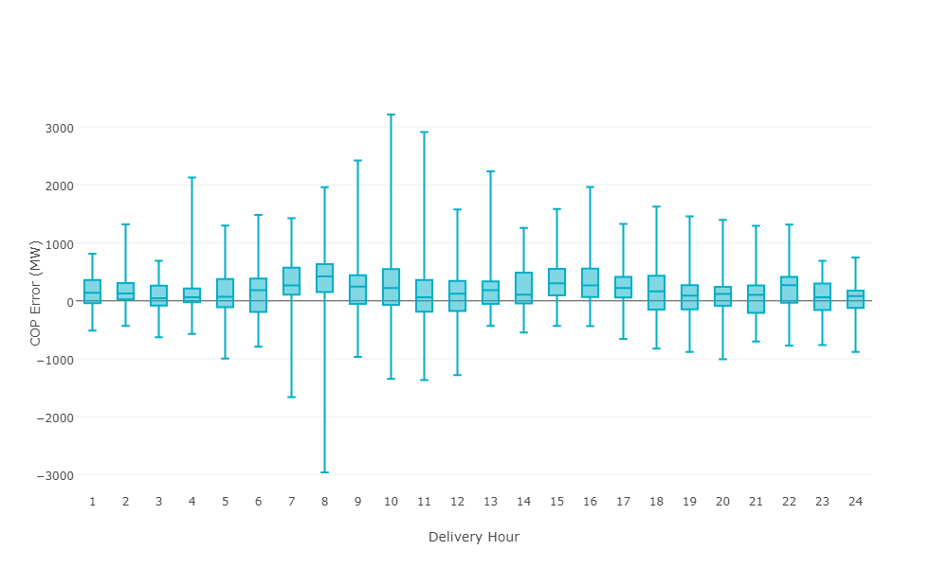
Monthly COP Error by Delivery Hour: Latest
Latest means after the Adjustment Period
Monthly Mean Absolute Error (MAE) = 384 MW

Slide 8
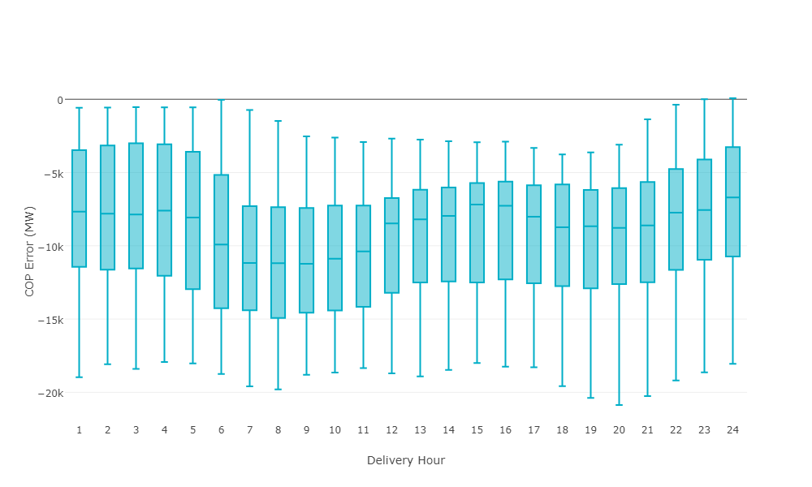
Monthly COP Error by Delivery Hour: Day-Ahead at 12:00
Monthly Mean Absolute Error (MAE) = 9,222 MW

Slide 9
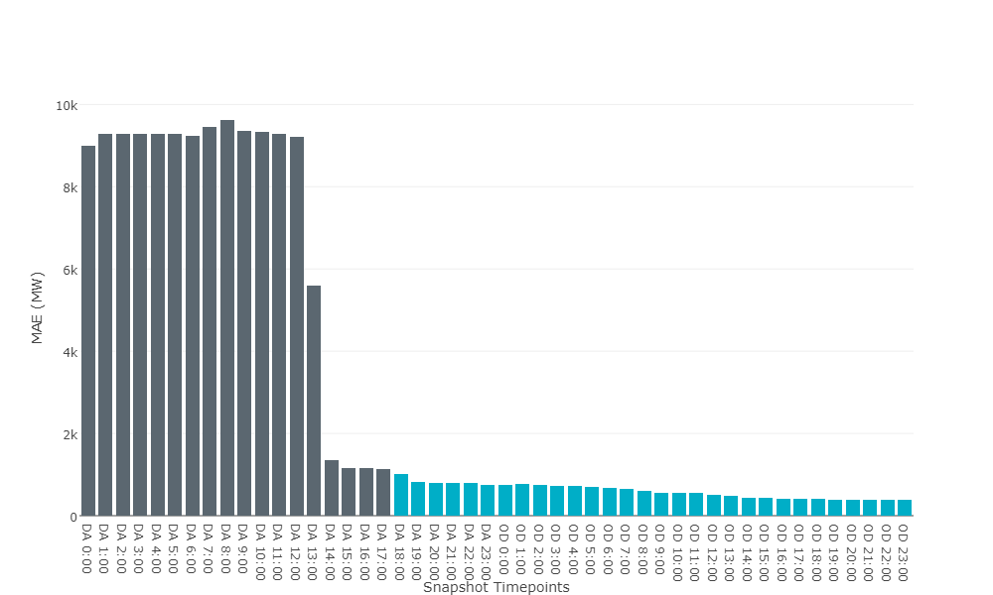
Monthly COP Error by Snapshot Timepoint
COP Error = COP Capacity – SCED Capacity
Under-Scheduling Error
Over-Scheduling Error
Day-Ahead between noon and 2pm
is when COPs are significantly updated.
DA = Day-Ahead OD = Operating-Day

Slide 10
Observation and Impact
COP Error is large (~9,000 MW) up to Day-Ahead at noon.
Any reliability assessment before Day-Ahead at 2pm contains significant error.

