Slide 1
TX SET Interactive

Slide 2
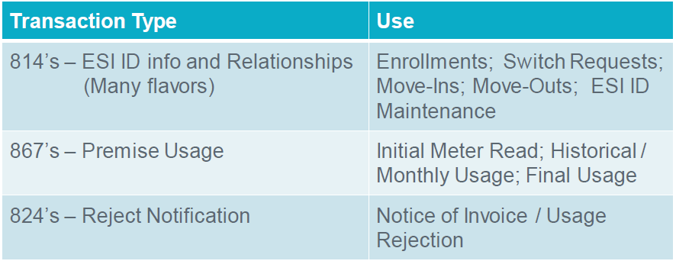
Texas Standard Electronic Transactions (TX SET) – Interactive
Many transactions involve ERCOT

Slide 3
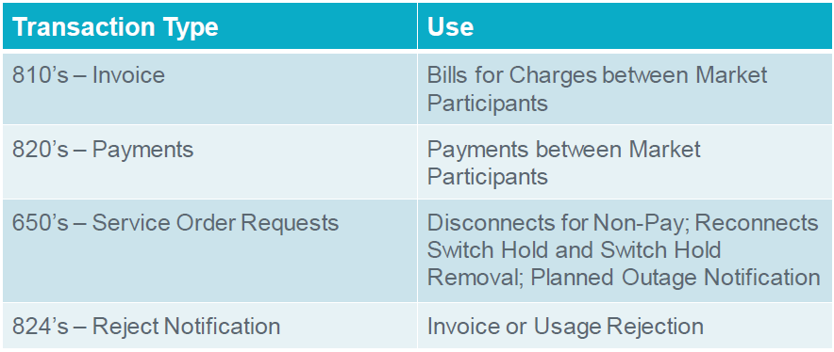
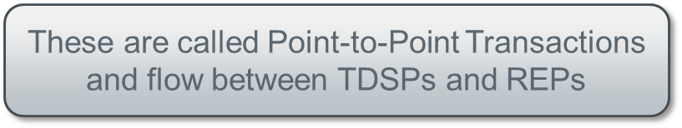
Texas Standard Electronic Transactions (TX SET) – Interactive
Some transactions do not involve ERCOT

Slide 4
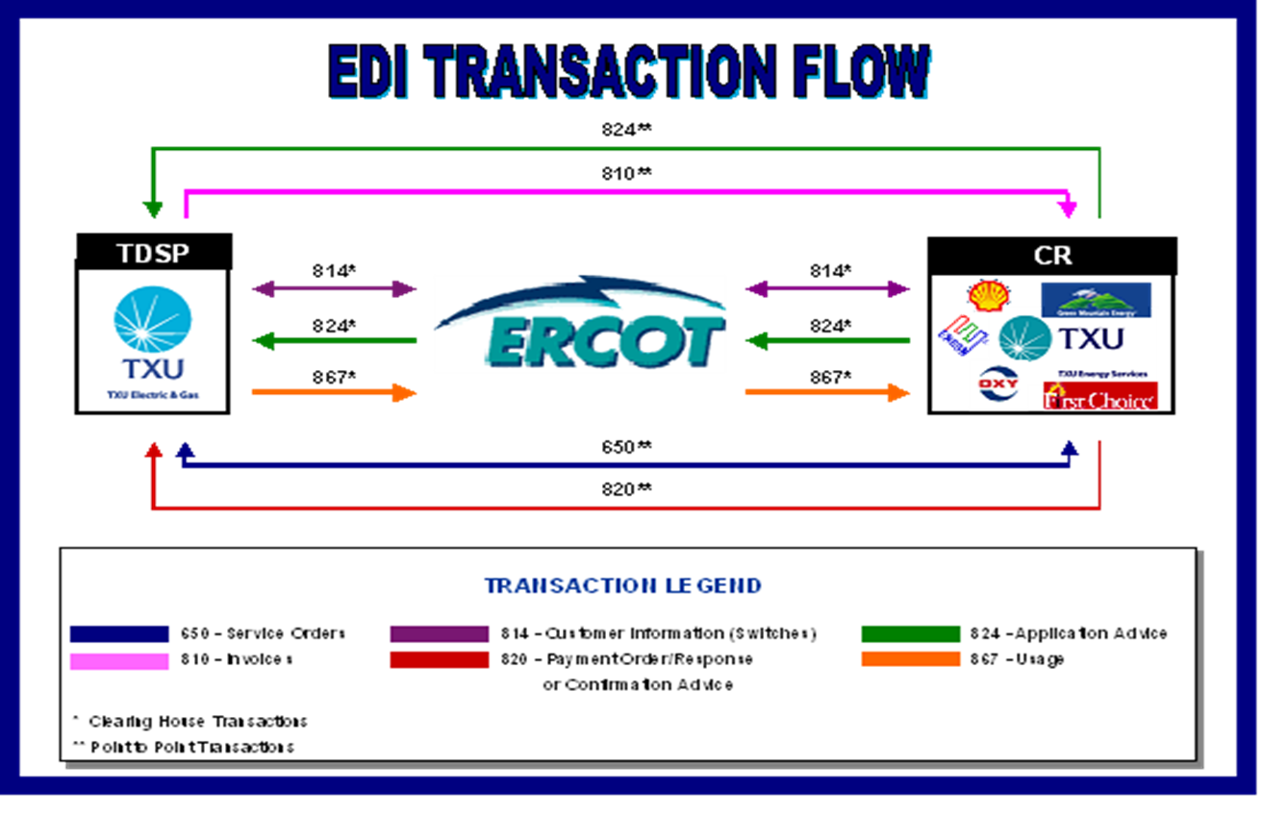
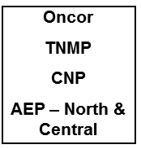
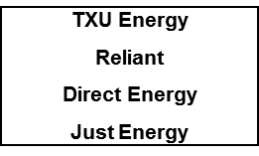
Texas Standard Electronic Transactions (TX SET) – Interactive
Overview of transaction flow

Slide 5
Transaction Names
TX SET Version 4.0 – Transaction Names Inventory

Slide 6
Transaction Names
TX SET Version 4.0 – Transaction Names Inventory

Slide 7
Transaction Names
TX SET Version 4.0 – Transaction Names Inventory

Slide 8




Transaction Flows
Switch – Reject & Accept

Slide 9
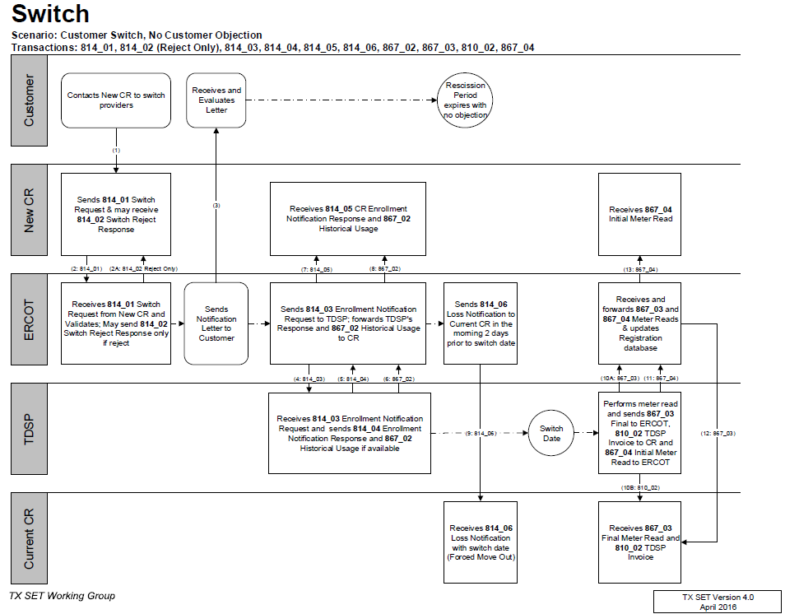
TX SET Swimlanes
Switch – Reject & Accept

Slide 10
Transaction Flows
Switch Hold – Add/Remove - DPPs

Slide 11
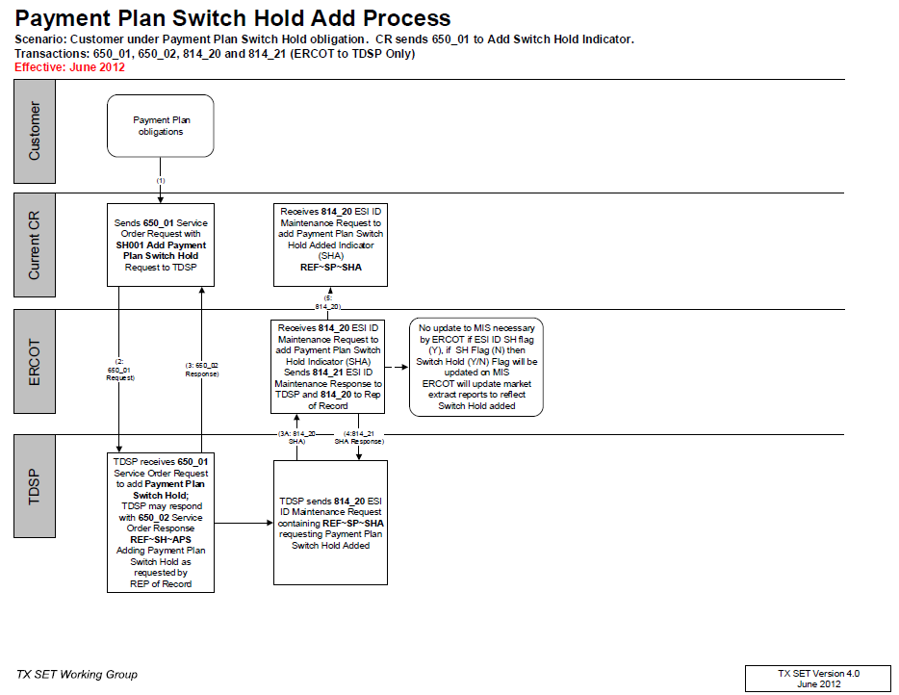
TX SET Swimlanes
Switch Hold – Add DPP

Slide 12
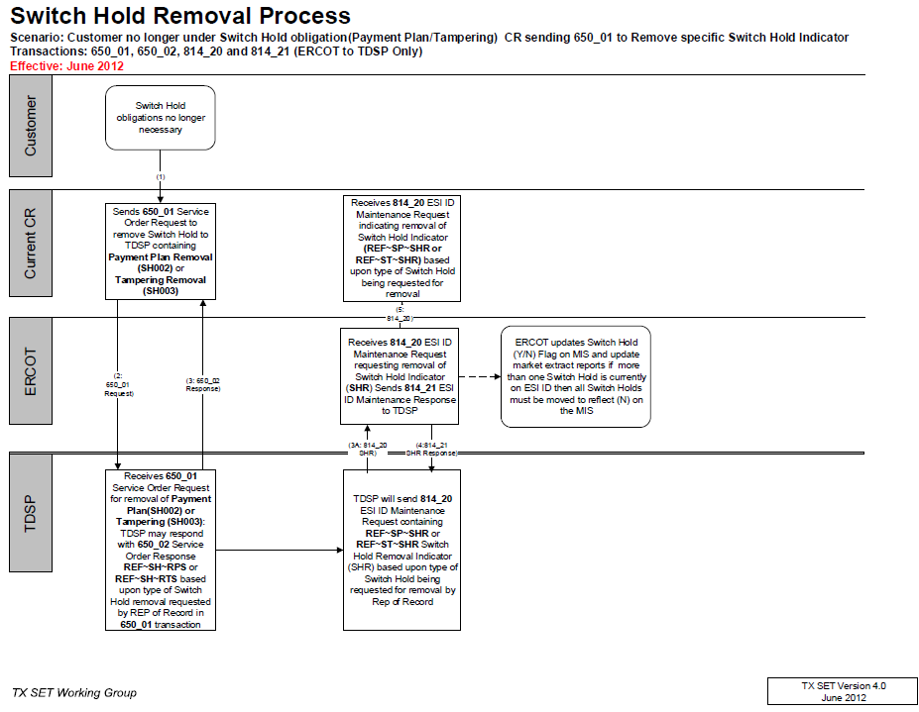
TX SET Swimlanes
Switch Hold – Remove - DPPs

Slide 13
Transaction Flows
Switch Hold – Add/Remove - Tampering

Slide 14
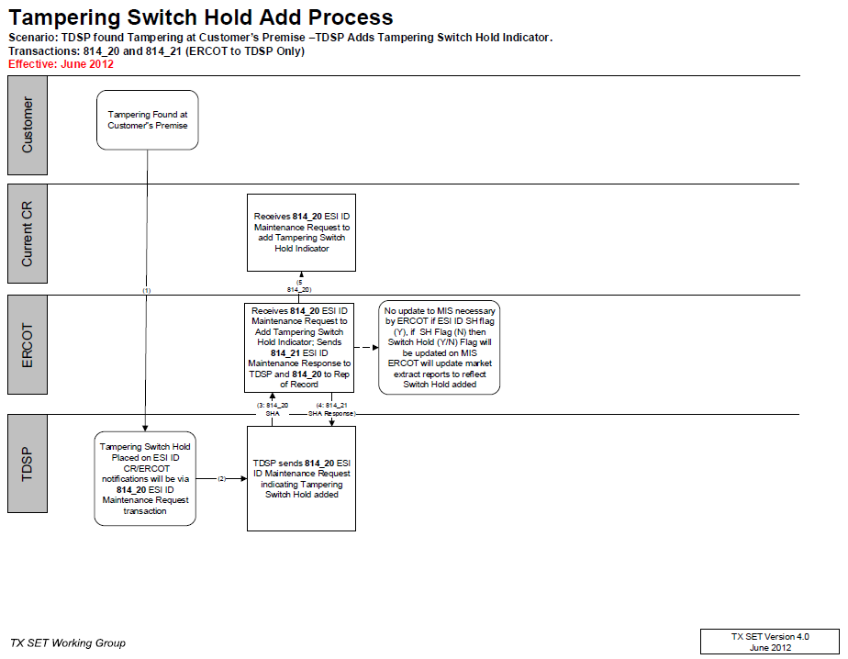
TX SET Swimlanes
Switch Hold – Add - Tampering

Slide 15
Transaction Flows
Switch w/ Switch Hold

Slide 16
Transaction Flows
Move In – Reject & Accept (ERCOT)

Slide 17
Transaction Stacking Logic
Operating Rule 1

Slide 18
Transaction Flows
Move In w/ Permit Required

Slide 19
Transaction Flows
Move In w/ Date Change & Cancel

Slide 20
Transaction Flows
Move Out – Reject & Accept (ERCOT)

Slide 21
Transaction Stacking Logic
MVO Trumps SWI

Slide 22
Transaction Flows
Move Out w/ Future dated Switch

Slide 23
Transaction Flows
Continuous Service Agreement (CSA) – Add & Delete

Slide 24
Transaction Flows
Move Out to CSA

Slide 25
Transaction Flows
Disconnect for Non-Pay (DNP)
Reconnect after DNP

Slide 26
Transaction Flows
Disconnect for Non-Pay (DNP)
Move Out after DNP

Slide 27
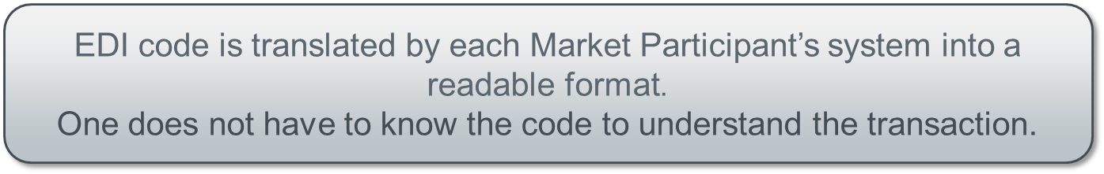
Electronic Data Interface (EDI) Transactions
Example of an 814_20 EDI transaction

Slide 28
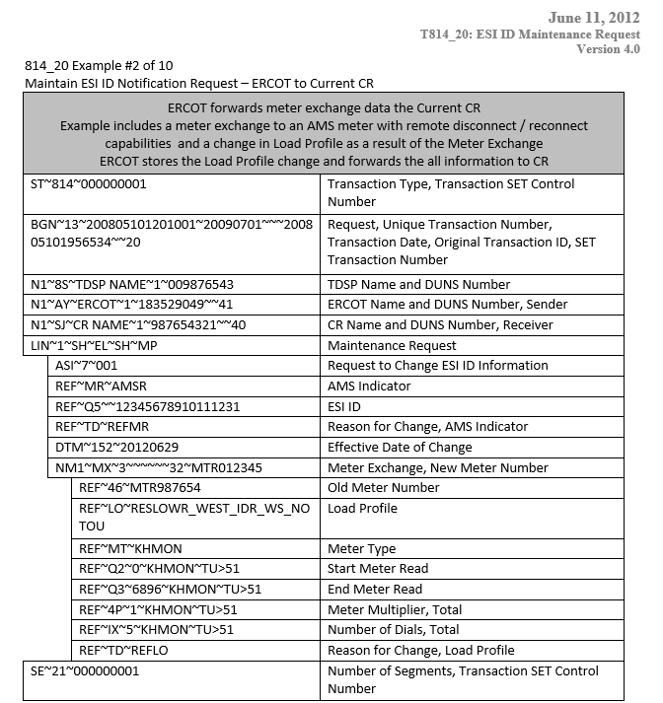
TX SET Implementation Guides w/ Examples
814_20 EDI transaction example – meter exchange

Slide 29
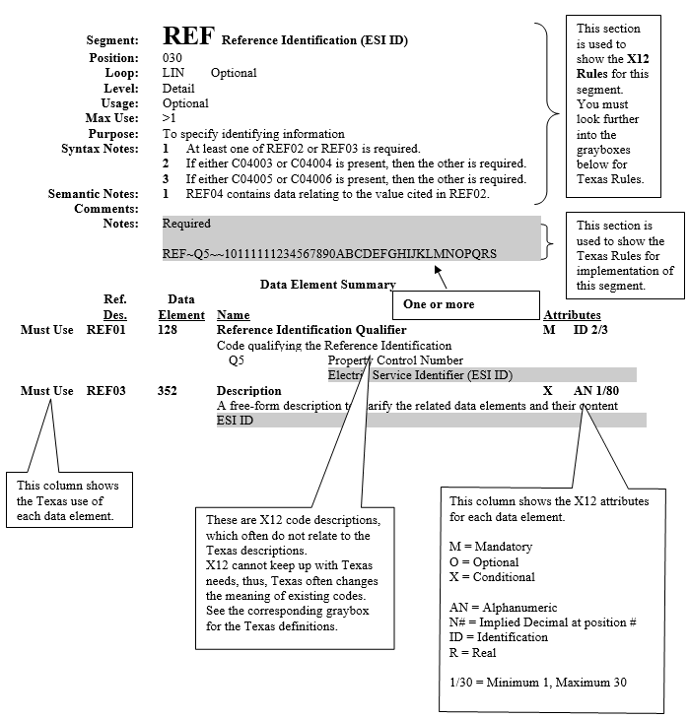
TX SET Implementation Guides w/ Examples
814_20 EDI transaction guide

Slide 30
ERCOT’s Market Information System (MIS)
Find ESI ID
Point out key attributes-
status, premise type, Switch Hold, AMS Indicator, metered flag, MRU, dates
Link to “View Transactions” for past 7 months

Slide 31
ERCOT’s Market Information System (MIS)
Find Transactions
Learning “how to read ERCOT”
Key points:
Transaction status, key dates
Review some examples of ESIs with the following:
MVI, no CSA
MVI on retired ESI ID
MVI with permit pending
MVI with permit required
Switch and customer loss
MVO to CSA, with date change
HU requested after MVO to CSA - Switch > MVO to CSA > then MVO BY CSA - MVI with another CR - MVI with TXUE on same day > Cancelled after ERCOT reviewed for SMRD that is on same day
MVI energized, no other CR, metered premise - MVO trumped by MVI - MVI with another CR - CSA Addition - MVO to CSA - MVI with another CR > customer loss for TXUE on CSA

Slide 32
Est ut oportere expetendis:
Sed partem utamur ei
Has mundi bonorum te
EDI code is translated by each Market Participant’s system into a readable format.
One does not have to know the code to understand the transaction.

