Slide 1
Far West Texas Project 2
Presentation to ERCOT Regional Planning Group
at Feb 27, 2018 Meeting
Austin, TX – MET Center
Brent Kawakami, PE
brent.kawakami@oncor.com
When any portion of this presentation is used as a reference, please include attribution to Oncor Electric Delivery Company LLC (Oncor) and include the date of the presentation.
Plans are subject to change due to factors including, but not limited to, load, generation, engineering, system protection and system topology.

Slide 2
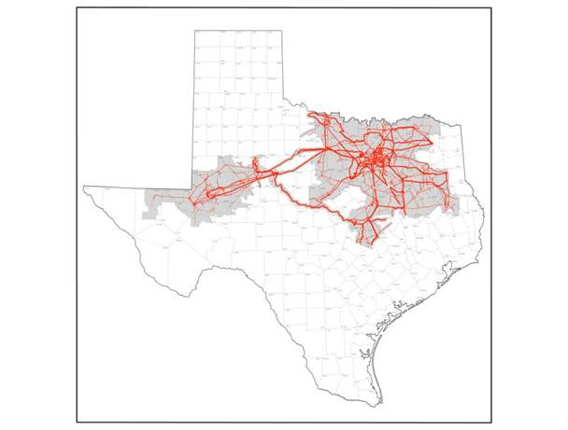
Far West Texas Projects History
Far West Texas Project
Submitted to ERCOT RPG in Apr 2016
Approved by ERCOT RPG in May 2017
Approved by ERCOT Board of Directors in Jun 2017
Odessa EHV – Riverton 345 kV Line
Component of approved Far West Texas Project
Formal request to ERCOT for Critical Designation Status
Approved by ERCOT Board of Directors Feb 20, 2018
CCN expected to be filed at PUC in March 2018
Dynamic Reactive Devices Project
Submitted to ERCOT RPG on Dec 15, 2017
Expected in-service in 2019
Immediate voltage support needs due to load increases
Far West Texas Project 2
Submitted to ERCOT RPG on Feb 01, 2018
Proposal to close the 345 kV loop, add autotransformer capacity, and new 138 kV lines
2

Slide 3
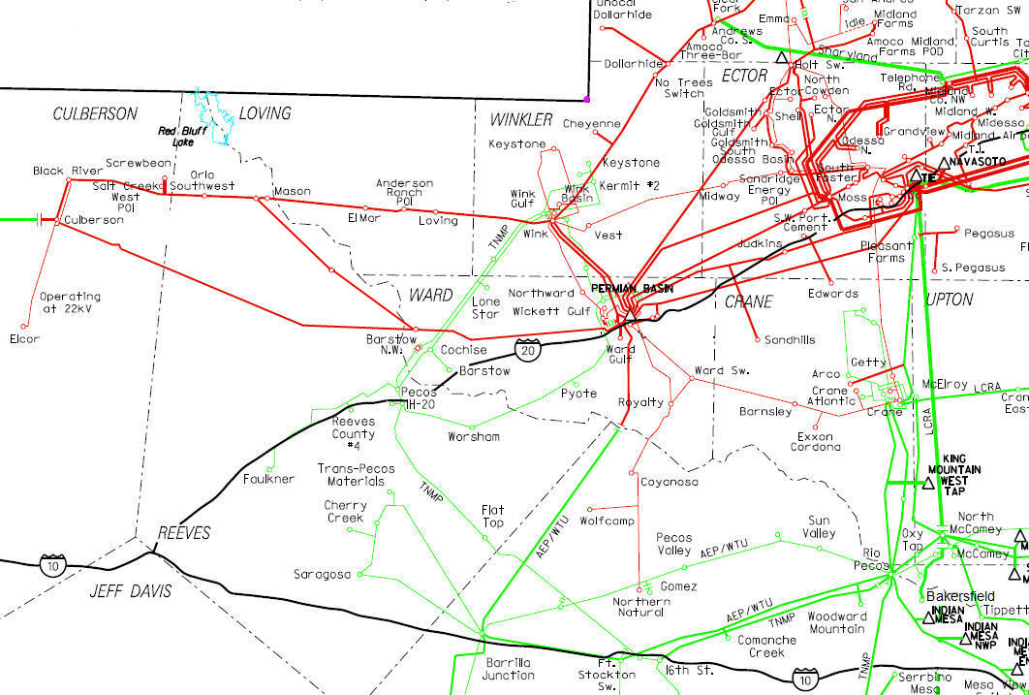
FAR WEST TEXAS PROJECT (PROPOSED)
345 kV LINE
345 kV AUTO
RIVERTON
MOSS
ODESSA EHV
Sand Lake
Yucca Dr
~
~
LYNX
BAKERSFIELD
SOLSTICE

Slide 4
FAR WEST TEXAS PROJECT (APPROVED)
345 kV LINE
345 kV AUTO
RIVERTON
MOSS
ODESSA EHV
Sand Lake
Yucca Dr
BAKERSFIELD
SOLSTICE
Notes:
ERCOT indicated that the approved project could serve up to 717 MW

Slide 5
FAR WEST TEXAS PROJECT 2 (PROPOSED)
345 kV LINE
138 kV LINE
345 kV AUTO
MOSS
ODESSA EHV
RIVERTON
Sand Lake
Yucca Dr
SAND LAKE
~
~
BAKERSFIELD
SOLSTICE

Slide 6
Project Description
Close the 345 kV Loop
Riverton – Sand Lake 345 kV Line
Sand Lake – Solstice 345 kV Line
Moss – Riverton 345 kV Line (Second Circuit)
Sand Lake 345 kV Sw. Sta.
(2) - 345/138 kV, 600 MVA Autotransformers
New 138 kV Lines
Riverton – Owl Hills 138 kV Line
Riverton – Kyle Ranch 138 kV Line
Estimated Cost: $194M

Slide 7
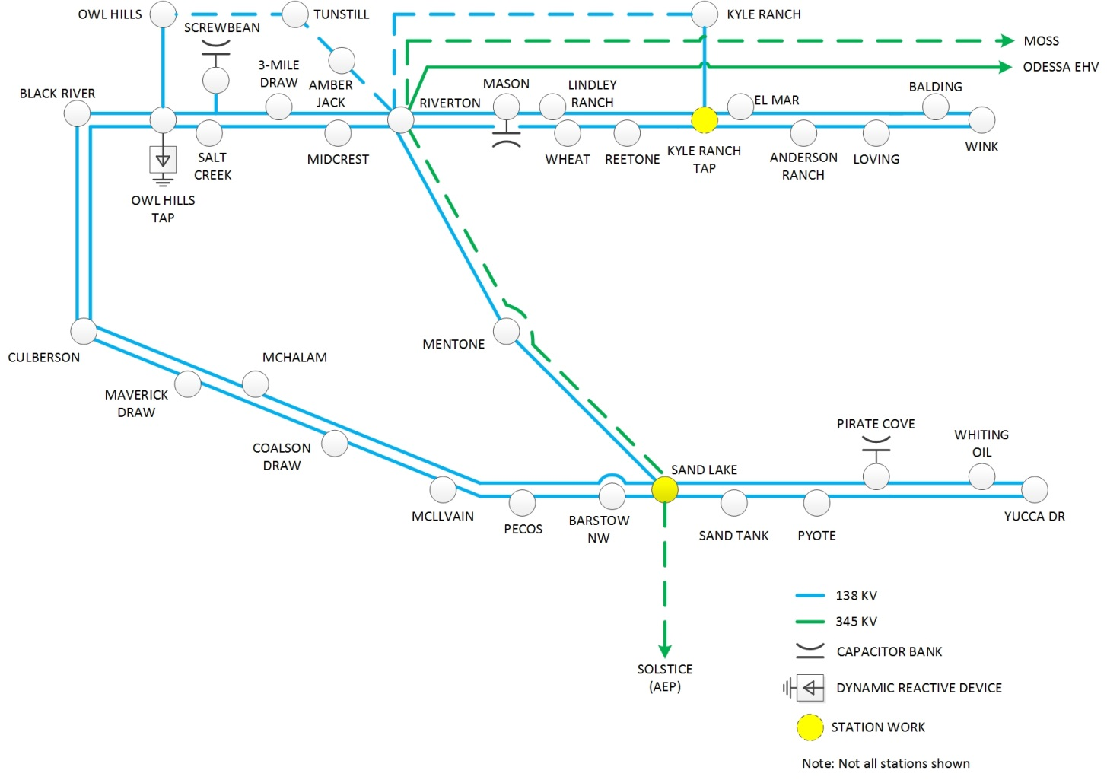
Project Schematic

Slide 8
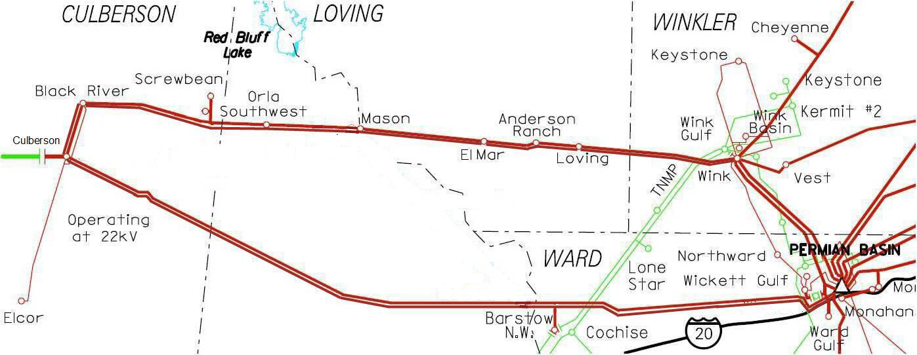
Culberson Loop Projected Load Growth
 | 2018 | 2019 | 2020 | 2021 | 2022
Confirmed | 580 MW | 775 MW | 893 MW | 964 MW | 1013 MW
Potential | 670 MW | 984 MW | 1163 MW | 1292 MW | 1340 MW

Slide 9
ERCOT Original FWTP Recommendations (May 2017)
Close the Loop
Close the Loop + DRD
Option 1 - (917 MW)
New 345 kV line between Riverton – Sand Lake
345/138 kV autotransformer at Sand Lake
New 345 kV line between Sand Lake – Solstice (AEP)
Option 2 - (1037 MW)
New 345 kV line between Riverton – Sand Lake
345/138 kV autotransformer at Sand Lake
New 345 kV line between Sand Lake – Solstice (AEP)
200 MVAR Synchronous Condenser at Culberson
Current Total: 1013 MW
Potential Total: 1340 MW

Slide 10
Base Case Analysis
Cases used
SSWG 2023SUM (October 2017)
DWG 2023SP (Spring 2017)
6 Contingencies with voltage collapse
15 Contingencies with low voltages along the Culberson Loop
Voltage collapse observed in dynamic simulations

Slide 11
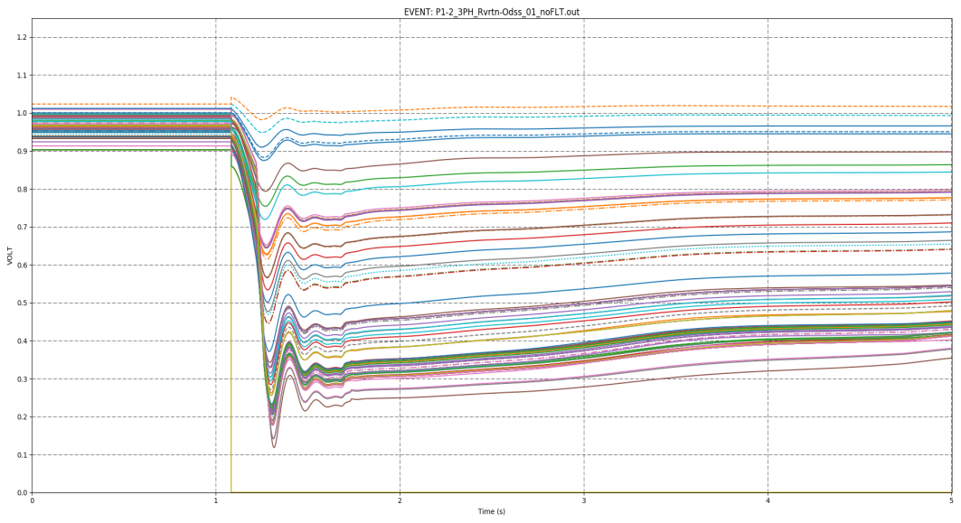
Loss of Radial 345 kV Line

Slide 12
Final Recommendation
Closing the 345 kV Loop is recommended
The needs for the Far West DRDs remain after the 345 kV construction
Due to load growth and post-contingency operating conditions

