Slide 1
Far West Texas Dynamic Reactive Devices - ERCOT Independent Review
ERCOT Transmission Planning
Regional Planning Group
February 27, 2018

Slide 2
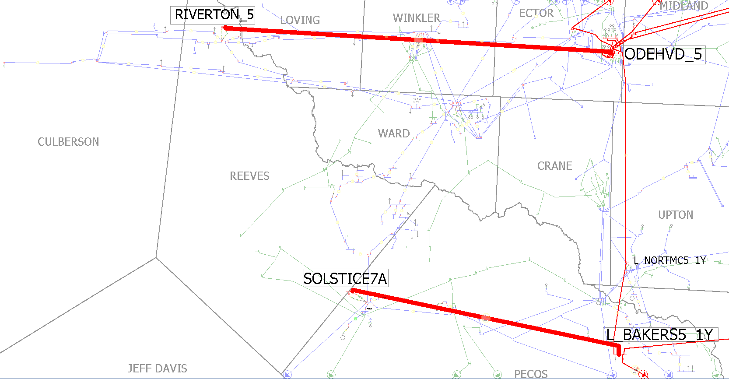
Far West Texas Transmission Project in June Endorsed by ERCOT BOD in 2017
At the time, the endorsed project (“Option 2”) was found to be reliable for a 2022 projected Culberson Loop load of 596 MW.
The Odessa EHV-Riverton 345 kV line is expected to be in service in 2020.
Option 2 had several expansion alternatives that would allow it to meet a higher load demand.
Description | Option 2 | Option 3 (Option 2 + closing loop 345 kV circuit) | Option 4 (Option 3 + dynamic devices)
Culberson Loop Load Serving Capability | 717 | 917 | 1037

Slide 3
Culberson Loop Load Forecast Since 2016
Confirmed load requests
Could be over 1,300 MW by 2022 with 300 MW potential additions
Projected in May, 2017
Projected in April, 2016
596
425

Slide 4
Overview
Oncor submitted Far West Texas Dynamic Reactive Devices for Regional Planning Group review. This is a Tier 1 project that is estimated to cost $86 million.
Proposed for 2019 timeframe
Addresses load growth due to the oil and gas industry
Reliability Issues
Voltage Violation
Voltage Collapse
Provide Operational Flexibility

Slide 5
Study Procedure
Voltage Stability and Dynamic Stability Analysis
Study Case: 2017 DWG 2019 Summer Peak Flat Start
Criteria: NERC TPL and ERCOT Planning Guides
Scenarios to be evaluated:
Base Scenario for 2019, 2020, and 2021
Zero Solar Scenario
Same as study case but with 0 MW Solar dispatched in study region
Sensitivities based on Planning Guide 3.1.3(4):
Generator additions with Signed Interconnection Agreements but that DO NOT meet Planning Guide Section 6.9 criteria in study region at time of study will be added to the case

Slide 6
?
Stakeholder Comments Also Welcomed Through:
rpg@ercot.com

