Slide 1
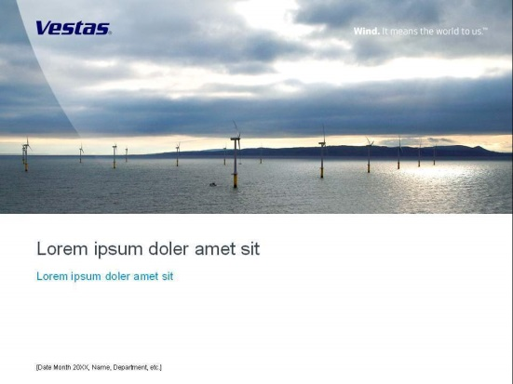
Reactive Power Capabilities from Vestas 2MW turbines
Title slide/end slide image dimensions:
Title slide images must always fit this size:
Height: 10.6 cm; Width: 25.4 cm
Title slide images must always follow this position:
Horizontal: 0 cm; Vertical: 0 cm
To change title slide/end slide image:
  Insert image according to the
  dimensions and position listed above
  Right-click on image and select
  ‘Order/Send to back’
  Delete original image
Tip:
Fit images easily to the right dimension using Vestas drawing guides.
Vestas drawing guides will help you position and crop images. Images will snap to drawing guides when repositioned or cropped.
To add drawing guides:
  Right-click on next to slide
  Select ‘Grid and Guides…’
  Check ‘Display drawing guides on screen’
  Press ‘OK’
ERCOT NPRR849 Workshop February 23 2018

Slide 2
INTRODUCTION
Traditionally, wind farms with the Vestas 2MW turbines have used additional substation equipment in order to meet ERCOT Nodal Protocol Section 3 Dynamic VAr requirements
Vestas has introduced an alternative concept to achieve compliance:
Dynamic Q from the WTGs
This concept will introduce a number of advantages over the traditional solution:
Simpler design (NO STATCOM just to meet Protocols)
Comparable WPP performance to grid operator as with STATCOM
Less components and interfaces involved in design & integration
Ability to recover voltage within the grid for short duration faults

Slide 3
ERCOT Requirements for Reactive Power Support
At the PoI the steady state voltage can vary in range of 0.95-1.05 pu
  0.9 pu – 1.1pu is voltage range for post contingency condition (for short duration)
At the PoI reactive power supply equivalent to 0.95 lag to 0.95 lead pf
  This reactive power is to be dynamic in nature
  Collector system losses can be met by capacitor bank
WPP should be operated in the voltage control mode (VSS). Nodal Op Guide 2.2.10(3)(a): “the response (within the operating Reactive Power capability of the Generation Resource) must be sufficient to initiate response in no more than one minute”
Modeling of switchable shunts in the reactive power study:
  If the proposed resource includes an automatic control scheme for adjusting the switchable shunts in response to voltage, and this scheme can operate quickly (e.g. in tens of seconds), then switchable shunts may be considered movable in the reactive power study and may be adjusted at any time.

Slide 4
PQ Capability Curve of 2 MW WTG
At rated 2 MW, a max of 657 kVAR continuously @ 0.95Vpu (seen at gen LV terminals)
At rated 2 MW only 410 kVAR continuously @ 0.90 Vpu (seen at gen LV terminals)
Proposed supply of 657 kVAR at 2 MW generation is based on
  Maintaining the WTG’s internal systems to within thermal design ratings and protection schemes
  Continuously maintained

Slide 5
Meeting ERCOT requirement using present PQ capability
Grid
0.95 pf dynamic reactive power support
PoI
=
33 MVAR
100 MW WPP
STATCOM:
10-15% of plant MW rating to meet 0.95 pf dynamic range at the PoI
At rated 2 MW, a maximum of 410 kVAR can be supplied continuously
20-25% of plant MW to meet reactive power loss of collector system

Slide 6
Meeting ERCOT requirement using proposed PQ capability
Grid
0.95 pf dynamic reactive power support
PoI
=
33 MVAR
100 MW WPP
At rated 2 MW, a maximum of 657 kVAR can be supplied Continuously
20 MVAR to meet reactive power loss of collector system
5 MVAR to meet reactive power loss of collector system when V @ +/-10% Vn

