Slide 1



NPRR849
Workshop
Invenergy Comments
February 23, 2018

Slide 2
ERCOT CURRENT REACTIVE CAPABILITY REQUIREMENTS
    Four types of voltage ranges:
      Normal operating conditions voltage range → (0.95pu – 1.05pu)
      Theoretical setpoint range to provide +/-0.95 pf → (0.95pu – 1.05pu)
      ERCOT reactive study scope pass range → this is the seasonal voltage range/profile, for example, 1.00pu – 1.04pu, 0.98 – 1.02, etc.
      Testing pass range (CURL) → Within seasonal voltage range/profile at a given point in time; (i.e., the Generation Resource is in compliance as long as it can meet the requirements for the given voltage profile)

Slide 3
ERCOT CURRENT REACTIVE CAPABILITY REQUIREMENTS
    Meeting ERCOT reactive requirements (+/-0.95pf):
Invenergy agrees that generators must meet the +/-0.95pf for the reactive study scope pass range, as currently contemplated in the reactive study scope document (this is the seasonal voltage range/profile, for example 1.00pu - 1.04pu, 0.98-1.02, etc.)
Invenergy agrees it is reasonable to run scenarios that show the available reactive capability over the normal operating conditions voltage range (0.95pu – 1.05pu)
Invenergy does not agree that generators should meet the +/-0.95pf for the normal operating conditions voltage range (0.95pu – 1.05pu).

Slide 4
ERCOT PROPOSED PROTOCOL CHANGE
We understand the proposed language is intended to narrow the theoretical setpoint voltage range for which +/-0.95pf is required (i.e., “B”) from the normal operating conditions voltage range (0.95 – 1.05) to:
      +0.95pf (0.95-1.04)
      -0.95pf (0.98-1.05)
  But, are there specific studies or historical voltage control problems/issues demonstrating the need for the above voltage range of setpoints?

Slide 5
ERCOT PROPOSED PROTOCOL CHANGE
Determining an adequate voltage range:
The voltage range for which +/-0.95pf is required should be based on sufficient objective evidence, which in our opinion ERCOT has not yet provided.
Why not consider the NERC proposal?
Why use a wider range/more stringent requirements than other regions?
What studies support the proposed values?

Slide 6
REACTIVE REQUIREMENTS IN OTHER REGIONS
NERC Example
NERC Whitepaper on Docket No. RM16-1-000 (cont):
T
Terminal voltage limitations of the units can affect reactive power capability
Provide reactive power at 0.95 lagging when voltage is between 0.95 - 1.0 pu at the POI
Absorb reactive power at 0.95 leading when voltage is between 1.0 - 1.05 pu.
Capability to provide reactive power decreases as voltage at the POI exceeds 1 pu
Capability to absorb reactive power decreases as voltage at the POI drops below 1 pu.
This is used as an illustration and may need to be adapted by Transmission Providers dependent on voltage schedule needs (e.g., based on POI voltage level).
Non-synchronous generation may not, and should not necessarily, be required to provide full capability range at all operating voltages (e.g., a generator should not be required to provide full reactive power consumption when low voltage conditions are occurring at the POI).

Slide 7
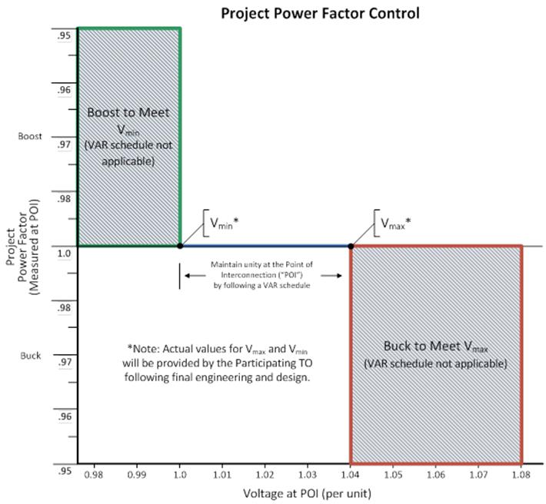
REACTIVE REQUIREMENTS IN OTHER REGIONS
Southern California Edison Example
Southern California Edison

Slide 8
REACTIVE STUDY SCOPE
Reactive study scope provided by ERCOT
Evolving and currently in Rev 9.
Focus on latest revision is Locked OLTC
We choose taps that make the scenario work for the VAR reversal.
In reality, OLTC won’t be on that tap because that’s not how the OTLC controller is set to operate.

Slide 9
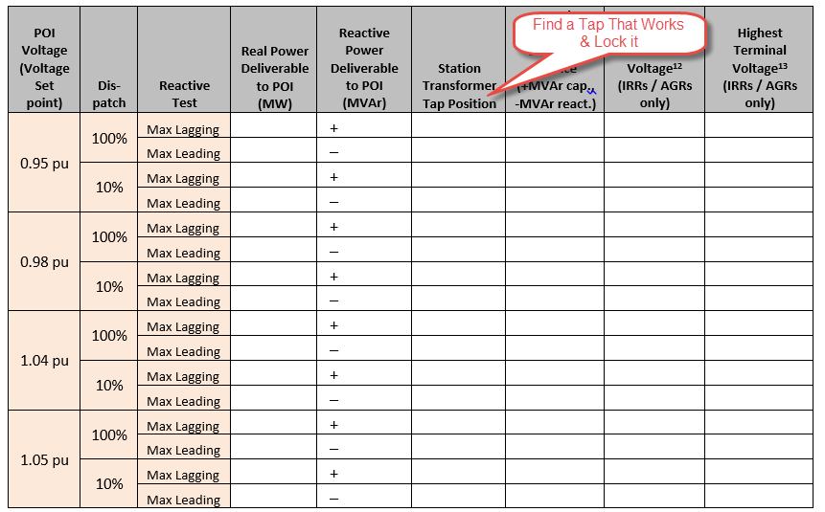
REACTIVE STUDY SCOPE

Slide 10
REACTIVE STUDY SCOPE
The locked OLTC test without a change in voltage is not a realistic scenario.
In an instantaneous situation, for VARs to reverse, there had to be a change in the POI voltage (or no response from WTGs). For a complete reversal to occur the change had to be approximately 2x the droop setting. ERCOT requires plants operate in droop mode (typically 2%).
In a non-instantaneous situation TSP could order a change in the set point voltage – in which case ERCOT allows up to 5 minutes to comply (OLTC would move in this time)

Slide 11
ERCOT PROPOSED PROTOCOL CHANGE
Invenergy proposes:
Before making any changes to the protocol language, Invenergy requests that ERCOT performs more detailed engineering studies that investigate and substantiate the need for a specific range of voltage setpoints for which Generation Resources need to provide maximum reactive power (0.95 PF leading and lagging).
Before making any changes to the protocol language, a reactive study scope guide should be developed, describing a clear methodology including OLTC operation and droop, among other factors
If ERCOT wants to change the study pass range (C) or compliance range (D), use objective evidence that can be shared with generators to determine the appropriate range for which +/-0.95pf is required

Slide 12
ERCOT PROPOSED PROTOCOL CHANGE
QUESTIONS/COMMENTS?

Slide 13
NPRR849 PROPOSED LANGUAGE
(3) Each Generation Resource required to provide VSS shall comply with the following Reactive Power Requirements:
(a) An over-excited (lagging or producing) power factor capability of 0.95 or less determined at the generating unit's maximum net power to be supplied to the ERCOT Transmission Grid and the Generation Resource’s set point in the Voltage Profile at any voltage Voltage Setpoint from 0.95 per unit to 1.04 per unit, as measured at the POI;
(b) An under-excited (leading or absorbing) power factor capability of 0.95 or less, determined at the generating unit's maximum net power to be supplied to the ERCOT Transmission Grid and the Generation Resource’s set point in the Voltage Profile at any voltage Voltage Setpoint from 0.98 per unit to 1.05 per unit, as measured at the POI;

