Slide 1
WPP/SPP Collection System(S)
& finding “safe harbor”
Concerning FERC ORDERS & NERC STD(s)
By
Thomas Wilkins & Miles Downing

Slide 2
Disclaimers
  This report was prepared with references that incorporate work sponsored by private corporate persons, individual(s), or those with an agency of the United States government, as such this disclaimer presented includes references with disclaimers and any such disclaimers are incorporated herein; whereas neither the corporate persons, individuals, or United States government nor any agency thereof, nor any agent, agents or groups of agents acting as principle or agent, make any warranty, express or implied or assumes any legal liability or responsibility for the accuracy, completeness, or usefulness of any information, apparatus, product, or process disclosed or represents that its use would infringe privately or publicly on owned rights. References herein to any national, international, public or private commercial product, process, or service by tradename, trademark, manufacture, or otherwise does not necessarily constitute or imply endorsement, recommendation, or favoring by any of the authors, sponsors, references, governmental organizations, agencies, individual, or corporate persons.
Fair Use Notice
  Some of the material present herein is provided for educational purposes and informational purposes. It may contain copyrighted material the use of which has not always been specifically authorized by the copyright owner. It is being made available in an effort to advance the understanding of scientific, environmental, economic issues etc…. It is believed that this notice is fair use of any such copyrighted work incorporated herein as provided for in section 107 of the U.S. Copyright Law. In accordance with Title 17 U.S.C. Section 107, the material incorporated in this report by reference or otherwise is distributed to those who receive it upon condition it is a presentment for educational purposes only. Those who use this information beyond fair use you must obtain permission from the copyright owner.
Safe Harbor Notice
  As incorporated by reference in the Disclaimers section, all words or statements in this presentation are forward looking and the discussion includes predictions, estimates or other information in part is forward-looking and a good faith attempt to recognize the meaning or words presented by regulatory bodies. While these forward-looking statements represent our current judgment on what the future holds, they are subject to risks and uncertainties that could cause actual results to differ materially. You are cautioned not to place undue reliance on these forward-looking statements, which reflect our opinions only as of the date of this presentation. Please keep in mind that we are not obligating ourselves to revise or privately or publicly release the results of any revision to these forward-looking statements in light of new information or future events.

Slide 3
ERCOT SGIA for IRR(s) compared to FERC ORDER & NERC STANDARDS
ERCOT requires that IRR’s meet relevant FERC ORDERS and NERC Standards.
We did not find exceptions or exemptions.
ERCOT SGIA sections 2.1, 2.9.1 require compliance with nerc standards
Nerc’s standards add operating requirements to ercot’s SGIA [after the fact].

Slide 4
FERC ORDERS & NERC STANDARDS APPLY
FERC and NERC are mandated by the U.S. Congress to provide the public a safe and reliable
Bulk Electric Power system(BES).
ERO and EPC used best practices at the time
The WPP/SPP WAS commissioned!
FERC ORDERS and NERC STANDARDS ARE Changing therefore via the sgia, therefore new burdens are placed on the irr

Slide 5
NERC PRC-024-1-2 Requirement 1

Slide 6
PRC-024-1-2 Requirements and the BES I4 Requirements

Slide 7
COLLECTOR SYSTEM
SOURCE NERC BES Definition Guidance Document – DRAFT for Comment ‐ January, 2014

Slide 8
PRC-024-Attachment 1 shows the variation in Frequency requirements for various regions where the rule applies.

Slide 9
PRC-024-Attachment 2 shows the Voltage requirements for all regions.
Variance may have been provided by the local authority at the time of construction, but must be reported each year

Slide 10
The August 2016 CAISO event
The CAISO event high lighted the fragile support that renewable generation provides to the transmission system during an event. The ISO’s and other authorities are acutely aware of the situation, and are rightly concerned now that renewables have achieve 100% saturation at low demand.
So, how do we take a renewable project, and find the up side to the situation?

Slide 11
Please find the U.S. Congress’s
Declaration of policy at:
Please find the words “Bulk Power System” 16 U.S.C. 824o (a)(1)
Please find the words “Electric Reliability Organization” 16 U.S.C 824o (a)(2)
Please find the words “Reliability Standard” 16 U.S.C 824o (a)(3), (d)
Please find the words “Reliable Operation” 16 U.S.C 824o(a)(4)
Please find the word “Interconnection” 16 U.S.C 824o (a)(5)
Please find the word “enforcement” 16 U.S.C. 824o (e)

Slide 12
VARIOUS Changing FERC ORDERS
FERC ORDER 661, 2005 Wind Exemption
FERC ORDER 827, 2016 Wind Exemption Eliminated. Dyn. Reactive
FERC ORDER 693, 2007, Mandatory Reliability Standards for the BES
FERC ORDER 796, 2014, Gen. Verification of Reliability Standards

Slide 13
FERC ORDER 693, 2007, Mandatory Reliability Standards for the BES
FERC ORDER 693, 2007 Terms(still changing today in 2018!)
BAL pg. 305
CIP pg. 445
EOP pg. 541
FAC pg. 677
INT pg. 795
IRO pg. 888
MOD pg. 1006
PER pg. 1324
PRC pg. 1418
TOP pg. 1567
VAR pg. 1847

Slide 14
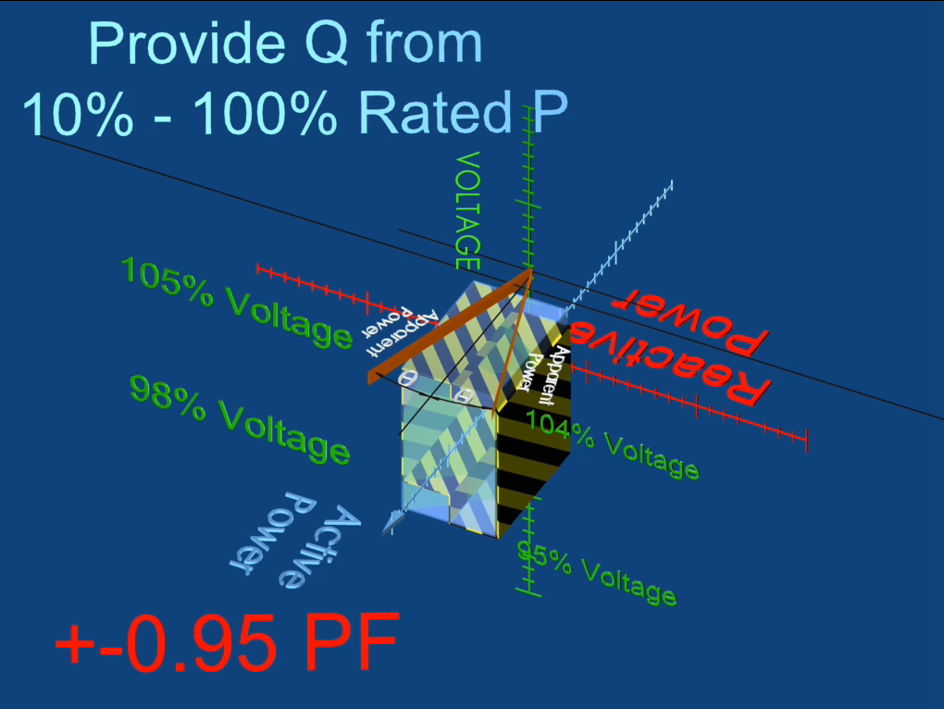

Slide 15
JUST A PART OF THE REQUIREMENT
Please Find ERCOT PLANNING GUIDE MAY 1, 2015
SECTION 4.1.1.4 STEADY STATE VOLAGE RESPONSE
NORMAL CONDITIONS
Voltage 0.95pu to 1.05pu

Slide 16
JUST A PART OF THE REQUIREMENT
Please Find SGIA
SECTION 4.1.1.4 STEADY STATE VOLAGE RESPONSE
NORMAL CONDITIONS
Voltage 0.95pu to 1.05pu

Slide 17
JUST A PART OF THE REQUIREMENT
Please Find GUIDE TO THE INTERCONNECTION
PROCESS APPENDIX F
+/- 0.95 pf at all MW LEVELS
Determined at POI

Slide 18


ERCOT REQUIRE A
P.Q,V
WEDGE!
See Safe-Harbor and Fair Use Statement

Slide 19
ERCOT MAY REQUIRE A
P.Q,V
BOX
See Safe-Harbor and Fair Use Statement

Slide 20
COLLECTOR SYSTEM & CONSTRAINTS

Slide 21
COLLECTOR SYSTEM & CONSTRAINTS
Example of a Constraint.
Given Case: At an individual generating unit,
high side voltage on high side of generator step up
during high active power production
causing the voltage
on the low side to be above 1.1 pu
and causing the control system to
limit reactive power production.

Slide 22
COLLECTOR SYSTEM & CONSTRAINTS
Location of Constraints within
a Wind Power Plant or Solar Power Plant?
High and Low side of each GSU,
Collector Cables, Junction Boxes
High and Low side the Main Plant Transformer
On Load Tap Changer

Slide 23
Dynamic Constraints
Slow Voltage Regulation Equipment.
OLTC
Mechanical Taps,
Switching Capacitor and Reactors
Impedances

Slide 24
DYNAMIC MODELS

Slide 25
PLANT MODELS
NREL and others
without new NERC standards in mind
promoted
“equivalencing the collection system!”
thus masking “fast dynamic constraints” within the IRR’s facility.
Where with the knowledge of such “fast dynamic constraints” the engineer or record would have changed their designs.

Slide 26
DYNAMIC MODELS
See NERC Reliability Guideline
Power Plant Dynamic Model Verification Inverter Based Resources. (2017).
ERCOT currently USES PSCAD for several Studies
We propose that ercoT “verify” with existing
pscad models that the
irr meets nerc’s standards and
The irr’s Sgia with respect to
Fast dynamic p,q,v requirements as they relate to
FRT and Frequency conditions at the poi.
Solar Inverters

Slide 27
CONCLUSION
IRR(s) installed with NERC’S “Relatively” new requirements are not projected to be
Designed or built
to meet such requirements.
Therefore we believe remediation of an existing IRR
warrants
Additional Capitalization of expenditures and
warrants re-visiting a
Qualified Facility’s
Marginal Cost of Energy calculation.
Thankyou for your time

