Slide 1
ERCOT System Strength Assessment PSCAD Study
Public Presentation – ROS, Austin Texas
March 1, 2018

Slide 2
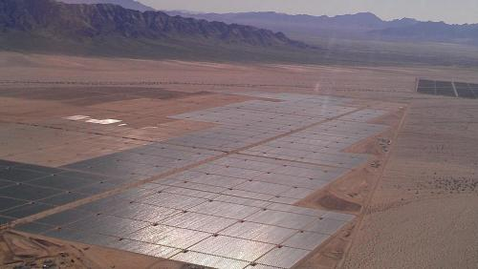
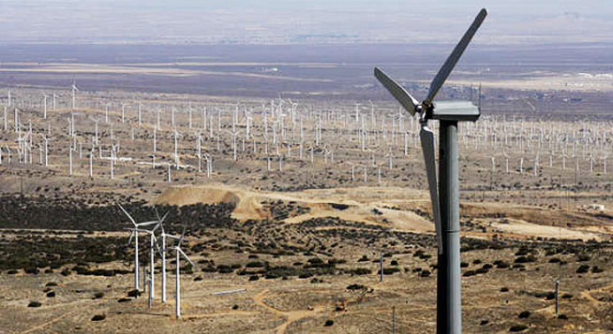
Electranix Corporation
ELECTRANIX Corporation is an independent specialist engineering company providing services in transmission and distribution studies and simulation, HVDC transmission, FACTS, modeling and simulation tools, training, and renewable energy generation.

Slide 3
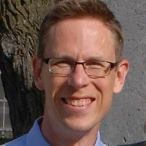
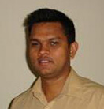

Who Are We?
Leadership and Consulting Team
Dennis Woodford – President, Owner
Garth Irwin – VP, Owner
Andrew Isaacs – VP, Engineer
Studies Team
Anuradha Dissanayaka M.Sc. –Study Engineer
Francisco Gomez Ph.D. –Study Engineer
Chaminda Amarasinghe Ph.D. – Modeling Specialist Engineer
Xiuyu Chen Ph.D. – HVDC Specialist Engineer
Amit Jindal Ph.D. – Study Engineer
Jake Wiebe – Study Engineer
Jeremy Sneath M.Sc. – Study Engineer
Lukas Unruh - Analyst
Software Team
Joel Dyck M.Sc. – Computer Scientist
Nathan Kroeker – Computer Scientist
Suren Dadallage M.Sc. – Computer Engineer
3
Notes:
Dennis joined the English Electric Company in 1966 and worked on variable speed drives and HVDC transmission until 1970. He completed a Master's degree in Electrical Engineering at the University of Manitoba and joined Manitoba Hydro in 1972. There he worked in transmission planning of AC and DC EHV transmission and wrote the EMTDC algorithm. In 1986 he was appointed Executive Director of the fledgling Manitoba HVDC Research Centre. He has worked on many projects and conducted business all over the world, and serves as an Adjunct Professor at the University of Manitoba. Recently Dennis was awarded the prestigious Uno Lamm Award by the IEEE in recognition of his services and contributions to the field of Power Systems Engineering.
Garth joined the Manitoba HVDC Research Centre after graduating from the University of Manitoba in 1987. At the Centre, he undertook studies and projects including insulation coordination of HVDC transmission substations, subsynchronous resonance, and digital controls development. As leader of the PSCAD/EMTDC development team, he was responsible for the improvements to the EMTDC solution algorithm and the precision modeling of transmission lines and cables.
Andrew has been working at Electranix since 2003. He has performed system impact and planning studies for transmission utilities, ISOs, and private generation companies across Canada and internationally. Additional project involvement includes PSCAD studies, software training, HVDC large system segmentation, specialized transient stability analysis, device specification and probabilistic reliability analysis. Andrew is past-chair of the Winnipeg Chapter of the IEEE Power & Energy Society, and holds an M.Sc. (EE) from the University of Manitoba in the field of transmission expansion planning.
Chaminda received his BSc.(Eng) degree from the University of Moratuwa, Sri Lanka in 2000 and his PhD in the field of electricity markets from the University of Manitoba, Canada in 2008. Since joining Electranix in 2007, he is involved with various types of power system planning and system impact studies for utilities and developers both in Canada and internationally. Additional project involvement includes PSSE custom model developments, PSCAD studies and segmentation studies. He is a member of the IEEE.

Slide 4
PSCAD Study Background
January 2016, Electranix completed an unprecedented study evaluating the ERCOT Panhandle System. Key recommendations of that study included:
  Use of the WSCR metric threshold of 1.5 was suitable for the proposed system buildout at the time
  PSS/E studies were still useful with WSCR > 1.5, however should be validated periodically using PSCAD. For WSCR < 1.5, PSCAD studies should be performed.
  Fast wind power plant control would provide benefit for improving system stability at lower WSCR numbers.
  The proposed Panhandle system upgrades would be adequate for the proposed operating scenarios
  Synchronous condensers should be part of the VAR support mix
  There are limits to inverter capacity, as well as dispatched active power
  Further study would be required
4

Slide 5
PSCAD Study Objectives
June 2017, Electranix began a second round of study building on the first. Objectives of the new study included:
  Evaluate dynamic performance of an updated Panhandle buildout
  Evaluate dynamic performance of a stressed South Texas future buildout
  Review WSCR planning metric in Panhandle and propose adjustments if necessary
  Evaluate suitability of the WSCR planning metric in South Texas
  Provide recommendations for area-wide voltage regulation in the Panhandle
  Explore the impact of load on low system strength issues, as well as the importance of detail in load modelling
  Transfer study tools and knowledge to ERCOT planners
5

Slide 6
Panhandle/Lubbock System Model
37 wind generation projects with a total of 6891 MW capacity
  (Includes 7 several projects outside the Panhandle proper)
Distributed STATCOM devices associated with projects
Composite load models (including induction machines) for Lubbock Region
Tesla SVC
Alibates synchronous condenser
Tule Canyon synchronous condenser
Transmission lines, transformers, switched shunt devices
435 network busses
6

Slide 7
South Texas System Model
22 wind generation projects with a total of 4339 MW capacity
Distributed STATCOM devices associated with projects
Composite load models (including induction machines) for the entire system
Dynamic VAR Support devices:
  MILITARY0A (bus# 80003) +130/-180 MVAR
  LAREDO0C (bus# 80012) +130/-180 MVAR
  FALFUR0A (bus# 88508) +50/-40 MVAR
  LAPALMA0C (bus# 80319) +130/-80 MVAR
  LAPALMA0E (bus# 80321) +130/-80 MVAR
  PHARR0A (bus# 80372) +130/-80 MVAR
  PHARR0C (bus# 80374) +130/-80 MVAR
Transmission lines, transformers, switched shunt devices
356 network busses
7

Slide 8
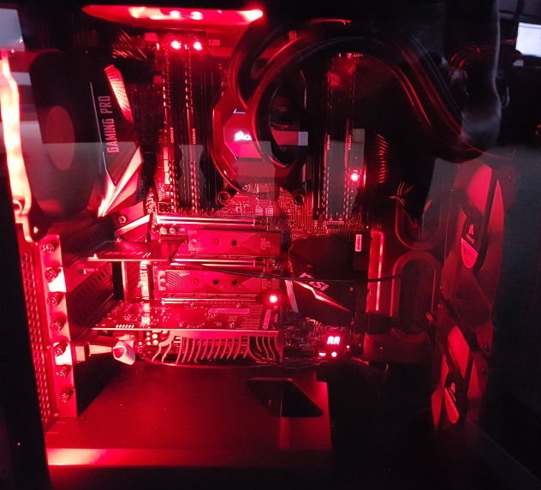
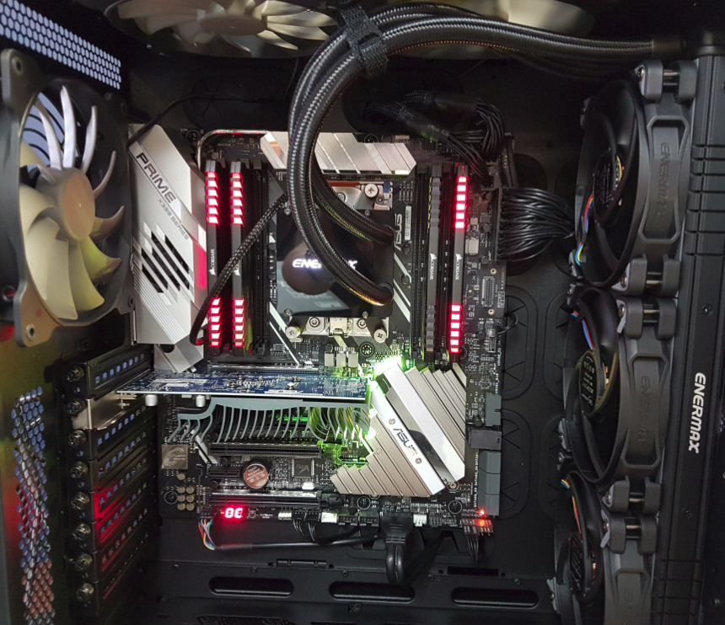
Cases were modelled using “E-Tran Plus for PSCAD” via parallel processing on new custom built AMD “Threadripper” PCs. Each PC has:
  16 physical cores (liquid cooled and overclocked), 32 parallel threads
  64 GB DDR4 RAM, High speed M.2 solid state drives
ThreadRipper 1 ThreadRipper 2

Slide 9
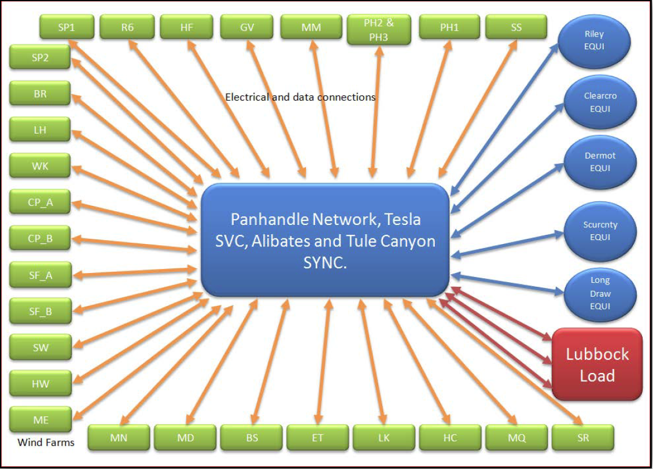
Panhandle/Lubbock System Model
(Lubbock and 7 wind plants are outside Panhandle)
9

Slide 10
South Texas System Model
LV5_SR_WW
Wind Farms/STATCOMs
PW
RW
JW_PaW
LONHIL7 EQUI
CH_BB
South Texas System 2 Network, SVCs, detailed load
South Texas System 1 Network, SVCs, detailed load
LON_HILLEQUI
LV3
HS
ALAZAN4 EQUI
LV1A
South Texas System 3 Network, SVCs, detailed load
NLARSW4 EQUI
LV1B
Electrical and data connections
MIGUE5 EQUI
LV4_CW_SW
BW
GW
CR_TWA_B_AW
10

Slide 11


Background – SCR Metric limitations
Doesn’t account for load
Can be misleading if there are multiple wind plants sharing system strength (Credit Cigre/AEMO)
100
MVA
600
MVA
WF
1
100
MW
WF1 SCR =
600+100+100+100
= 9 ???
$$\frac{600}{100}=SCR= 6$$
100
(The correct answer is something like 1.5!)

Slide 12
Background – Weighted SCR (WSCR)
Allows consideration
of nearby resources
which share SCMVA
Neglects electrical
separation
May misrepresent group
strength if there are
outliers
Critically depends on where the study area boundaries are drawn! (and on load)

Slide 13
Key Results…

Slide 14
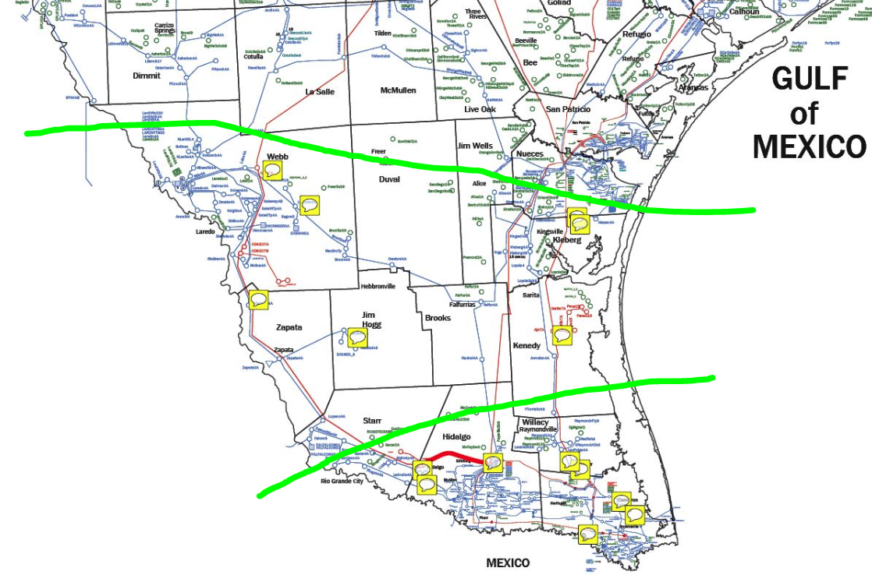
WSCR in South Texas
Issue… Regional boundaries dramatically affect WSCR

Slide 15
WSCR in South Texas

Slide 16
South Texas WSCR
It is not recommended to use WSCR to define real-time operating limits in South Texas for the current time. Reasons:
  Difficulty in defining WSCR boundaries
  Susceptibility to load variations
  Wide electrical separation between plants
  Complexity of technical issues and model uncertainties make WSCR screening difficult. (More on this later)
Parametric WSCR method failed due to tripping plants

Slide 17
Panhandle WSCR (no Lubbock)
WSCR of 1.5 in the Panhandle (representing a 70% dispatch) performs acceptably.
WSCR of 1.0 in the Panhandle (representing a 100% dispatch) does not perform acceptably.
Intermediate levels were studied as sensitivities, and due to improvements in models and plant control response, it is likely that a reduced WSCR threshold is possible. Requires complete study.
Boundaries of the “Panhandle” are getting blurry. In the future, WSCR may not be applicable.

Slide 18
WSCR – Parametric ramp test
(Panhandle, no Lubbock)
WSCR (after outage) | Large Signal Stable
Source impedance increase linearly (Applied to 70% capacity case)
1.50 | Yes
1.48 | Yes
1.44 | Yes
1.40 | Yes
1.35 | Yes
1.31 | Yes
1.27 | Yes
1.18 | No
1.09 | No

Slide 19
Dynamic Performance in Panhandle
(No Lubbock)
Severe faults and outages during high wind scenarios were stable with a WSCR of 1.5 prior to the fault.
Localized tripping was observed at several plants, but these do not result in any wide-spread loss of generation or instability.
If wind dispatch is too high, widespread tripping and/or instability occurs in the Panhandle

Slide 20
Dynamic Performance in Panhandle
(Case 3 includes Lubbock)
Case | Study Case | Panhandle Wind Capacity (MW) | Panhandle Wind Dispatch (MW) | Results | Maximum wind tripped for any contingency (MW)
1 | 70% Capacity (WSCR 1.5) | 5536 | 3780 | Wind Trips* | ≈ 256
2 | 100% Capacity (WSCR 1.0) | 5536 | 5536 | Fail ** | ≈ 1165
3 | 100% Capacity with Lubbock | 5536 | 5536 | Wind Trips* | ≈ 248
4 | 70% Capacity w/ Prior Outage | 5536 | 3780 | Wind Trips* | ≈ 94
5 | 70% Capacity w/ Prior Outage | 5536 | 3780 | Wind Trips* | ≈ 192
6 | 61% Capacity w/ Prior Outage | 5536 | 3385 | Fail ** | ≈ 714
(*) Localized tripping not resulting in wide area system impact.
(**) System collapse or widespread instability.

Slide 21
Dynamic Performance in Panhandle
(100% dispatch, no Lubbock connection, double circuit outage)

Slide 22
Dynamic Performance in South Texas
Severe faults and outages during high wind scenarios with no local thermal generation in service resulted in numerous severe dynamic performance issues, including:
  Significant portions of the total wind generation mix tripping following critical contingencies
  Poor voltage profiles following events due to slow or non-existent power plant controllers
  Stability concerns relating to series capacitors
  Stability concerns relating to model assumptions and approximations

Slide 23
Dynamic Performance in
South Texas
Dynamic Reactive Devices | Integral Time Constant (s) | South Texas Wind Capacity (MW) | South Texas Wind Dispatch (MW) | Results | Oscillations induced by Reactive Devices | Maximum wind tripped for any contingency (MW)
Fast | 0.005 | 4339 | 4339 | Wind Trips* | Severe | ≈ 853
Slow | 0.1 | 4339 | 4339 | Wind Trips* | Mild | ≈ 1358
*Wind trips, but the system recovers after the wind trips. May have damped or critically damped oscillations.

Slide 24
Voltage Regulation in Panhandle
Panhandle plants are generally very responsive as modelled; most plant level voltage control response times within 2-4 seconds. This is very beneficial!
Several outages still indicate low reactive power margins.
Additional plant control coordination may be required where plants are electrically close. This may be either droop based or a multi-plant controller.

Slide 25
Voltage Regulation in South Texas
More than half the wind resources do not have PPCs modelled. These plants and all future plants should provide fast plant level voltage control, as in the Panhandle. (eg. 2 second response time)
7 existing and planned dynamic VAR devices were all approximated using generic models.
  If they are tuned fast, you get good voltage recovery and sustained control oscillations
  If they are tuned slow, you get poor voltage recovery and no oscillations.
  Tuning these devices is important in this region!!
Additional plant control coordination may be required where plants are electrically close. This may be either droop based or a multi-plant controller.

Slide 26
Load Sensitivity - Panhandle
An increase in wind dispatch to 100% is possible under the “Lubbock Connected” scenario. This is because:
  Additional circuits increase the SCMVA in the Panhandle
  Lubbock load offloads transfers out of the Panhandle
  Load provides some damping which can improve stability

Slide 27
Load Sensitivity – South Texas
Loads are integrated much more tightly in South Texas, and variation in load can cause very different operating conditions. Combined with other South Texas issues, this makes simply quantifying impact of load in South Texas difficult. Generally:
  Addition of load offsets transfers out, and improves stability
  Use of complex motor models (including induction machines) improves damping, but degrades voltage profile on fault recovery.

Slide 28
Additional Recommendations
All new dynamic VAR devices should be specified to provide damping at sub-synchronous frequencies, and should be studied to ensure no negative interactions are introduced with the wind resources.
Several severe inadequacies were identified in the South Texas models. Model quality should improved prior to further study being performed.
  List of model inadequacies is being provided to ERCOT
  Individual plant performance was evaluated and tabulated
DFR infrastructure should be in place for future validation and event analysis

Slide 29
Thank you! Questions?

