Slide 1
CRR Activity Calendar Update
Donald House
Supervisor, CRR
WMS
February 28, 2018

Slide 2
CRR activity calendar - overview
NPRR852, CRR Activity Calendar Approval Process, approved by the ERCOT Board on February 20, 2018
Simplifies the review process and posting requirements while removing unnecessary language about advisory and firm dates
Moves final approval of calendar updates to WMS instead of TAC
Sets the date for ERCOT to post an updated calendar “no later than April 1 of each calendar year”
Each calendar will include activity dates for the remainder of the current calendar year and for the two subsequent calendar years
Draft calendar shared with CMWG on February 12, 2018
WMS to vote today for final approval

Slide 3
CRR activity calendar – description of changes
Current calendar
Dates from the currently approved calendar remain unchanged (through the 2019.MAY.Monthly.Auction)
Added dates to cover CRR activity through 2020
Applied the same patterns to assign the dates as have been used for previous calendars to maintain Protocol requirements and consistency
As with previous calendars, we have moved a few auctions by one week (earlier or later) to avoid holidays when necessary to maintain consistent activities on the same day of the week

Slide 4
CRR activity calendar – general reminders
The model build process begins 2-3 weeks prior to the model posting date (get outages and Common Information Model snapshot)
Long-term (6-month) auctions begin 3 weeks prior to posting date
Monthly auctions begin 2 weeks prior to posting date
We now hold a monthly auction and a long-term auction every month of the year
Typical pattern is monthly auction bid window in the first half of the month followed by the long-term auction bid window the very next week
Monthly auction credit is usually released 1 day after the long-term auction credit is locked

Slide 5
CRR activity calendar – general reminders
There are two additional tabs on the calendar
“Calendar Protocol References” includes any references to protocol sections relating to the selection of dates
“PCRRs” gives activity dates and protocol sections related to the annual PCRR allocation process
Note that the changes associated with NPRR808, Three Year CRR Auction, have moved the annual allocation process into July/August of each year

Slide 6
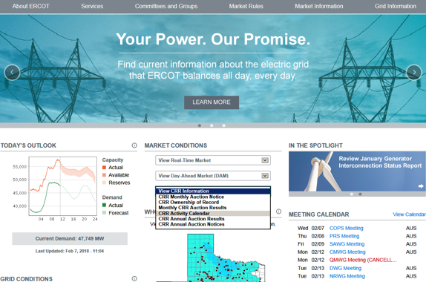
CRR activity calendar – next steps
WMS vote today for final approval
Once approved, the new version of the calendar will be posted on the ERCOT public site by April 1

