Slide 1
Generator Reactive Capability Discussion
Physics and Engineering vs the Protocols
Daniel J Hansen & John Palen

Slide 2
Generator Basics

Slide 3
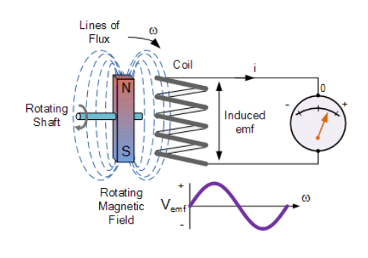
Electromagnetic Induction
Electrical conductors in the presence of an alternating magnetic field have an alternating voltage induced upon it.
The induced voltage magnitude is based upon the strength of the magnetic field and its speed (rate-of-change).

Slide 4
Impact of Generator Field Current
Exciter: Source of Field Current
Generator Output Voltage magnitude |E_{T}|, voltage angle θ, active power output P_{GEN}, and reactive power output Q_{GEN} are all interrelated with the magnitude of the generator field current I_{FG} and field voltage E_{FG}

Slide 5
CREATING REACTIVE
There is no button to push to directly create and control reactive. Reactive power is an outcome based upon multiple variables.
Generator field current is increased or decreased.
Field current increases or decreases the magnetic field strength.
Magnetic field strength and generator loading affect and determine the generator terminal voltage.
The progressive impact of these items determine only one variable: generator terminal voltage.
Generator terminal voltage (E_{T}) is only one of three primary variables to determine the Reactive Power at the POI: E_{T}, Z_{GSU}, and V_{POI}.

Slide 6
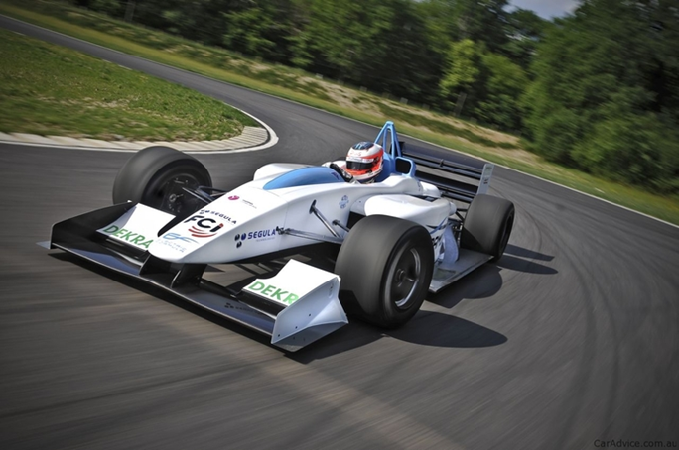
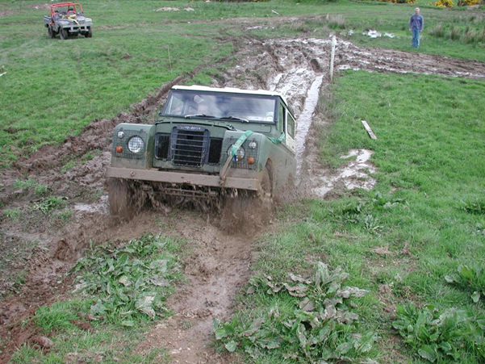
OPERATING CONDITIONS AFFECT PERFORMANCE
REACTIVE CAPABILITY

Slide 7
REACTIVE CAPABILITY

Slide 8
Generation of Reactive?
For a cylindrical synchronous generator, there is no equivalence when comparing the “generation” of active and reactive power. Active power output is entirely is within the control of the generator operator. The same is not true for reactive power.
The generator operator can normally impact and influence the voltage at the POI, but they CANNOT always control it to a given level. The grid itself has a much greater impact on the POI than any generator can.
To an even lesser extent, the generator operator cannot absolutely determine the amount of reactive delivered at the POI. However, a predetermined level of reactive at the POI is never the operating objective, voltage is the desired end objective.
REACTIVE CAPABILITY

Slide 9
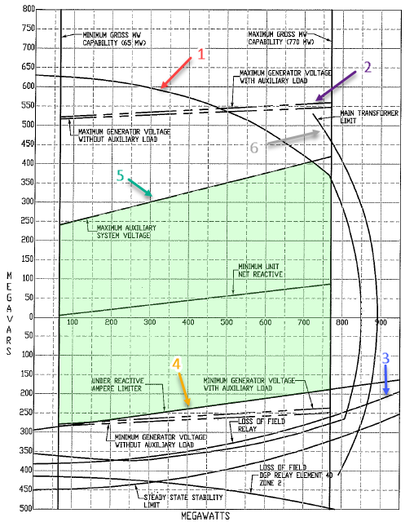
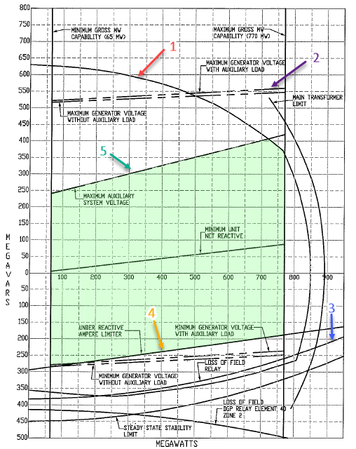
CURL Explained
Real World Limits
Generator Manufacturer’s Design Operating Limit
Generator limitation w/o auxiliaries (at schedule voltage, independent of auxiliaries)
Protective Relay Limitation
Under Excitation Limit
Auxiliary System Voltage Limit
GSU Transfer Limit

Slide 10
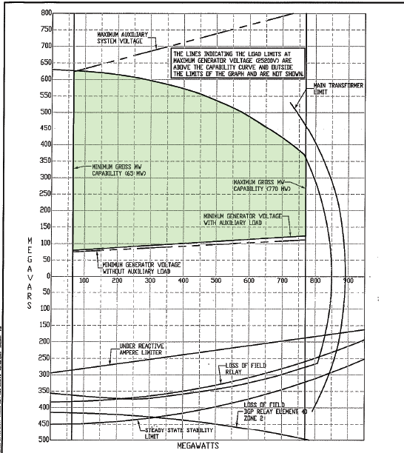
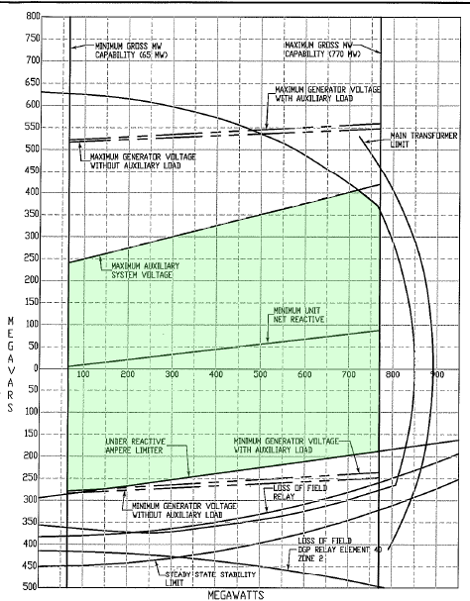
Impact of POI Voltage on Thermal Steam Unit
CURVE at 138kV CURVE at 145 kV

Slide 11
CURL for 850 MVA Steam Unit
Grid voltage plays a significant role in reactive capability
0.95 pf at the point of interconnection equates to 245 MVARS lagging and -245 MVARs leading.
At 138kV voltage, the unit reactive capability is shifted in the lagging direction and produces ~360 MVARs lagging. In the leading direction, the limit is reached at a minimum of 120 MVARs LAGGING. The defined limits in the lead are established by the generator low voltage limit.
At 145kV voltage, the generator has a broader operating range and can still produce 360 MVARs lagging, but now, it can also absorb ~185 MVARs, with the limiting factor shifting to the minimum excitation limiter

Slide 12
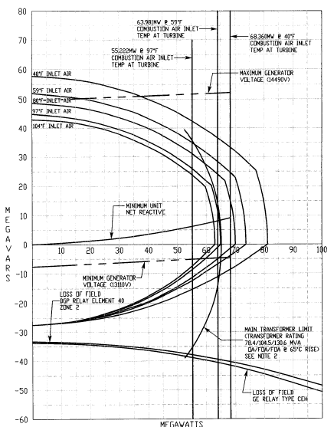
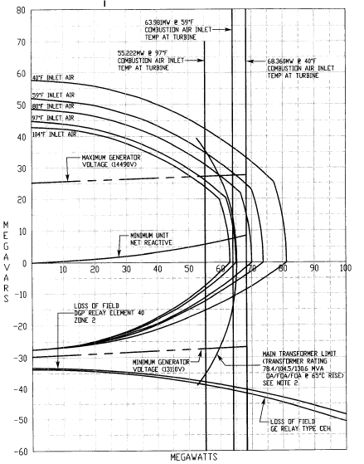
Simple-Cycle Gas Turbine
CURVE at 138kV CURVE at 145 kV

Slide 13
CURL for Simple-Cycle Gas Turbine
0.95 pf at the point of interconnection equates to 18 MVARS lagging and -18 MVARs leading.
At 138kV, the unit is capable of producing 35 MVARs lagging, but is limited to -5 MVARs leading due to reaching minimum generator voltage.
At a grid voltage of 144kV, leading capability has increased to -27 MVARs, but lagging capability is reduced to 27 MVARs due to reaching maximum generator voltage.
Air cooled GT reactive capability is not only impacted by POI voltage, but is highly sensitive to ambient temperature as well.

Slide 14
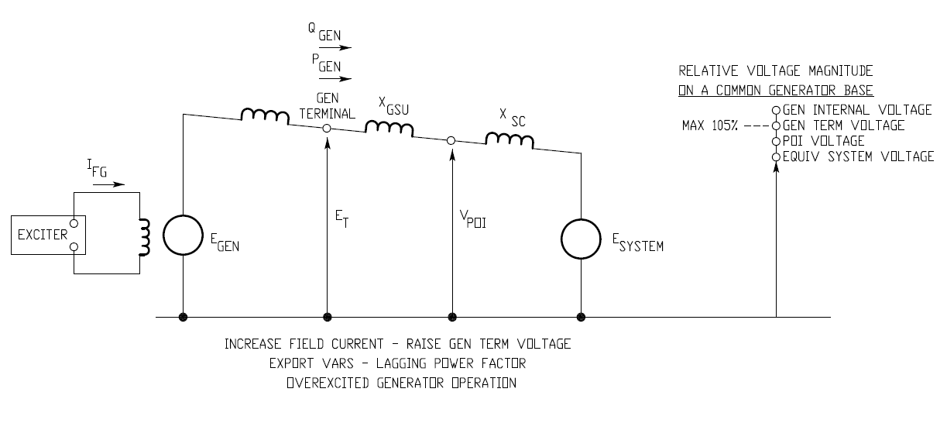
Export of Reactive Power: Generator Voltage must be higher than the System Voltage (on per unit basis)

Slide 15
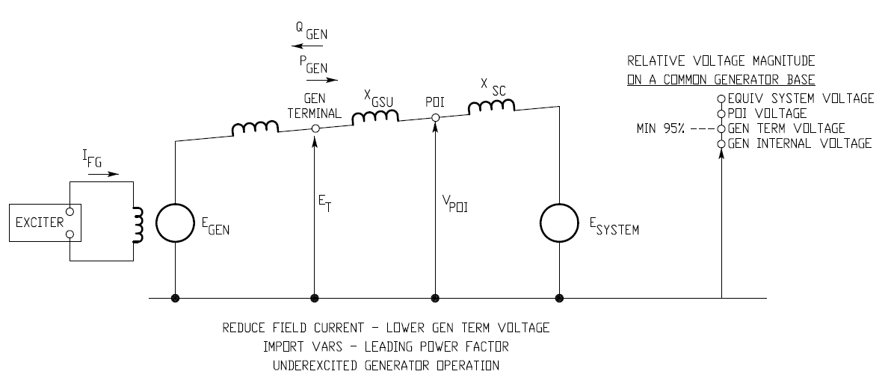
Import of Reactive Power: Generator Voltage must be lower than the System Voltage (on per unit basis)

Slide 16
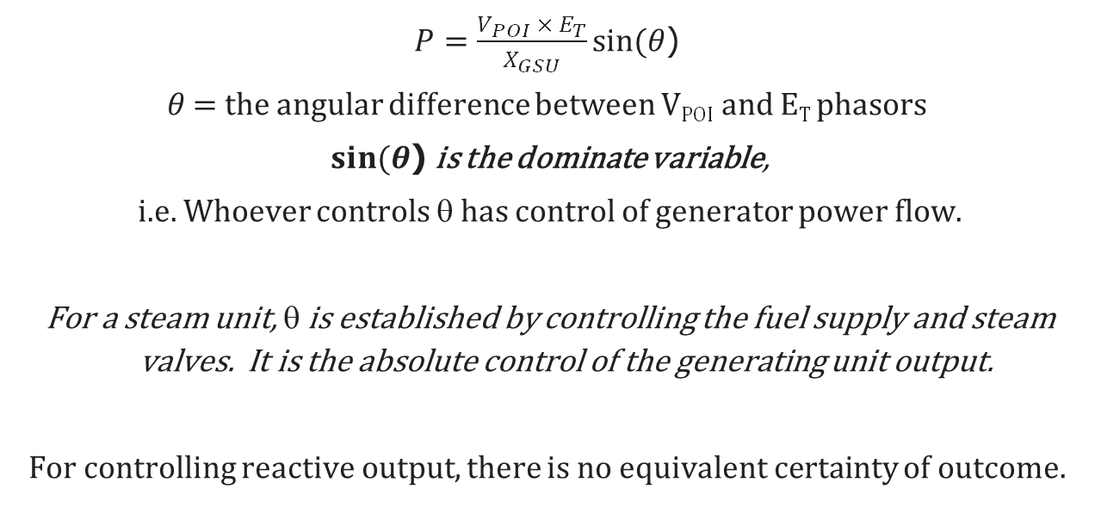
Generator Power Output (in per unit)
$P=\frac{V_{POI} ×{ E}_{T}}{X_{GSU}}sin⁡(θ$)
$θ$ = the angular difference between V_{POI} and E_{T} phasors
$sin⁡(θ$) is the dominate variable,
i.e. Whoever controls θ has control of generator power flow.
For a steam unit, θ is established by controlling the fuel supply and steam valves. It is the absolute control of the generating unit output.
For controlling reactive output, there is no equivalent certainty of outcome.

Slide 17
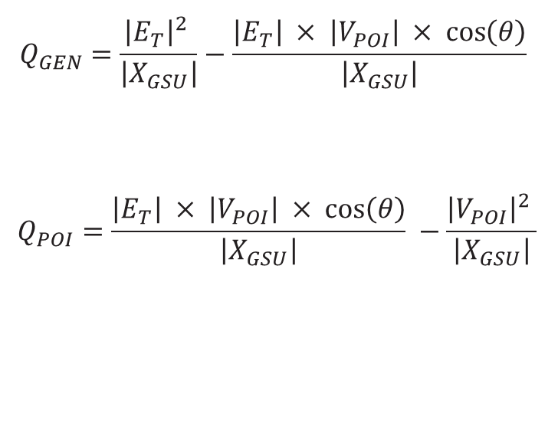
Reactive Flow Equation: neglecting resistance
$$Q_{GEN}=\frac{{\left|E_{T}\right|}^{2} }{\left|X_{GSU}\right|}−\frac{\left|E_{T}\right| × \left|V_{POI}\right| × \cos\left(θ\right)}{\left|X_{GSU}\right|}$$
$$Q_{POI}=\frac{\left|E_{T}\right| × \left|V_{POI}\right| × \cos\left(θ\right)}{\left|X_{GSU}\right|} −\frac{{\left|V_{POI}\right|}^{2} }{\left|X_{GSU}\right|}$$
Missing From the Equations
Generator MVA Rating
Exciter Rating or Capability

Slide 18
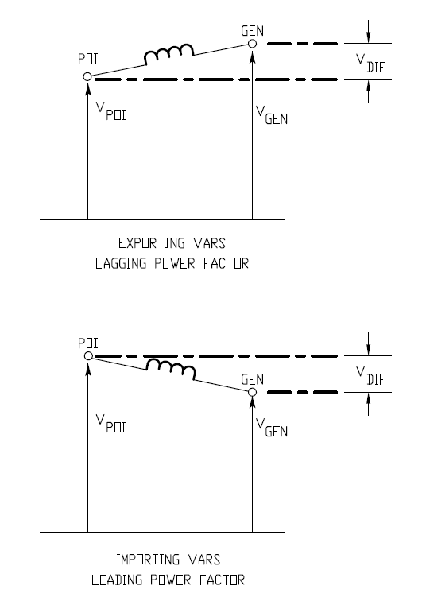
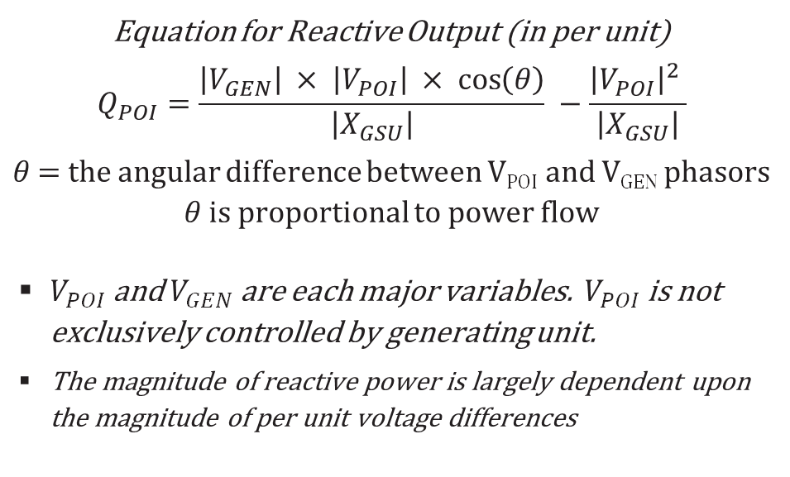
Creating Reactive
Predominately, V_{DIF} makes the difference
X
Equation for Reactive Output (in per unit)
$$Q_{POI}=\frac{\left|V_{GEN}\right| × \left|V_{POI}\right| × \cos\left(θ\right)}{\left|X_{GSU}\right|} −\frac{{\left|V_{POI}\right|}^{2} }{\left|X_{GSU}\right|}$$
$θ$ = the angular difference between V_{POI} and V_{GEN} phasors
$θ$ is proportional to power flow
$V_{POI}$ and $V_{GEN}$are each major variables. $V_{POI}$ is not exclusively controlled by generating unit.
The magnitude of reactive power is largely dependent upon the magnitude of per unit voltage differences

Slide 19
What is the Real Objective
Protocol requirements for generator reactive: The entire focus is on a specific quantity of power factor as the desired objective.
This is an incorrect metric.
The real objective is to achieve and maintain the desired V_{POI}, not to operate at a designated power factor, supplying a given amount of VARs.
NERC VAR-002 recognizes the primary objective: Each generator shall operate in voltage control mode.
The measured generator reactive is a secondary outcome, not the primary objective.
REACTIVE CAPABILITY

Slide 20
Example
Two identical generators side by side.
Each generator is connected to an identical GSU with fixed NLTC. GSUs are connected in parallel to a common HV bus.
One GSU tap is set 2.5% higher than the other.
The generators operate on alternating days, both maintain the same V_{POI}
Due to GSU ratio difference, the two generator’s reactive outputs are different, even though generators are identical, have the same capability curve, and are maintaining the same V_{POI}
If V_{POI} is maintained, generator operating pf is irrelevant.
One generator has better lagging capability, the other is better in the lead
REACTIVE CAPABILITY

Slide 21
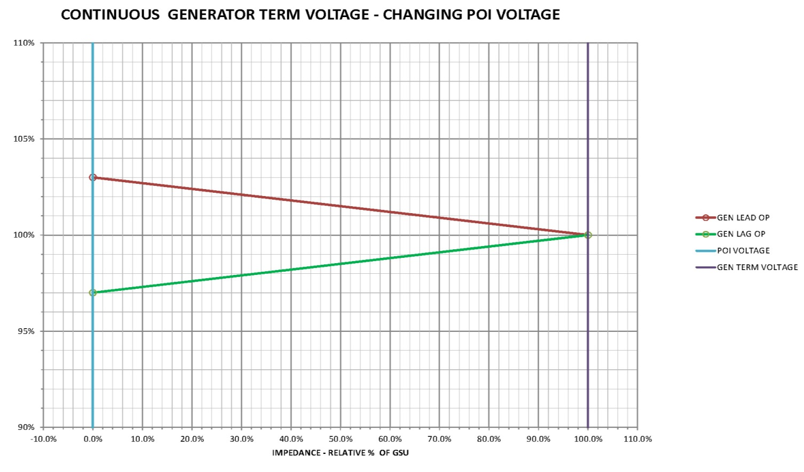
Changing grid conditions affect reactive output, but 100% responsibility for POI voltage is placed upon the G.O.
POI Voltage
Gen Term Voltage
Voltage %

Slide 22
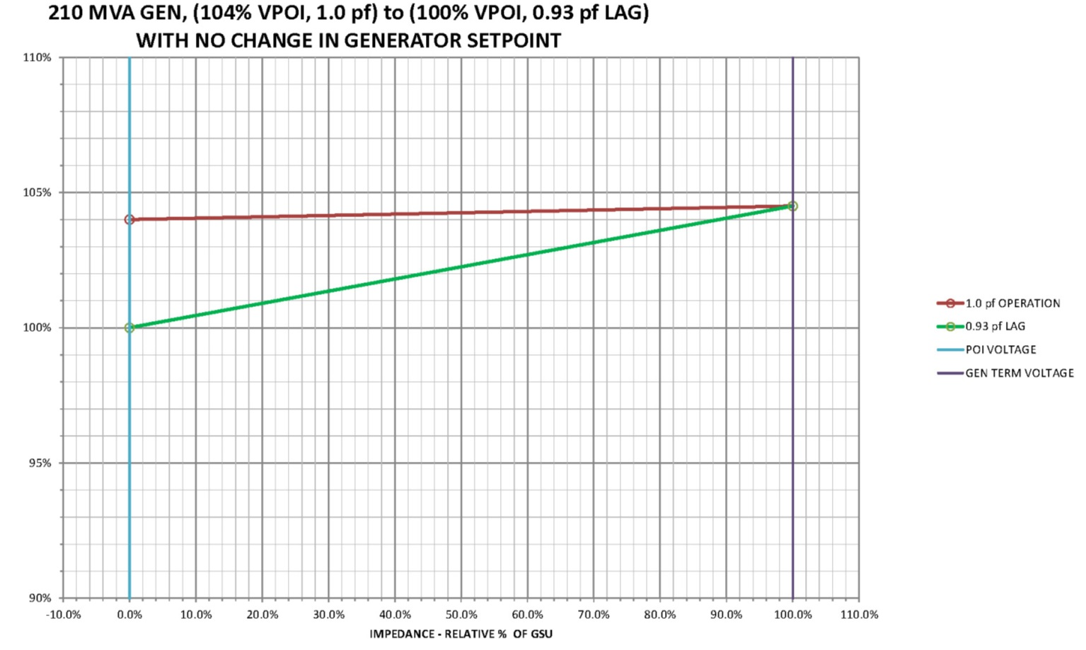
Constant Generator Terminal Voltage
Variable Reactive Output
POI Voltage Start
Gen Term Voltage Constant
Voltage %
POI Voltage Finish

Slide 23
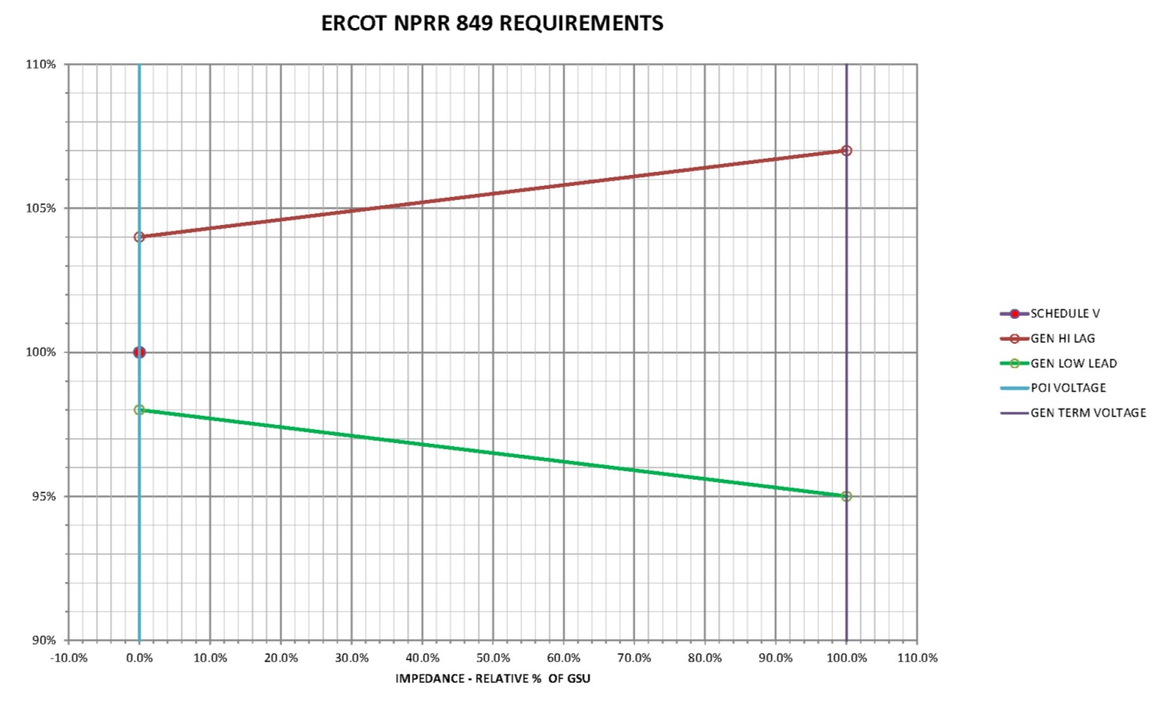
Generator Terminal Operating Range: 105% to 95%
(IEEE C50.13)
POI Voltage
Gen Term Voltage
0.95 p.f. lagging
10% max adjustment limit (considering generator voltage only)
Voltage %
0.95 p.f. leading
GSU Tap Settings establish a bias of reactive capability in either the leading or lagging direction, but NOT at the same time.

Slide 24
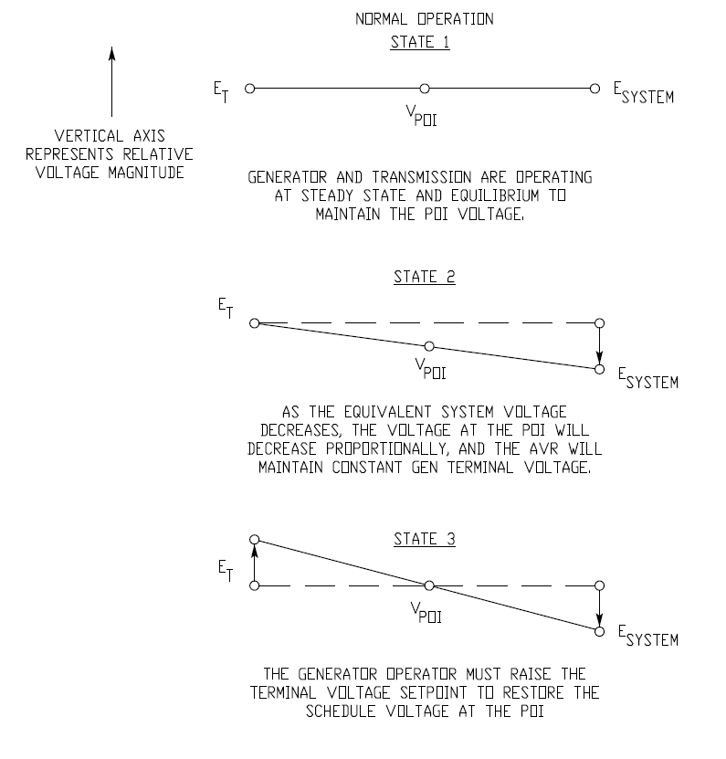
VOLTAGE ADJUSTMENTS FOR
NORMAL OPERATION
Normal Voltage adjustment is explained in three steps.
It is an unfamiliar expectation to create State 2, a POI undervoltage condition, as a result from lowering generator voltage to create a leading power factor operating.

Slide 25
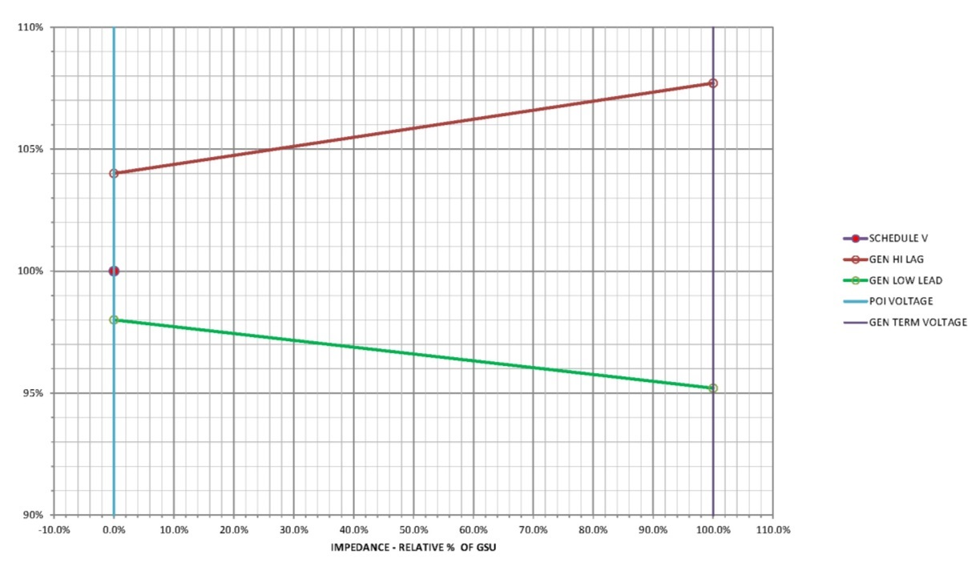
Example: 210 MVA Generator, 345kV Interconnection,
GSU Z=8.88% @ 150 MVA Base
POI Voltage
Gen Term Voltage
Requires 12.5% adjustment span, which exceeds generator rated operating range.
REACTIVE CAPABILITY

Slide 26
Changing Reactive Capability Requirements
It is common to design a generating unit for 0.95 pf at POI. What is not common, are lagging pf requirements at high POI voltage and leading pf requirements at low POI voltage. Why is it needed here?
Lead & lag pf criteria are generally achievable for most units at nominal voltage, even with the following responses to V_{POI} deviations.
  Lagging reactive increases even more as V_{POI} decreases.
  Leading reactive increases even more as V_{POI} increases.
  For steady state, continuous operation, it is illogical to mandate lagging reactive capability at high V_{POI} extremes and leading reactive capability at low V_{POI} extremes.

Slide 27
The Primary Problems
The primary difficulty and objections to NPRR 849 are as follows:
The concurrent expectation for a generating unit to be capable of operating at diametrically opposite reactive extremes.
0.95 Lagging power factor operation at 104% V_{POI,} and
0.95 Leading power factor operation at 98% V_{POI}
  The requirement to significantly design over and above normal practices for the continuous capability of a unit to respond to where it is never called upon to operate.

Slide 28
Steady State ≠ Short Term Contingency
Short term operating contingencies should not be the basis to establish continuous, steady state operating requirements.
Planning for short term transients ≠ NPRR-849 requirements
No one starts the day with plans to operate a generating unit continuously at 0.95 lagging power factor and V_{POI} at 104%.
Short term transient capability already exist. PRC-025 anticipates a gross unit output at 85% V_{POI}. No tripping allowed at the following generator output: GEN_{Out} [MVA] = 100% [MW] + (150%×MVA_{rated} ×pf_{rated}) [MVAR]
PRC-024 creates “No trip” zones for voltage excursions. These excursions can result in temporary reactive output greater than rated.

Slide 29
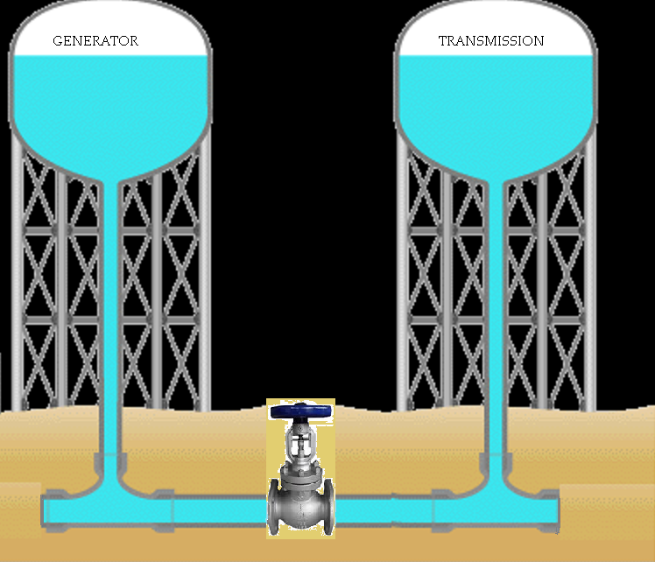
A Physical Analogy: Conditions Unfavorable to Reactive Flow
NPRR 849 mandates full flow when the valve is opened.
How do you expect full flow from the “Generator” when “Transmission” has reached its limits?

Slide 30
Summary and Conclusion

Slide 31
Challenges Faced by Generators
Physical laws requires a relative voltage difference between the generator (as stepped up by the GSU) and the grid voltage to import or export VARs to the system.
At most locations, POI voltage is driven less by the generator than by the grid as a whole. A single generator can affect POI voltage only so much.
By standard design (IEEE C50.13), each generator manufacturer designs to the voltage operating range of 105% to 95% of rated voltage. This range is insufficient for the average generator installation to operate between a 0.95 pf lagging and 0.95 pf leading at a POI operating voltage of 104% to 98%.

Slide 32
Challenges cont…
ERCOT only recognizes a single reactive limit, (RARF, NDCRC, etc.). In reality, the generators reactive capability it is highly dynamic, changing as the grid voltage changes, and to a lesser extent, ambient temperature.
Most GSUs have NLTC (no-load tap changers). The available tap setting adjustments are not counted towards meeting the 0.95 power factor requirement across the entire range of possible settings, as they cannot be performed while the generator is on-line.

Slide 33
Conclusion
Changing the GSU ratio (i.e. transformer tap change) to adjust from a leading to a lagging mode, has the greatest impact on a generator’s reactive capability. It is only operationally practical if the GSU has an automatic tap changing capability.
A single generator will never have the ability to overcome the “Voltage Inertia” of the grid, it can only operate up to the limitations of its design.
As POI voltage approaches its limits, the generators reactive capability will decrease to the point where Protocol 3.15 requirements cannot be met.

Slide 34
Conclusion cont…
ERCOT HV buses generally operate higher than nominal. The average voltage setpoint for Winter 2017/Spring 2018 for the 69kV, 138kV and 345kV busses are 1.016 p.u.V, 1.024 p.u.V, and 1.027 p.u.V, with some busses running as high as 1.041 p.u.V. Unless GSU tap settings are biased for these values, operations in these areas seem at odds with the stated goal to maintain maximum dynamic reactive capability for leading power factor operation.
A generator may be fully capable of following its voltage setpoint (the true goal), and still not be in compliance with 3.15 of the Protocols, in effect, exposing the generator to unnecessary compliance risk.

