Slide 1
Lower Rio Grande Valley (LRGV) Import Project
ERCOT Regional Planning Group
February 27th, 2018

Slide 2
Study Region & Generation
LRGV Interface
Generation within the LRGV (Updated January, 2018)
 | Gas (MW) | Renewable (MW) | Total (MW) | Cumulative (MW)
Operational | 1458 | 1853 | 3311 | 3311
PG 6.9 Compliant | 0 | 238 | 238 | 3549
Executed IA Only | 871 | 145 | 1016 | 4565
GINR Queue | 0 | 3397 | 3397 | 7962

Slide 3
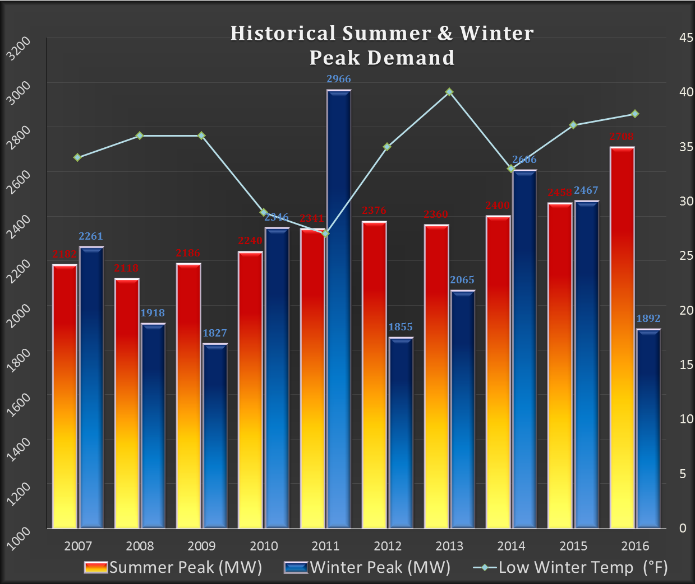
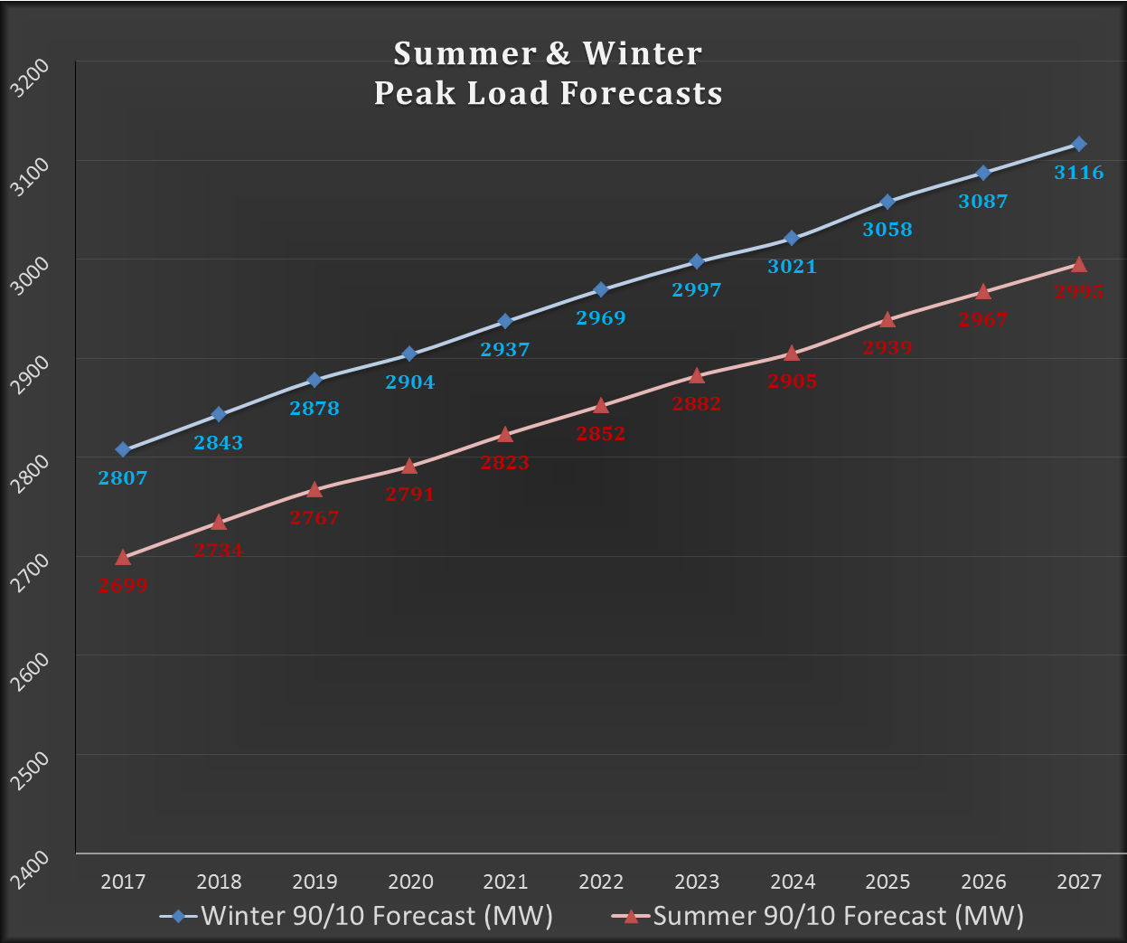
LRGV Load
2016 Summer Peak: 2,708 MW
*10% Increase Over Summer 2015*
AEP’s 2017 LRGV 90/10 Summer Forecast
~2,800 MW by 2020
~3,000 MW by 2027
Prospective Point Loads at Port of Brownsville Not Included

Slide 4
(Re)Study Drivers
Updated Load Forecast
ERCOT’s 2016 LRGV Endorsement: 2,800 MW
2016 Summer Peak: 2,708 MW
Cancelled/Delayed Conventional Generation
16INR0004 Cancelled; 16INR0005 Delayed
Updated Composite Load Model (Dynamics)
LNG Development
3 Projects Representing 240 – 1245 MW of Load

Slide 5
Case Preparation Assumptions
Steady State BC: 2023 Summer Case
Posted by SSWG Feb, 2017
Stability BC: 2023 Case
Finalized by DWG in Feb, 2017
Latest CMLDZNU2 Composite Load Model Applied to LRGV
LRGV and Near-By Wind Dispatched at 10%
LRGV Conventional Generation Dispatched at 100%
Distributed Generation: Offline
Mexico Ties: Railroad; Laredo, Eagle Pass
Exporting (N-0 and N-1)
Neutral (N-1/N-1, G-1/N-1, A-1/N-1)
LRGV Pre-Contingency Voltage Profile: ~1.03 PU
2016 Endorsed LRGV Reactive Support and West Valley Improvements Included in Base Case

Slide 6
Study Methodology
Perform Transfer Analysis for Increasing LRGV Loads
Applied to Steady State and Transient Stability Analysis
“LRGV” Load Defined by Zones (610, 615, 800, 829, 875, 876)
LRGV Load Increases Offset by Oncor & Panhandle Generation Increases
Load Scaled with Constant P/Q Ratio
Identify Load Serving Capability of Existing System
Overlay Results on Load Forecast to Define Project Need
Compare Performance of Upgrade Options
Based on Incremental Increases in LRGV Load Serving Capability (MW)
Based on Estimated Cost of Upgrade Options ($M)
LNG Analysis Utilized Same Transfer Analysis Approach, HOWEVER
Native LRGV Load Set at Forecasted Amount (Years 2023 & 2027)
Analyze System Response with Increasing LNG Load

Slide 7
Ground Rules
Steady State Transfer Analysis:
Project Need Identified on Basis of NERC P3 (G-1/N-1) Scenarios
Identified Need to Monitor Thermal Limits on LRGV Interface Lines
Transient Stability Transfer Analysis:
“The System shall remain stable.” (TPL-001-4, Table 1).
Applied to NERC P3 and NERC P6 (N-1/N-1) Events
UVLS Operation Not Considered Acceptable System Response
G-1 = Loss of Entire Combined Cycle Train (MVEC and HEC)

Slide 8
Existing System Results
VSAT P3:
LSC: 2,740 MW
Lon Hill – Bessel 138 kV Overload
FLO: MVEC + Lon Hill – North Edinburg
***17.9 Mile Rebuild -> 3,090 MW***
Stability P6:
LSC: 2,800 MW
LRGV Angular Instability & Loss of Synchronism
FLO: Ajo – Rio Hondo + Lon Hill – North Edinburg
Stability P3:
LSC: 2,900 MW
Voltage Collapse and UVLS due to Reactive Resource Exhaustion
FLO: MVEC + Lon Hill – North Edinburg
System Improvements Required by Jan 1st, 2021

Slide 9
Improvement Options
(See Appendix for Additional Detail)
Option 1: Additional LRGV Reactive Support (300 MVAR Dynamic Reactive)
$73.37 M
Option 2: San Miguel – Lobo – Del Sol Ckt 2; New Del Sol – Frontera 345 kV
$277.84 M
Option 3: NSUBLH – Ajo – Bonilla 345 kV BOLD (2 x 1590 ACSR Configuration)
$357.19 M
Option 4: NSUBLH – Ajo – Bonilla 345 kV BOLD (3 x 954 ACSR Configuration)
$381.16 M
Option 5: NSUBLH – Bonilla 345 kV BOLD (2 x 1590 ACSR Configuration)
$353.96 M
Option 6: NSUBLH – Bonilla 345 kV BOLD (3 x 954 ACSR Configuration)
$377.65 M
Option 7: Nelson Sharpe – Rio Hondo 138 kV Rebuild (2 x 954 ACSR/ACSS)
$169.95 M

Slide 10
System Improvements: Steady State Results
Upgrade Option | LRGV LSC¹ (MW) | Incremental LSC (MW) | Limiting Contingency | Limiting Condition | Facility Violation | Comparison (MW/$M)
None | 3090 | NA | MVEC + LH - NE | Overload | NS – CB | NA
1 | 3125 | 35 | MVEC + AJ - RH | Overload | NS – CB | 0.73
2 | 3530 | 440 | MVEC + AJ - RH | Overload | NS – CB | 1.58
3 | 3940 | 850 | MVEC + HEC | Voltage Drop | Multiple West Valley Busses | 2.38
4 | 3965 | 875 | MVEC + HEC | Voltage Drop | Multiple West Valley Busses | 2.30
5 | 3775 | 685 | MVEC + AJ - RH | Overload | NS – CB | 1.94
6 | 3840 | 750 | MVEC + AJ - RH | Overload | NS – CB | 1.99
7 | 3480 | 390 | MVEC + AJ - RH | Voltage Drop | Armstrong | 2.35
2
[1] Table Abbreviations: LSC = Load Serving Capability, MVEC = Magic Valley Energy Center, HEC = Hidalgo Energy Center, AJ – RH = Ajo – Rio Hondo 345 kV, LH – NE = Lon Hill – North Edinburg 345 kV, NS – CB = Nelson Sharpe – Celanese Bishop 138 kV
[2] Lon Hill – Bessel 138 kV Rebuild Assumed as Base Case Improvement.
Base Case Beyond 3,000 MW and 2027 Forecast.
Ajo Hairpins for Corpus to Valley BOLD Line (Opts 3 & 4) Outperform Direct Line (Opts 5 & 6).
Opt 4 (3 x 954 ACSR BOLD) Improves Valley LSC, But Not Enough to Justify Incremental Cost over Opt 3 (2 x 1590 ACSR).
Nelson Sharpe – Rio Hondo 138 kV Rebuild is Amongst Top Performing Upgrades (in Steady State Analysis).

Slide 11
System Improvements: Transient Stability Results
Upgrade Option | G1-N1¹ Limit | G1-N1 Limiting Contingency | N1-N1² Limit | N1-N1 Limiting Contingency | Incremental LSC (MW) | Comparison (MW/$M)
None | 2900 | MVEC + LH-NE | 2800 | AJ-RH + LH-NE | NA | NA
1 | 3100 | MVEC + LH-NE | 3100 | AJ-RH + LH-NE | 300 | 6.29
2 | 3200 | MVEC + LH-NE | 3100 | AJ-RH + LH-NE | 300 | 1.08
3 | 3100 | MVEC + LH-NE | 3300 | AJ-RH + LH-NE | 300 | 0.84
4 | 3100 | MVEC + LH-NE | 3400 | AJ-RH + LH-NE | 300 | 0.79
5 | 3000 | MVEC + LH-NE | 3200 | AJ-RH + LH-NE | 200 | 0.57
6 | 3100 | MVEC + LH-NE | 3300 | AJ-RH + LH-NE | 300 | 0.79
7 | 2900 | MVEC + LH-NE | 2800 | AJ-RH + LH-NE | 0 | 0
[1] The limiting system conditions were found to be voltage collapse due to reactive resource exhaustion and UVLS
[2] The limiting system conditions were found to be instability, loss of synchronism due to slow post-fault voltage recovery, and UVLS
Primary Need for LRGV: Additional Reactive Support (Opt 1)
New Transmission Lines: Not An Efficient Means to Fulfill Primary Need
Opt 7 (138 kV Rebuild): Effective in Steady State Analysis; Provides Little to No Stability Improvement

Slide 12
Native LRGV Load Growth Recommendation
Recommended Upgrades
Rebuild Lon Hill – Bessel 138 kV Line
17.9 Miles; 2 x 795 ACSR/ACSS Conductor
Estimated Cost: $25.66 M
Install Additional LRGV Reactive Support
+300 MVAR STATCOM/SVC at South McAllen 138 kV
One (1) 57.6 MVAR Shunt Cap Bank at Polk Avenue 138 kV
Estimated Cost: $47.71 M
Total Cost: $73.37 M
138 kV Rebuild: Addresses Steady State Limitation
At 3,090 MW: Sufficient to Serve LRGV Beyond Year 2027 Forecast
Additional Reactive Support: Addresses Primary Stability Need
At 3,100 MW: Also Sufficient Beyond 2027 Forecast
Lowest Cost Option Evaluated
Requires No New Transmission Right-of-Way (No CCN)
Conducive to Meeting January, 2021 Need Date

Slide 13
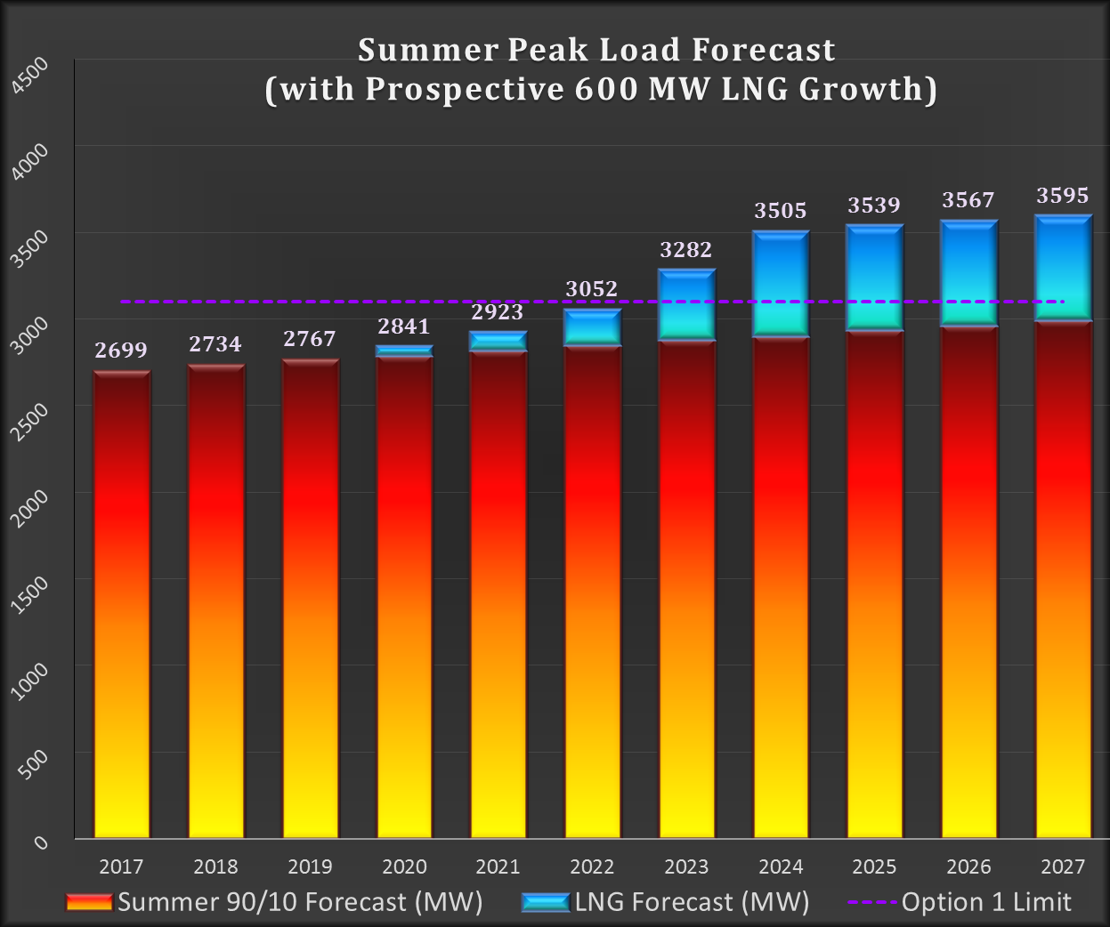
LNG Sensitivity Drivers
3 Prospective LNG Projects at Port of Brownsville
Load Forecasts Range from 240 MW – 1,245 MW
Any Single Project Accelerates Need for Additional Improvements
Option 1 Recommendation: Improves Load Serving Capability to 3,100 MW
LRGV Native Growth 2023 Forecast: 2,882 MW (+ 240 MW -> 3,122 MW)
Why Now?
Lead Time
ERCOT Independent Review (2018)
Scoping, Funding, Siting, & ROW (2018 - 2020)
EPC (2020-2023)
Plan or React?
Rio Grande LNG Timeline
FERC Pre-Filing: Mar, 2015
Open Houses/FERC Scoping: May – Aug, 2015
FERC Application (Site, Construct, Operate): May, 2016
Anticipated FERC Ruling: Spring, 2018
Anticipated FERC Approval: Fall, 2018
Projected Load: ~600 MW

Slide 14
LNG Study: Methodology and Assumptions
Steady State and Transient Stability Transfer Analysis
Hold Native LRGV Load Static at 2023 (2,882 MW) and 2027 (2,995 MW) Forecast
Increase LNG Load to Identify Minimum LNG Load Threshold Requiring Additional Upgrades
Compare Options 2 – 7 in Terms of Incremental LNG Load Improvements
Base Case Assumptions
Same SSWG and DWG Cases as with Preceding Analysis
Same LRGV Dynamic Load Model as with Preceding Analysis
Upgrade Option 1 Included in Base Cases
LNG Load(s) Added to Model and Interconnected via Looped 138 kV Service
Included Intra-Valley Upgrades Necessary to Support Local Integration of LNG Load(s)
Load Model for LNG Plant Derived from Freeport LNG Plant Model Characteristics

Slide 15
Minimum LNG Threshold
Aims to Identify Minimum Level of LNG Load Development Requiring LRGV Upgrades Beyond Option 1
Native LRGV Load Set at Year 2023 Forecast (2,882 MW)
LRGV Import Transfers Initiated by Increasing LNG Load
Steady State State Results:
LNG Limit: 235 MW
Constraint: Nelson Sharpe – Celanese Bishop 138 kV Overload
Contingency: MVEC Plant + Ajo – Rio Hondo 345 kV (P3)
Stability Results:
LNG Limit: 300 MW
System Condition: Angular Instability and Voltage Collapse
Contingency: Ajo – Rio Hondo + Lon Hill – North Edinburg 345 kV (P6)

Slide 16
Improvement Options Evaluation (Steady State: 2027 Forecast)
Upgrade Option | LNG Load Limit (MW) | Limiting Contingency | Limiting Condition | Facility Violation | Incremental LNG (MW) | Comparison (MW_{LNG}/$M)
None | 145 | MVEC + AJ - RH | Overload | NS – CB | NA | NA
2 | 535 | MVEC + AJ - RH | Overload | NS – CB | 390 | 1.40
3 | 1250 | MVEC + HEC | Low Voltage | Multiple Brownsville Area Busses | 1105 | 3.09
4 | 1260 | MVEC + LH - NE | Low Voltage | Multiple Brownsville Area Busses | 1115 | 2.93
5 | 840 | MVEC + AJ - RH | Overload | NS – CB | 695 | 1.96
6 | 900 | MVEC + AJ - RH | Overload | NS – CB | 755 | 2.00
7 | 500 | MVEC + AJ - RH | Voltage Drop | Armstrong | 355 | 2.14
Top Performing: Upgrade Options 3 and 4 (BOLD Line Hairpinned at Ajo)
Ajo Hairpin Protects Nelson Sharpe – Celanese Bishop 138 kV from Redirected Coastal Wind
Options 3 and 4 Limited by Local LNG Load Integration Assumptions
Option 7 (138 kV Rebuild) Once Again Fares Well in Steady State Analysis
Table Abbreviations: MVEC = Magic Valley Energy Center, HEC = Hidalgo Energy Center, AJ – RH = Ajo – Rio Hondo 345 kV, LH – NE = Lon Hill – North Edinburg 345 kV, NS – CB = Nelson Sharpe – Celanese Bishop 138 kV

Slide 17
Improvement Options Evaluation (Stability – 2027 Forecast)
Upgrade Option | LNG Load Limit | Limiting Contingency | Limiting System Condition | Incremental LNG Load (MW) | Comparison (MW_{LNG}/$M)
None | 100 | AJ-RH + LH-NE | LRGV Area Instability / Voltage Collapse | NA | NA
2 | 300 | LH-NE + RH-AJ | LRGV Area Instability / Voltage Collapse | 200 | 0.72
3 | 750 | MVEC + LH-NE | Slow Recovery / UVLS | 650 | 1.82
4 | 800 | MVEC + AJ-RH MVEC + LH-NE | Slow Recovery / UVLS | 700 | 1.84
5 | 700 | MVEC + AJ-RH MVEC + LH-NE AJ-RH + LH-NE | Slow Recovery / UVLS “ “ | 600 | 1.70
6 | 750 | MVEC + AJ-RH | Slow Recovery / UVLS | 650 | 1.72
7 | 200 | AJ-RH + LH-NE | LRGV Area Instability / Voltage Collapse | 100 | 0.60
Options 2 and 7: San Miguel – Valley Ckt #2 and 138 kV Rebuild
Support Only Relatively Small LNG Load Development (from 2027 Perspective)
Neither Solution Overcomes Tendency for LRGV Area Instability & Loss of Synchronism
Upgrade Options 3 and 4: Support Large LNG Plant Development with Margin
Also Top Performing Options in Terms of Value

Slide 18
LNG Contingent Recommendation
Recommended Upgrade: Option 3 “NSUBLH – Ajo – Bonilla (2 x 1590 ACSR)”
*Contingent Upon Executed/Secured LOA for 200 MW LNG Load*
Construct “NSUBLH” 345 kV Substation
Bisect Lon Hill – Pawnee and Lon Hill – Coleto Creek
Install 100 MVAR Shunt Reactor
Estimated Cost: $27.58 M
Expand Ajo Substation
Add Two New 345 kV Terminals
Estimated Cost: $4.2 M
Construct Bonilla 345 kV Substation
Bisect Rio Hondo – North Edinburg Line
Install 100 MVAR Shunt Reactor
Estimated Cost: 24.88 M
Construct NSUBLH – Ajo 345 kV Line
BOLD Line Structures
2 x 1590 ACSR Conductor
~64 Miles
Estimated Cost: $144.15 M
Construct Ajo – Bonilla 345 kV Line
BOLD Line Structures
2 x 1590 ACSR Conductor
~71 Miles
Estimated Cost: $156.39 M
Total Estimated Cost: $357.19 M
Supports Up to 750 MW LNG Development
While Reliably Serving Native LRGV Growth Through 2027
BOLD Design Does Not Expose Generators to a New Series Compensated Line
Ajo Hairpin Protects Nelson Sharpe – Rio Hondo 138 kV From Overloads
While Mitigating Ajo Area GTC

Slide 19
Appendix

Slide 20
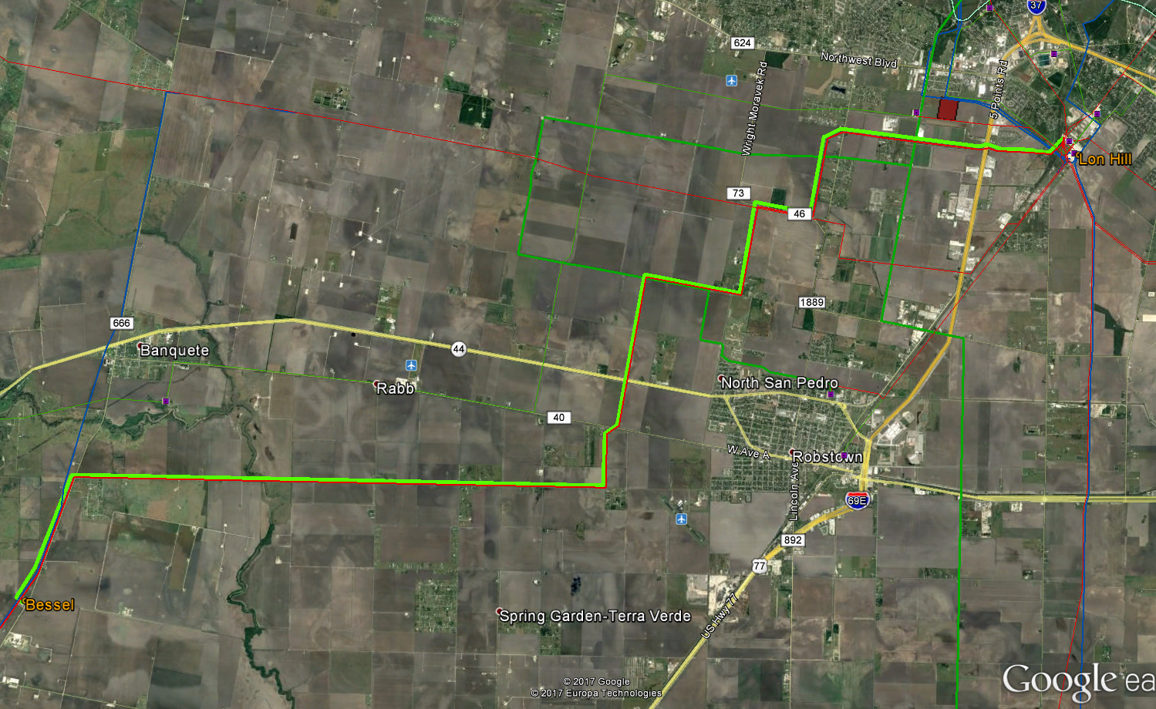
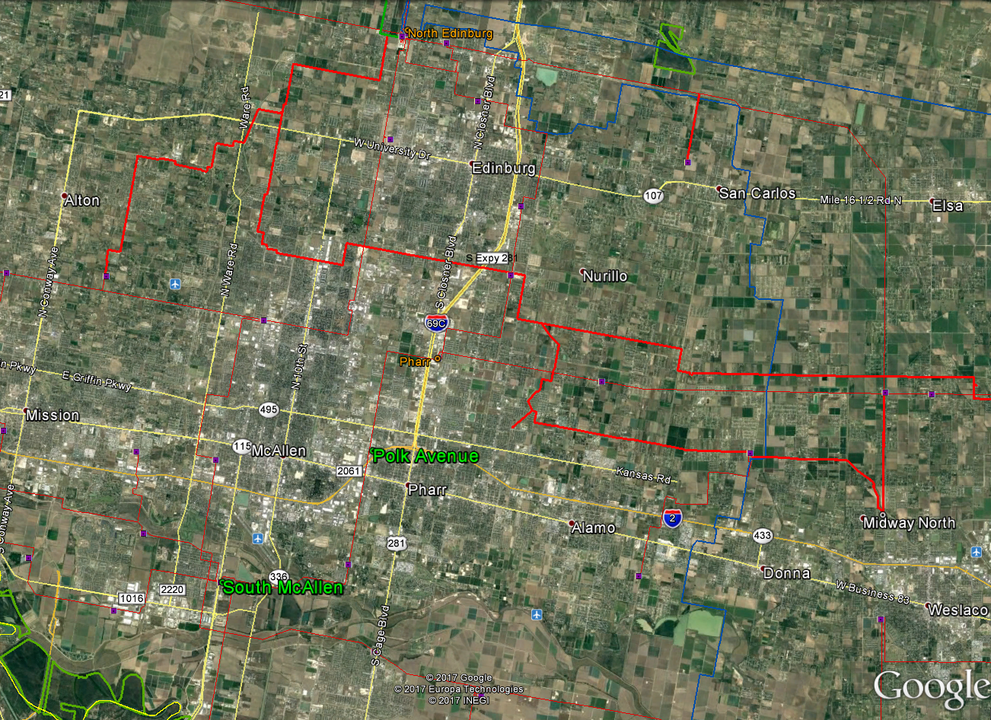
Improvement Options
Option #1: Additional LRGV Reactive Support
South McAllen: Install +300 MVAR STATCOM/SVC
Polk Avenue: Add One 57.6 MVAR Shunt Cap Bank
Lon Hill – Bessel: Rebuild 138 kV Line
17.9 mi; 2 x 795 ACSR/ACSS
Estimated Cost: $73.37 M

Slide 21
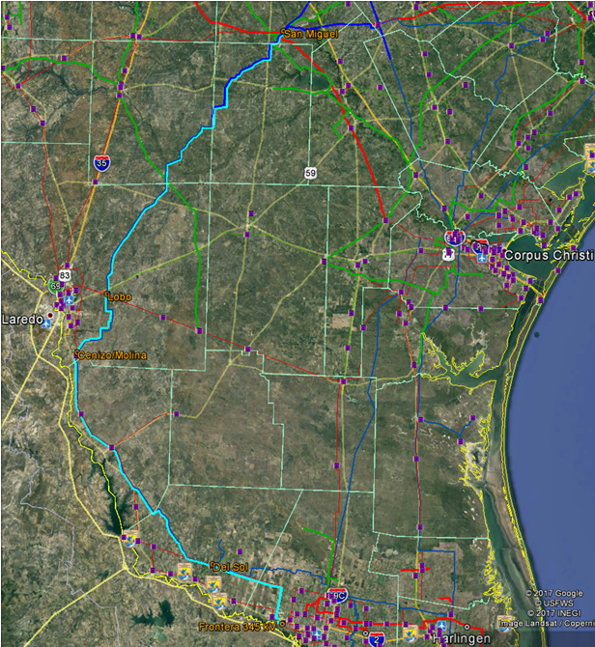
Improvement Options
Option #2: San Miguel – Del Sol Ckt 2; New Del Sol – Frontera 345 kV
San Miguel, Lobo, Del Sol: Construct New 345 kV Terminals
San Miguel – Lobo & Cenizo – Del Sol: Install Davit Arms and String Ckt 2
~191 miles; 2 x 954 ACSR
Lobo – Molina: Convert 138 kV to 345 kV
Cenizo / Molina: Install Two 345/138 kV Autos
Frontera: Construct New 345 kV Station with One 345/138 kV Auto
Del Sol – Frontera: Construct New 345 kV Line
~34 miles; 2 x 954 ACSR
Estimated Cost: $277.84 M

Slide 22
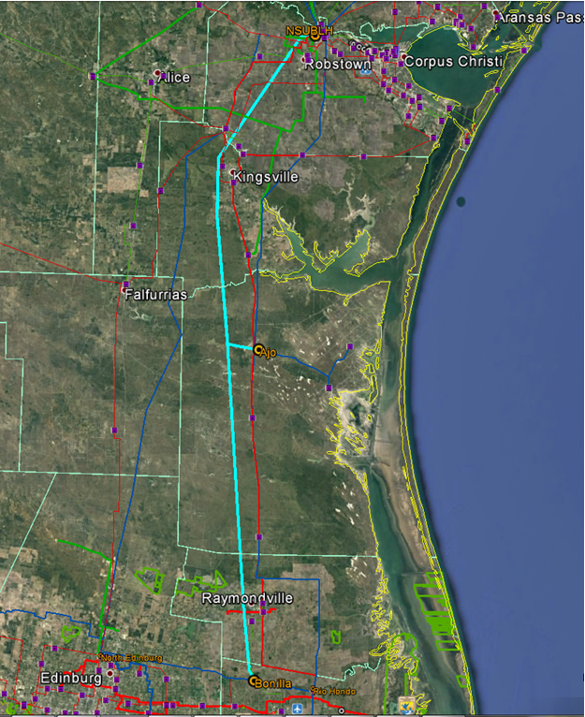
Improvement Options
Option #3: NSUBLH – Ajo – Bonilla 345 kV BOLD Line (2 x 1590 ACSR)
“NSUBLH”: Construct New 345 kV Station
Lon Hill – Coleto Creek and Lon Hill Pawnee Cut-Ins
Ajo: Add 2 – 345 kV Terminals
Bonilla: Construct New 345 kV Station
North Edinburg – Rio Hondo Cut-In
NSUBLH – Ajo: Construct New 345 kV BOLD Line
~64 miles; 2 x 1590 ACSR
Ajo - Bonilla: Construct New 345 kV BOLD Line
~71 miles; 2 x 1590 ACSR
Estimated Cost: $357.19 M
Option #4: NSUBLH – Ajo – Bonilla 345 kV BOLD Line (3 x 954 ACSR)
Same as Option #3, but with 3 x 954 ACSR BOLD Line Configuration
Estimated Cost: $381.16 M

Slide 23
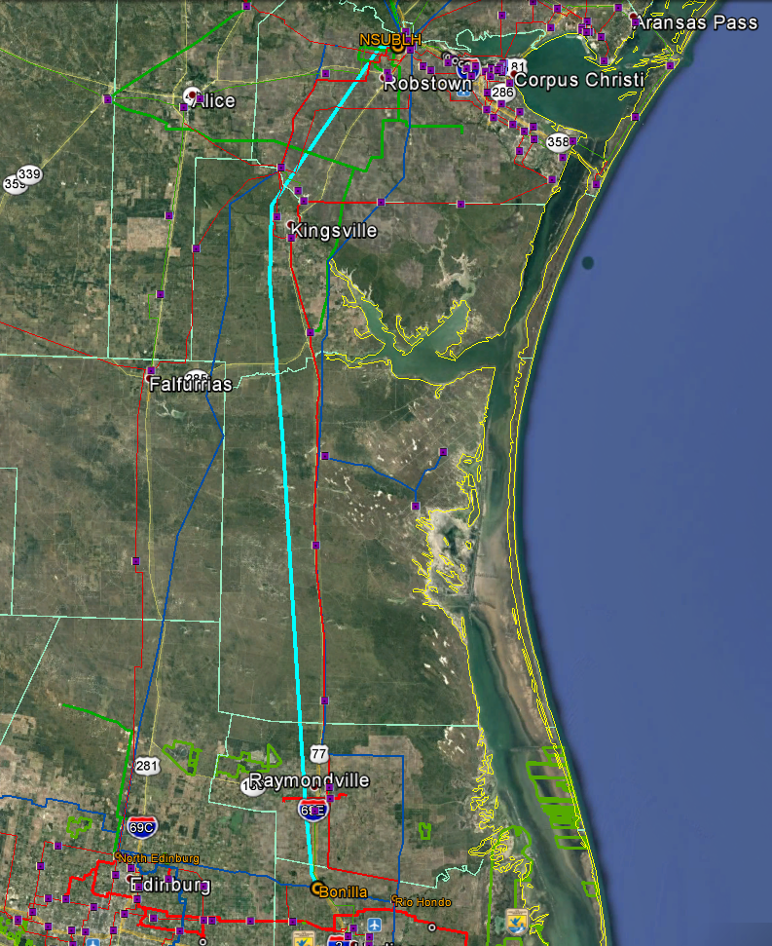
Improvement Options
Option #5: NSUBLH – Bonilla 345 kV BOLD Line
(2 x 1590 ACSR)
“NSUBLH”: Construct New 345 kV Station
Lon Hill – Coleto Creek and Lon Hill Pawnee Cut-Ins
Include Line Shunt Reactor
Bonilla: Construct New 345 kV Station
North Edinburg – Rio Hondo Cut-In
Include Line Shunt Reactor
NSUBLH – Bonilla: Construct New 345 kV BOLD Line
~133 miles; 2 x 1590 ACSR
Estimated Cost: $353.96 M
Option #6: NSUBLH – Bonilla 345 kV BOLD Line
(3 x 954 ACSR)
Same as Option #5, but with 3 x 954 ACSR BOLD Line Configuration
Estimated Cost: $377.65 M

Slide 24
Improvement Options
Option #7: Rebuild Nelson Sharpe – Rio Hondo 138 kV
Nelson Sharpe – Rio Hondo: Rebuild 138 kV Line
~112 miles; 2 x 795 ACSR/ACSS
Nelson Sharpe and Rio Hondo: Upgrade 138 kV Terminals
Other 138 kV Station Upgrades: Upgrade Station Through-Path
Celanese Bishop
Kleberg
Loyola
Armstrong
Yturria
Raymondville #2
Estimated Cost: $165.95 M

