Slide 1
Reactive Capability with respect to POI voltage Current and potential Future with NPRR 849
Stephen Solis – System Operations Improvement Manager
WebEx
Date : February 23, 2018

Slide 2
Current Reactive Capability Requirements
.95 leading/lagging requirements is at the POI for Generation Resources required to provide Voltage Support Service (VSS) (Gross >20MVA).
Losses must be accounted/compensated for to provide the .95 leading/lagging at the POI (not just at the generator terminals).
.95 leading/lagging requirement is required currently at any potential voltage profile set point which changes seasonally and can vary in real time.
Voltage profile can be set anywhere within normal system voltage limits (i.e. Between .95 pu and 1.05 pu).
GR must maintain the Voltage Set Point subject to the Generation Resource’s operating characteristic limits, voltage limits, and within + or – 2%. If voltage limits are more restrictive than the 2% (e.g. 1.04 pu set point, only has +1% tolerance and a -2% tolerance), then limits reduce the tolerance range.

Slide 3
NPRR 849
Modifies the potential range of Voltage Profile set points from .95 to 1.05 to a potential range of .98 to 1.04 to better match historical Voltage Profile set points.
This reduces the reactive capability requirements below .98 pu to .95 full lagging only.
This reduces the reactive capability requirement above 1.04 pu to .95 full leading only.
Exemptions identified in Section 3.15 are still maintained as is (no changes).
Reactive study scope document is aligned with NPRR 849 for new units seeking to Interconnect in ERCOT.
Reactive tests conducted just as they are today (no changes) at a single POI voltage between .98 and 1.04 pu.

Slide 4
Reactive Capability comparison with respect to POI Voltage
NERC White Paper on FERC NOPR Docket No. RM16-1-000 p. 9 Figure 4: Reactive Capability Corresponding to POI Voltage [Source: CAISO⁷]

Slide 5
Proposed NPRR for Section 3.15 (corner clipping)

Slide 6
NPRR Section 3.15 Reactive Capability deliverability expectations and Reactive Study voltages
Protocols 3.15.3 (1) Generation Resources required to provide VSS shall have and maintain Reactive Power capability at least equal to the Reactive Power capability requirements specified in these Protocols and the ERCOT Operating Guides.

Slide 7
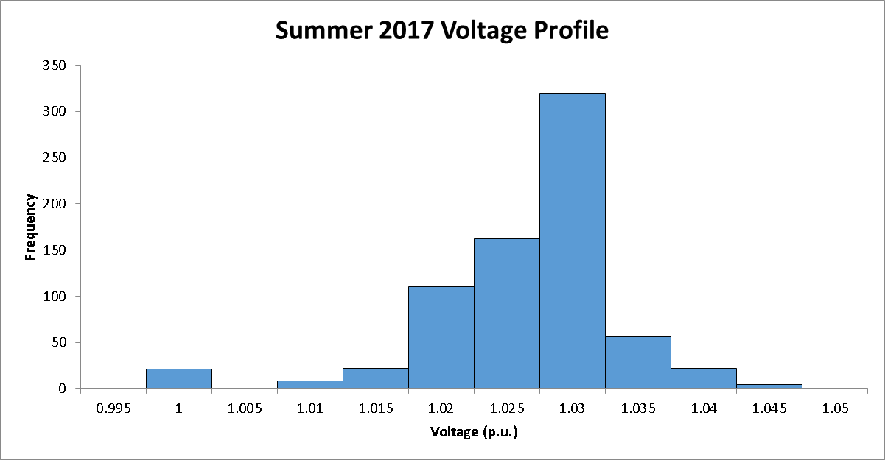
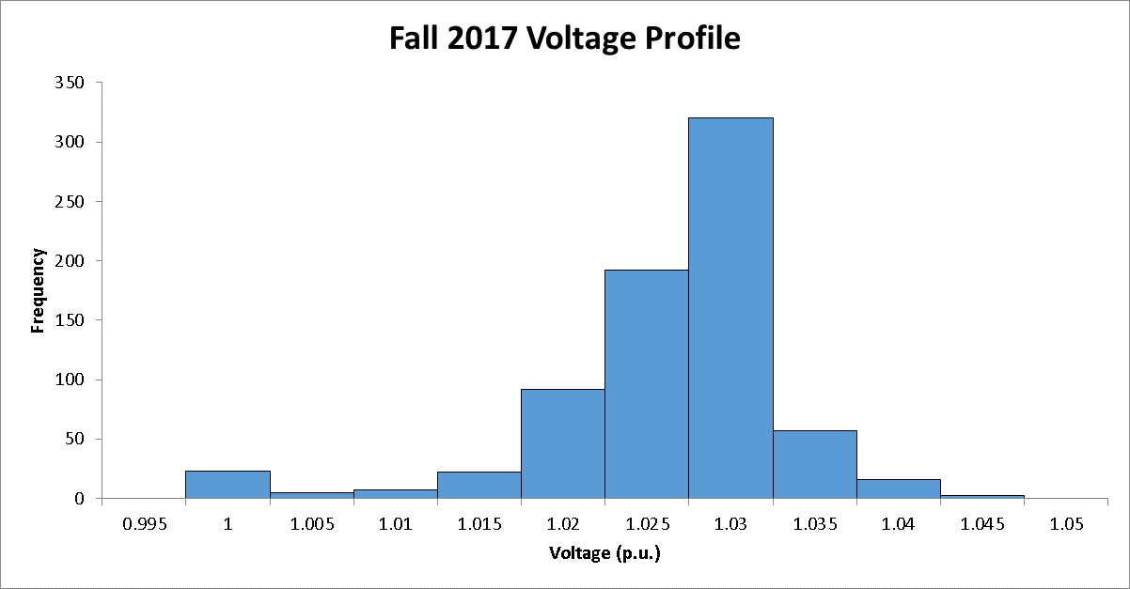
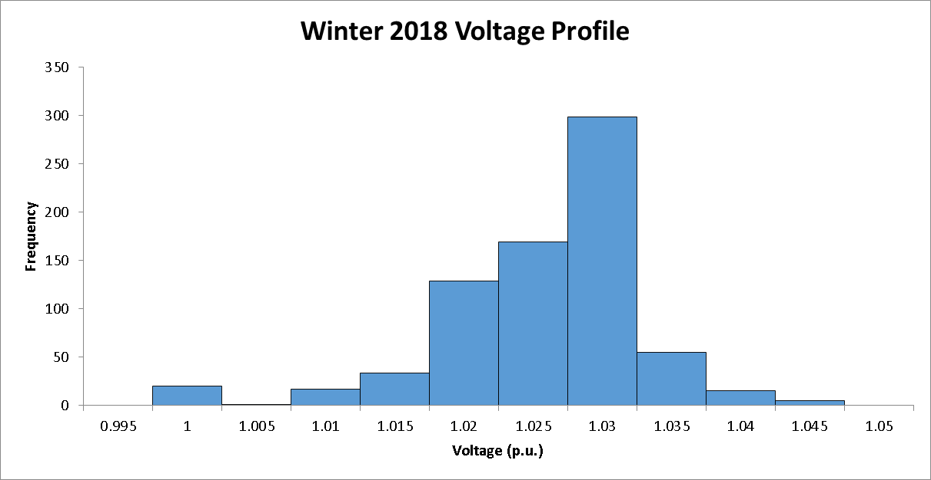
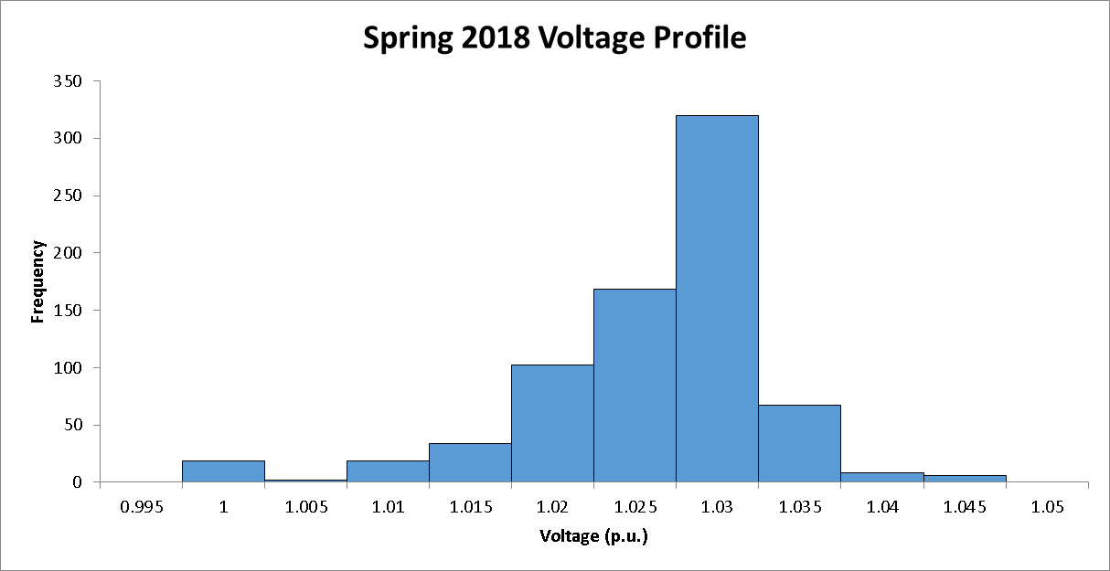
4 most recent Voltage Profiles distribution

Slide 8
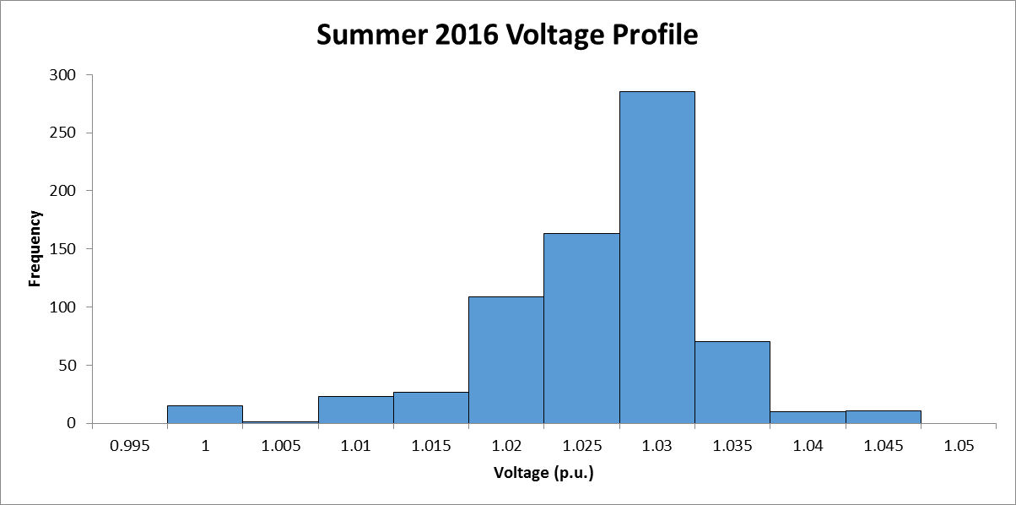
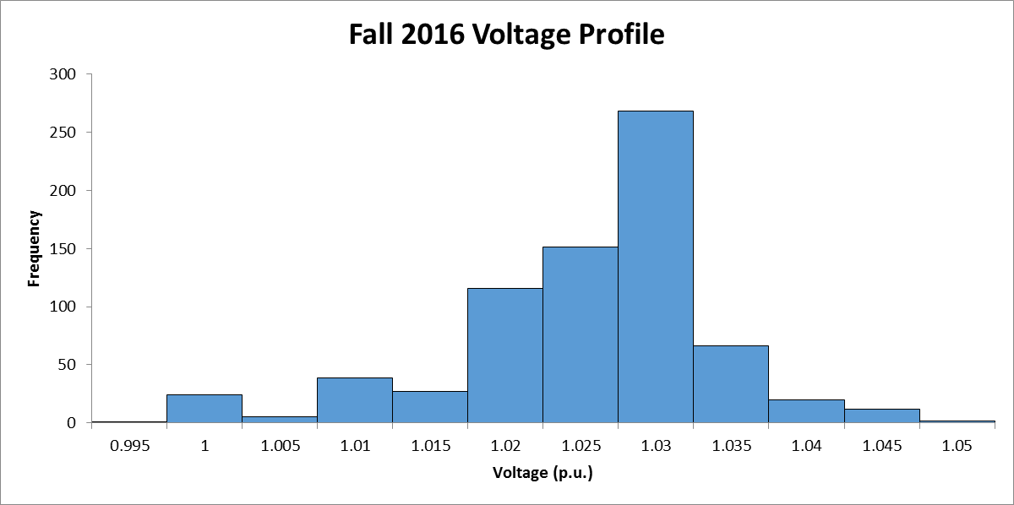
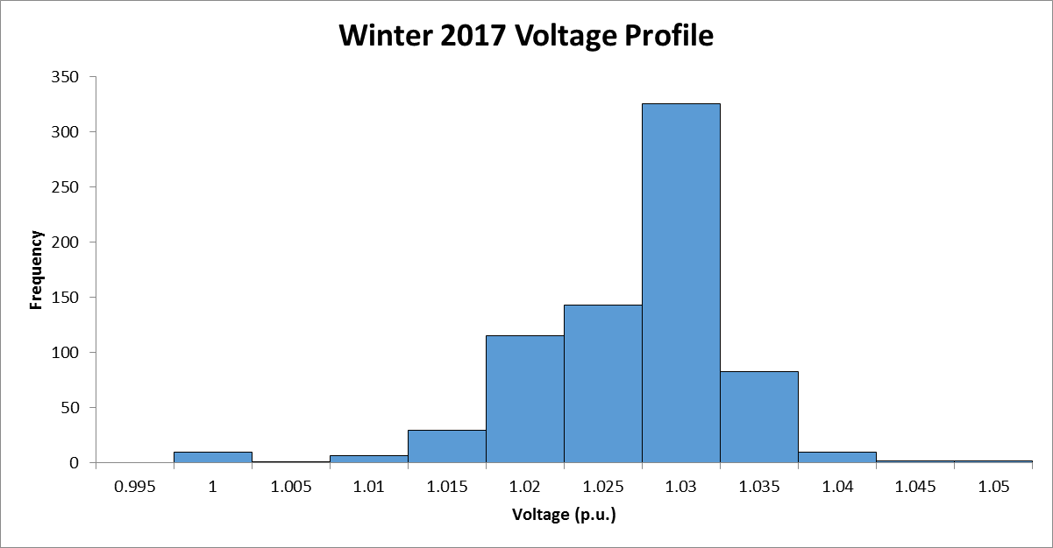
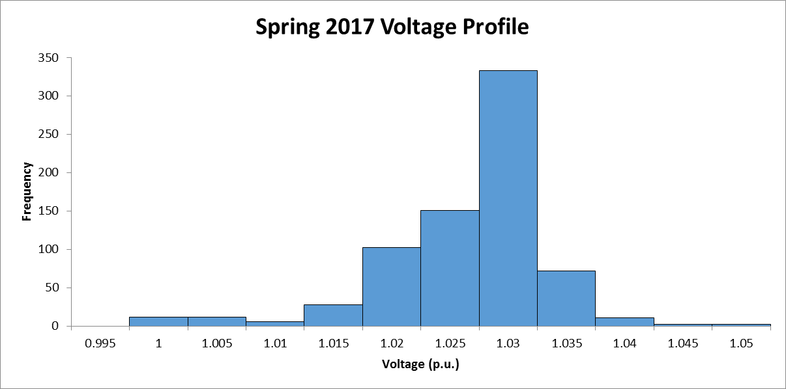
Next 4 most recent Voltage Profiles distribution

Slide 9
Reactive Capability deliverability expectations (outside of normal voltage ranges)
Protocols 3.15.3(6) The reactive capability required must be maintained at all times that the Generation Resource is On-Line.
Operating Guides 2.3.7.5 (5) The required reactive capability must be maintained at all times that the Generation Resource is On-Line. When a Generation Resource experiences a change that affects unit reactive limits or excitation system performance and is unable to meet the minimum reactive requirements, the associated Resource Entity shall notify its QSE and its TO immediately.
(4) At a minimum, a Resource Entity shall notify ERCOT and the QSE of the following:

Slide 10
Reactive Capability deliverability expectations (voltage ride through)
Protocols 3.15.3 (2) Generation Resources providing VSS shall be compliant with the ERCOT Operating Guides for response to transient voltage disturbance.
Operating Guides Section 2.9.1 (1) Generation Resources must be designed and generation voltage relays must be set to remain connected to the transmission system during the following operating conditions.
Operating Guides Section 2.9.1 (2) During operating conditions listed in paragraph (1) above, each Generation Resource shall not, during and following a transient voltage disturbance, cease providing real or reactive power except to the extent needed to provide frequency support or aid in voltage recovery.
Operating Guides Section 6.2.6.3.6 In addition, protective relaying for Generation Resources must be designed to meet Voltage Ride-Through (VRT) criteria as detailed in Section 2.9.

Slide 11
Reactive Capability deliverability expectations (abnormal conditions)
Protocols 3.15 (11) Generation Resources shall not reduce high reactive loading on individual units during abnormal conditions without the consent of ERCOT unless equipment damage is imminent.
Protocols 3.15.3(6) The reactive capability required must be maintained at all times that the Generation Resource is On-Line.
Operating Guides 2.7.3.5 (2) Generation Resources with high reactive loading resulting from abnormal conditions shall not reduce their reactive loading without the consent of ERCOT unless equipment damage is imminent based on the sole and reasonable judgment of the Resource Entity. In that case the Resource Entity will notify its QSE and its TO as soon as practicable of its action.

Slide 12
Next Steps
If agreeable language changes are identified, ERCOT will submit comments to NPRR 849 capturing those comments.
ERCOT will then try to get NPRR 849 progressing along the stakeholder process.

Slide 13

Questions and Answers

