Slide 1
2018 LTSA Update
Regional Planning Group Meeting
February 27, 2018

Slide 2
Outline
System Topology and Starting Capacity Mix
Main Assumptions for Current Trends Scenario
Generation Expansion Results for Current Trends Scenario
Next Step

Slide 3
System Topology and Starting Capacity Mix
Panhandle
4792 MW
The Rest
DC Ties
External

Slide 4
Main Assumptions for Current Trends Scenario
1.4% annual load growth rate;
1 GW rooftop PV;
LNG – Freeport three trains;
Gas price – 2018 AEO High Oil and Gas Resource and Technology Case;
DC tie – 2,000 MW Southern Cross.

Slide 5
Current Trends Results
Reserve margin in final year : 7.3%
Built 4,500 MW gas generation capacity
Built 3,000 MW wind
Built 15,900 MW solar
Retirements total 7,392 MW by 2033
4,500 MW of coal retirements
Unserved energy in 2023 to 2033, short of capacity in hour ending 20, 21 and 22, maximum magnitude over 6,000 MW
Panhandle interface is congested over 30% of time after 2023

Slide 6
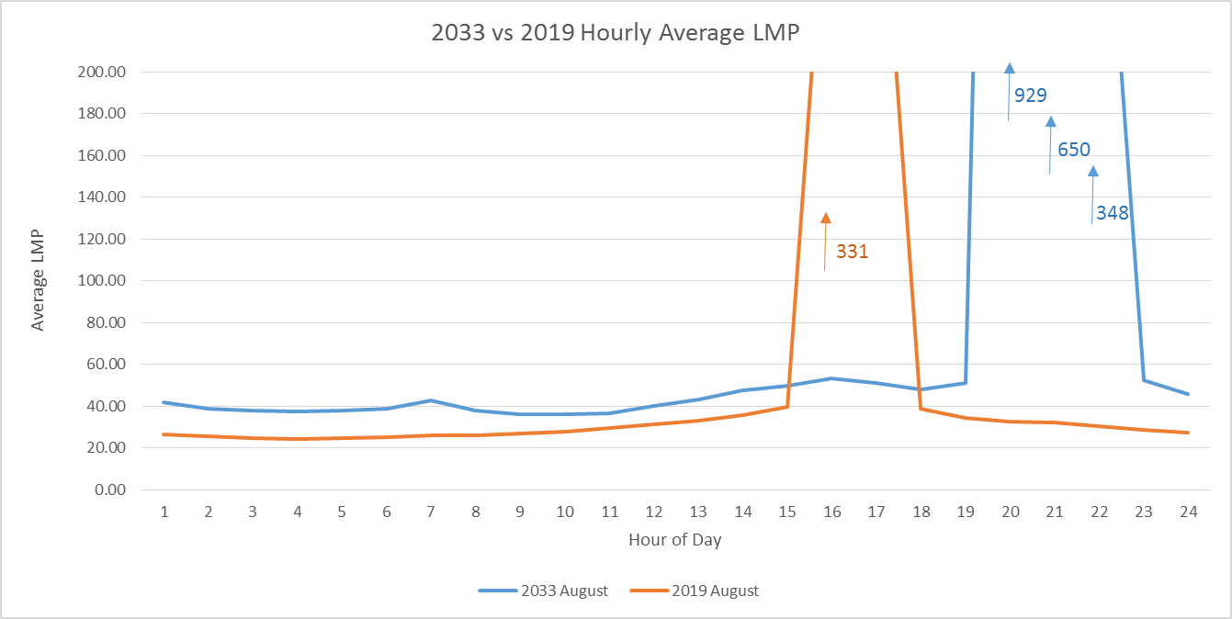
August Average LMP 2019 vs 2033

Slide 7
Next Step
Transmission expansion
  Current Trends Scenario
Generation expansion
  High Economic Growth Scenario

Slide 8
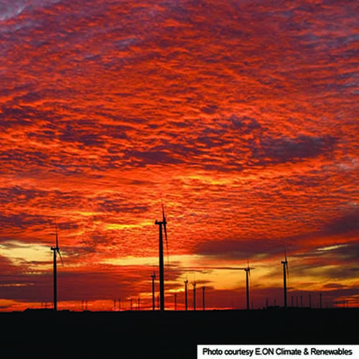
Questions
Contact info:
Doug Murray Julie Jin
douglas.murray@ercot.com julie.jin@ercot.com
512.248.6908 512.248.3982
Sandeep Borkar
sandeep.borkar@ercot.com
512.248.6642

