Slide 1
January 2018 Revenue Neutrality Allocation
David Maggio
Market Analysis and Validation
WMS
February 28th, 2018

Slide 2
High Revenue Neutrality Allocation (RENA)
January had three simultaneous days of high RENA, January 16th – 18th.
All three days are in the top 10 highest RENA charges since go-live of the Nodal Market.
During these days, the ERCOT region was experiencing very low temperatures and a new winter peak demand record was set on the 17th.
ERCOT experienced higher than average prices and volumes related to Point-to-Point (PTP) Obligations.
ERCOT experienced increased DC Tie imports at higher prices.

Slide 3
RENA Components
There are several real-time components in the determination of RENA:
  Energy Imbalance Payments or Charges (RTEIAMTTOT)
  Payments for Block Load Transfers (BLTRAMTTOT)
  Payments for DC Tie Imports (RTDCIMPAMTTOT)
  Charges for DC Tie Exports (RTDCEXPAMTTOT)
  Congestion Payments or Charges for Self-Schedules (RTCCAMTTOT)
  Payments or Charges for PTP Obligations (RTOBLAMTTOT)
  Payments for PTP Obligations with Links to Options (RTOBLLOAMTTOT)

Slide 4
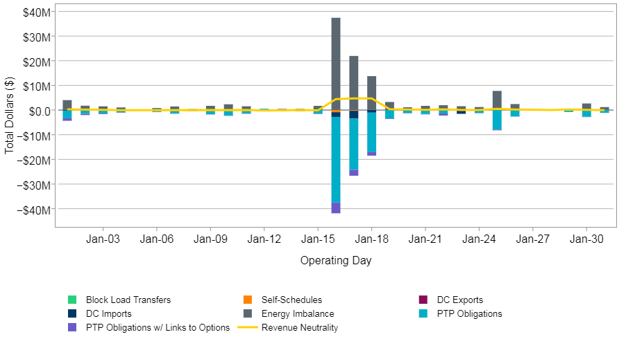
RENA Components for January ‘18

Slide 5
Drivers of RENA
Significant Real-Time Market (RTM) congestion cost combined with other factors can lead to high RENA amounts.
  “Over-selling” of transmission in the Day-Ahead Market (DAM)
    Differences in topology between DAM and real-time (e.g., a forced outage of transmission equipment)
    Inaccurate load distribution factors
  Application of the -$251/MWh price floor to real-time Settlement Point Prices (SPPs)
  Modeling of PTP Obligations with Links to Options

Slide 6
Example of Drivers
SPP price floor of -$251/MWh
  The RTM Locational Marginal Price (LMP) is -$500/MWh
  The RTM injection at the Settlement Point is 120 MW for 1 hour
  The DAM injection at the Settlement Point is 100 MW for 1 hour
  The energy imbalance collected is (100-120 MW) * -$251/MWh * 1 hour = $5,020 when it would have been $10,000 without the floor
Modeling of PTP Obligations with Links to Options
  There is a PTP Obligation with a Link to an Option of 100 MW from Resource A to Load Zone 1 for 1 hour
  The RTM prices at Resource A and Load Zone 1 are $100/MWh and $30/MWh, respectively
  The 100 MW * ($100/MWh - $30/MWh) * 1 hour = $7,000 is not available to offset the payment of other transactions

Slide 7
Real-Time Congestion and RENA for January ‘18

Slide 8
RENA Drivers for January 16th-18th, 2018
There was significant congestion in RTM, particularly in the southern part of ERCOT.
  Transformer at North Edinburg
  The Valley Import Generic Transmission Constraint (GTC)
With this congestion, the modeling of PTP Obligation with Links to Options was the most significant contributor across these three days.
“Over-selling” also played a smaller role on the 17th and 18th.
  The SPP price floor did not significantly contribute to the RENA to load.

Slide 9
Next Steps
During their February meeting, members of the Qualified Scheduling Entity Managers Working Group (QMWG) had expressed an interest in looking at the January ‘18 RENA in more depth.
ERCOT can continue discussing this topic with QMWG at their March meeting.

