Slide 1
Alternatives for Exiting Generic Transmission Constraint (GTC) - Update
ERCOT Transmission Planning
Regional Planning Group
February 27, 2018

Slide 2
Existing Effective GTC Definitions
https://mis.ercot.com/misapp/GetReports.do?reportTypeId=11425&noOfDaysofArchive=1&reportTitle=Generic%20Transmission%20Limits%20Methodology&showHTMLView=undefined&mimicKey
Generic Transmission Constraint | Effective Date
North to Houston | December 1, 2010 (Nodal Go-Live)
Rio Grande Valley Import | December 1, 2010 (Nodal Go-Live)
Nelson Sharpe – Rio Hondo | October 30, 2017
Panhandle | July 31, 2015
North Edinburg to Lobo | August 24, 2017
East Texas | November 2, 2017
Red Tap | August 29, 2016

Slide 3
Protocol Section 3.10.7.6 (7) (gray box)
No later than 180 days after the effective date of a new GTC, ERCOT shall post a report listing alternatives for exiting the GTC to the MIS Secure Area. The listed alternatives may include but are not limited to the implementation or modification of a RAS or a transmission improvement project.

Slide 4
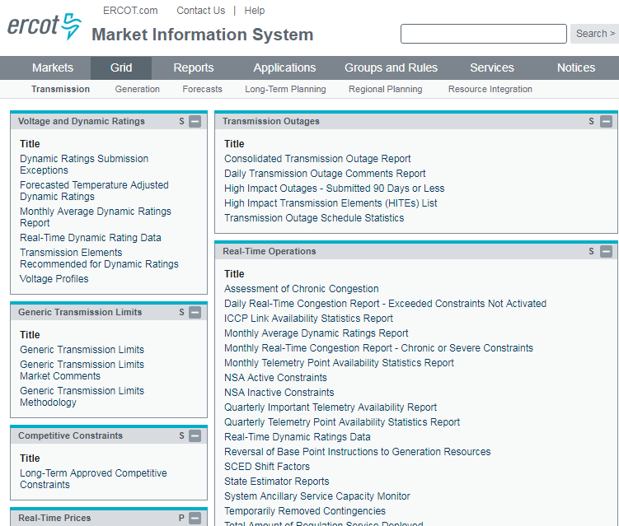
MIS Posting
The alternative for existing GTCs will be included in the posted GTC study report on MIS.

Slide 5
Status of Identifying Alternatives for Exiting the GTCs
Generic Transmission Constraint | Tentative Schedule
North to Houston | 3Q, 2018
Rio Grande Valley Import | TBD
Nelson Sharpe – Rio Hondo | 3Q, 2018
Panhandle | Complete Panhandle Renewable Energy Zone Study Report
North Edinburg to Lobo | TBD
East Texas | March, 2018
Red Tap | April, 2018

