Slide 1
MarkeTrak Training

Slide 2
Antitrust Admonition
  To avoid raising concerns about antitrust liability, participants in ERCOT activities should refrain from proposing any action or measure that would exceed ERCOT’s authority under federal or state law. For additional information, stakeholders should consult the Statement of Position on Antitrust Issues for Members of ERCOT Committees, Subcommittees, and Working Groups, which is posted on the ERCOT website.¹

Slide 3
What is Marketrak?
The MarkeTrak tool is a web based database application used to track, manage, and store data utilized by ERCOT and the Market Participants (MPs). This tool is the supported method to track ERCOT Retail market issue management and data discrepancies in the market.
The high level objectives for MarkeTrak:
Improve reporting functionality
Improve tracking/metrics functionality
Create usable issue status
Create usable issue types and sub types
Create a method to allow users to interface the solution
Improve search functionality
Improve monitoring and response capabilities
Improve the usability
Provide all functionality that is deemed required with the legacy tool as part of the enhanced solution

Slide 4
What is Marketrak?
There are two primary MarkeTrak issue types
Data Extract Variances (DEVs)
  An issue that cannot be resolved with a transaction
Day to Day (D2D)
  An issue that can be resolved with a transaction

Slide 5
What is Marketrak?
There are several D2D issue types including:
Inadvertent Gain
Cancel without Approval
Cancel with Approval
Switch Hold Removal
Account for XX% of all MarkeTrak’s
Usage/Billing
Siebel Change
997s
Market Rule
Premise Type
REP of Record
Usage/Billing AMS LSE Interval, Missing
Usage/Billing AMS LSE Interval, Dispute
Service Address
Missing Transactions
Projects
Service Orders (650s)
Move Out with Meter Removal
Reject TXNs
Safety Net
Customer Rescission
Redirect Fees
Other

Slide 6
MarkeTrak Online Training
MarkeTrak online training is available on www.ercot.com and includes the following modules:
MarkeTrak Overview
Inadvertent Gain/Loss
Cancel With/Without Approval
Switch Hold Removal
Data Extract Variance (DEV) LSE Subtypes
Email Functionality
Usage/Billing Disputes
Additional Day to Day Subtypes
Bulk Insert
Admin Functionality
Data Extract Variance (DEV) Non-LSE Subtypes
Reporting

Slide 7
MarkeTrak Training Objectives
This training covers the following topics:
General MarkeTrak Navigation
Email Notifications
ERCOT ListServ
Admin Functionality
Bulk Insert Process
Usage & Billing
Missing Enrollments
Switch Hold
Cancel with Approval
Other Issues
Data Extract Variance (DEV) LSE (Load Serving Entity) and Data Extract Variance (DEV) Non LSE Issue Subtypes
Inadvertent Gain (IAG)
GUI and Background Reporting

Slide 8
MarkeTrak Training
General MarkeTrak Navigation

Slide 9
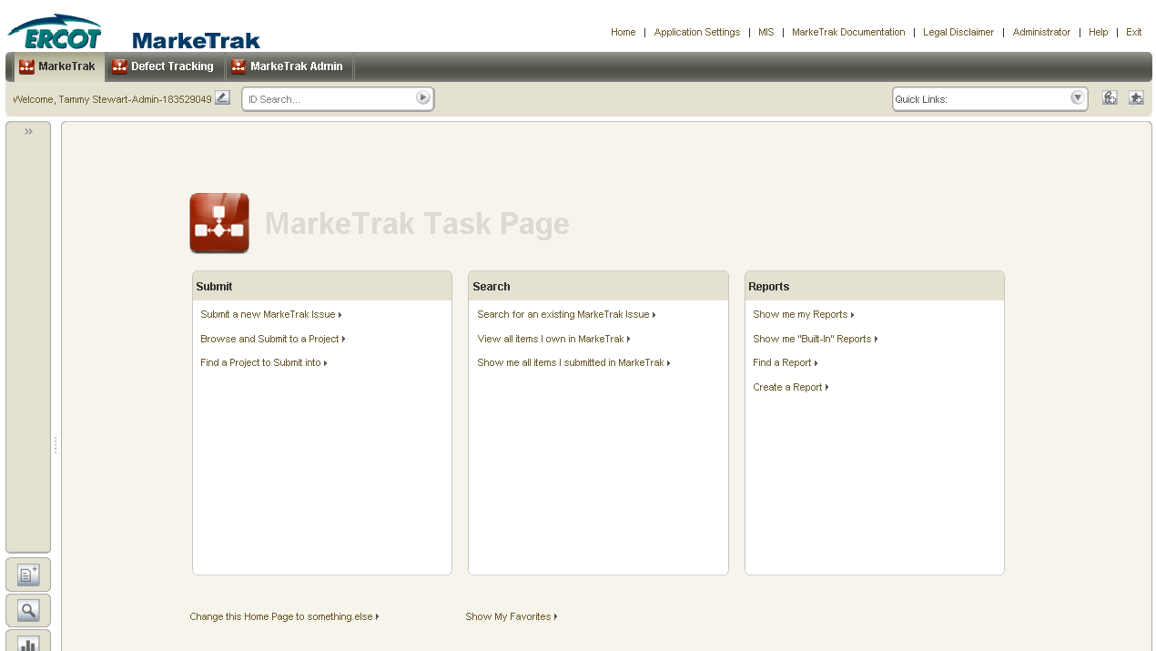
General Functionality: Navigating MarkeTrak
Launch Page
  Upon successful login, the user is initially taken to the MarkeTrak Task Page. The Task Page can be used as the starting point for each login or a specific Home Page Report can be selected as the default login page.

Slide 10
General Functionality: Navigating MarkeTrak
Setting a specific Home Page Report
  Select the link at the bottom of the Task Page to set a specific Home Page Report.

Slide 11
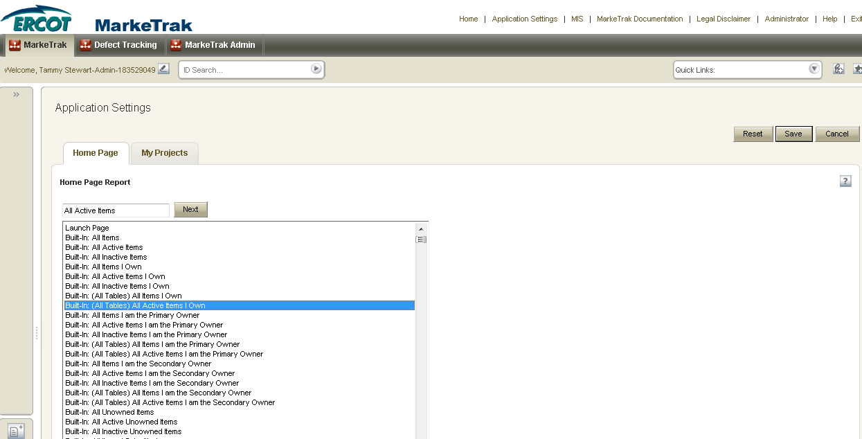
General Functionality: Navigating MarkeTrak
Select a report from the list displayed for your Home Page Report and click Save.

Slide 12
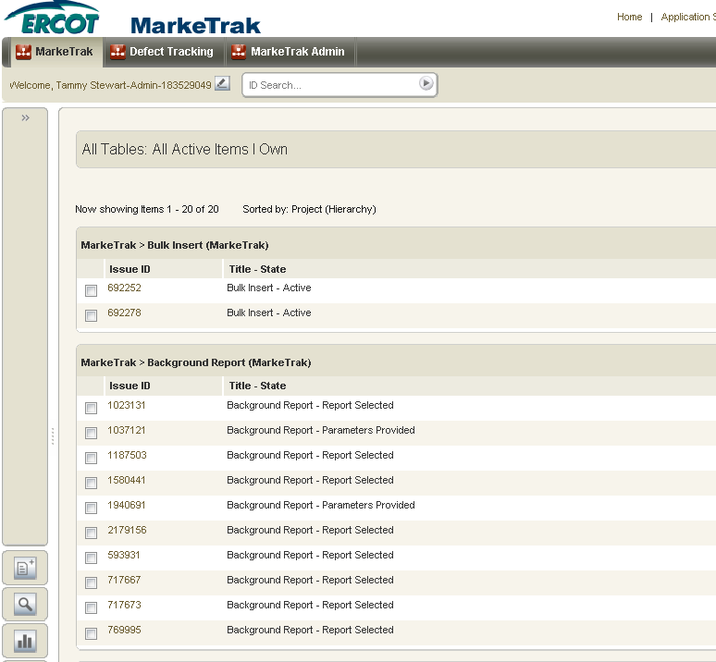
General Functionality: Navigating MarkeTrak
Home page now defaults to the selected report with each login.

Slide 13
General Functionality: Navigating MarkeTrak
MarkeTrak Tool Bar: The Home, Application Settings, MIS, MarkeTrak Documentation, Legal Disclaimer, Administrator, Help, and Exit links are available across the top of each window view in the MarkeTrak application.
  Home: This button returns the user to the Home Page Report.
  Application Settings: This link enables the user to select a Home Page Report and preferred projects for the application.
  MIS: This link will take you directly to the main page of the Market Information System website. From there, you can select the Reports and Extracts Index link which will take you to your reports and extracts.
  MarkeTrak Documentation: This link will take you to the MarkeTrak Information Page which contains several key documents such as the User Guide, Tips & Tricks document, bulk insert templates, etc.
  Legal Disclaimer: A quick link to the legal disclaimer relevant to the MarkeTrak application.
  Help: The help feature is an indexed and searchable resource with a thorough explanation of ‘out-of-the-box’ tool functionality. The purpose of this guide and appendix is to bridge the gap between the application and the ERCOT help documents
  Exit: This is the method to log out of the MarkeTrak tool.

Slide 14
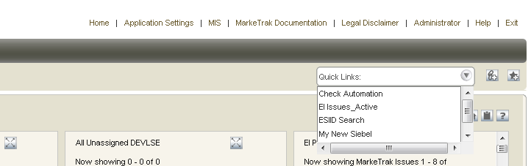
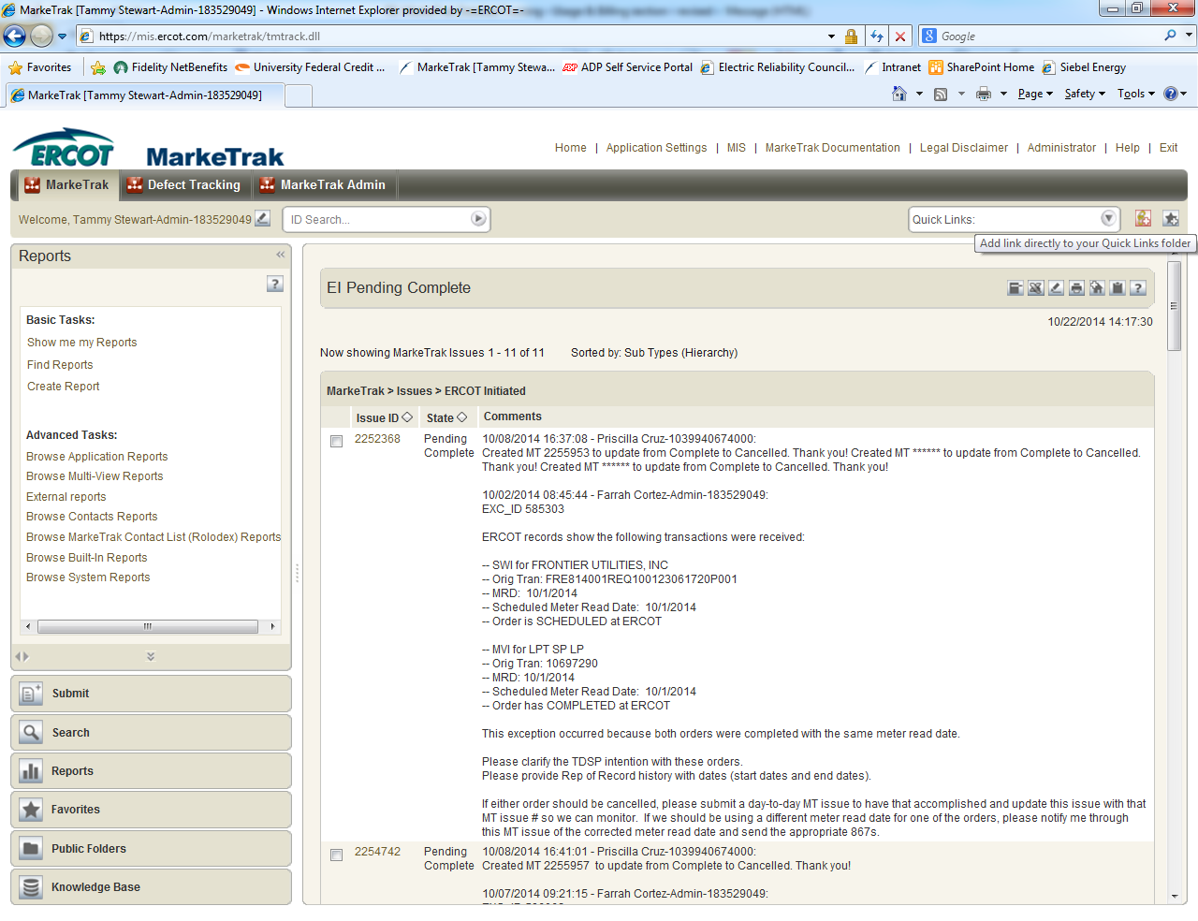
General Functionality: Navigating MarkeTrak
Quick Links: These are links updated to an individual user toolbar. This can include useful URLs such as ERCOT.com or common reports a user may wish to access in one click as demonstrated below:
To add a quick link:
  Navigate to the report, form, view, or page to which you want to create a link.
  Click the icon on the application toolbar. The Add to Quick Links dialog box opens.
  Type a name for the quick link. This name is used to label the quick link on the application toolbar and in the Favorites view. Click Save.

Slide 15
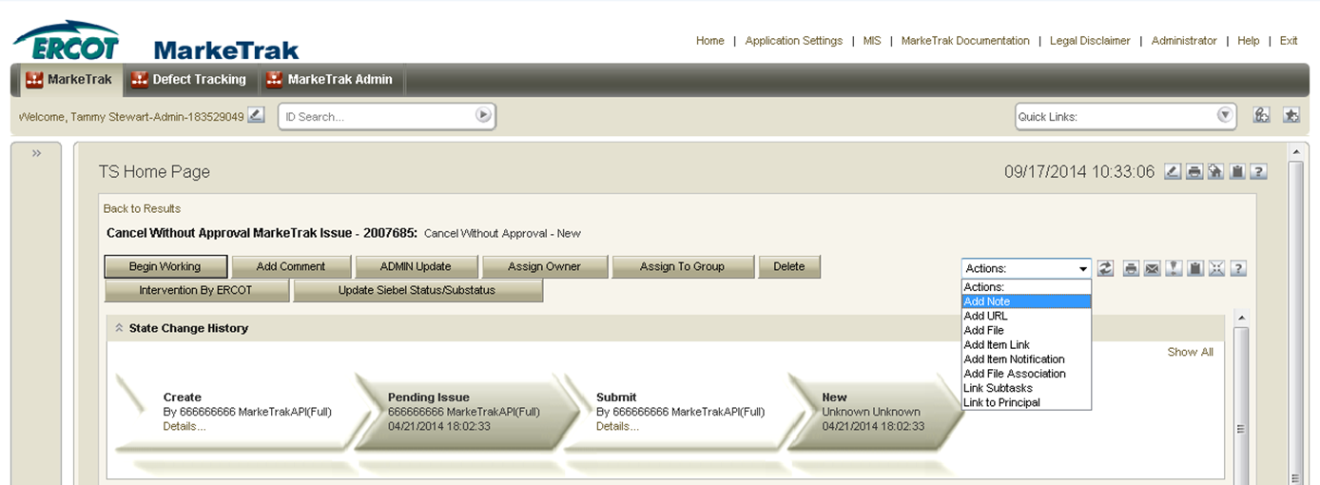
General Functionality: Navigating MarkeTrak
Actions dropdown: Available in the header of the issue details pane:
  Add Note: This allows the user to include a text message on the individual issue.
  Add URL: Creates a hyperlink on an individual issue to an external website.
  Add File: Allows the user to locate and attach an external file to an item which will be visible by all MPs Involved. This is not to be used to submit a file of ESI IDs to be researched on the issue.
  Add Item Link: This action gives the user the ability to create several different kinds of links to other issues within the MarkeTrak application. In order to successfully create these links, the current user must have visibility rights to both linked items.
  Add Item Notification: Selecting this action allows the user to choose one of five distinct item notifications. These differ from the system generated notifications in that they are selected individually on items by any user with visibility.

Slide 16
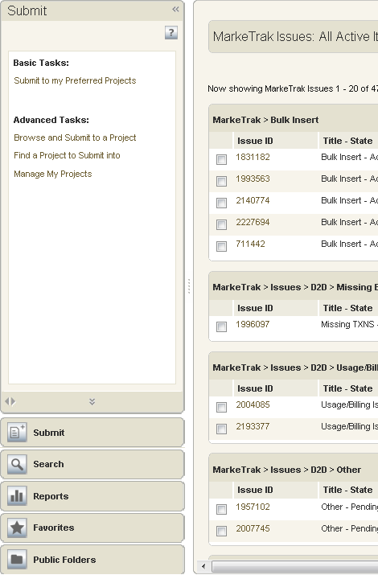
General Functionality: Navigating MarkeTrak
Navigation Pane: The navigation pane is available on the left side of the User Workspace. You can do the following in the navigation pane:
  Submit: The Submit view provides links to submit issue subtypes.
  Search: Provides links to the following search features in the MarkeTrak application.
  Reports: Provides links to reports the user has permissions to run, modify, or delete.
  Favorites: Favorites enable users to add links to frequently used features, items, and reports to folders that you create or that are provided by the system. Favorites can provide a personal view of items in the system; other users cannot view your favorites, nor can you view other users’ favorites.
  Public Folders: Displays links, reports, URLs, etc that can be viewed by all other MarkeTrak users unless specifically restricted by MarkeTrak Administrators.

Slide 17
General Functionality: Navigating MarkeTrak
States and Transitions - All issues in the MarkeTrak tool are routed into one of several workflows based on the Type and Sub Type selected by the submitter. These Issue Type/Sub Types are: Day to Day Issues, Cancel with Approval, Cancel without Approval, and Inadvertent Gain related Sub Types as well as Data Extract Variance Issues- LSE Relationship.
States - A state is the position of an issue in the workflow process; this is often similar to the concept of an issue status combined with the issue’s current ‘owner’. Examples of this include: New (ERCOT), In Progress(Assignee), or Cancelled (Pending Complete).
Transitions - Transitions are the movement of an issue from one state to another. Available transitions are associated on the GUI with buttons. Selection of different buttons from the same state will typically result in the issue appearing in different states when the transition successfully completes. One example is a Day to Day Issue - Cancel with Approval currently in state In Progress with TDSP. If TDSP user selects transition button ERCOT Cancel, the item will move to state Auto Complete. Alternately if the TDSP user is unable to approve the cancel and selects transition button Unable to Cancel, the issue would appear in the submitting CR’s queue in state Unable to Cancel – (PC). Some transitions, such as Unable to Cancel, require additional steps to complete; in this case completion of a required field: Comments.

Slide 18
General Functionality: Navigating MarkeTrak
Issue Ownership: There are several varieties of ownership in the MarkeTrak application: Submitter, Responsible MP, MP’s Involved, and Assigned Owner.
  Submitter: The Submitter of the item is indicated near the top of each primary data pane on the issue details window. Submitter Duns number is also incorporated into the title of each issue and listed in the MPs Involved field discussed below.
  Responsible MP: Responsible MP is the single Duns number contained in the MPs Involved list that is considered to be the next participant responsible for transitioning the item towards a resolution. Examples include: the TDSP when an issue is waiting for approval to cancel a service order, ERCOT when the approval has been granted, and the CR when the cancel is complete and the issue is waiting for acceptance of the resolution.
  MP’s Involved: MP’s Involved is a list of all MP duns numbers which are party to an issue. As additional assignments are made to an item the MPs Involved field will be updated with the selected DUNs numbers, reflecting an increase in market participants with the ability to view the item. As ERCOT can always view any issue in the system, this will always be reflected in the MPs Involved list.
  Assigned Owner: Assigned Owner is null when an issue is initially assigned to a Market Participant. Assigned owners are individual users. These are assigned by the Responsible MP automatically as issue is acknowledged by way of transition, Begin Working. Taking this action will populate the associated individual’s user id as the Assigned Owner.

Slide 19
MarkeTrak Training
Email Notifications

Slide 20
Email Notifications
Automated Email Notifications
  Automated emails are controlled by MarkeTrak’s Notification system and sent to MP Administrator assigned contacts. Receipt of these emails is an indication that an issue has exceeded the time allotted to complete a transition based uon the issue subtype. Examples of scenarios which trigger automated email notifications are:
    Day to Day Issues
      Cancellation:
        Escalation after 7 days without transition
        TDSP Escalation: Siebel Status/Sub-status of the service order should be Cancelled within 24 hours
      Inadvertent Issues:
        Responsible MP Escalation: after 7 calendar days without transition
        ERCOT Escalation: 48 hours to update/transition the issue from the “New (ERCOT)” or “In Progress (ERCOT)” states
        Losing MP Escalation: The Regaining Transaction Status should be “Scheduled” or “Complete” within 72 hours of the “Regaining Transaction Submitted”

Slide 21
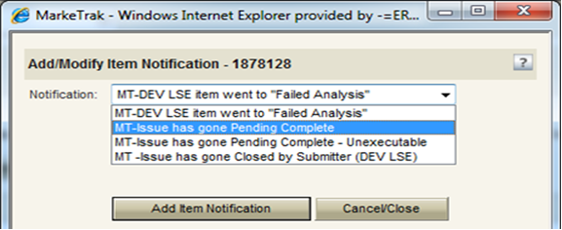
Email Notifications
Individual Email Notifications
  Each user with access to an item has the ability to manually select a notification related specifically to that individual issue. The email address entered in MarkeTrak for the user who selects this option from the Actions: drop down list will be the destination for this email notification.

Slide 22
MarkeTrak Training
ERCOT ListServ

Slide 23
Subscribing to ListServ
To subscribe to an email distribution list on ERCOT ListServ, navigate to http://lists.ercot.com and create an account.
You will receive a confirmation at the email address you list and once you click on the confirmation link you can then log into the listserv application.
Select the desired lists from the menu and click “submit”.
You will receive an email with a link requesting verification of subscription to each list selected. Once you click this link, you will receive all subsequent emails addressed to the selected list(s).

Slide 24
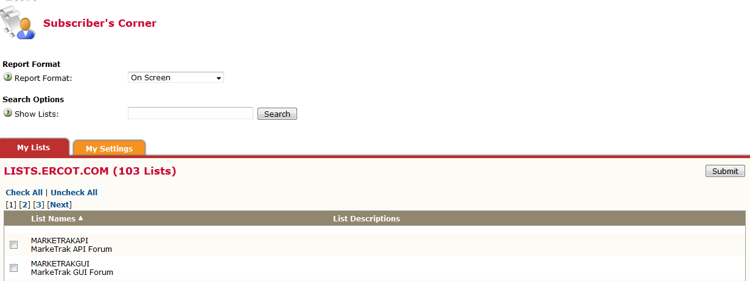
Subscribing to ListServ

Slide 25
MarkeTrak Training
Admin Functionality

Slide 26
Admin Functionality: Roles & Responsibilities
The MP Administrator will be responsible for establishing and maintaining the users associated with their Market Participant organization. MP Administrators will only be able to establish or maintain users associated with their organization.
The MP Administrator will be responsible for maintaining the MarkeTrak Rolodex. This is the list owned by each MP Administrator which determines the destination of Notification Emails.
The MP Administrator will be responsible for maintaining the MarkeTrak Contacts List. This is the list owned by each MP Administrator which provides contact information for each MarkeTrak user for that company.
The MP Administrator will also be responsible for Report Management. – creating reports for use by multiple users registered under the same DUNS.

Slide 27
MarkeTrak Training
Bulk Insert Process

Slide 28
Bulk Insert: Overview
MarkeTrak Bulk Insert functionality is a browser-driven, automated method of submitting multiple MarkeTrak Issues using the GUI. Through a web browser interface, a CSV file containing the data for a batch of issues is uploaded via the Bulk Insert workflow. The data contained in the CSV file will use the defined required field ordering that must be used for the issue type being submitted by the user.

Slide 29
Bulk Insert: CSV File
The data format required for Bulk Insert is a file which will contain a text-row list of data for Issues of common type and subtype. A text-row will be a set of Comma Separated Value (CSV) data fields, with these fields in an expected order based on their Issue type . Any text-row that does not conform to the expected order will not be processed by Bulk Insert.
If enabled, validations are performed on certain fields contained within the CSV file. All validations will default to “off”. If any processing validation flag is “blank”, the processing will assume the validation is turned “off”. If populated with “1” the validation is turned “on”. If enabled, validations are performed on the following fields:
Validation Types:
ESIID Duplicate Check
  ‘1’ indicates that Duplicate ESIID Check be performed. Will NOT submit issue with this check enabled if a duplicate issue is located in MarkeTrak containing this ESIID to which the submitter has access. Potentially duplicated issues will be returned in result set.
  ‘0’ indicates that Duplicate ESIID Check should be overridden. This option will submit the issue (given all criteria and validations met) regardless of potentially duplicated items in the MarkeTrak system.
  If this field is left blank, a ‘0’ will automatically default in and the Duplicate ESIID Check will NOT be performed.

Slide 30
Bulk Insert: CSV File (cont.)
Global ID Duplicate Check
  ‘1’ indicates that Duplicate Global ID Check be performed. Will NOT submit issue with this check enabled if a duplicate issue is located in MarkeTrak containing this ESIID to which the submitter has access. Potentially duplicated issues will be returned in result set.
  ‘0’ indicates that Duplicate Global ID Check should be overridden. This option will submit the issue (given all criteria and validations met) regardless of potentially duplicated items in the MarkeTrak system.
  If this field is left blank, a ‘0’ will automatically default in and the Duplicate Global ID Check will NOT be performed.
ESIID Validation
  ‘1’ indicates the submitter wishes to submit the ESIID for validation against the ERCOT Registration System. If the ESIID is not returned as valid, the issue will not be created
  ‘0’ indicates the submitter wishes to submit the item to the MarkeTrak system regardless of ESIID existence in the ERCOT Registration System.
  If this field is left blank, a ‘0’ will automatically default in and the ESIID Validation check will NOT be performed.
  ESIID Validation must be enabled for Premise Type to be returned .

Slide 31
Bulk Insert: CSV File (cont.)
Evaluation Window Validation
  ‘1’ indicates the submitter wishes to enable the Tran Type/SMRD evaluation rules for Cancel With Approval new Issues. If the evaluation rule is violated, the issue will not be created.
  ‘0’ indicates the submitter does NOT wish to enable the Tran Type/SMRD evaluation rules for Cancel With Approval new Issues. If the evaluation rule is violated, the violation will be ignored and the issue will be created.
  If this field is left blank, a ‘0’ will automatically default and the Tran Type/SMRD evaluation rules for Cancel With Approval will NOT be performed.
  Global ID Validation must be enabled for Evaluation Window Validation flag to be evaluated.
Global ID Validation
  ‘1’ indicates the submitter wishes to validate the Global ID involved with the submitted issue against the ERCOT Registration System. If the Global ID involved with issue is not in the ERCOT Registration System, the issue will not be created
  ‘0’ indicates the submitter does NOT wish to validate the Global ID involved with the submitted issue against the ERCOT Registration System.
  If this field is left blank, a ‘0’ will automatically default and the Global ID Validation will NOT be performed.

Slide 32
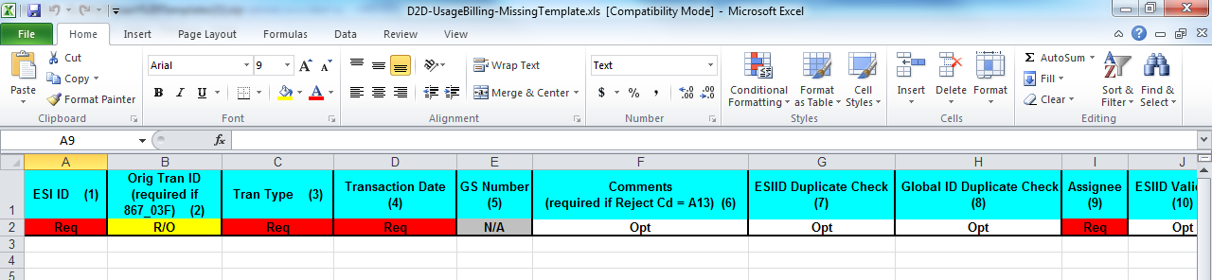
Bulk Insert: CSV File (cont.)
Bulk Insert Templates:
  Bulk Insert templates for every applicable subtype are available on the MarkeTrak Information Page. Below is a sample of the template for the Usage/Billing Missing subtype:
The definition of the data fields is as follows:
  Required (Req)
  Optional (Opt)
  Not Applicable (N/A)
  Required or Optional (R/O)
  Required or Not Applicable (R/NA)
  Optional or Not Applicable (O/NA)
  DateTime format = ccyy-mm-ddThh:mm:ss eg: 2015-11-15T13:20:57
  Date format = ccyy-mm-dd eg: 2015-11-15

Slide 33
Bulk Insert: CSV File Template
Once all data has been entered into the required fields the bulk insert template header row should be deleted before saving the file in the CSV format.
Before submission of the bulk insert CSV file the user should ensure all rows are accounted for in the file template to successfully pass validation for submission of the file.

Slide 34
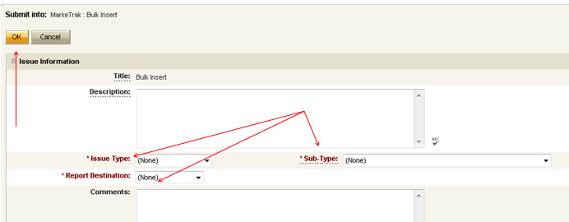
Bulk Insert: Submit
Submitting a Bulk Insert Issue:
  The following fields must be populated for successful submission of Bulk Insert: Note: This is not for the CSV file.
    Issue Type
    Sub-Type
    Report Destination
  The Submitter selects OK

Slide 35
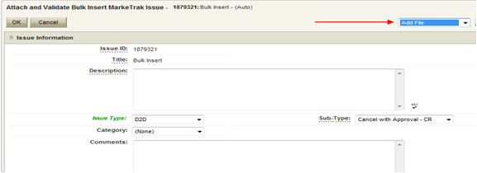
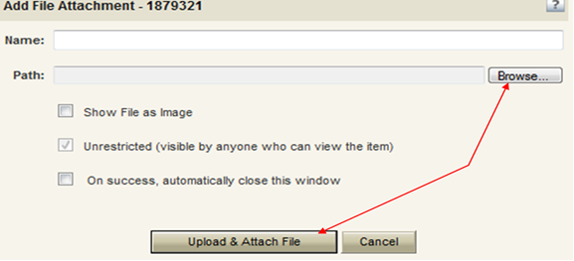
Bulk Insert: Submit (cont.)
From the Actions dropdown, select Add File
Select Browse, locate the CSV file for your Bulk Insert, and then press Upload & Attach File

Slide 36
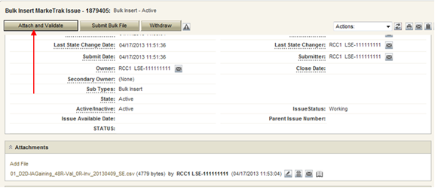
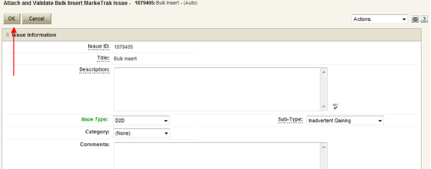
Bulk Insert: Submit (cont.)
Press Attach and Validate.
Once the file has been attached select OK to validate the format of the CSV file

Slide 37
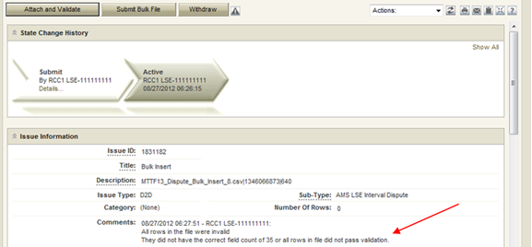
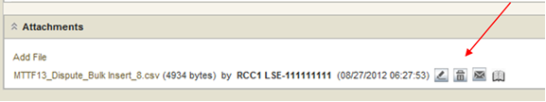
Bulk Insert: Submit (cont.)
Validation will be done on the uploaded file.
  If the upload fails for incorrect number of columns or the file is formatted incorrectly it will not pass validation and, the comments section will display a failure message. The user will then have the option of correcting the CSV file. Once the file is corrected the file must be deleted before it can be re-attached. To delete the file, select the trash can icon(delete) next to the attached file and select “Delete File” from the resulting “pop up” window.

Slide 38
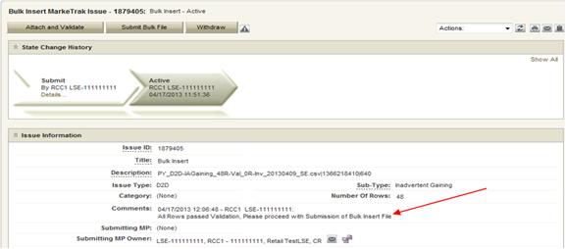
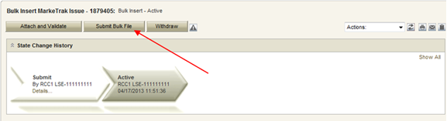
Bulk Insert: Submit (cont.)
If the upload is successful, a message indicating “All rows passed validation” will appear.
Select Submit Bulk File to create individual issues.

Slide 39
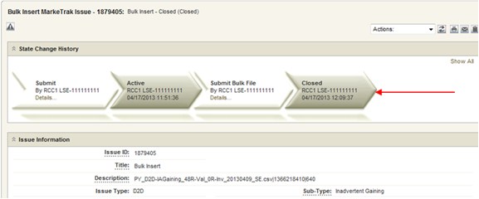
Bulk Insert: Submit (cont.)
After submitting the issue it will automatically close the Bulk Insert issue
When a Bulk Insert is submitted, the Bulk Insert MarkeTrak Number becomes the “parent” and will be populated on each individual MarkeTrak issue (which are the “children”) created by the Bulk Insert.

Slide 40
Bulk Insert: Validations
File format level validation is performed on the CSV file during the Attach and Validation transition to determine if the correct number of columns is present and will immediately return confirmation results back to MarkeTrak. This will show the number of rows that successfully uploaded and the number that did not upload due to an invalid number of columns.
Business data validations are also performed on the file and the results from this will be posted to the report destination selected during Submit. This validation is performed on the required field’s portion of the CSV file. The results will either post to the MarkeTrak issue or the Reports and Extracts Index on MIS, depending upon which report destination was selected upon Submit. This report will contain five additional fields, which will be added at the end of each row on the report. The additional fields will represent the following data:
  Success or Fail: This field contains the word “success” or “fail”. Success will indicate the MarkeTrak issue was successfully submitted in MarkeTrak via bulk insert. Fail will indicate the MarkeTrak issue failed to be submitted in MarkeTrak via bulk insert.
  Error Code: This code contains the error code of a failed attempt to submit a MarkeTrak issue via bulk insert. This field will only be populated when an issue has failed.
  Error Message: This field contains the error message explaining why the MarkeTrak issued failed to be submitted via bulk insert. This field will only be populated when an issue has failed.
  Date/Time Stamp: This field contains the date and time of when the issue was attempted to be submitted via bulk insert in MarkeTrak.
  Issue ID: The field contains the MarkeTrak issue ID for successfully submitted issues.
Allow adequate time after submitting a bulk insert issue for the system to create each individual issue. This will take an average of just a few seconds for each issue or row submitted, but can add up if several are submitted at once.

Slide 41
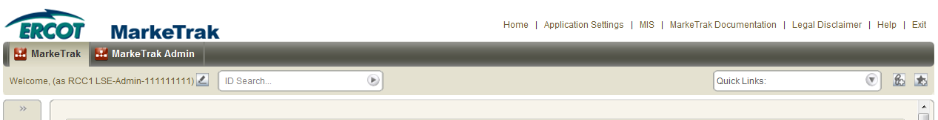
Bulk Insert: Report Destination
Users have a choice during the submit process to post the results file as an attachment to the MarkeTrak issue or to the reports section on MIS. If MIS is the report destination selected, the results file will post to MIS and the user will need to download the file. To access MIS, select the MIS link at the top of the MarkeTrak GUI screen.

Slide 42
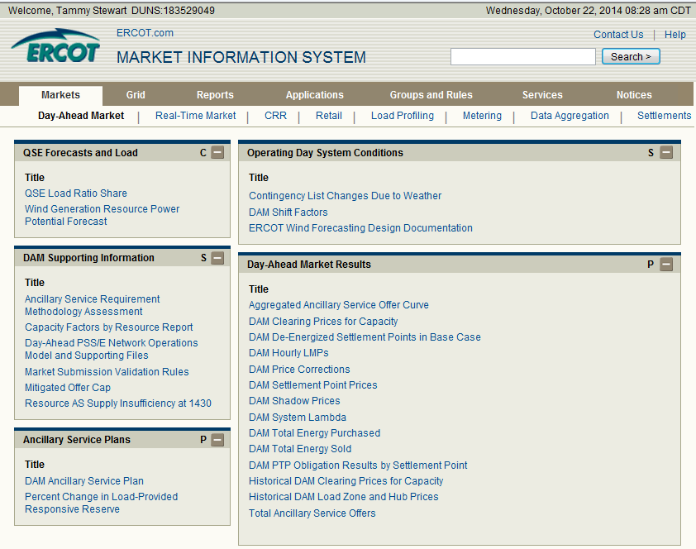
Bulk Insert: Report Destination
From within MIS, select the Retail link to access the reports.

Slide 43
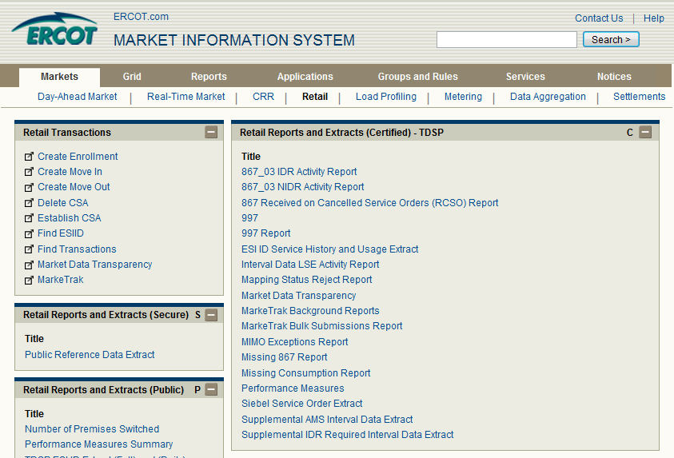
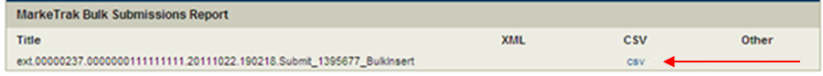
Bulk Insert: Report Destination
Select the MarkeTrak Bulk Submissions Report link to access the .csv file.

Slide 44
MarkeTrak Training
Usage Billing Issues

Slide 45
D2D Issues: Usage Billing Subtypes
867/810s Usage & Billing
Missing – CR is missing 867_03, 867_03F, 810s
Dispute – CR has an issue with the data found on the 867and/or 810
AMS interval data/LSE files
Missing – No LSE file or interval data for a period of time
Dispute – CR has an issue with the interval data on the LSE file

Slide 46
D2D Issues: Usage Billing - Missing
Examples of Usage/Billing Issues – Missing:
If a CR is missing an 867_03 Monthly usage transaction
If a CR is missing an 867_03 Final usage transaction
If a CR is missing an 810 transaction
If a CR is missing an 867_03 and an 810 transaction

Slide 47
D2D Issues: Usage Billing - Missing
Submitting a Usage/Billing – Missing Issue:
  The following fields must be populated for successful submission of Day to Day issue sub type Usage/Billing-Missing Issues: (For this example, the submitter selects the TDSP.)
    Assignee
    ESIID
    Original Tran ID (Optional except for 867_03 Final) - BGN02 of the 814_01, 814_16 or 814_24. The TDSP will see it as the BGN06 of the 814_03/814_25.
    Tran Type (select from drop down)
    TNX Date – same as the Service period start date (or is the current date)
    IDR/Non-IDR (IDR indicates true IDR meter, does not include AMS meters)
    Start Time = Service Period Start Date

Slide 48
D2D Issues: Usage Billing - Missing
Submitting a Usage/Billing – Missing Issue:
  The Comments field is optional. Please include any additional information in this box. New field added: Stop Time = Service Period Stop Date. Although optional it is encouraged to be populated. If left blank it will be assumed that the Stop date is the date up to the most current read date. The submitting MP will be validated as the ROR for the Start Time provided on the issue to prevent users from submitting invalid issues.
Comments are always a good idea!

Slide 49
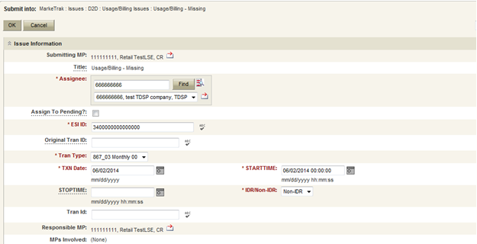
D2D Issues: Usage Billing - Missing
Submitting a Usage/Billing – Missing Issue (cont.):
TRAN TYPE:
867_03 F
867_03 Monthly 00- original
867_03 Monthly 01- cancel
867_03 Monthly 05- rebill
810_02 Monthly 00- original
810_02 Monthly 01- cancel
810_02 Monthly 05- replace
Select OK.

Slide 50
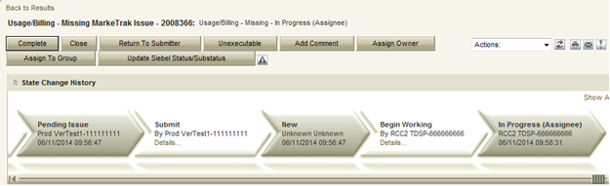
D2D Issues: Usage Billing - Missing
Submitting a Usage/Billing – Missing Issue (cont.)
  The issue enters TDSP queue in a state of New and is visible only by the Submitting CR and TDSP.
  The Submitting CR can Withdraw the issue at this point.
  The TDSP selects Begin Working and the issue is transitioned in a new state of In Progress-Assignee.
  At this point, the Submitting CR can no longer Withdraw the issue.
  TDSP reviews the issue and has the options:
    Unexecutable, which results in state Unexecutable- Pending Complete – requires comments
    Return to Submitter which requires comments and then the issue is transitioned back to the Submitter for additional information
    Complete which transitions to a state of Pending Complete. The Submitter has the option to close the issue by selecting Complete or the issue will be auto closed in 14 calendar days.

Slide 51
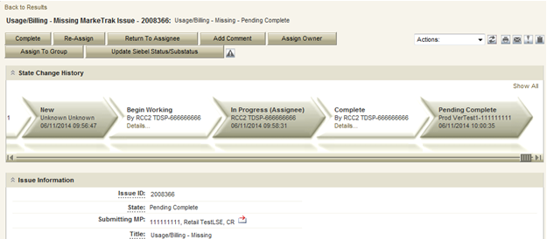
D2D Issues: Usage Billing - Missing
Submitting a Usage/Billing – Missing Issue (cont.)
  In this example the TDSP selects Complete, provides the required Tran ID of the missing transaction, and the issue is transitioned to the submitting CR in a state of Pending Complete. If the issue covers multiple service periods, information regarding those transactions should be provided in the comments.
  The Submitting CR has the option to close the issue by selecting Complete or the issue will be Auto Closed in 14 Calendar days.

Slide 52
D2D Issues: Usage Billing - Dispute
Examples of Usage/Billing Issues – Dispute:
  For use when a CR has an issue with any data found on an 867 or 810 which may pertain to one or more of the following examples:
    Consumption / Usage Data
    Bill Calculations – kW, kWh, power factor, meter multiplier
    Rate Issues – rate classifications/tariffs
    Discretionary Service Charge dispute
    Crossed Meter Situation
    Dispute of Estimated Bill
    Estimation Methodology

Slide 53
D2D Issues: Usage Billing - Dispute
Submitting a Usage/Billing – Dispute Issue:
The following fields must be populated for successful submission of Day to Day issue sub type Usage/Billing Issues: (For this example, the submitter selects the TDSP.)
  Assignee
  ESIID
  Original Tran ID (Optional except for 867_03 Final) - BGN02 of the 814_01, 814_16 or 814_24. The TDSP will see it as the BGN06 of the 814_03/814_25.
  Tran Type
  TXN Date
  Start Time - Service Period Start Date
  Dispute Category
    Priority Issue – defined as a subsequent MarkeTrak issue submitted/resubmitted due to initial MarkeTrak issue being auto closed without resolution or a follow-up MarkeTrak issue exceeding Market accepted SLA
    Consumption/Usage Issue
    Billing Calculations kWh
    Billing Calculations kW
    Billing Calculations Power Factor
    TDSP Charge Issue
    Rate Issue
    Crossed Meter Issues
    Non-Metered Issues
    Other – Comments Required
  Tran ID
  IDR/Non-IDR

Slide 54
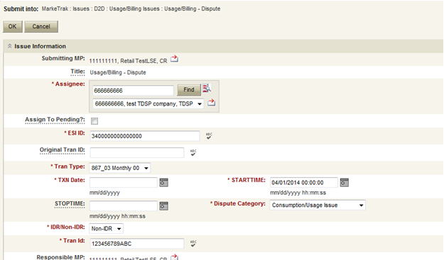
D2D Issues: Usage Billing - Dispute
Submitting a Usage/Billing – Dispute Issue (cont.):
NOTE: The Comments field is optional except when the Dispute Category is Other. Please include any additional information in this box. Stop Time = Service Period Stop Date. Although optional it is encouraged to be populated. If left blank it will be assumed that the Stop date is the date up to the most current read date. The submitting MP will be validated as the ROR for the Start Time provided on the issue to prevent users from submitting invalid issues.
Select OK.

Slide 55
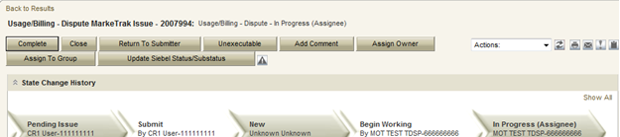
D2D Issues: Usage Billing - Dispute
Submitting a Usage/Billing – Dispute Issue (cont.):
The issue enters TDSP queue in a state of New and is visible only by the Submitting CR and TDSP.
The Submitting CR can Withdraw the issue at this point.
The TDSP selects Begin Working and the issue is transitioned in a new state of In Progress-Assignee.
At this point, the Submitting CR can no longer Withdraw the issue.
TDSP reviews the issue and has the options:
  Unexecutable, which results in state Unexecutable- Pending Complete – requires comments
  Return to Submitter which requires comments and then the issue is transitioned back to the Submitter for additional information
  Complete which transitions to a state of Pending Complete. The Submitter has the option to close the issue by selecting Complete or the issue will be auto closed in 14 calendar days.
In this example the TDSP selects Complete and the issue is transitioned to the submitting CR in a state of Pending Complete. The Submitting CR has the option to close the issue by selecting Complete or the issue will be Auto Closed in 14 Calendar days.

Slide 56
AMS LSE Interval Subtypes
AMS LSE Interval Subtypes are submitted for questions regarding AMS interval level data whereas questions regarding 867s or 810s are handled via Usage & Billing subtypes.
The Supplemental AMS Interval Data Extract is used as reference for AMS LSE Dispute subtype. The extract is posted daily to the ERCOT Market Information System (MIS) on ercot.com website.
Additional information about the extract can be found in the Supplemental AMS Interval Data Extract User Guide located on ERCOT.com.

Slide 57
AMS LSE Interval: Missing
Competitive Retailers (CRs) submit this Subtype when they discover an interval usage gap with the AMS LSE interval data from the TDSP.
Typically submitted requesting AMS data for one or more consecutive days of a service period. (Remember LSE files will have all 96 intervals completed for each day)
In order to submit this subtype, the following is required:
  The ESIID must have an AMS meter profile at ERCOT. (AMS Settlement Flag = true on Find ESI functionality)
  The CR must be the current Rep of Record for ALL usage days specified by the STARTIME and STOPTIME range.

Slide 58
AMS LSE Interval: Missing
How to submit this SubType?
From the MarkeTrak submit tree, under the D2D option:
  Select the Usage/Billing AMS LSE Interval Missing option.
  Enter the data for the required fields.

Slide 59
AMS LSE Interval: Missing
CR enters required information indicating STARTTIME and STOPTIME as formatted above for the missing period only and selects ‘OK’.

Slide 60
AMS LSE Interval: Missing
“Happy Path”
Requesting CR selects Missing under Usage/Billing AMS LSE Interval from the Submit Tree.
Requesting CR enters all required information and selects ‘OK’.
The issue is now in the state of ‘New’ with the TDSP as Responsible MP.
TDSP selects ‘Begin Working’.
The issue is now in a state of ‘In Progress (Assignee)’.

Slide 61
AMS LSE Interval: Missing
TDSP selects ‘Begin Working’ and then selects ‘Complete’ and enters optional Comments. TDSP selects ‘OK’.
NOTE: If CR is no longer ROR, SMT cannot be referenced and interval data should be attached to MarkeTrak.

Slide 62
AMS LSE Interval: Missing
“Happy Path” (cont.)
TDSP selects ‘Complete’, enters Comments (optional) and selects ‘OK’.
The issue is now in a state of ‘Pending Complete’ with the Submitting MP as the Responsible MP.
Submitting MP selects ‘Complete’ and the issue closes to ‘Complete’.

Slide 63
AMS LSE Interval: Missing
Submitting CR selects ‘Complete’ and the issue is closed to a state of ‘Complete.

Slide 64
AMS LSE Interval: Dispute
Competitive Retailers (CRs) submit this Subtype when they discover a discrepancy with the AMS LSE interval data from the TDSP.
Before submitting a Usage & Billing AMS LSE Dispute issue, the CR should allow 5 business days for transaction processing to complete.
In order to submit this subtype, the following is required:
  The ESIID must have an AMS meter profile at ERCOT.
  The usage data must be loaded in the ERCOT system and is identified by the unique identifier ‘UIDAMSINTERVAL’ from the Supplemental AMS Interval Data Extract. This code is retrieved and is a required field for this subtype.
Each issue should reflect the intervals from a single day or a consecutive period; a new issue should be created for each additional period.

Slide 65
AMS LSE Interval: Dispute
How to submit this SubType?
From the MarkeTrak submit tree, under the D2D section:
  Select the Usage/Billing AMS LSE Interval Dispute option.
  Enter the data for the required fields.

Slide 66
AMS LSE Interval: Dispute
Code retrieved from AMS Supplemental Extract for service interval in question or the last interval for the specific day or period in question. If past 30 days, enter the oldest date available
Comments are essential in efficiently and accurately processing the MT in a timely manner
STARTTIME = service period start time formatted as mm/dd/yyyy 00:00:00
STOPTIME = service period stop time (varies by TDSP)
mm/dd/yyyy 23:59:59

Slide 67
AMS LSE Interval: Dispute
“Happy Path”
Requesting CR selects Dispute under Usage/Billing AMS LSE Interval from the Submit Tree.
Requesting CR enters all required information and selects ‘OK’.
The issue is now in the state of ‘New’ with the TDSP as Responsible MP.
TDSP selects ‘Begin Working’.
The issue is now in a state of ‘In Progress (Assignee)’.

Slide 68
AMS LSE Interval: Dispute
TDSP selects ‘Begin Working’ and then selects ‘Complete’ and enters optional Comments. TDSP selects ‘OK’.

Slide 69
AMS LSE Interval: Dispute
“Happy Path” (cont.)
TDSP selects ‘Complete’, enters Comments (optional) and selects ‘OK’.
The issue is now in a state of ‘Pending Complete’ with the Submitting MP as the Responsible MP.
Submitting MP selects ‘Complete’ and the issue transitions to ‘Complete’.

Slide 70
AMS LSE Interval: Dispute
Submitting CR selects ‘Complete’ and the issue is closed to a state of ‘Complete.

Slide 71
Checkpoint Question
Which subtype should a CR submit if a customer is questioning the monthly consumption value they received on their monthly bill?
  Usage & Billing – Missing
  Usage & Billing – Dispute
  AMS LSE – Missing
  AMS LSE – Dispute
ANSWER
Usage & Billing – Dispute

Slide 72
Checkpoint Question
True or False
A CR should submit an AMS LSE – Dispute MarkeTrak as soon as they receive the 867_03 monthly from the TDSP.
FALSE

Slide 73
Checkpoint Question
True or False
When submitting any Usage & Billing MarkeTrak, if the STOP time is left blank it will be assumed it is the end of the 30 day period following the START time.
FALSE

Slide 75
D2D Issues: Missing Enrollment Transactions
Examples of missing enrollment transactions are if a CR is missing any 814’s, or an 867_04.
NOTE: The reprocessing of retail transactions by ERCOT will be limited to one year from the original processing date. If the missing transaction is to be reprocessed, or dependent upon another transaction being reprocessed, the original transaction dates must be within one year of submission of the MarkeTrak issue.
Allow the market time to process the transactions before submitting the MarkeTrak issue
A CR or TDSP can submit this subtype
Required Fields on Submit:
  Assignee
  ESI ID
  Original Tran ID
  Tran Type

Slide 76
MarkeTrak Training
Switch Hold

Slide 77
Switch Hold Overview
References and General Overview of Switch Hold Process:
PUCT Rule References:
PUCT Subst. Rule 25.126, Adjustments due to Non-Compliant Meters and Meter Tampering in Areas where Customer Choice has been Introduced
PUCT Subst. Rule 25.480, Bill Payments and Adjustments
Retail Market Guide References:
7.16, Business Processes & Communications Related to Meter Tampering
  7.16.4.3, Removal of a Switch Hold for Meter Tampering for Purposes of a Move In
7.17, Business Processes & Communications Related for Switch Holds Related to Deferred Payment Plans
  7.17.3.3, Removal of a Switch Hold for Deferred Payment Plans for Purposes of a Move In

Slide 78
Switch Hold Removal
How it works:
When a requesting CR submits a Move-In request for an ESIID with a Switch Hold, the requesting CR must initiate the appropriate MarkeTrak (MT) issue to begin the Switch Hold removal process.
  Only one MarkeTrak issue per ESIID.
The TDSP, current REP of Record, and requesting CR will work together to determine if the new occupant is in any way associated with the current occupant who is subject to Switch Hold, and the MT issue must be resolved within four (4) business hours.
The requesting CR must provide one of several PUCT-approved forms of documentation for all MPs involved to review.
  List of approved documentation can be found here:
  Retail Market Guide 7.16.4.3.2 (Removal of Switch Hold for Meter Tampering)
  Retail Market Guide 7.17.3.3.2 (Removal of Switch Hold for Deferred Payment Plan)

Slide 79
Switch Hold Removal
How it works:
If it is determined that the New Occupant is not associated with Customer of Record, the TDSP will remove all Switch Hold(s) applied to the ESIID.
If an issue has been open for more than four (4) business hours without resolution, the TDSP will make the final decision as to whether or not the switch hold will remain.

Slide 80
Switch Hold Removal
What does it mean: Four (4) Business Hours?
MarkeTrak Switch Hold Removals are worked during Business Hours only (Monday-Friday, 8:00AM-5:00PM)
Market Participant Timelines:
  TDSP “Initial” review: one (1) business hour
  Current REP of Record review: one and a half (1.5) business hours
  TDSP “Final” review: one and a half (1.5) business hours (or any remaining time within the four-hour period)
If issue remains unresolved at the end of a business day, the Responsible MP’s time will resume next business day at 8:00AM
  Example: REP of Record is assigned the issue at 4:00PM Friday. Business hours cease at 5:00PM Friday. Business hours resume 8:00AM Monday. REP of Record has until 8:30 AM Monday to respond, for a total of one and a half business hours as Responsible MP.

Slide 81
Switch Hold Removal
Standard Documentation Requirements
Per RMG 7.16 & 7.17, the Requesting CR must include the New Occupant Statement (RMG Appendix J2) AND one of the following:
Copy of a current signed lease;
Notarized Affidavit of Landlord (RMG Appendix J9);
Utility bill, in new occupant’s name, dated within last two months from a different Premise address;
Closing documents indicating transfer of ownership occurred subsequent to Switch Hold applied to Premise; or
Certificate of occupancy

Slide 82
Switch Hold Removal
Standard Documentation “Best Practices”
TDSPs will review all supplied documentation for completeness. For quickest resolution, the documentation provided should include:
Current Signed Lease
  Customer name, service address, portion of lease signed by both landlord and tenant
  Any expired agreements or agreement not signed by all parties will be rejected by TDSP
Utility bill
  New Occupant’s name and service address should be visible
  Dated within last two months from a different Premise address
Closing Documents
  New Occupant’s name and service address should be visible
  Indicating transfer of ownership occurring after Switch Hold was applied
Affidavit of Landlord
  Notarized
  If form Appendix J9 is not used, the document must contain all data elements required within J9

Slide 83
Switch Hold Removal
Continuous Service Agreement (CSA) Documentation Requirements
For a premise where a CSA agreement is present, only the CSA form in Appendix J4/J5 is required. The New Occupant Statement does not need to accompany the CSA form, and it does not need to be notarized.
The Requesting CR must be the CSA provider, established via 814_18 CSA Add transaction.
If there is not an actual CSA, the Requesting CR must use the previously mentioned process.
  New Occupant Statement + documentation
  Example: Non-CSA vacant agreement

Slide 84
Switch Hold Removal
“Happy Path” #1 – All users agree and switch hold is removed
Requesting CR selects Switch Hold Removal from Submit Tree.
Requesting CR enters all required information, attaches all necessary documentation and chooses the ‘Submit’ transition.
The issue is now in the state of ‘New (TDSP)’ with the TDSP as Responsible MP.
TDSP selects ‘Begin Working’.
The issue is now in a state of ‘In Progress (TDSP)’.

Slide 85
Switch Hold Removal
“Happy Path” #1 – All users agree and switch hold is removed (cont.)
TDSP selects ‘Send to REP of Record’.
  Enters DUNS/company name via dropdown.
The issue is now in a state of ‘New’ with the REP of Record as Responsible MP.
REP of Record selects ‘Begin Working’.
Issue is now in a state of ‘In Progress (Assignee)’.
REP of Record selects ‘Agree’.

Slide 86
Switch Hold Removal
“Happy Path” #1 – All users agree and switch hold is removed (cont.)
Issue is now in a state of ‘New (TDSP) - Final Review’ with the TDSP as Responsible MP.
TDSP selects ‘Begin Working’.
Issue is now in a state of ‘In Progress (TDSP)- Final Review’ with the TDSP as Responsible MP.
TDSP selects the ‘Switch Hold Removed’ transition.
Issue is now in a state of ‘Pending Complete’ with Requesting CR as Responsible MP.
Requesting CR selects ‘Complete’, and issue is closed.

Slide 87
Switch Hold Removal
CR enters required information and attaches file(s).

Slide 88
Switch Hold Removal
TDSP sends to REP of Record.

Slide 89
Switch Hold Removal
REP of Record DUNS is used by TDSP to assign issue.

Slide 90
Switch Hold Removal
REP of Record agrees to release switch hold.

Slide 91
Switch Hold Removal
TDSP confirms removal of switch hold.

Slide 92
Switch Hold Removal
Submitting (Requesting) CR selects ‘Complete’ and the issue is closed.

Slide 93
Switch Hold Removal
“Happy Path” #2 – No REP of Record.
TDSP selects ‘No REP of Record’.
Issue is now in a state of ‘In Progress (TDSP)- Final Review’ with the TDSP as Responsible MP.
TDSP selects the ‘Switch Hold Removed’ transition.
Issue is now in a state of ‘Pending Complete’ with Requesting CR as Responsible MP.
Requesting CR selects ‘Complete’ and issue is closed.

Slide 94
Switch Hold Removal
Alternate Path #1 – REP of Record disagrees; TDSP still removes hold.
REP of Record selects ‘Disagree’.
  Comments required. REP of Record should also attach supporting documentation.
Issue is now in a state of ‘New (TDSP) - Final Review’ with the TDSP as Responsible MP.
TDSP selects the ‘Switch Hold Removed’ transition.
Issue is now in a state of ‘Pending Complete’ with Requesting CR as Responsible MP.
Requesting CR selects ‘Complete’ and issue is closed.

Slide 95
Switch Hold Removal
REP of Record selects ‘Disagree’.

Slide 96
Switch Hold Removal
TDSP confirms removal of switch hold.

Slide 97
Switch Hold Removal
Alternate Path #2 – REP of Record disagrees; TDSP declines to remove hold.
REP of Record selects ‘Disagree’.
  Comments Required. REP of Record should also attach supporting documentation.
Issue is now in a state of ‘New (TDSP) - Final Review’ with the TDSP as Responsible MP.
TDSP selects ‘Begin Working’.
Issue is now in a state of ‘In Progress (TDSP)- Final Review’ with the TDSP as Responsible MP.
TDSP selects the ‘Switch Hold Not Removed’ transition.
  Comments required
Issue is now in a state of ‘Unexecutable (PC)’ with Requesting CR as Responsible MP.
Requesting CR selects ‘Accept’ and issue is closed.

Slide 98
Switch Hold Removal
TDSP declines removal of switch hold.

Slide 99
Switch Hold Removal
Issue is in a state of Unexecutable.

Slide 100
Switch Hold Removal
Alternate Path #3 – TDSP rejects issue during first step as Responsible MP.
TDSP selects ‘Unexecutable’ and is prompted to choose Unexecutable Reason (comments required).
  Documentation Invalid/Incomplete
  No Switch Hold Pending on this ESIID
  Customer Associated with Current Occupant
  Issue Should not be Submitted by REP of Record
Issue is in a state of ‘Unexecutable (PC)’ with Requesting CR as Responsible MP.
Requesting CR selects ‘Accept’ and issue is closed.

Slide 101
Switch Hold Removal
Alternate Path #4 – REP of Record does not choose “Begin Working”, exceeds time limit.
The issue is now in a state of ‘New’ with the REP of Record as Responsible MP.
Requesting CR chooses ‘Time Limit Exceeded’ transition.
Issue is now in a state of ‘New (TDSP) - Final Review’ with the TDSP as Responsible MP.
TDSP selects ‘Begin Working’.
Issue is now in a state of ‘In Progress (TDSP)- Final Review’ with the TDSP as Responsible MP.

Slide 102
Switch Hold Removal
Alternate Path #4 – REP of Record does not choose “Begin Working”, exceeds time limit.
TDSP selects the ‘Switch Hold Removed’ transition.
Issue is now in a state of ‘Pending Complete’ with Requesting CR as Responsible MP.
Requesting CR selects ‘Complete’ and issue is closed.

Slide 103
Switch Hold Removal
Alternate Path #5 – REP of Record selects ‘Begin Working’, exceeds time limit.
The issue is now in a state of ‘New’ with the REP of Record as Responsible MP.
REP of Record selects ‘Begin Working’.
Issue is in a state of ‘In Progress (Assignee)’.
Requesting CR chooses ‘Time Limit Exceeded’ transition.
Issue is now in a state of ‘New (TDSP) - Final Review’ with the TDSP as Responsible MP.

Slide 104
Switch Hold Removal
Alternate Path #5 – REP of Record selects ‘Begin Working’, exceeds time limit.
TDSP selects ‘Begin Working’.
Issue is now in a state of ‘In Progress (TDSP)- Final Review’ with the TDSP as Responsible MP.
TDSP selects the ‘Switch Hold Removed’ transition.
Issue is now in a state of ‘Pending Complete’ with Requesting CR as Responsible MP.
Requesting CR selects ‘Complete’ and issue is closed.

Slide 105
Switch Hold Removal
CR chooses Time Limit Exceeded transition

Slide 106
Switch Hold Removal
Alternate Path #6 – ‘Time Limit Exceeded’ used before one and a half business hours.
Requesting CR chooses ‘Time Limit Exceeded’ transition.
Issue is now in a state of ‘New (TDSP) - Final Review’ with the TDSP as Responsible MP.
TDSP selects ‘Begin Working’.
Issue is now in a state of ‘In Progress (TDSP)- Final Review’ with the TDSP as Responsible MP.
TDSP chooses ‘Return to REP of Record’ transition.

Slide 107
Switch Hold Removal
TDSP returns to REP of Record

Slide 108
Switch Hold Removal
Alternate Path #6 – ‘Time Limit Exceeded’ used before one and a half business hours.
The issue is now in a state of ‘New’ with the REP of Record as Responsible MP.
Requesting CR chooses ‘Time Limit Exceeded’ transition after waiting until time limit is finally expired.
Issue is now in a state of ‘New (TDSP) - Final Review’ with the TDSP as Responsible MP.
TDSP selects ‘Begin Working’.
Issue is now in a state of ‘In Progress (TDSP)- Final Review’ with the TDSP as Responsible MP.

Slide 109
Switch Hold Removal
Alternate Path #6 – ‘Time Limit Exceeded’ used before one and a half business hours.
TDSP selects the ‘Switch Hold Removed’ transition.
Issue is now in a state of ‘Pending Complete’ with Requesting CR as Responsible MP.
Requesting CR selects ‘Complete’ and issue is closed.

Slide 110
MarkeTrak Training
Cancel Issues

Slide 111
Cancel with Approval
CR Initiated Manual Cancels:
The CR must try to send the 814_08 EDI Cancel Transaction on Scheduled orders outside the ERCOT Evaluation Window.
CRs can only request cancellation of their own service orders.
TDSP must be made the Assigned MP of MarkeTrak issue.
All CR initiated manual cancellations of service orders require TDSP approval.
The TDSP will evaluate whether the transaction can be cancelled and select TDSP Cancel or request ERCOT cancel the issue by selecting ERCOT Cancel on the MarkeTrak issue. The TDSP can also add a comment stating they will send the 814_28 “09” (Complete Unexcutable) if the order can still be cancelled.
The TDSP will select Already Cancelled when the Siebel Status shows Cancelled Unexecutable on the MarkeTrak issue or Unable to Cancel if the order is already in a Complete state.
For MP’s that cannot generate an 814_08 for an order that is in an In Review status in Siebel, a Cancel with Approval will need to be submitted, requesting ERCOT to manually cancel and send the 814_08.

Slide 112
Cancel with Approval
TDSP Initiated Manual Cancels – Requiring CR Approval:
If the Service Order to be cancelled is Scheduled or In Review in Siebel, and is not an approved reason in the TDSP Approved Cancellation Reasons Table, CR approval is necessary prior to manual cancellation.
The TDSP must obtain this approval by having CR select OK to Cancel on the MarkeTrak issue.
For a Service Order that has completed in Siebel, a Siebel CHG/Info issue will need to be submitted.

Slide 113
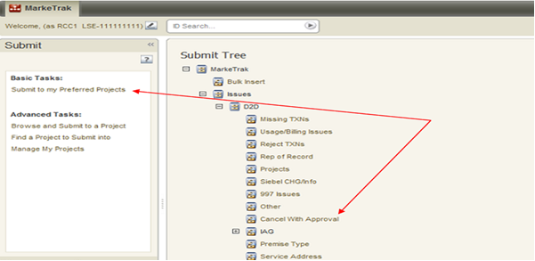
Cancel with Approval
Submitting Cancel with Approval – CR Submit/TDSP Cancels:
From the Submit Tree, select Cancel with Approval.
The following fields must be populated for successful submission of Day to Day issue sub type Cancel with Approval:
  Assignee
  ESI ID
  Original Tran ID – BGN02 of the 814_01, 814_16 or the 814_24
  Comments- recommended for rescission based issues: “Customer rescission-please process this issue per P.U.C. SUBST. R. 25.474 (n).”
Select OK

Slide 114
Cancel with Approval
Validations on Submit Transition:
MarkeTrak has added a validation to verify that the CR associated with the issue is the CR associated with the transaction being cancelled.
  ERROR Message: “The ESI ID/Tran ID combination provided is not associated with this CR”
MarkeTrak has added a validation to verify that the “Cancel With Approval” issue is being submitted within the Evaluation Window for the scheduled transaction.
  If transaction type = 814_01(Switch) the Evaluation Window is 1 Retail Business Day prior to the SMRD
  If transaction type = 814_16 (Move In) the Evaluation Window is 1 Retail Business Day prior to the SMRD
  If transaction type = 814_24 (Move Out) the Evaluation Window is 1 Retail Business Day prior to the SMRD
  MarkeTrak will automatically populate the applicable Tran Type to the issue.
Example: Texas SET transaction is scheduled for Wednesday. 814_08 cancellations will be accepted through end of Retail Business Day Monday.
  Warning Message: “Issue is being submitted outside of the Evaluation Window and transaction should be canceled using an 814_08.”

Slide 115
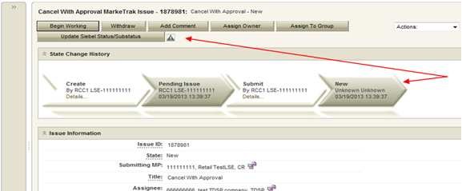
Cancel with Approval
By selecting OK, the issue is transitioned to the Assigned MP (TDSP) and is showing as New in the TDSP’s queue. The Submitter has the option to Withdraw the issue at any time until the Begin Working has been selected by someone other than the submitter.
The TDSP becomes the Responsible MP.
The TDSP selects Begin Working. The issue becomes In Progress with the TDSP and the CR is no longer able to Withdraw the issue.

Slide 116
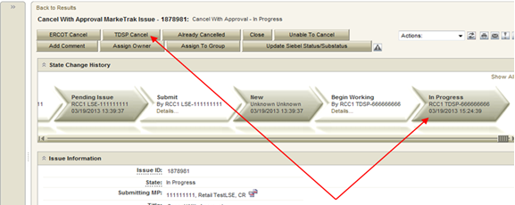
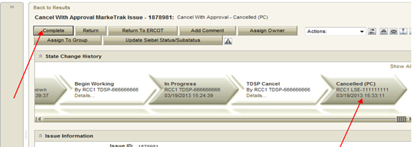
Cancel with Approval
The TDSP reviews the issue then sends the 814_28 and selects TDSP Cancel.
When the TDSP selects TDSP Cancel the issue is transitioned to a state of Cancelled (PC). The issue transitions back to the CR and they will select Complete.

Slide 117
Cancel without Approval
TDSP initiated manual cancellations on pending orders – not requiring CR approval:
TDSPs must provide one of the following approved cancellation reasons (see chart on next slide) for each pending service order.
Standardized language will be provided along with the MarkeTrak number in the 814_08s sent to Market Participants (see chart on next slide for standard language).
This procedure is only applicable if the order is scheduled in Siebel and the meter read has not been sent.

Slide 118
Cancel without Approval
TDSP Approved Cancellation Reasons | 814_08 Text
Scenario A Rep A submits MVO Rep B submits MVI which precedes or is the same day as a scheduled MVO TDSPs can request cancel MVO, after MVI completed thru MarkeTrak without CR approval | MVO or MVO to CSA cancelled because MVI worked instead MT ________ (to be inserted by ERCOT)
Scenario B TDSP wants to cancel a switch because it received a safety new MVI before the switch effectuated ERCOT will cancel the switch | TDSP works a safety net move in instead of pending Drop or Switch MT ________ (to be inserted be ERCOT)
Scenario C Expired (20 days) 814_28 PT transactions because 814_04 has not been received by ERCOT ERCOT will send a cancel with exception 814_08 on day 21 | Per TDSP request Order should have expired MIMO 23 MT _______ (to be inserted by ERCOT)
Scenario D Service Order is unexecutable (e.g., when meter removed from a premise but no ESIID retired) TDSP enters a MarkeTrak ticket to request cancellation of Service Order ERCOT will cancel Service Order | Per TDSP request Unexecutable MT ________ (to be inserted by ERCOT)
Scenario E Switch that is in a scheduled status. An even occurred prior to completion requiring the meter to be removed TDSP enters a MarkeTrak issue to request cancellation of Switch ERCOT will cancel Switch | Per TDSP meter has been removed and switch can not be completed

Slide 119
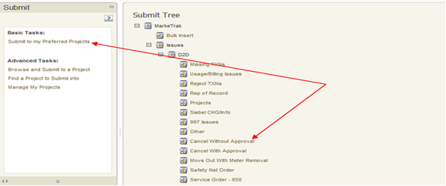
Cancel without Approval
Submitting Cancel without Approval – TDSP Submit/ERCOT Cancels:
From the Submit Tree, select Cancel with Approval.
The following fields must be populated for successful submission of Day to Day issue sub type Cancel without Approval:
  ESI ID
  Original Tran ID
  NOTE: Please include the TDSP Approved Cancellation Reason in the COMMENTS field. The Reason will need to be given in order for ERCOT to work the issue. If the reason not given, ERCOT will return the issue back to the TDSP.
Select OK

Slide 120
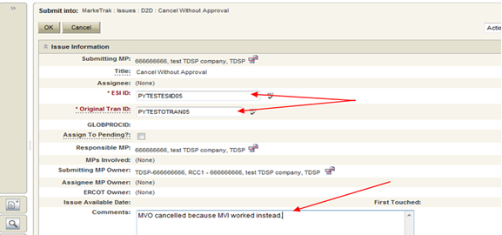
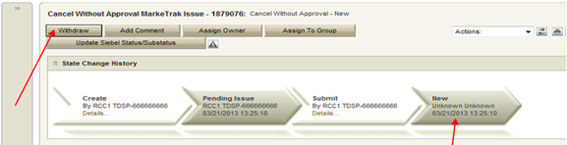
Cancel without Approval
Submitting Cancel without Approval – TDSP Submit/ERCOT Cancels:
By selecting OK, the issue is transitioned to ERCOT’s queue in the state of New and is visible only by the TDSP and ERCOT. The TDSP has the option to Withdraw the issue at this point.

Slide 121
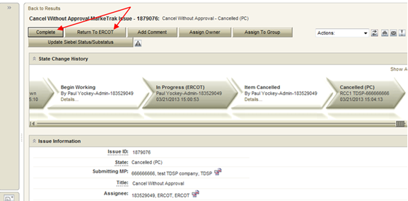
Cancel without Approval
ERCOT selects Begin Working. The TDSP is no longer able to Withdraw the issue.
ERCOT has the options to select Item Cancelled or Unable to Cancel. If ERCOT is able to cancel and the TDSP Cancellation Reason is included in the Comments field, ERCOT will manually cancel the Siebel service order and send 814_08s to all market participants involved. ERCOT selects Item Cancelled and has the option to add any comments by selecting Add Comment.
The issue is now in a Cancelled(PC) (Pending Complete) state. The TDSP can select to Return to ERCOT (to return to state New ERCOT) or Complete to transition to a state of Complete and close the issue. If the issue is not transitioned for 14 calendar days, then the item will automatically move to Auto Complete and close

Slide 122
MarkeTrak Training
‘Other’ Issues

Slide 123
D2D Issues: Other
Examples of Other Issues but not limited to:
  Questions pertaining to discrepancy between sum of AMS Interval data and the 867 consumption value
  Questions pertaining to Siebel Reports
  Questions pertaining to request for filenames
  Questions pertaining to 997 reports
  Questions pertaining to CSAs
  Questions pertaining to missing information on non-required EDI fields
  Request for reprocessing of transactions
  Questions pertaining to Texas SET Transaction Issues
  Questions pertaining to MIS Portal
A CR or a TDSP can submit this subtype
Required Fields on Submit:
  Assignee

Slide 124
D2D Issues: Other Workflow
Many subtypes in MarkeTrak have unique workflows. Other subtypes follow one workflow very closely which is the ‘Other’ workflow. The following is an illustration of the ‘Other’ workflow:
State Name Responsible MP MP’s Involved | Transitions Available | Resulting State | Actioned By
*Create* -Submitting MP -Submitting MP | Assign to Pending OK | Pending Issue New | Submitting MP Submitting MP
*Pending Issue* -Submitting MP -Submitting MP | Submit Withdraw | New Withdrawn | Submitting MP Submitting MP
*New* -ERCOT/Assignee MP -Submitting MP/Assignee MP | Begin Working Withdraw | In Progress (Assignee) Withdrawn | Assignee MP Submitting MP
*In Progress (Assignee)* -ERCOT/Assignee MP -Submitting MP/Assignee MP | Complete Close Return to Submitter Unexecutable | Pending Complete Closed by Submitter New – All Unexecutable (PC) | Assignee MP – Tran ID required on certain subtypes Submitting MP Assignee MP Assignee MP
*New – All* -Submitting MP -Submitting MP/Assignee MP | Begin Working Close | In Progress Closed by Submitter | Submitting MP Submitting MP
*In Progress* -Submitting MP -Submitting MP/Assignee MP | Complete Assign to ERCOT Close Return to Assignee Unexecutable | Pending Complete New Closed by Submitter New Unexecutable (PC) | Submitting MP Submitting MP Submitting MP Submitting MP Submitting MP
*Pending Complete* -Submitting MP -Submitting MP/Assignee MP | Complete Re-Assign Return to Assignee Auto Complete | Complete New New Auto Complete | Submitting MP Submitting MP Submitting MP System
*Unexecutable* -Submitting MP -Submitting MP/Assignee MP | Accept Re-Assign Return to Assignee Auto Complete | Complete New New Auto Complete | Submitting MP Submitting MP Submitting MP System

Slide 125
D2D Issues: Siebel Change/Info
Examples of Siebel Change/Info:
  Service order status changes
    Questions pertaining to transactions status updates where EDI message is present on ERCOT MIS. NOTE: If not present, then submit under “Missing Enrollment Transaction”
    Questions pertaining to why a transaction was cancelled
    Questions pertaining to Siebel not reflecting the correct status based on transaction(s) that the TDSP has submitted
    Cancelling a Siebel service order after completion
    Completing a Siebel service order after it was cancelled – limited to one year from original processing date

Slide 126
D2D Issues: Siebel Change/Info
Examples of Siebel Change/Info:
  Start time issues
    Questions pertaining to why an ESIID is not in ERCOT’s system
    Changing a start time of a Siebel service order
  A CR or TDSP can submit this subtype
  Required fields on Submit:
    ASSIGNEE
    ESIID
    Original Tran ID - BGN02 of the initiating transaction (814_01, 814_16, 814_24)
    Comments – always encouraged

Slide 127
MarkeTrak Training
Data Extract Variance (DEV) Issue Subtypes

Slide 128
Data Extract Variance (DEV) Overview
What is the purpose of DEVs? Data Extract Variances (DEVs) are used to synchronize the data among all Market Participants (MP)
What is a DEV? It's a discrepancy between the MP’s data and ERCOT’s extract data
There are two types of DEVs: LSE (Load Serving Entity) and Non-LSE (Reference: MarkeTrak SubTypes Quick Reference)
  LSE DEVs are used to correct the MP's StartTime and/or StopTime for Rep of Record (ROR) synchronization
  Non-LSE DEVs are used to synchronize ESI_ID Characteristics, Existence and/or usage data
  There are several subtypes for both LSE and Non-LSE DEVs that are used to synchronize specific data variances
One of the larger buckets of “Invalid” DEV submissions involves the +/- (2 calendar day) window for the StartTime and/or StopTime. If your discrepancy is within this 2 day window and you attempt to file a DEV issue, ERCOT will reject it. The correct action is to file a D2D Siebel MarkeTrak issue (Reference: MarkeTrak SubTypes Quick Reference)
“Valid” DEV submissions should only occur after transactions have been attempted to correct the discrepancy. Statistically there are no common DEV subtypes as DEVs are submitted on an as needed basis.

Slide 129
Data Extract Variance (DEV) Issues
There are many possible scenarios that may result in differences between ERCOT data and MP data. There are two Types of Data Extract Variances:
  Invalid submission: Differences that have been found invalid and do not require resolution. A Data Extract Variance cannot be filed for ‘Invalid submission’.
  Valid submission: Differences that are ‘Valid’ and do require analysis. A Data Extract Variance should be filed for ‘Valid submission’.
DEV issues should be filed for data discrepancies identified by comparing Extract data to the MP source system data.
  DEV issues require that transactions have been tried to correct the data discrepancy (i.e. back dated MVI, 814_20 Update for ESIID Characteristics, etc.), if applicable.
  DEV issues require the most recent SCR 727 Extract Addtime record to complete and update SCR 727 data extract.

Slide 130
Inadvertent
Gain/Loss (IAG)
Overview

Slide 131
What is an IAG?
An Inadvertent Gain/Loss (IAG) is an unauthorized
change of a customer’s Retail Electric Provider
Commonly referred to as either an Inadvertent Gain (IAG) or Inadvertent Loss (IAL), an inadvertent situation occurs when a customer or a premise is changed to a REP that is different than their expected REP of choice.
When resolving IAG issues, the ultimate goal is to return the Customer to their REP of choice in a quick and efficient manner with minimal inconvenience to the Customer.

Slide 132
Reference Documents
PUCT Subst. Rule §25.495, Unauthorized Change of Retail Electric Provider
ERCOT Retail Market Guide Section 7.3, Inadvertent Gain Process
MarkeTrak User’s Guide, Section 2

Slide 133
How does an IAG occur?
An Inadvertent Gain or Loss can occur under various circumstances:
Incorrect information provided by the Customer during enrollment – service address or ESI ID
Incorrect information entered by the REP during enrollment
Unauthorized enrollments – slamming
Variety of different enrollment processes used by REPs

Slide 134
Who does an IAG impact?
Customer
Gaining REP
ERCOT
Losing REP
TDU

Slide 135


How is the market impacted?
Customer
  Confusion as to who is their REP
  Delayed Billing
  Possible Lights Out Situation
  Poor Customer Experience
Market
  Most used MT Subtype -represents over 40% of all MTs
  One of the longest MT issues to resolve
  Can create distrust and confusion in the Market
Cost
  Resource Commitments
  Consumption Write-offs
  IAG Fees from TDSPs

Slide 136

Questions

Slide 137
Customer Rescission
Walkthrough

Slide 138
Right of Rescission
PUCT Subst. Rule 25.474(j) - Right of Rescission
A REP shall promptly provide the applicant with the terms of service document after the applicant has authorized the REP to provide service to the applicant and the authorization has been verified. For switch requests, the REP shall offer the applicant a right to rescind the terms of service without penalty or fee of any kind for a period of three federal business days after the applicant's receipt of the terms of service document. The provider may assume that any delivery of the terms of service document deposited first class with the United States Postal Service will be received by the applicant within three federal business days. Any REP receiving an untimely notice of rescission from the applicant shall inform the applicant that the applicant has a right to select another REP and may do so by contacting that REP. The REP shall also inform the applicant that the applicant will be responsible for charges from the REP for service provided until the applicant switches to another REP. The right of rescission is not applicable to an applicant requesting a move-in.

Slide 139
Right of Rescission
In other words …
Applicable to Switch requests only, not Move-Ins.
After receiving the Terms of Service, Customer is allowed three (3) federal business days to rescind without penalty or fees from the Gaining REP.
Ultimate goal is to return the Customer to their REP of choice quickly and efficiently with minimal inconvenience to the Customer.

Slide 140
Rescission vs. Inadvertent Switch
Strongly recommended that involved CRs share as much information as possible at the onset of issue creation to aid in resolution of Customer Rescission issue quickly and efficiently (e.g. Customer Name, Meter #, etc.)
Although Customer Rescission is part of the Inadvertent Switch ‘family’ within the MarkeTrak tool, resolution of a Customer Rescission does not follow the same criteria nor follow the same completion timeline.
The research and investigation normally pursued during resolution of an Inadvertent Switch is not utilized when resolving Customer Rescission.
If/when the customer requests rescission (within the 3 federal business day window), the ‘losing’ REP must promptly regain the Customer – no questions asked.

Slide 141
Rescission vs. Inadvertent Switch
Handling of Fees/Charges Associated with IAG vs Rescission
(per TDSP tariff):
 | Customer Rescission | Inadvertent Gain/ Loss
Can CRs pass TDSP fees to customer? | No | Yes – TDSPs may charge Gaining CRs an IAG fee and/or pass-through charges. Gaining CRs may choose to pass these charges to the customer.
Can CRs pass kWh usage to customer? | No | Yes – because IAG reinstatement date can range from “DOL + 1” to “Date of MT submission +10”, Gaining CRs may choose to pass kWh charges (usage) to the customer.
Notes:
NEW SLIDE

Slide 142
Customer Rescission Guidelines
Only the Gaining CR in a rescission scenario may utilize the rescission-based MarkeTrak process to initiate reinstatement of a customer to its original CR.
In order for an issue to be submitted through this subtype, it must be submitted on or before the twenty-fifth (25th) calendar day following ERCOT’s established First Available Switch Date (FASD).
If a Customer Rescission issue has not been submitted within the specified timeframe above, the two CRs should work to resolve the rescission issue through the Inadvertent Gaining subtype.

Slide 143
Completion Timeline for Customer Rescission
Once a Customer Rescission MarkeTrak (MT) issue has been submitted, the losing CR has two (2) business days to agree to the Customer Rescission MT issue.
Once the Transmission and/or Distribution Service Provider (TDSP) has updated the MT issue to “Ready to Receive”, the losing CR has another two (2) business days to send a backdated 814_16, Move-In Request.

Slide 144
Rescission Walkthrough – Gaining CR
The Gaining CR selects the Submit tab.
From the Submit Tree, select Customer Rescission.
Note: The submitter should include any details (ex. customer name) in the comments section which may expedite resolution of the issue.

Slide 145
Rescission Walkthrough – Gaining CR
The following fields must be populated:
ESI ID
Original Tran ID
Comments (Recommended)

Slide 146
Rescission Walkthrough - Validations
ERCOT validates ESI ID, submission timeframe and valid originating transaction.
Upon passing validation, MarkeTrak issue is created and ERCOT updates the issue with the following information:
  Losing CR Name and Duns
  TDSP Name and Duns
  Gaining CR ROR = Y or N
  Gaining CR Start Date
  Regain Date – auto populated by ERCOT.
  (Gaining CR Start Date +1 calendar day)
MarkeTrak issue is assigned to the state of ‘New (Losing CR)’ with the Losing CR as the Responsible Party.
[Starts the 2 Business Day clock for Losing CR to Agree]
Losing CR user selects ‘Begin Working’.

Slide 147
Rescission Walkthrough – Losing CR
MarkeTrak issue is assigned to the state of ‘In Progress (Losing CR)’ with the Losing CR as the Responsible Party.
Losing CR selects ‘Send to TDSP’.
[Implies “Agreement” & ends the 2 Business Day clock]

Slide 148
Rescission Walkthrough – TDSP
Issue is in a state of ‘New (TDSP)’ with TDSP as Responsible MP.
TDSP selects ‘Begin Working’.
Issue is in a state of ‘In Progress (TDSP)’ with TDSP as Responsible MP.

Slide 149
Rescission Walkthrough - TDSP
TDSP selects ‘Ready to Receive’
[Starts the 2 Business Day clock for Losing CR to submit BDMVI]

Slide 150
Rescission Walkthrough – Losing CR
Issue is in a state of ‘New (Losing CR Submit)’ with the Losing CR as Responsible MP.
Losing CR selects ‘Begin Working’.
Issue is in a state of ‘In Progress (Submit Regaining)’ with the Losing CR as Responsible MP.

Slide 151
Rescission Walkthrough – Losing CR
Losing CR selects ‘Provide Regaining BGN02’.

Slide 152
Rescission Walkthrough – Losing CR
Losing CR populates all required information:
  Regaining Transaction Submit Date
  Regaining BGN 02

Slide 153
Rescission Walkthrough - Resolution
Issue is in a state of ‘Regaining Transaction Submitted (PC)’ with the Gaining (Submitting CR) as Responsible MP.
Once the regaining transaction (Backdated 814_16 MVI) has been successfully sent by (Losing/Original CR), Siebel will automatically:
  Check Regaining Transaction Siebel Status every 30 minutes using the BGN 02 from the new initiating transaction.
  Update the issue with the current Regaining Transaction Siebel Status.
The issue will move to a state of ‘Complete’ with the Submitting MP as the Responsible Party once the Regaining Transaction Siebel Status is Complete.
[Ends the 2 business day clock for the Losing CR]

Slide 154

Checkpoint Question #1
Who can submit a Rescission MarkeTrak?
  The Losing REP
  The Gaining REP
ANSWER
The Gaining REP – only the Gaining REP may initiate the Rescission process

Slide 155
Checkpoint Question #2
In order to efficiently process a Rescission MT, the customer name should be stated in the comments.
  True
  False
ANSWER
TRUE – providing any relevant information assists in the timely resolution of the MT

Slide 156
Checkpoint Question #3
A customer who has exercised their ‘right of rescission’ may receive fees from the Gaining REP.
  True
  False
ANSWER
FALSE – per PUC Subst. Rule 25.474(j), a customer has the right to rescind the terms of service without penalty or fee of any kind

Slide 157
Checkpoint Question #4
Once the Losing REP has agreed to the Rescission, they have _______ days to submit the BDMVI.
  10 days
  5 business days
  2 business days
  14 days
ANSWER
2 business days – once the TDSP has transitioned the MT to “Ready to Receive”

Slide 158
Questions

Slide 159
Inadvertent Gain (IAG)
MarkeTrak
Walkthrough

Slide 160
Inadvertent Gain
An inadvertent issue begins upon the discovery of an Inadvertent Gain or Move-In transaction submission.
Upon identification of an Inadvertent Gain, the CR will check the transaction status via the ERCOT MIS.
  If transaction Status is “In Review” or “Scheduled” with a ‘key date’ > 1 day and the Inadvertent CR is the submitting CR, then the CR will cancel their submitting transaction either by submitting an 814_08 EDI cancel transaction or by submitting a Cancel with Approval MarkeTrak issue.
  For “Completed” or “Scheduled” status where the ‘key date’ is the same day, or if the CR is not the submitter of the transaction, the CR will log a MarkeTrak Inadvertent issue.
814_08
Cancel w/ Approval
IAG MarkeTrak
“Key Date” – 1
“Key Date”

Slide 161
Inadvertent Gain
CR’s will work together in a manner outlined in Section 7.2 of the Retail Market Guide (RMG) to determine appropriate resolution.
  CRs, both Losing and Gaining Reps, must investigate the matter and provide all necessary/relevant information – customer name, service address, meter number
If resolution requires a backdated move-in (BDMVI), the regain date should be Date of Loss + 1 (DOL+1) or at the latest 10 days from the date the MarkeTrak was submitted to avoid creating transaction business process exceptions at ERCOT and the TDSP.
  The Losing Rep shall submit the BDMVI 814_16 no later than 12 days after submittal of the MarkeTrak and shall be dated with the ‘proposed regain date’ as agreed in the MarkeTrak.

Slide 162
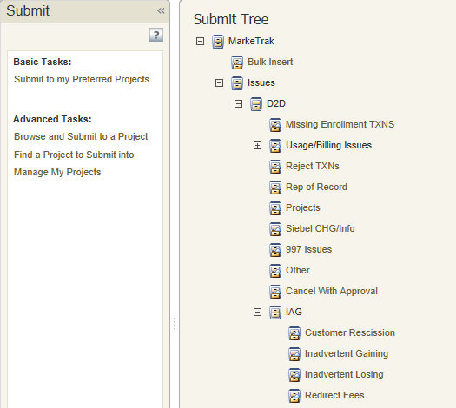
Inadvertent Gain
Submitting an Inadvertent Gain – CR Submits as the Gaining CR
From the Submit Tree, select IAG – Inadvertent Gaining

Slide 163
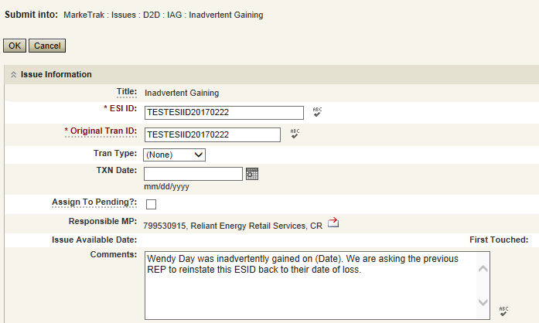
Inadvertent Gain
CR1 (Gaining/Original CR) will enter all required information.
  ESIID
  Original Tran ID – The original tran id of the other CR’s enrollment. (BGN06 of the 814_06).
  CRITICAL: The Comments field is technically optional; however, not providing the required information referenced in RMG Section 7.3.2(1) could result in a delay of issue resolution.
  Please include any additional information in this box.
        Customer Name (Always)
        Meter Number (If available)
        Any other pertinent information that will help expedite resolution

Slide 164
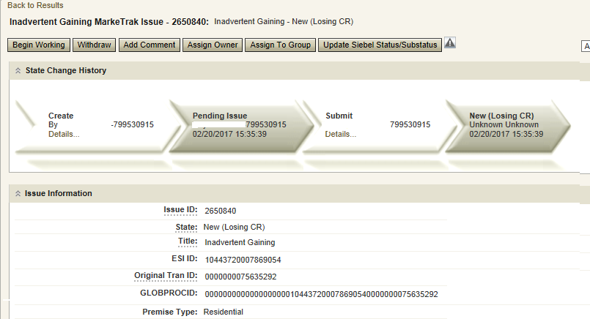
Inadvertent Gain
Select OK to create the IAG – Inadvertent Gaining MarkeTrak Issue. The issue enters the state of New (ERCOT) and is visible only by the Submitting CR and ERCOT.
The Submitting CR has the option to Withdraw the issue at this point
ERCOT will select Begin Working to provide the Gaining CR Start Date, if the Gaining CR is still the rep of record (Gaining CR ROR), assign CR2 (Gaining CR) and TDSP. ERCOT will then select “OK” to move the issue to CR2 (Gaining CR).

Slide 165
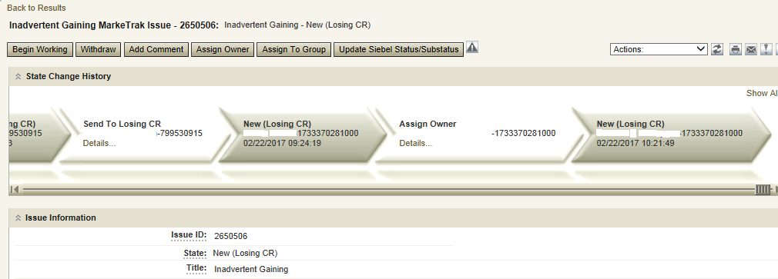
Inadvertent Gain
CR2 (Losing CR) will select Begin Working and Issue details and Investigate Market Conditions to determine the appropriate regain date.
CR2 (Losing CR) will select Begin Working and Issue details and Investigate Market Conditions to determine the appropriate regain date.

Slide 166
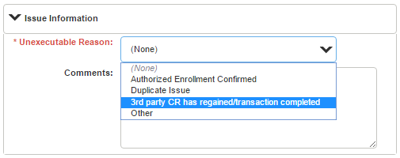
Inadvertent Gain
If CR2 (Losing/Original CR) determines that an Inadvertent Gain has NOT taken place, they have the option to select “Unexecutable” to stop the Inadvertent Gain process as outlined in Section 7.3.2.4 of the Retail Market Guide.
7.3.2.4 Valid Reject/Unexecutable Reasons
The Losing CR may reject the return of an inadvertently gained ESI ID from the Gaining CR for one of the following reasons only:
  A new transaction has completed in the market, including, but not limited to the following transactions:
    The 814_16, Move In Request; or
    The 814_01, Switch Request.
    Use “3rd Party CR has regained/transaction completed”

Slide 167
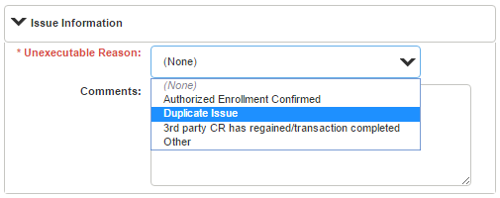
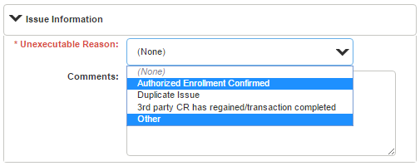
Inadvertent Gain
7.3.2.4 Valid Reject/Unexecutable Reasons
The Losing CR may reject the return of an inadvertently gained ESI ID from the Gaining CR for one of the following reasons only:
Duplicate Inadvertent Gaining issue in MarkeTrak for the same Customer on the same ESI ID.
Use “Duplicate Issue”
NOTE:
“Authorized Enrollment Confirmed”
and “Other” should not be used

Slide 168

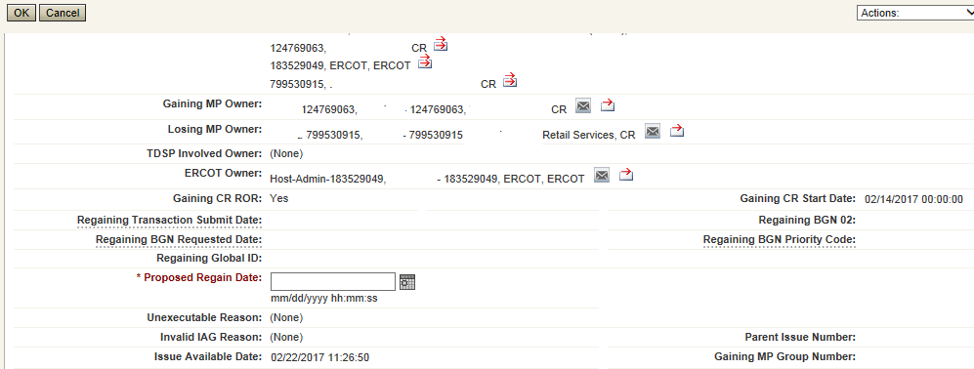
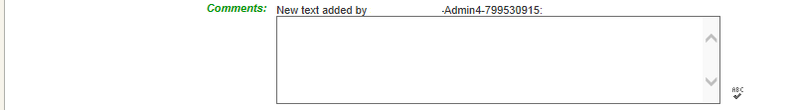
Inadvertent Gain
If CR2 (Losing/Original CR) determines they will need more information from CR1 (Gaining CR), then they will need to select Send to Gaining CR. This transition allows both CR’s to talk back and forth while transitioning the issue back and forth before a resolution is made.
If CR2 (Losing/Original CR) determines that an Inadvertent Gain has taken place, they will select Send to TDSP, enter the proposed regain date, add comments and select “OK” to move the issue to the TDSP. A validation will occur on the Proposed Regain Date: Validate that the date is less than “Submit Date” + 10 days. If not the following error message will be displayed “Proposed Regain Date is greater than 10 Calendar days from the submittal of MarkeTrak Issue, please update with valid Proposed Regain date.”

Slide 169
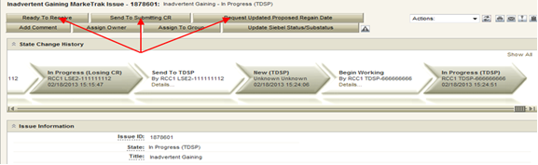
Inadvertent Gain
The TDSP will select Begin Working, investigate the issue details, then select one of the following:
Ready to Receive – The TDSP would select this transition to send the issue back to CR1 (Losing/Original CR). It is extremely important that CR1 (Losing/Original CR) wait for the TDSP to select Ready to Receive indicating TDSP’s systems have been prepared to receive the Original MP’s transaction before the EDI is actually sent. If not, the EDI will be rejected at the TDSP.
Send To Submitting CR – The TDSP would select this transition if they needed further information from CR1 (Losing/Original CR).
Request Updated Proposed Regain Date – The TDSP would select this transition if they do not agree with the proposed regain date that was provided. They would suggest a new date and send the issue back to CR1 (Losing/Original CR).

Slide 170

Inadvertent Gain
CR2 (Losing/Original CR) will select Begin Working then select Provide Regaining BGN 02. CR2 (Losing/Original CR) will provide the Regaining BGN02 and then select “OK”. When the regaining transactions process into ERCOT’s registration system, the Regaining Transaction Submit Date, Regaining BGN Requested Date and Regaining BGN Priority Code will be auto-populated on the MarkeTrak issue.
All parties should continue to monitor MIS and internal systems for the successful delivery and completion of the EDI transaction being sent by CR1 (Losing/Original CR) to the Market to regain a premise and resolve the associated Inadvertent Gain MarkeTrak issue.
Once the regaining transaction has been successfully sent to the Market by CR2 (Losing/Original CR), Siebel will update the status automatically.

Slide 171
Key Points to Remember
Provide as much information when opening Inadvertent Gain/Loss MarkeTrak in order to help facilitate quick resolution to the issue.
Suggested Information includes:
Customer Name (Always)
Meter Number (If available)
Any other pertinent information you may have that is crucial to help resolve issue.
Regain date should be:
Date of Loss (DOL) + 1
Date of Loss (DOL) less than or equal to 10 days from date MT was submitted when gaining on a prospective basis.

Slide 172
Valid Reject / Unexecutable Reasons
7.3.2.4 Valid Reject / Unexecutable Reasons
The Losing CR may reject the return of an inadvertently gained ESI ID from the Gaining CR for one of the following reasons only:
  A new transaction has completed in the market, including, but not limited to the following transactions:
The 814_16, Move In Request; or
The 814_01, Switch Request.
Duplicate Inadvertent Gaining issue in MarkeTrak for the same Customer on the same ESI ID.

Slide 173
Valid Reject / Unexecutable Reasons
7.3.2.4 Valid Reject / Unexecutable Reasons (Con’t)
The Gaining CR may reject returning an inadvertently gained ESI ID to the Losing CR for one of the following reasons only:
A new transaction has completed in the market, including, but not limited to the following transactions:
The 814_16 transaction; or
The 814_01 transaction.
Duplicate Inadvertent Losing issue in MarkeTrak for the same Customer on the same ESI ID;
Gaining CR has confirmed with the Customer that the Customer’s CR of choice is the Gaining CR:
Gaining CR has a valid enrollment with the same Customer and provides the Customer name, service address and meter number (if available) in the comments section of the MarkeTrak issue.
Customer has successfully completed an enrollment regarding the same ESI ID and the Gaining CR has the most recent effective date; or
In cases of Customer rescission, Inadvertent Losing MarkeTrak issue is rejected/unexecuted and a Rescission MarkeTrak issue is created

Slide 174
Key Points to Remember: Invalid Reject Reasons
7.3.2.5 Invalid Reject / Unexecutable Reasons
The Losing CR shall not reject the return of an inadvertently gained ESI ID due to:
Inability to contact the Customer;
Past due balances or credit history;
Customer no longer occupies the Premise in question;
Contract expiration or termination;
Pending TX SETs; or
Losing CR serving the Premise under a Continuous Service Agreement (CSA).

Slide 175
Checkpoint Question #1
If a Losing CR receives an IAG MT and their customer does not occupy the premise, the Losing CR should Unexecute the IAG.
  True
  False
ANSWER
FALSE – this is not a valid reject reason, the Losing CR should regain the ESI ID and execute the Current Occupant process

Slide 176
Checkpoint Question #2
If a Losing CR has agreed to regain an ESI ID yet their customer at the time of the IAG no longer occupies the premise, the Losing CR may propose the following regain date:
  DOL + 1
  Date of MT submittal + 10
  Either
ANSWER
Either is applicable and is dependent upon the Losing CR’s business practices

Slide 177
Checkpoint Question #3
A back dated MVI (BDMVI) for an IAG must be submitted within _____ days.
  2 days of “ready to receive” status
  Date of MT submittal + 10
  12 days of MT submittal
  21 days
ANSWER
Per the RMG 7.3.2.3.1 Reinstatement Date, the Losing REP shall submit the BDMVI no later than 12 days after submittal of the MarkeTrak.

Slide 178
Checkpoint Question #4
A customer enrolled for service at the wrong apartment number. Their REP of choice should issue a MVO on the incorrect address and issue a MVI on the correct address.
  True
  False
ANSWER
Generally speaking, FALSE, issuing a MVO on an active ESI will create a lights out situation at the incorrect address. An Inadvertent Gain MT should be submitted to resolve the incorrect address.

Slide 179
Questions

Slide 180
Common IAG Issues,
Best Practices, & Quick Tips

Slide 181
MVO vs IAG
Issue:
MVO’s are incorrectly being submitted for IAG situations
Solution:
CR’s SHOULD NOT issue MVOs for ESI IDs when IAG situations occur and/or while the MarkeTrak IAG/IAL process is in progress.
Best Practices:
Ask probing questions to ensure proper customer action is taken. (i.e. “Do you currently live here?”; “Was the original address given incorrect?”

Slide 182
3rd Party Transactions
Issue:
3rd party transaction has occurred, nullifying the IAG MarkeTrak therefore causing the Gaining CR to be left with charges they may not be able to recover.
Solution:
Utilize the applicable market approved process to regain a lost ESI ID via MarkeTrak. Educate the customer as to what the process entails and set proper expectations with the customer.
Best Practices:
Identify IAGs in progress for ESI IDs by:
Identifying IAGs on daily basis utilizing ERCOT MarkeTrak reporting or notification
Flagging within your own system the ESI IDs that have been IAG/IAL to ensure subsequent transactions are not submitted to the market until the IAG is completed.
Timely resolution of IAG/IAL MarkeTraks

Slide 183
Non-timely resolution of IAG’s
Issue:
MTs and/or Escalated MTs are not receiving responses or being completed in a timely manner
Solution:
Market participants should update their “rolodex” with the appropriate escalation contacts
Best Practices:
Designate one of the escalation contacts as a departmental mailbox instead of an individual
Audit the Rolodex list on Quarterly basis
Expected level of performance:
    After 3 calendar days if a MarkeTrak issue remains in “New Status” an automatic escalation email is generated.
    Initial Response – 10 calendar days
    Updating the issue thereafter – 7 calendar days
    Per 7.3.2.3.1 “Reinstatement Date” - The Backdate MVI must be sent No later than 12 days after the submittal of the Inadvertent MarkeTrak

Slide 184
No Current Occupant
Issue:
Losing REP responds to an IAG indicating “their customer no longer occupies the premise” and attempts to ‘unexecute’ the IAG MT issue.
Solution:
“Customer no longer occupies the Premise” is NOT a valid reason for unexecuting MT (RMG 7.3.2.5 Invalid Reject/Unexecutable Reasons)
Best Practice:
Losing REP must regain ESI ID and initiate a “current occupant” process
  Reference: PUCT Subst. R. 25.489(i)

Slide 185
Switch Hold on IAG
Issue:
A switch hold is active on account which has been identified as having an IAG
Solution:
When IAG is submitted and accepted, the switch hold should be removed in order prevent BDMVI from being rejected and any delay in completing the MarkeTrak
Best Practice:
When working IAL/IAG issues identify if your ESI ID currently has a Switch Hold active and remove as needed

Slide 186
Questions

Slide 187
Verification & Reconciliation Process

Slide 188
Verification & Reconciliation
All parties involved in any Inadvertent Gain related MarkeTrak issue should perform some sort of Verification and Reconciliation process.

Slide 189
Verification & Reconciliation
In other words …
In addition to verifying that an Inadvertent Gain has actually taken place, also verify the state/status of the MT issue to determine what action needs to take place from either party.
Verify the current status of the account to determine if there are any transactions that may impact the resolution of the issue.
Perform a reconciliation of the transactions sent to the Market to ensure that the transactions are being sent, received and processed successfully as agreed upon by all parties.
Ultimate goal is to return the Customer to their REP of choice quickly and efficiently with minimal inconvenience to the Customer.

Slide 190
CR Verification & Reconciliation
All parties have a role in researching IAGs on their end, however for the Losing CR/Original, the following verification process can assist in making the resolution of an Inadvertent Gain MarkeTrak run smoothly when the following checks are performed:
Any Subsequent transactions in the Market?
  Yes – STOP the transaction if possible by submitting an 814_08, Cancel Request (or “Cancel w/Approval” MarkeTrak).
  No – Proceed to the next step
Any Holds?
  Yes – Submit 650_01 to remove any Holds
  No – Proceed to the next step
Proposed Regain Date =< Gaining CR Start Date?
(Proposed Regain Date: no greater than 10 days from MT submittal date)
  Yes – Update “Proposed Regain Date”
  No – Proceed by “Send to TDSP”

Slide 191
TDSP Verification & Reconciliation
When received by the TDSP, the issue goes through a verification process similar to the CR process. Once those preliminary checks are made, the TDSP will go on to perform the following steps:
Check for Permit Requirements and override if any exist
Add ESI ID, Original CR and Proposed Regain Date to the TDSP system to allow a backdated MVI and verify loaded correctly
Update MarkeTrak issues with comments indicating readiness
Press the “Ready to Receive” button which will move the issue to a state of New Losing CR (Submit)
Review the Critical Care status of the account

Slide 192
CR Verification & Reconciliation
Once the TDSP completes their portion of the research, the issue is sent back to the Losing CR/Original who will send an EDI transaction (Backdated MVI) and thus more verification will need to take place:
Ensure that the MarkeTrak issue is in a State of “New (Losing CR Submit)”
Any Subsequent transactions in the Market?
  Yes – Cancel W/Approval if possible
  No – Proceed
Send EDI for the Proposed Regain Date that the Original CR entered within the issue
Verify the EDI was processed successfully by consulting the ERCOT Market Information System (MIS) as well as any internal systems used for verifying transactions.

Slide 193
Final CR Verification & Reconciliation
The backdated MVI can be verified as successful per the receipt of an 814_05 Accept
Add the Regaining BGN information into the MarkeTrak issue only after verifying that it was successfully received
DO NOT click the “Send to TDSP” transition as this will prevent the issue from Auto-completion

Slide 194
Checkpoint Question #1
Once an IAG situation has been discovered it is the responsibility of both the Gaining and Losing CR to verify if there are any new MVI/Switch or MVO transactions pending for the impacted ESI ID.
  True
  False
ANSWER
TRUE – Any completed MVI/Switch or MVO transactions received after the initial transaction that caused the IAG will render the IAG regain process invalid.
Note - If the new transaction is still pending and was sent by either the Gaining or Losing CR, every effort should be made to cancel the transaction before it completes.

Slide 195
Checkpoint Question #2
Although the RMG officially states a back dated MVI (BDMVI) for an IAG must be submitted within 12 days of MT creation, in order to lessen the possibility of a new transaction being sent to the market, what is considered the best practice for Losing CR’s to submit their BDMVI?
  As soon as the TDSP updates the MarkeTrak giving the Losing CR the ok to send the BDMI
  Whenever it becomes convenient to do so
  12 days of MT submittal as the RMG states
ANSWER
a) The best practice is for Losing CR’ to send their BDMVI’s as soon as the TDSP gives the ok to send the BDMI. With each passing day there is an increased risk of new transactions being sent on the impacted ESI ID.

Slide 196
Checkpoint Question #3
If either the Losing CR or the Gaining CR discovers they are unable to communicate with the other party to move the IAG regaining process forward, what resource is available to both CR’s to re-engage communication with the other CR?
  Contacting ERCOT to intervene
  Contacting the TDSP to intervene
  Using the MarkeTrak Rolodex tool to identify escalation contacts within the non communicating CR’s organization
ANSWER
c) Using the MarkeTrak Rolodex tool to identify and reach out to escalation contacts within the non communicating CR’s organization.

Slide 197
IAG / IAL Reporting

Slide 198
Monthly IAG/IAL Reporting
What information is reported?
Monthly IAG/IAL Statistics
Top 10 Monthly – IAG/IAL
Top 10 – 12 Month Average IAG/IAL
  % of the aggregated totals for the last 12 months
Explanation of the IAG/IAL Stats
Top REPs – 12 Month Average Rescission
% of the aggregated totals for the last 12 months
Explanation of Rescission Stats
18 Month Running Market Totals

Slide 199
August 2017 – IAG / IAL Statistics
Total IAG+IAL % of Total Enrollments: 0.96%
IAG/IAL % Greater Than 1% of Enrollments
Total IAG+IAL Count: 1,648
IAG/IAL % Less Than 1% of Enrollments
Total IAG+IAL Count: 1,647
Retail Electric Provider Counts
 | Percent of Enrollments Resulting in IAG/IAL
Enrollment Total | .00% to .25% | .26% to .50% | .51% to .75% | .76% to 1.00%
<= 500 | 0 | 2 | 9 | 5
> 500 and <= 2500 | 3 | 4 | 2 | 6
> 2500 | 0 | 2 | 3 | 8
The above chart shows a count of REPs whose IAG/IAL percentage of their total enrollments is below 1%.
    Blue row shows counts of REPs that have less than 500 total enrollments by their % ranges
    Orange row shows counts of REPs that have between 500 and 2500 total enrollments by their % ranges
    Purple row shows counts of REPs that have greater than 2500 total enrollments by their % ranges

Slide 200
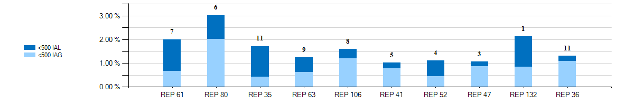
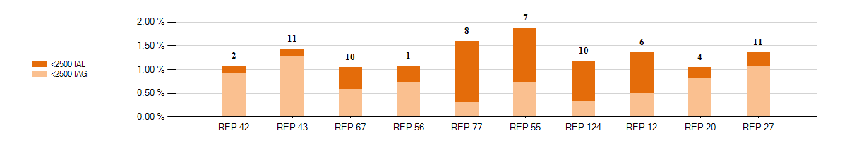
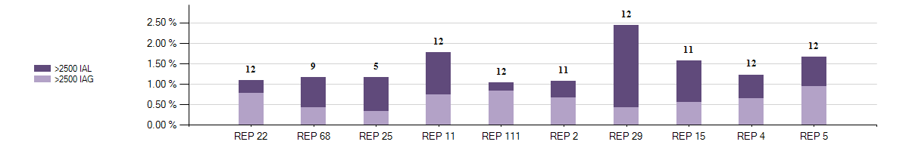
2017 August – IAG / IAL Statistics
Top 10 - August 2017 – IAG / IAL % Greater Than 1% of Enrollments With Number of Months Greater Than 1%

Slide 201



2017 August – IAG / IAL Statistics
Top 10 - 12 Month Average IAG / IAL % Greater Than 1% of Enrollments thru August 2017 With Number of Months Greater Than 1%

Slide 202
Explanation of IAG / IAL Slides Data
Slide 88 charts show the top 10 REPs whose IAG/IAL percentage of their total enrollments is above 1%.
  The blue chart shows enrollment totals of less than 500 for the month being reported
  The orange chart shows enrollment totals between 500 and 2500 for the month being reported
  The purple charts show enrollment totals of over 2500 for the month being reported
  REPs with the lowest AG/IAL totals start on the left, and move to the highest counts on the right
Slide 89 charts show the top 10 REPs whose 12 month average IAG/IAL percentage of their total enrollments is above 1%.
  The blue chart shows enrollment total averages of less than 500 for the month being reported
  The orange chart shows enrollment total averages between 500 and 2500 for the month being reported
  The purple charts show enrollment total averages of over 2500 for the month being reported
  REPs with the lowest IAG/IAL averages start on the left, and move to the highest counts on the right
  Number labels represent the number of months the REP has been over 1% during the 12 month period

Slide 203

2017 August – Rescission Statistics
Top - 12 Month Average Rescission % Greater Than 1% of Switches thru August 2017 With number of months Greater Than 1%

Slide 204
Explanation of Rescission Slide Data
NOTE:
A 10% chart range limit has been set. REPs data points that exceed 10% will be bordered in yellow. Please see the spreadsheet for actual percentages of these REPs.
Slide 91 charts show the top REPs whose 12 month average Rescission percentage of their total Switches is above 1%.
  The blue shades show switch totals of less than 250 for the month being reported
  The orange shades show switch totals between 250 and 1750 for the month being reported
  The purple shades show switch totals of over 1750 for the month being reported
  The REPs with the lowest count of rescission totals start on the left, and move to the highest counts on the right
  Number labels represent the number of months the REP has been over 1% during the 12 month period

Slide 205
18 Month Running Market Totals
 | Enrollments |  |  | IAG, IAL, Rescission |  |  |  |  | Days to Resolution
Month | SWI | MVI | Total | IAG | IAL | Rescission | IAG,IAL,Res Total | Overall % | IAG | IAL | Rescission
2016-03 | 76,235 | 218,245 | 294,480 | 1,784 | 1,613 | 839 | 4,236 | 1.44% | 8 | 10 | 7
2016-04 | 70,300 | 199,804 | 270,104 | 1,786 | 1,457 | 855 | 4,098 | 1.52% | 8 | 9 | 6
2016-05 | 75,323 | 214,383 | 289,706 | 1,846 | 1,467 | 912 | 4,225 | 1.46% | 8 | 11 | 6
2016-06 | 86,376 | 247,481 | 333,857 | 2,335 | 1,662 | 1,026 | 5,023 | 1.50% | 9 | 11 | 6
2016-07 | 82,923 | 241,844 | 324,767 | 2,153 | 1,323 | 904 | 4,380 | 1.35% | 8 | 11 | 6
2016-08 | 86,656 | 268,781 | 355,437 | 2,188 | 1,389 | 819 | 4,396 | 1.24% | 8 | 12 | 7
2016-09 | 67,323 | 231,999 | 299,322 | 1,856 | 1,229 | 731 | 3,816 | 1.27% | 8 | 12 | 7
2016-10 | 64,452 | 220,958 | 285,410 | 1,836 | 1,160 | 726 | 3,722 | 1.30% | 9 | 12 | 7
2016-11 | 56,202 | 201,714 | 257,916 | 1,974 | 1,147 | 728 | 3,849 | 1.49% | 10 | 13 | 8
2016-12 | 66,556 | 196,236 | 262,792 | 1,884 | 1,211 | 767 | 3,862 | 1.47% | 11 | 14 | 13
2017-01 | 87,140 | 202,612 | 289,752 | 1,928 | 1,350 | 1,094 | 4,372 | 1.51% | 9 | 13 | 11
2017-02 | 66,875 | 201,984 | 268,859 | 1,613 | 1,328 | 884 | 3,825 | 1.42% | 10 | 13 | 9
2017-03 | 71,809 | 229,868 | 301,677 | 1,950 | 1,476 | 728 | 4,154 | 1.38% | 10 | 12 | 9
2017-04 | 71,769 | 197,865 | 269,634 | 1,631 | 1,485 | 731 | 3,847 | 1.43% | 10 | 13 | 8
2017-05 | 130,828 | 237,611 | 368,439 | 2,153 | 1,580 | 815 | 4,548 | 1.23% | 10 | 14 | 11
2017-06 | 108,784 | 257,759 | 366,543 | 2,036 | 1,706 | 772 | 4,514 | 1.23% | 11 | 15 | 10
2017-07 | 84,059 | 252,360 | 336,419 | 1,930 | 1,387 | 639 | 3,956 | 1.18% | 10 | 14 | 9
2017-08 | 84,134 | 258,046 | 342,180 | 1,865 | 1,430 | 663 | 3,958 | 1.16% | 12 | 15 | 10

Slide 206
How can we drive efficiency? Reporting
Reporting to measure success … New format!!
Impact by REP
% of IAG/IALs to total enrollments by REP
Each REP is assigned a REP # - this # won’t change
Enrollments are MVIs+SWIs for IAG/IALs
For Rescissions, enrollments are SWIs only
IAG/IAL totals & % are calculated using the counts of the acknowledged Inadvertent Gaining REP only for both IAG & IAL issues.
If the Gaining REP in a submitted IAL issue does not agree they are the Gaining REP, that issue will not be counted
The Losing REP is not represented in any of the totals or % in any data
Two month lag in reporting to allow for IAG/IALs to be tied to enrollment transaction
MVI sent in November that resulted in an IAG MT submitted in December, will be reported on the % IAG/IAL total for November

Slide 207

Market Challenge
CHALLENGE:
Reduce issue count by 10% !!
Drive % of enrollment volume to below 1.5% !!

Slide 208


Market Challenge
Together we can make it a …

Slide 209
Checkpoint Question #1
An Inadvertent Loss MT submitted by the Losing REP will count toward which REP’s % total?
  The Losing REP
  The Gaining REP
ANSWER
The Gaining REP – valid IAG & IAL MTs will only count toward the Gaining REP’s total

Slide 210
Checkpoint Question #2
The assigned REP’s # on the IAG report will change each month.
  True
  False
ANSWER
FALSE – Assigned REP #s will remain consistent for the market reporting

Slide 211
Checkpoint Question #3
Driving down the number IAGs / IALs / Rescissions in the market will result in which of the following:
  Fewer customer complaints
  Improved customer experience
  Addressing customer issues faster
  Fewer back-off resources
  All of the above
ANSWER
All of the above – If all REPs work to drive efficiencies in their processes, the market will benefit

Slide 212
Questions

Slide 213
MarkeTrak Training
GUI and Background Reporting

Slide 214

MarkeTrak GUI Reporting
MarkeTrak contains a vast amount of reporting options. Report types include Distribution, Trend, Duration, Change History, Multi-View, Summary and most commonly Listing Reports. A thorough explanation of each of these report types is available via the Help option.
To access help information regarding reporting in MarkeTrak:
  Select the Help link from the toolbar
  Click in the Search text box in the upper right corner of the screen
  In the text box type Creating Report
  Select the Title hyperlink for the report you want to create

Slide 215


MarkeTrak GUI Reporting
Creating a Report
  Users can create and save ad hoc reports through the Create a Report option accessed from the Reports tab.
The screen below will appear after selection of Create a Report, Type: Listing as indicated above. Select Columns to Display: is a complete population of fields available to the user based on privileges and functions like the ‘Select’ statement of an SQL statement. Multiple fields can be selected to return in the result set and moved into the request via the left and right arrows.

Slide 216

MarkeTrak GUI Reporting
Sample Report: ‘Issues Over 5 Days Not Touched’
  Select Columns to Display:
Select Filter Criteria:

Slide 217


MarkeTrak GUI Reporting
Sample Report – ‘Issues Over 5 Days Not Touched’
  Filter Criteria Cont.:

Slide 218
MarkeTrak GUI Reporting
Sample Report – ‘Issues Over 5 Days Not Touched’
  Additional Options: Calculated Field

Slide 219

MarkeTrak GUI Reporting
Sample Report – ‘Issues Over 5 Days Not Touched’
  Results:

Slide 220

MarkeTrak GUI Reporting
Sample Report – Multi-View
  From the Reports pane select ‘Other Reports’ from the Type drop down field

Slide 221

MarkeTrak GUI Reporting
Sample Report – Multi-View
  Select ‘Multi-View’ from the Type drop down field

Slide 222

MarkeTrak GUI Reporting
Sample Report – Multi-View
  Browse for and select the reports to be displayed in your multi-view report in the search box next to Select Reports. Up to four reports can be selected. Click the Add button to select each report.

Slide 223

MarkeTrak GUI Reporting
Sample Report – Multi-View
  Use the up or down arrows to select the layout of your multi-view report. Up to four reports can be displayed.
  Select the Preview button at the top of the GUI screen to view the report.

Slide 224

MarkeTrak GUI Reporting
Sample Report – Multi-View
  View Results
  To save the report, select the Save button and name your new multi-view report.

Slide 225
MarkeTrak Background Reporting
MarkeTrak Background Reports provide the following functionality:
  Allow users to run a report and work in the GUI at the same time
  Allow users to search multiple inputs, for example:
    Multiple Issue IDs
    Multiple ESI IDs
  Allow users to access archived information that is not available in GUI reports
  API users have the ability to execute and retrieve background reports

Slide 226
MarkeTrak Background Reporting
Available Background Reports
Report Name | Report Description
Average Days Open | Report to Provide average days open by subtype for the time frame specified.
Count of Active and Inactive Issues | Report to provide a count of Active and Inactive issues for the time frame specified.
Count of Issues Resolved Outside Benchmark | Returns a count of issues closed outside of the specified benchmark number of days for a particular time frame.
Count of Issues Resolved Within Benchmark | Returns a count of issues resolved within the specified benchmark number of days for a particular time frame.
Count of Issues in State | Report to provide the total number of issues in each state for the selected subtype(s) for the time frame specified.
Count of Issues by Sub-Type by Submit MP DUNS | Report to provide the count of issues by sub-type for a given submitting MP DUNS for the sub-type(s) selected.
Count of Issues by Submitting MP DUNS | Report to provide the total number of issues identifying the submitting MP type of CR or TDSP.
Count of Issues by Sub-Type | Report to provide the total number of issues submitted for the selected sub-type(s).

Slide 227
MarkeTrak Background Reporting
Available Background Reports
Report Name | Report Description
Details for Issues Resolved Outside of Benchmark | Returns details for issues closed outside of the selected benchmark number of days within the time frame specified.
Issue Details by ESIID | Issue Details for a select group of ESIIDs for the subtype(s) selected.
Issue Details by Issue ID | Issue Details for a select group of Issue IDs for the subtype(s) selected.
Time in State | Report to provide the days an issue spent in each distinct state both the first time it moves into the state as well as the last time if applicable.
Total No. Closed | Report to provide a count by subtype of all issues closed within the specified time frame.
Issues Open Outside Benchmark | Report to Provide the active issues that have been open outside of the selected benchmark number of days.
Issue Transition Details | Report to Provide by subtype the issue transition details. This report will also help with tracking the transition details for the Meter Tampering Switch Hold Issues.

Slide 228
ERCOT Live Demo

Slide 229
MarkeTrak Training

