Slide 1
Appendix

Slide 2
Checkpoint Answers
Slide | Answer
64 | b) Usage & Billing – Dispute
65 | False
66 | False
120 | False - Confirmation of the customers intent to change REPs is not a valid Reject / Unexecuteable reason.
139 | False - Only a gaining REP can claim customer rescission.
172 | c) Missing Enrollment Transaction
173 | b) Siebel Change
174 | False
175 | False
200 | False - Invalid submission via the +/- (2 calendar day) window.
201 | e) All of the Above

Slide 3
Admin Functionality
Add User
Update User
Delete User
Admin Reporting

Slide 4
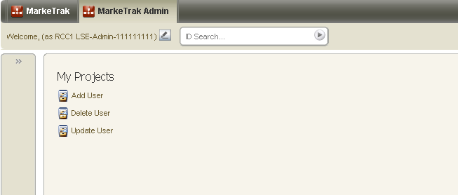
Admin Functionality: Add User
‘Add User’ is located on the Submit Tree under a ‘MarkeTrak Admin’ tab for Administrator use only.

Slide 5
Admin Functionality: Add User
Submit Transition Fields:
  Employee ID: Required
  First Name: Required
  Middle Name/Initial: Optional
  Last Name: Required
  Email Address: Required
  Phone Number: Required
Validations Performed on Submit Transition:
  Email Address is formatted correctly
  Phone number has 10 digits
  Employee ID is alpha-numeric
  Employee ID is not a duplicate

Slide 6
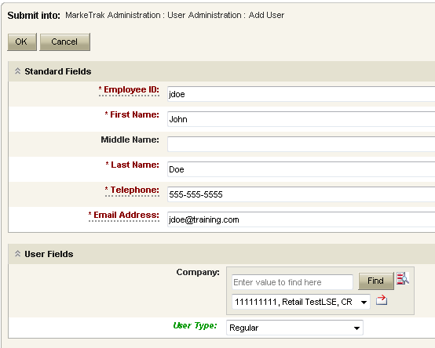
Admin Functionality: Add User
Employee ID: Enter the Employee ID from the digital certificate. There is no need to precede the Employee ID with duns$. MarkeTrak automatically adds duns$ to the Employee ID.
Enter remaining information making sure telephone number is 10 digits and Email address is formatted correctly.
Your Company duns will be defaulted in the Company field.
User Type: User type will typically be either Regular or MP Admin User.
Select OK to continue.

Slide 7
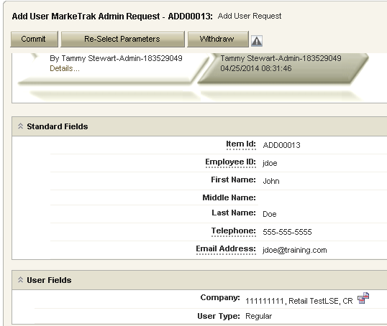
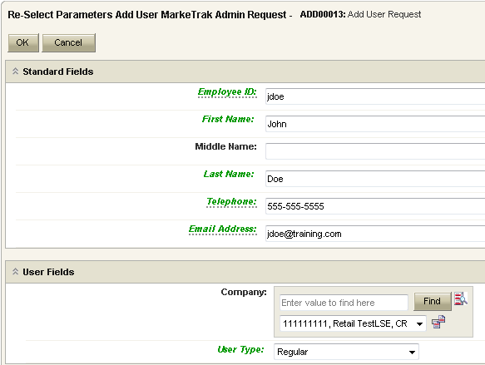
Admin Functionality: Add User
Add User issue is created
The Contact Record and Company Association have been created.
Review the information and if edits are needed, select the ‘Re-Select Parameters’ button. Or the user can select Withdraw to cancel the Add User process.
Edit the information and select ‘OK’.

Slide 8
Admin Functionality: Add User
Select the ‘Commit’ transition to complete the Add User request.

Slide 9
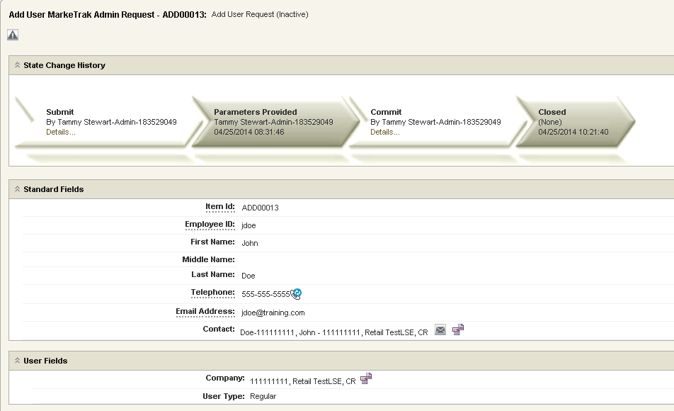
Admin Functionality: Add User
Add User request is complete and the issue auto closes.

Slide 10
Admin Functionality: Update User
‘Update User’ is located on the Submit Tree under the ‘MarkeTrak Admin’ tab for Administrator use only.

Slide 11
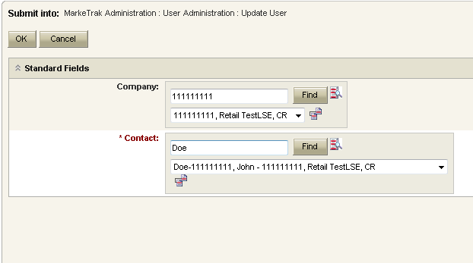
Admin Functionality: Update User
Company: Your Duns number will be defaulted in this field.
Contact: Enter the user name to be updated or select Find and review the list of users in your company.
Select OK

Slide 12
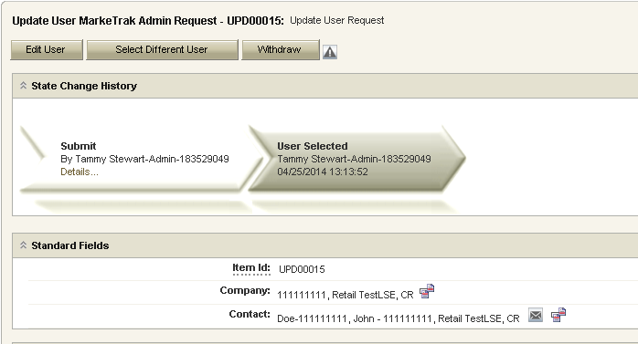
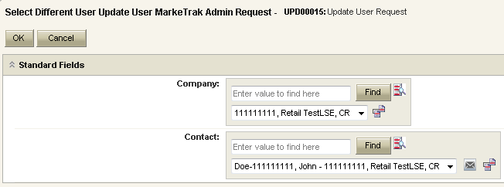
Admin Functionality: Update User
Edit User issue is created
From this screen, the MP Admin would either select ‘Edit’ to make changes to the selected user or choose ‘Select Different User’ if the current user selected is incorrect

Slide 13
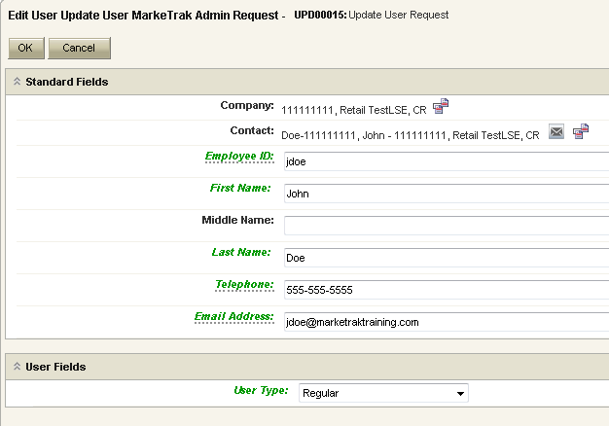
Admin Functionality: Update User
The fields appearing in green can be edited. For this example, the email address was modified.
Select OK
“Now I’m jdoe@marketraktraining.com!”

Slide 14
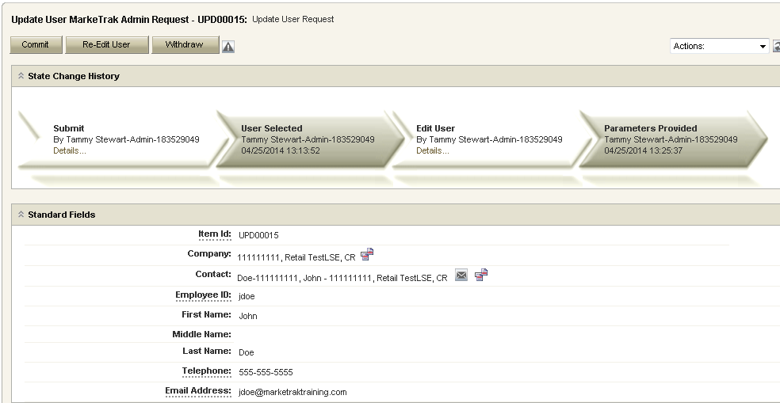
Admin Functionality: Update User
To complete the Update User request, select ‘Commit’. The MP Admin can also ‘Re-Edit User’ or ‘Withdraw’ the issue.

Slide 15
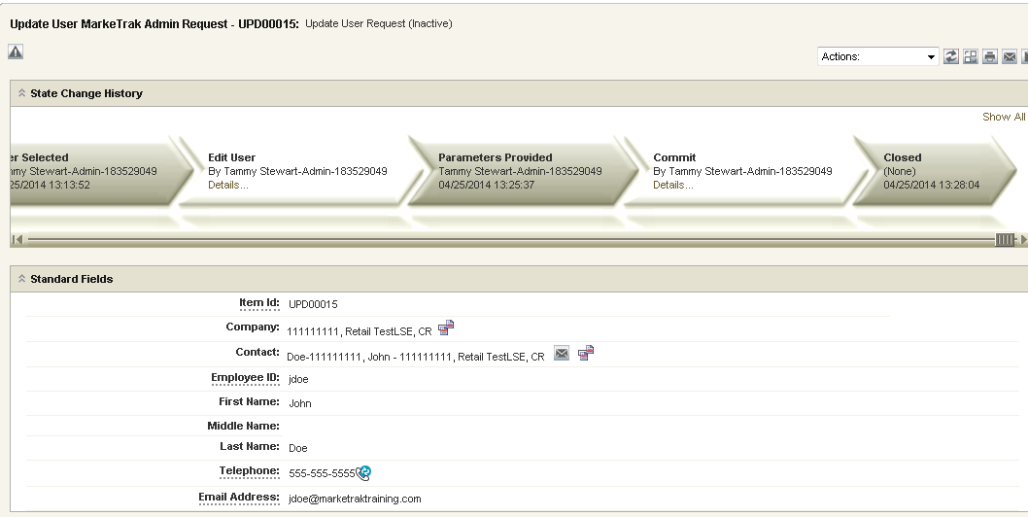
Admin Functionality: Update User
Update User is complete and the issue auto closes.

Slide 16
Admin Functionality: Delete User
‘Delete User’ link is available on the Submit Tree under a ‘MarkeTrak Admin’ tab for Administrator use only.

Slide 17
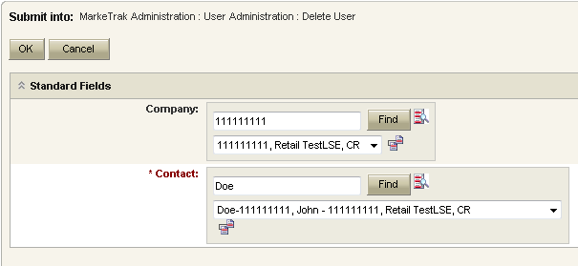
Admin Functionality: Delete User
Company – Your Duns number will be defaulted in this field.
Contact – Enter the user name to be deleted or select Find and review the list of users in your company.
Select OK

Slide 18
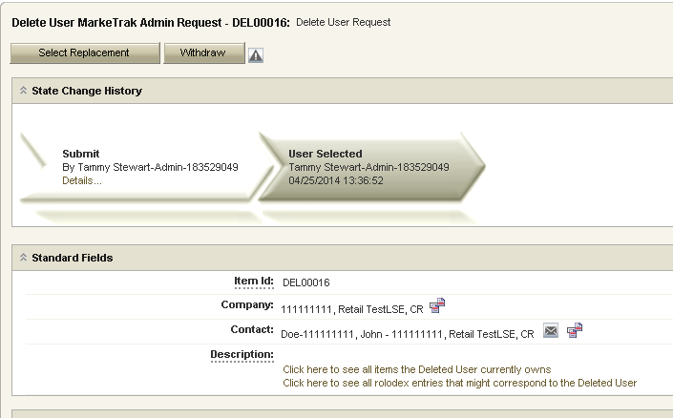
Admin Functionality: Delete User
This workflow allows the MP Admin to view all items owned by the user being deleted. It also provides a means to identify all rolodex entries corresponding to the deleted user. To view issues and rolodex contacts, select the links under Description.

Slide 19
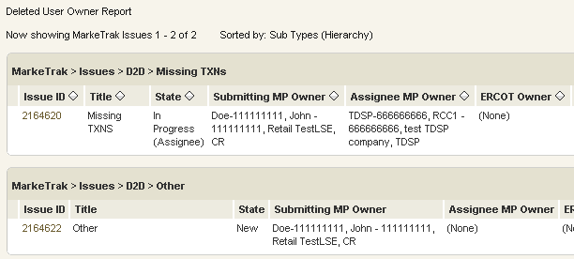
Admin Functionality: Delete User Owner Report

Slide 20
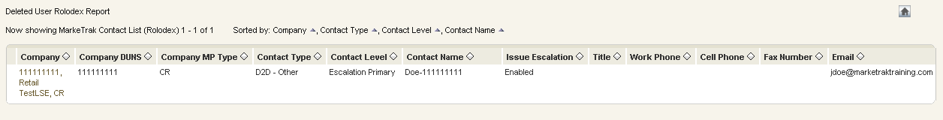
Admin Functionality: Delete User Rolodex Report

Slide 21
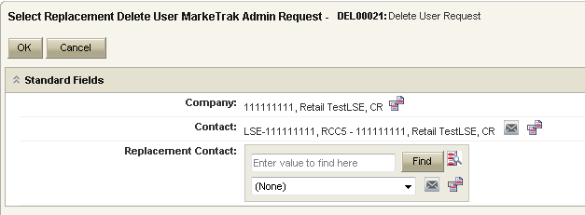
Admin Functionality: Delete User
Delete User issue is created
This workflow allows the MP Admin to select a replacement for the user being deleted. If there is no replacement, the value should remain (None).
Enter either a replacement user or leave (None) and select ‘OK’.

Slide 22
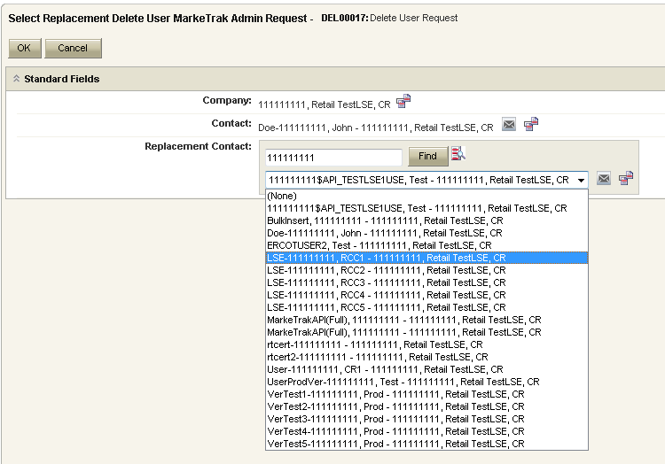
Admin Functionality: Delete User
To choose a replacement user, select the Find button and choose a user from the list.
Select ‘OK’.

Slide 23
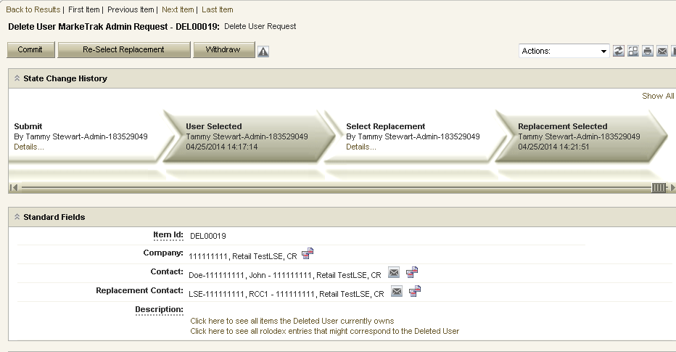
Admin Functionality: Delete User
To complete the replacement selection, click the ‘Commit’ button. The MP Admin also has an option to select another replacement if necessary by selecting the ‘Re-Select Replacement’ button.

Slide 24
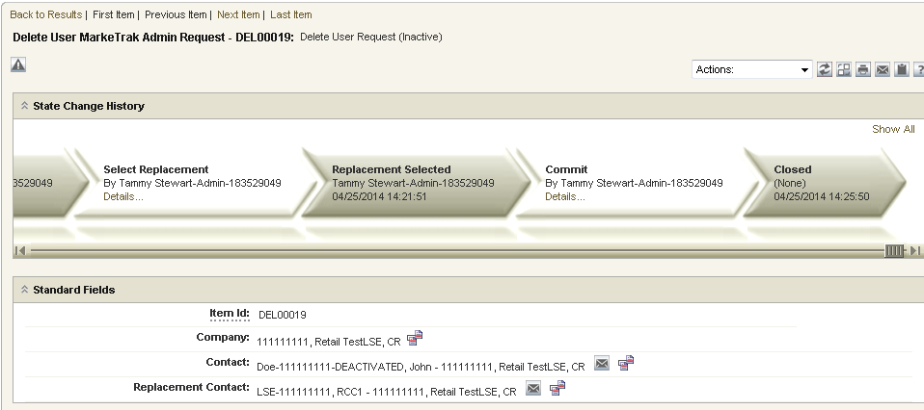
Admin Functionality: Delete User
Delete User request is complete and the issue auto closes.

Slide 25
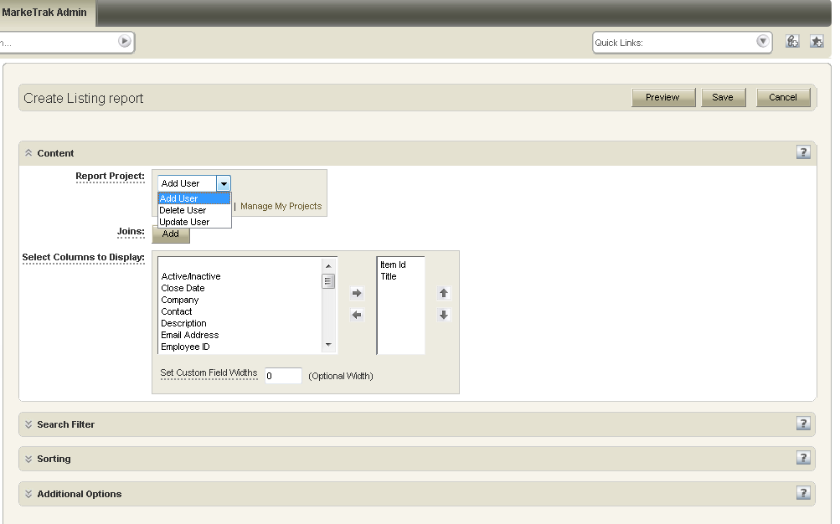
Admin Functionality: Admin Reporting
Ability to report against the Add User, Delete User, and Update User workflows

Slide 26
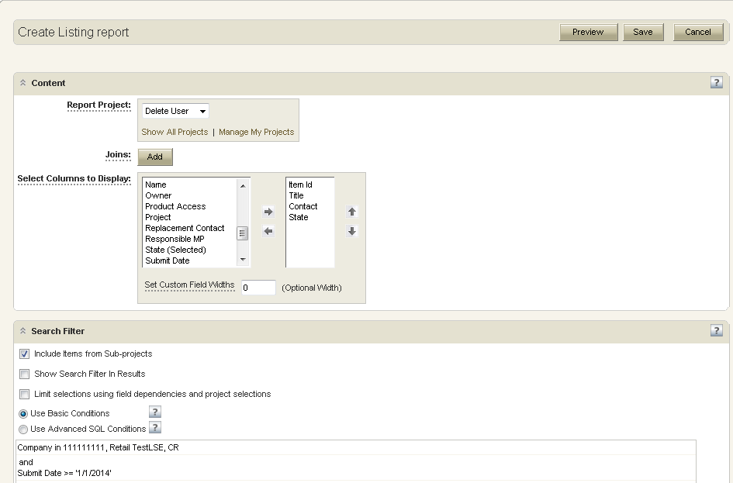
Admin Functionality: Admin Reporting
Report criteria:
  Delete User Workflow
  All users deleted on or after 1/1/2014

Slide 27
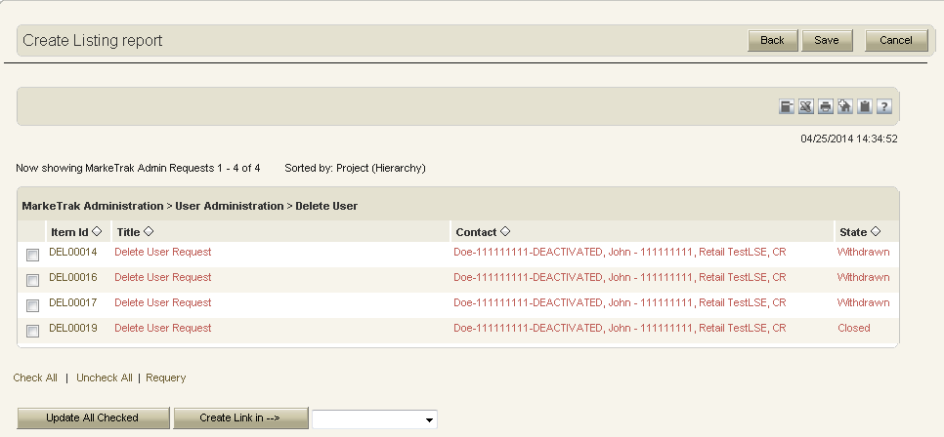
Admin Functionality: Admin Reporting

Slide 28
MarkeTrak Training
‘Other’ Issues

Slide 29
D2D Issues: Reject Transactions
Examples of Reject Transactions:
  Submission of questions pertaining to Rejected transactions.
  Submission of questions pertaining to Reject Reasons
  Duplicate Transactions
  Invalid EDI
  Reject Explanations
  Why a CR received a “Not First In” response to a transaction they submitted.
  Why a CR does not have a valid relationship with this customer for this action.
  When additional information is requested from the TDSP on a 814_PD rejects with A13
A CR or TDSP can submit this subtype
Required Fields on Submit:
  Assignee
  ESI ID
  Original Tran ID
  Tran Type
  Reject Code
  Comments
Based on the Tran Type that was entered a drop down box will appear with the TX Set reject codes that are valid for that Tran Type. If you select A13 then comments will be required.

Slide 30
D2D Issues: Service Address
Example of Service Address
  Request that a TDSP send an 814_20 transaction to update new service address for an ESIID.
A CR may submit an issue from this sub-type, and should assign to a TDSP.
Required Fields on Submit:
  Assignee
  ESIID
  New Service Street
  New Service City
  New Service State
  New Service Zipcode
  Current Service Street
  Current Service City
  Current Service State
  Current Service Zipcode
  Comments
Required Field on Sent/Complete:
  Tran ID

Slide 31
D2D Issues: Premise Type
Example of Premise Type
  Request that a TDSP send an 814_20 transaction to update premise type for an ESIID. This is to be used in regards to an out of sync condition only.
A CR may submit an issue from this sub-type, and should assign to a TDSP.
Required Fields on Submit:
  Assignee
  ESIID
  New Premise Type (dropdown)
    Residential
    Small Non-Residential
    Large Non-Residential
  Comments
Required Field on Sent/Complete:
  Tran ID

Slide 32
D2D Issues: Projects
Examples of Projects:
  System issues
  Project related issues
A CR or TDSP can submit this subtype
Required Fields on Submit
  Assignee
NOTE: The ESI ID, Original Tran ID, Tran Type, TXN Date, GS Number, ISA Number, Start Time and Comments box are all optional fields. Please include any additional information relevant to resolving this issue in the comments section.

Slide 33
Market Rule
Current MT subtype utilized as the market approved process supporting PUC Subst. Rule 25.133 Non-Standard Metering Service
For further details on timelines, see RMG 7.18.1 Transmission and/or Distribution Service Provider Notification Requirements to Retail Electric Provider
  If a Customer currently served through an Advanced Meter elects to receive service through a Non-Standard Meter, the TDSP will notify the REP in accordance with the timelines below upon receipt of the Customer’s signed acknowledgement form electing to receive Non-Standard Metering service and payment of the one-time fee.
    Within three days of receipt of the acknowledgement form and fee, the TDSP will notify the current REP of record via MarkeTrak.
    The TDSP will create a Day-to-Day MarkeTrak issue, selecting the Market Rule subtype and entering “NSMSRVC” in the required field to indicate that the Customer has elected Non-Standard Metering service.

Slide 34
Market Rule
TDSP selects Market Rule subtype from the Submit Tree.
TDSP enters required information:
  Assignee – REP of RECORD
  Market Rule - NSMSRVC
  Comments
TDSP selects ‘OK’.
Issue transitions to state of ‘New’ with the CR (REP of Record) as the Responsible MP.
CR selects ‘Begin Working’.

Slide 35
Market Rule
REP of Record
NSMSRVC

Slide 36
Market Rule
Issue transitions to state of ‘In Progress (Assignee)’ with CR as the Responsible MP.
CR selects ‘Assign To Submitter’ and enters required comments.
Issue transitions to state of ‘New - All’ with the Submitting TDSP as the Responsible MP.
Submitting MP selects ‘Begin Working’ and the issue transitions to state of ‘In Progress’.
Submitting MP selects ‘Complete’ and issue transitions to state of ‘Pending Complete’.

Slide 37
Market Rule
Market Rule subtype will allow other workflows such as assigning a secondary responsible market participant
The Market Rule field will be an approved standardized code. Today, only the NSMSRVC is active and valid

Slide 38
D2D Issues: Rep of Record
Examples of Rep of Record submissions:
  Questions pertaining to who ERCOT shows as the Rep of Record in ERCOT system.
  Questions pertaining to who the TDSP shows as the Rep of Record in the TDSP system
A CR or TDSP can submit this subtype
Situation example – A CR has submitted an initiating transaction yet does not show as the ROR at ERCOT nor has received a response transaction
  Required Fields on Submit:
  ASSIGNEE
  ESIID
  Start Time
  Comments – always encouraged

Slide 39
D2D Issues: 997
Examples of 997 Issues:
  Missing 997
  Why received a 997 Reject
  Verify 997 was sent or received
A CR or TDSP can submit this subtype
This subtype is primarily used for specific cases as opposed to system/connectivity issues.
Required fields on Submit:
  ASSIGNEE
  TXN Date
  GS Number – from EDI
  ISA Number – from EDI
NOTE: The Comments field is optional. Please include any additional information in this box. Also optional but available for providing additional information are the Tran Type, Original Tran ID, ESI ID, StartTime and StopTime fields.

Slide 40
D2D Issues: Service Order 650
Examples of Service Order – 650 Issues
  Questions pertaining to missing EDI transactions – 650_02 responses
  Any questions on 650 transactions which are missing, not completed, or rejected – example: a clearance request rejected by the TDSP
A TDSP or CR can submit this subtype
Required Fields on Submit:
  ASSIGNEE
  ESIID
  Original Tran Id (the Tran Id of the Initiating transaction)
  Tran Type (650_01, 650_02, 650_03, 654_04)
  Comments – always encouraged

Slide 41
D2D Issues: Safety Net
Only a TDSP can submit this subtype
Examples of Safety Net Issues:
  Questions pertaining to missing EDI transactions.
  Questions pertaining to who the TDSP shows as the Rep of Record in the TDSP system.
Required Fields on Submit:
  Assignee
  ESIID
  Date of Safety Net Spreadsheet Submittal
  Requested MVI Date
  Premise Energized Date
  Comments

Slide 42
D2D Issues: Move Out with Meter Removal
Only a TDSP can submit this subtype
Example of Move Out with Meter Removal
  TDSP notification of the 650_04 previously sent to the CR and the need for the MVO coded “B44” to terminate the meter on the account.
Required Fields on Submit:
  ESI ID
  Assignee
  Date of Meter Removal (or Date on 650_04)
  Comments
Required Field on Complete:
  Original Tran ID

Slide 43
Checkpoint Question
If a MVI is still ‘Scheduled’ in ERCOT and an 867_04 (initial read) transaction has not been received, which MT subtype should be submitted by the CR:
  REP of Record
  Usage & Billing – Missing
  Missing Enrollment Transaction
  Siebel Change
ANSWER
Missing Enrollment Transaction

Slide 44
Checkpoint Question
If a CR is requesting to cancel a MVO that is in a ‘Completed’ status at ERCOT, which MT subtype should be submitted:
  Cancel w/ Approval
  Siebel Change
  DEV
ANSWER
Siebel Change

Slide 45
Checkpoint Question
True or False
A market participant should submit 997 MT subtypes if they unexpectedly have not received any 997s from another market participant.
FALSE

Slide 46
Checkpoint Question
True or False
As outlined in the Retail Market Guide for non standard metering service, a CR initiates a Market Rule subtype and populates the appropriate field with NMSRVC.
FALSE

Slide 47
MarkeTrak Training
Data Extract Variance (DEV) Issue Subtypes

Slide 48
Data Extract Variance (DEV) Issues
Invalid submission of Data Extract Variance Types:
Description of Variance | Reason No Resolution Required
CR relationship records associated to the TDSP as LSE prior to 01-01-2002 | Per Market Decisions related to 2002-2003 Market Syn Project
CR relationship record date mismatches of +/- 2 calendar days on either the Start or Stop Time | Per Market Decisions related to 2002-2003 Market Syn Project
CR relationship records missing or date mismatches due to batch timing consideration (always consider a four-day data latency) | Siebel to Lodestar batch processing timing considerations
CR relationship records missing for consecutive Move In/Move outs for same CR. For example, ERCOT has CR1 from 01/15/2002 to current. TDSP/CR has CR1 from 01/15/2002 – 05/01/2002 and 05/01/2002 - current | Prior to recent ERCOT system changes, CR relationships that did not contain any ESI ID characteristic changes were compressed to a minimum Start date and maximum End date for the ESIIDSERVICEHIST row. In addition, due to the Safety Net process, ERCOT often does not receive transactions for each MVI/MVO. As long as there are no de-energized periods or changes in CR, date issues for consecutive periods should be considered valid
Continuous Service Agreements (CSAs) are NOT reflected in the data extract | The ESI ID Service History extract only includes CR relationships as the energy provider. If there is an issue with a CSA relationship, a day to day MarkeTrak issue may be filed.
Pending (In Review or Scheduled) energy relationship transactions are NOT reflected in the data extract | Only transactions completed by 867 transactions that have been updated to the Data Archive are provided in the data extract. If there is an issue with a pending service order, a day to day MarkeTrak issue may be filed.
ERCOT system IDR data that matches for each interval but Start and Stop Time do not match | There are instances where ERCOT has manually cut IDR data at midnight to support TDSP submission of 814_20 maintain transactions

Slide 49
Data Extract Variance (DEV) Issues
Valid submission of Data Extract Variance Types:
Description of Variance | Details
LSE relationship record present in MP system but not in ERCOT system | Relationship is still active Relationship is no longer active
LSE relationship record present in ERCOT system but not in MP system | Relationship is either active or not active
LSE relationship record present in both systems but has date issues | STARTTIME ONLY STOPTIME ONLY STARTTIME and STOPTIME Both

Slide 50
Data Extract Variance (DEV) Issues
Analysis Performed by Variance Type:
Variance Description | Analysis Details
LSE relationship record present in MP system but not in ERCOT system-Active and De-Engz. | Validation that there is not a Pending Service Order for the MP and time frame referenced on the MarkeTrak issue. Validation that there is not a Service Order with a sub-status of Cancelled By Customer Objection for the MP and time frame referenced on the MarkeTrak issue. Validation that the Requested New StartTime is not before the ESIID StartTime in ERCOT’s Registration System. Validation that the Service History Row to be added does not currently exist within a compressed period.
LSE relationship record present in ERCOT system but not in MP system | Validation that the Service History Row to be removed exists in ERCOT’s Registration System.
LSE relationship records present in both systems: Start Date Change | Validation that the Requested New StartTime is not before the ESIID StartTime in ERCOT’s Registration System. Validation that the StartTime and StopTime exist as submitted in ERCOT’s Registration System. Validation that the Requested New StartTime is not within a +/- two day variance of the StartTime. Validation that there is not a Pending Service Order for the MP and time frame referenced on the MarkeTrak issue. Validation that there is not a Service Order with a sub-status of Cancelled By Customer Objection for the MP and time frame referenced on the MarkeTrak issue.

Slide 51
Data Extract Variance (DEV) Issues
Analysis Performed by Variance Type:
Variance Description | Analysis Details
LSE relationship records present in both systems: Stop Date Change | Validation that the StartTime and StopTime exist as submitted in ERCOT's Registration System. Validation that the Requested New StopTime is not within a +/- two day variance of the StopTime. Validation that there is not a Pending Service Order for the MP and time frame referenced on the MarkeTrak issue. Validation that there is not a Service Order with a sub-status of Cancelled By Customer Objection for the MP and time frame referenced on the MarkeTrak issue.
LSE relationship records present in both systems: Start and Stop Date Change | Validation that the Requested New StartTime is not before the ESIID StartTime in ERCOT’s Registration System. Validation that the StartTime and StopTime exist as submitted in ERCOT's Registration System. Validation that the Requested New StartTime is not within a +/- two day variance of StartTime. Validation that the Requested New StopTime is not within a +/- two day variance of the StopTime. Validation that there is not a Pending Service Order for the MP and time frame referenced on the MarkeTrak issue. Validation that there is not a Service Order with a sub-status of Cancelled By Customer Objection for the MP and time frame referenced on the MarkeTrak issue.

Slide 52
Data Extract Variance (DEV) Issues
DEV LSE Timing
Per the 10-16-2003 RMS directive, a 75 calendar day deadline for completion of each issue will be implemented. Each MP (including ERCOT) will complete the DEV process in accordance with the timelines and other requirements of the DEV manual. Variance must be submitted at least 75 calendar days prior to the scheduled True-Up settlement/resettlement to allow the full 75 calendar day resolution period for the various parties Variances submitted in less than 75 calendar days from the scheduled resettlement of the True-Up settlement/resettlement may not be fully resolved prior to the True-Up settlement/resettlement. The following details the expected turn-around deadlines for variances to ensure the 75 calendar day timeline is met:
14 calendar days for initial validation and analysis by ERCOT
21 calendar days for analysis and response by TDSP or CR
40 calendar days for ERCOT & CR to take corrective action
Issues requiring additional analysis or follow-up data from other MPs will be updated in MarkeTrak to indicate such a need. MPs are required to respond with the necessary information within seven (7) business days.

Slide 53
Data Extract Variance (DEV) Issues
DEV Issues – LSE Relationship record present in MP system but not in ERCOT system Active
The DEV issue of LSE relationship present in MP system but not in ERCOT system- Active, the ESI ID relationship is in the MP’s system, but not in the data extract from ERCOT. This variance is used when a row being submitted shows MP as the current rep of record. A CR or a TDSP can submit this sub type.
If the change request is approved and the new relationship conflicts with existing LSE relationships, the affected CR will be notified.
Submitting a DEV LSE Relationship record present in MP system not ERCOT system – Active:
The following fields must be populated for successful submission of DEV-LSE sub type LSE in MP sys not ERCOT: active :
  ASSIGNEE
  New STARTTIME
  STARTTIME (The New STARTTIME must equal the STARTTIME or the Submitter will receive an error message and the submit process will fail. Submitter should correct the dates and select OK or select Cancel to exit.)
  ESIID
  ADDTIME

Slide 54
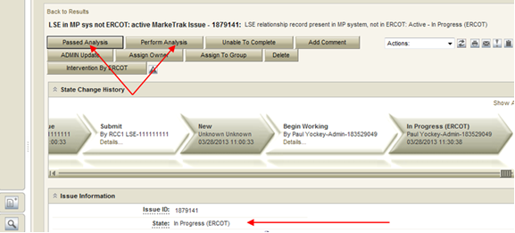
Data Extract Variance (DEV) Issues
Submitting a DEV LSE Relationship record present in MP system not ERCOT system – Active continued:
The submitter selects OK.
The issue enters ERCOT’s queue in the state of New and is visible only by the Submitter, Assignee and ERCOT.
The Submitter can Withdraw only. ERCOT can acknowledge it only.
ERCOT selects Begin Working.
The Submitter can no longer Withdraw the issue. ERCOT selects Perform Analysis and, depending upon the analysis results, the issue will either transition Passed Analysis and move to a state of New (Pending Approval) with the next Responsible MP, or will transition Unable to Complete, at which point the issue will transition to a Failed Analysis (PC) state. ERCOT selects primary path: Passed Analysis.

Slide 55
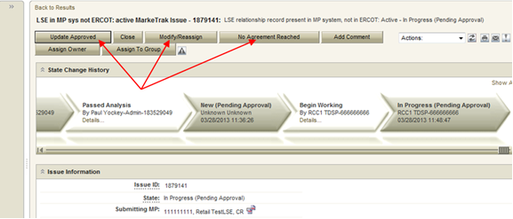
Data Extract Variance (DEV) Issues
Submitting a DEV LSE Relationship record present in MP system not ERCOT system – Active continued:
The issue is transitioned to a state of New-Pending Approval. The visibility of the issue remains unchanged. Only the Responsible MP (TDSP) can transition and the only option is Begin Working.
The Responsible party selects Begin Working.
From the state of In Progress-Pending Approval the Responsible party has three options: Update Approved, No Agreement Reached or Modify/Reassign for approval transitioning to a New-Pending Approval State with the submitting CR as the only entity with transition capabilities.

Slide 56
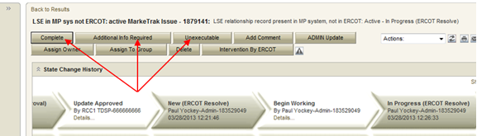
Data Extract Variance (DEV) Issues
Submitting a DEV LSE Relationship record present in MP system not ERCOT system – Active continued:
Selection of Update Approved, the Responsible party is agreeing to the current requested resolution. The Responsible party selects OK and the issue is transitioned back to ERCOT as New (ERCOT). ERCOT selects Begin Working. ERCOT has the following options:
Additional Info Required, if ERCOT needs additional information to make the change, this option is selected and the issue will be transitioned back to the TDSP. The TDSP selects Begin Working and provides the additional information in the comments field and selects Update Approved to transition the issue back to ERCOT or select Modify/Reassign to transition the issue to the Submitter to provide the additional information. When the CR is the submitting MP and the Modify/Reassign transition is executed, the ROR service history fields will be available to the TDSP to provide the service history.
Complete, the change would be made in Siebel/Lodestar and any notifications would be sent to any MPs affected by the change. The issue is transitioned to a Pending Complete state . The submitter has the option to close the issue by selecting Complete or the issue will be auto closed in 14 calendar days.

Slide 57
Data Extract Variance (DEV) Issues
Submitting a DEV LSE Relationship record present in MP system not ERCOT system – Active continued:
Selection of No Agreement Reached, the Responsible MP did not agree with the current requested resolution and the issue is transitioned back to the Submitter in an Unexecutable (Pending Complete) state. In this state the Submitter has the option to close the issue by selecting Accept or the issue will be auto closed in 14 calendar days.
Selection of Modify/Reassign. The Assigned MP did not agree with the original requested New STARTTIME. The Responsible MP is required to give a modified New STARTTIME and select OK. The modified history log will be captured in the ‘Comments’ section in the MarkeTrak issue. The issue is transitioned back to the Submitter in a New Pending Approval state.

Slide 58
MarkeTrak Training
Data Extract Variance (DEV) Non LSE Issue Subtypes

Slide 59
Data Variance (DEV) Non LSE Issues
Invalid submission of Data Extract Variance Types:
Description of Variance | Reason No Resolution Required
CR relationship records associated to the TDSP as LSE prior to 01-01-2002 | Per Market Decisions related to 2002-2003 Market Sync Project
CR relationship record date mismatches of +/- 2 calendar days on either the Start or Stop Time | Per Market Decisions related to 2002-2003 Market Sync Project
CR relationship records missing or date mismatches due to batch timing consideration | Siebel to Lodestar batch processing timing considerations
CR relationship records missing for consecutive Move In/Move Outs for same CR. For example, ERCOT has CR1 from 01/15/2002 to current. TDSP/CR has CR1 from 01/15/2002 – 05/01/2002 and 05/01/2002 – current | Prior to recent ERCOT system changes, CR relationships that did not contain any ESI ID characteristic changes were compressed to a minimum Start date and maximum End date for the ESIIDSERVICEHIST row. In addition, due to the Safety Net process, ERCOT often does not receive transactions for each MVI/MVO. As long as there are no de-energized periods or changes in CR, date issues for consecutive periods should be considered valid
Continuous Service Agreements (CSAs) are NOT reflected in the data extract | The ESI ID Service History extract only includes CR relationships as the energy provider. If there is an issue with a CSA relationship, a day to day MarkeTrak issue may be filed
Pending (In Review or Scheduled) energy relationship transactions are NOT reflected in the data extract | Only transactions completed by 867 transactions that have been updated to the Data Archive are provided in the data extract. If there is an issue with a pending service order, a day to day MarkeTrak issue may be filed
ERCOT system IDR data that matches for each interval but Start and Stop Time do not match | There are instances where ERCOT has manually cut IDR data at midnight to support TDSP submission of 814_20 maintain transactions

Slide 60
Data Variance (DEV) Non LSE Issues
Valid submission of Data Extract Variance Types:
Description of Variance | Details
ESI ID present in TDSP system but not in ERCOT system | ESI ID does not exist in ERCOT systems
ESI ID present in ERCOT system but not in MP system | ESI ID needs to be retired
ESI ID present in ERCOT system but has start date issues | ESI ID Start Date needs to be adjusted to an earlier date
Inactive record has date issues | ESI ID is Inactive but has incorrect date
Status Assignment | Status needs to be Inactive
Un-Retire ESI ID | ESI ID retired in error, reinstate to De-energized
Region Code Assignment | Incorrect Region Code
Loss Code Assignment | Incorrect Loss Code
Profile Code Assignment | Incorrect Profile Code
Station Code Assignment | Incorrect Station Code
Zip Assignment | Incorrect Zip

Slide 61
Data Variance (DEV) Non LSE Issues
Valid submission of Data Extract Variance Types:
Description of Variance | Details
IDR Usage present in MP system but not in ERCOT system | IDR Data needs to be loaded at ERCOT
IDR Usage present in ERCOT system but not in MP system | Data needs to be cancelled from ERCOT system or TDSP to submit IDR Data to CR
IDR Usage present in both systems but has date issues | Delete and reload LSE file or TDSP to verify IDR Data values
IDR Usage present in both systems but has kWh issues | Load corrected LSE file or TDSP to verify IDR Data values
Non-IDR Usage present in MP system but not in ERCOT system | NIDR Data needs to be loaded at ERCOT
Non-IDR Usage present in ERCOT system but not in MP system | Data needs to be cancelled from ERCOT system or TDSP to submit NIDR Data to CR
Non-IDR Usage present in both systems but has date issues | Dates of NIDR reads are incorrect. Update to new STOPTIME
Non-IDR Usage present in both systems but has kWh or kW total issues | Need to update loaded data or TDSP to verify NIDR Data values

Slide 62
Data Variance (DEV) Non LSE Issues
DEV Non LSE Timing
Per the 10-16-2003 RMS directive, a 75 calendar day deadline for completion of each issue will be implemented. Each MP (including ERCOT) will complete the DEV process in accordance with the timelines and other requirements of the DEV manual. Variance must be submitted at least 75 calendar days prior to the scheduled True-Up settlement/resettlement to allow the full 75 calendar day resolution period for the various parties Variances submitted in less than 75 calendar days from the scheduled resettlement of the True-Up settlement/resettlement may not be fully resolved prior to the True-Up settlement/resettlement.

Slide 63
Data Variance (DEV) Non LSE Issues
DEV Non LSE Timing (cont.)
The following details the expected turn-around deadlines for variances to ensure the 75 calendar day timeline is met:
NIDR and IDR Usage DEV Issues:
  45 calendar days for TDSP validation and analysis to be completed
  30 calendar days for TDSP to send transactions (if necessary) or for CR to manually update their system (if needed)
ESI ID Characteristics DEV Issues:
  45 calendar days for TDSP validation and analysis to be completed
  30 calendar days for TDSP to send transactions (if necessary) or for CR to manually update their system (if needed)
ESI ID Existence DEV Issues:
  10 calendar days for initial validation and analysis by ERCOT
  65 calendar days for TDSP to send transactions (if necessary)
Issues requiring additional analysis or follow-up data from other MPs will be updated in MarkeTrak to indicate such a need. MPs are required to respond with the necessary information within seven (7) business days.

Slide 64
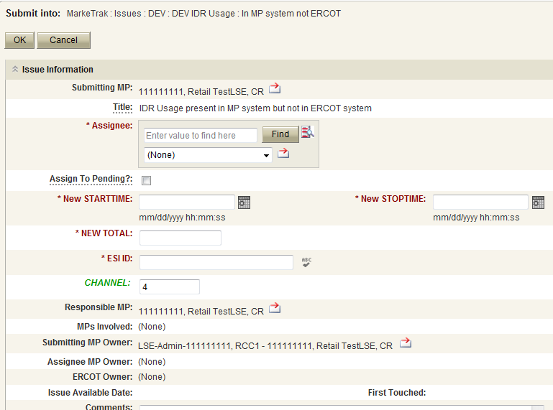
Data Variance (DEV) Non LSE Issues
Submitting a DEV Non LSE Issue – Example of IDR: In MP System not ERCOT
CR to TDSP
The DEV issue of In MP system not ERCOT should be submitted when the ESI ID IDR meter data is in the MP’s system, but not in the data extract from ERCOT.
The following fields must be populated for successful submission:
  Assignee
  New STARTTIME
  New STOPTIME
  NEW TOTAL
  ESIID
  ADDTIME
  CHANNEL is 4 by default
Select OK

Slide 65
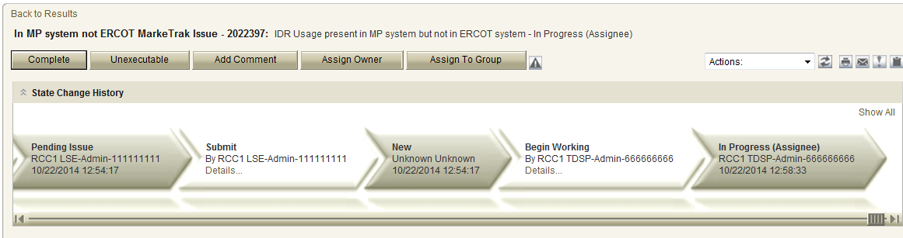
Data Variance (DEV) Non LSE Issues
Submitting a DEV Non LSE Issue – Example of IDR: In MP System not ERCOT
The issue enters TDSP’s queue in the state of New
The CR only may Withdraw the issue prior to acknowledgement by TDSP
TDSP selects Begin Working and the CR can no longer Withdraw the issue
TDSP has the options of Complete and Unexecutable
If in agreement TDSP will take appropriate action then select Complete which transitions the issue to Pending Complete with the CR.

Slide 66
Data Variance (DEV) Non LSE Issues
Submitting a DEV Non LSE Issue – Example of IDR: In MP System not ERCOT
The CR selects Complete and the issue is closed
If not in agreement the TDSP may:
  Select Unexecutable which will require a comment and return the issue back to the CR’s queue as Unexecutable (Pending Complete).
CR will select Accept and issue will be closed.
Once in the Pending Complete state, if the issue is not transitioned for 14 calendar days the issue will automatically go to Auto Complete. The issue will then be closed.

Slide 67
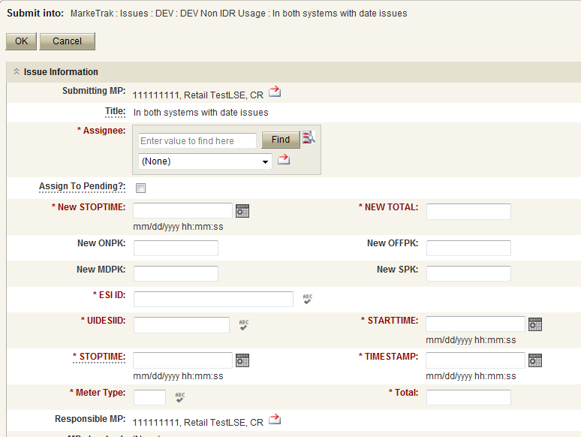
Data Variance (DEV) Non LSE Issues
Submitting a DEV Non LSE Issue – Example of IDR: In MP System not ERCOT
TDSP to ERCOT or CR to TDSP
The DEV Issue of In both system with date issues should be submitted when the ESI ID Non-IDR meter data is in the data extract from ERCOT and in the MP’s system, but has a STOPTIME issue.
The following fields must be populated for successful submission:
  Assignee
  New STOPTIME
  New Total
  ESIID
  UIDESIID
  STARTTIME (STARTTIME - SCR727 Extract)
  STOPTIME (STOPTIME - SCR727 Extract)
  TIMESTAMP (TIMESTAMP - SCR727 Extract)
  METERTYPE
  TOTAL (TOTAL - SCR727 Extract)
Select OK

Slide 68
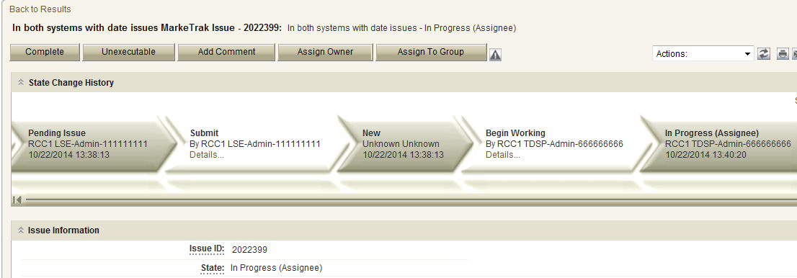
Data Variance (DEV) Non LSE Issues
Submitting a DEV Non LSE Issue – Example of Non-IDR: In Both Systems with Date Issues
The issue enters TDSP’s queue in the state of New.
TDSP has the options of Complete and Unexecutable
If in agreement TDSP will take appropriate action then select Complete which transitions the issue to Pending Complete with the CR. The CR selects Complete and the issue is closed
If not in agreement TDSP may:
  Select Unexecutable which will require a comment and return the issue back to CR’s queue as Unexecutable-Pending Complete.
CR will select Accept and issue will be closed
Once in the Pending Complete state, if the issue is not transitioned for 14 calendar days the issue will automatically go to Auto Complete. The issue will then be closed.

Slide 69
Checkpoint Question
True or False
In order to synchronize a Move-In StartTime from May 1, 2016 to May 3, 2016, a MarkeTrak DEV LSE should be submitted
FALSE
Invalid submission via the +/- (2 calendar day) window.

Slide 70
Checkpoint Question
DEV Non-LSE MarkeTrak issues are submitted to synchronize the following:
  ESI_ID Characteristics
  Usage Data
  ESI_ID Existence
  A and C Only
  All of the Above
ANSWER
All of the Above

Slide 71
MarkeTrak Training
Inadvertent Gain (IAG)

Slide 72
What is an IGL?
An Inadvertent Gain/Loss (IGL) is an unauthorized change of a customer’s Retail Electric Provider
Commonly referred to as either an Inadvertent Gain (IAG) or Inadvertent Loss (IAL), an inadvertent situation occurs when a customer or a premise is changed to a REP that is different than their expected REP of choice.
When resolving IGL issues, the ultimate goal is to return the Customer to their REP of choice in a quick and efficient manner with minimal inconvenience to the Customer.

Slide 73
How does an IGL occur?
An Inadvertent Gain or Loss can occur under various circumstances:
Incorrect information provided by the Customer during enrollment – service address or ESI ID
Incorrect information entered by the REP during enrollment
Unauthorized enrollments – slamming
Confusing enrollment processes by REPs

Slide 74
Reference Documents
PUCT Subst. Rule §25.495, Unauthorized Change of Retail Electric Provider
ERCOT Retail Market Guide Section 7.3, Inadvertent Gain Process
MarkeTrak User’s Guide

Slide 75
Reference Documents
ERCOT Retail Market Guide
    http://www.ercot.com/mktrules/guides/retail/current
7.3 Inadvertent Gain Process
  7.3.1 Escalation Process
  7.3.2 Competitive Retailer’s Inadvertent Gain Process
    7.3.2.1 Buyer’s Remorse
    7.3.2.2 Prevention of Inadvertent Gains
    7.3.2.3 Resolution of Inadvertent Gains
    7.3.2.4 Valid Reject/Unexecutable Reasons
    7.3.2.5 Invalid Reject/Unexecutable Reasons
    7.3.2.6 Out-of-Sync Conditions
    7.3.2.7 No Losing Competitive Retailer of Record
  7.3.3 Charges Associated with Returning the Customer
  7.3.4 Transmission and/or Distribution Service Provider Inadvertent Gain Process
    7.3.4.1 Inadvertent Dates Greater than 150 days
    7.3.4.2 Inadvertent Order is Pending
    7.3.4.3 Third Party has Gained Electric Service Identifier (Leapfrog Scenario)
    7.3.4.4 Transmission and/or Distribution Service Provider Billing
  7.3.5 Customer Rescission after Completion of a Switch Transaction
    7.3.5.1 Additional Valid Reasons for Rejection of a Rescission-based Issue

Slide 76
Reference Documents
Retail Market Guide Section 7.3 Inadvertent Gain Process
Guidelines for ensuring that inadvertently gained ESI IDs are returned to the Losing REP in a quick and efficient manner with minimal inconvenience to the Customer as required by PUC Subst. Rule 25.495 Unauthorized Change of Retail Electric Provider
Escalation Process:
Each Market Participant is responsible for it’s own compliance with the PUCT rules and RMG procedures & timelines.
Each Market Participant shall maintain and update escalation contacts within the MarkeTrak Rolodex
MarkeTrak will send escalation emails to the escalation contacts whenever an issue has remained in a ‘New’ or ‘Pending’ state for more than 3 calendar days

Slide 77
Reference Documents
MarkeTrak User Guide
  http://www.ercot.com/content/services/client_svcs/mktrk_info/MarkeTrak%2520User%2520Guide[1]%20(2).zip
2.1 Day to Day Issues – Inadvertent Gain
2.1.1 Required Fields for Inadvertent Gain
2.1.2 Definition of Inadvertent Gain
2.1.3 Submitting an Inadvertent Gain
2.1.4 Submitting a Customer Rescission Issue
2.1.5 Redirect Fees Subtype

Slide 78
Inadvertent Gain
An inadvertent issue begins upon the discovery of an Inadvertent Gain or Move-In transaction submission. Upon identification of an Inadvertent Gain or Move-in, the CR will check the transaction status via the ERCOT MIS.
  If transaction Status is pending, and the Inadvertent CR is the submitting CR, then the CR will cancel their submitting transaction either by submitting an EDI cancel transaction or by submitting a Cancel with Approval MarkeTrak issue.
  For other Status types or if the CR was not the submitter of the transaction, the CR will log a MarkeTrak Inadvertent issue.
  CR’s will work together in a manner outlined in Section 7.2 of the Retail Market Guide (RMG) to determine appropriate resolution.
  If the CR/TDSP resolution requires a backdated move-in being generated by the Original CR, then the date should be at least the Gaining CR start date plus 1 day to avoid creating transaction business process exceptions at ERCOT and the TDSP.
  The submitter should include any details, Customer name and/or meter number, which may expedite resolution of the issue.

Slide 79
Inadvertent Gain
ERCOT’s Receipt of Inadvertent Gain Issue:
Confirm the pending or actual change of CR relationship.
Assign CR2 and the TDSP to the MarkeTrak issue.
ERCOT will transition the MarkeTrak issue to the parties involved with CR2 as the Responsible MP.
CR2 is responsible for selecting Begin Working to transition the item into a State of In Progress.
The Original CR must wait for the TDSP to select Ready to Receive prior to sending the EDI to regain the account.
Examples of Invalid Inadvertent Gain Issues where ERCOT will select Invalid IAG and populate the Invalid IAG Reason field with the reason the issue could not be worked:
Invalid ESI ID
Wrong or Invalid Tran ID
Invalid Order Type (order something other than MVI or Switch)
Submitter selected Gaining and is not the Gaining CR
Submitter selected Losing and is not the Losing CR
ESI ID was De-Energized prior to completion of MVI
The Losing and Gaining CR are the same
Losing CR has left the Market
Gaining CR has left the Market
Order was Cancelled – No IAG
Other

Slide 80
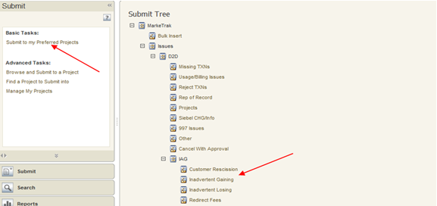
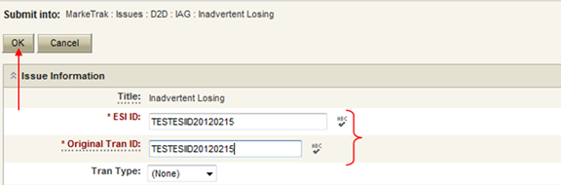
Inadvertent Gain
Submitting an Inadvertent Gain – CR Submits as the Gaining CR
From the Submit Tree, select IAG – Inadvertent Gaining
CR1 (Gaining/Original CR) will enter all required information.
ESIID
Original Tran ID – The original tran id of the other CR’s enrollment. (BGN06 of the 814_06).

Slide 81
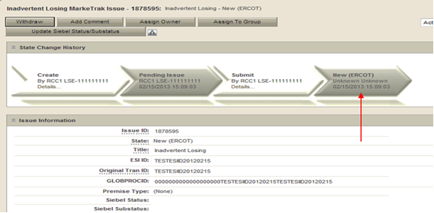
Inadvertent Gain
CRITICAL: The Comments field is technically optional; however, not providing the required information referenced in RMG Section 7.3.2(1) could result in a delay of issue resolution. Please include any additional information in this box.
  Customer Name (Always)
  Meter Number (If available)
  Any other pertinent information that will help expedite resolution
Select OK to create the IAG – Inadvertent Gaining MarkeTrak Issue. The issue enters the state of New (ERCOT) and is visible only by the Submitting CR and ERCOT.
The Submitting CR has the option to Withdraw the issue at this point
ERCOT will select Begin Working to provide the Gaining CR Start Date, if the Gaining CR is still the rep of record (Gaining CR ROR), assign CR2 (Gaining CR) and TDSP. ERCOT will then select “OK” to move the issue to CR2 (Gaining CR).

Slide 82
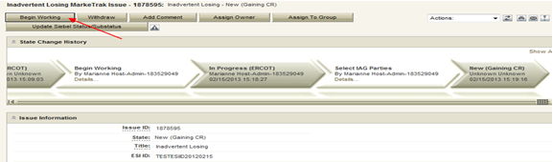

Inadvertent Gain
CR2 (Losing CR) will select Begin Working and Issue details and Investigate Market Conditions to determine the appropriate regain date.
If CR2 (Losing/Original CR) determines that an Inadvertent Gain has NOT taken place, they have the option to select “Unexecutable” to stop the Inadvertent Gain process. Invalid IAG Reason is required, enter one of the following:
  3rd party CR involved
  Authorized Enrollment Confirmed
  Duplicate Issue
  Other (should require comments)

Slide 83
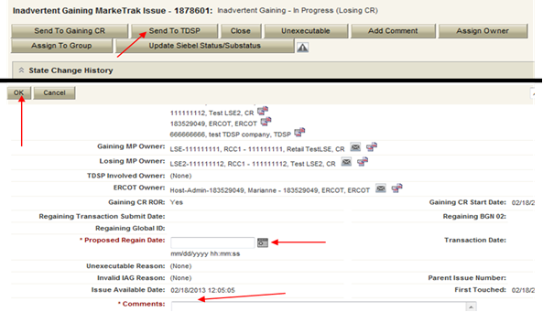
Inadvertent Gain
If CR2 (Losing/Original CR) determines they will need more information from CR1 (Gaining CR), then they will need to select Send to Gaining CR. This transition allows both CR’s to talk back and forth while transitioning the issue back and forth before a resolution is made.
If CR2 (Losing/Original CR) determines that an Inadvertent Gain has taken place, they will select Send to TDSP, enter the proposed regain date, add comments and select “OK” to move the issue to the TDSP. A validation will occur on the Proposed Regain Date: Validate that the date is less than “Submit Date” + 10 days. If not the following error message will be displayed “Proposed Regain Date is greater than 10 Calendar days from the submittal of MarkeTrak Issue, please update with valid Proposed Regain date.”

Slide 84
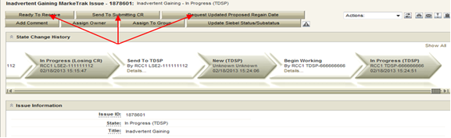
Inadvertent Gain
The TDSP will select Begin Working, investigate the issue details, then select one of the following:
Ready to Receive – The TDSP would select this transition to send the issue back to CR1 (Losing/Original CR). It is extremely important that CR1 (Losing/Original CR) wait for the TDSP to select Ready to Receive indicating TDSP’s systems have been prepared to receive the Original MP’s transaction before the EDI is actually sent. If not, the EDI will be rejected at the TDSP.
Send To Submitting CR – The TDSP would select this transition if they needed further information from CR1 (Losing/Original CR).
Request Updated Proposed Regain Date – The TDSP would select this transition if they do not agree with the proposed regain date that was provided. They would suggest a new date and send the issue back to CR1 (Losing/Original CR).

Slide 85
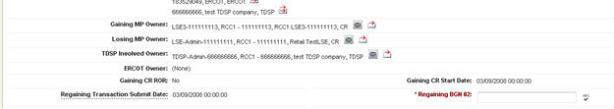
Inadvertent Gain
CR2 (Losing/Original CR) will select Begin Working then select Provide Regaining BGN 02. CR2 (Losing/Original CR) will provide the Regaining BGN02 and then select “OK”. When the regaining transactions process into ERCOT’s registration system, the Regaining Transaction Submit Date, Regaining BGN Requested Date and Regaining BGN Priority Code will be auto-populated on the MarkeTrak issue.
All parties should continue to monitor MIS and internal systems for the successful delivery and completion of the EDI transaction being sent by CR1 (Losing/Original CR) to the Market to regain a premise and resolve the associated Inadvertent Gain MarkeTrak issue.
Once the regaining transaction has been successfully sent to the Market by CR2 (Losing/Original CR), Siebel will automatically:
  Check Regaining Transaction Siebel Status every 30 minutes using the BGN 02 from the new initiating transaction
  Update the issue with the current Regaining Transaction Siebel Status
  Assign the state of Complete with the Submitting MP as the Responsible Party once the Regaining Transaction Siebel Status is Complete.
  Issues remaining in a state of ‘Regaining Transaction Submitted (PC)’ for 14 calendar days will be transitioned by MarkeTrak to a state of ‘New (Losing CR Re-Submit)’ with the following comment: “Regaining Transaction has been idle for too long. Please review and re-submit transaction.”

Slide 86
Key Things to Remember
Provide as much information when opening Inadvertent Gain/Loss MarkeTrak in order to help facilitate quick resolution to the issue.
Suggested Information includes:
Customer Name (Always)
Meter Number (If available)
Any other pertinent information you may have that is crucial to help resolve issue.
Regain date should be:
Date of Loss (DOL) + 1
Date of Loss (DOL) less than or equal to 10 days from date MT was submitted

Slide 87
Valid Reject/Unexecutable Reasons
7.3.2.4 Valid Reject/Unexecutable Reasons
The losing CR may reject the return of an inadvertently gained ESI ID from the gaining CR for one of the following reasons only:
  A new transaction has completed in the market, including, but not limited to the following transactions:
    The 814_16, Move In Request; or
    The 814_01, Switch Request.
  Duplicate Inadvertent Gaining issue in MarkeTrak for the same Customer on the same ESI ID.

Slide 88
Valid Reject/Unexecutable Reasons
7.3.2.4 Valid Reject/Unexecutable Reasons (cont.)
The gaining CR may reject returning an inadvertently gained ESI ID to the Losing CR for one of the following reasons only:
  A new transaction has completed in the market, including, but not limited to the following transactions:
    The 814_16 transaction; or
    The 814_01 transaction.
  Duplicate Inadvertent Losing issue in MarkeTrak for the same Customer on the same ESI ID;
  The Gaining CR has confirmed with the Customer that the Customer’s CR of choice is the Gaining CR:
    Gaining CR has a valid enrollment with the same Customer and provides the Customer name, service address and meter number (if available) in the comments section of the MarkeTrak issue.
  Customer has successfully completed an enrollment regarding the same ESI ID and the Gaining CR has the most recent effective date; or
  In cases of Customer rescission, Inadvertent Losing MarkeTrak issue is rejected/unexecuted and a Rescission MarkeTrak issue is created.

Slide 89
Invalid Reject/Unexecutable Reasons
7.3.2.5 Invalid Reject/Unexecutable Reasons
The losing CR shall not reject the return of an inadvertently gained ESI ID due to:
Inability to contact the Customer;
Past due balances or credit history;
Customer no longer occupies the Premise in question;
Contract expiration or termination;
Pending TX SETs; or
Losing CR serving the Premise under a Continuous Service Agreement (CSA).

Slide 90
Checkpoint Question
True or False
Based on the Retail Market Guide, in an inadvertent gain scenario, a losing REP can reject or mark unexecutable the MarkeTrak after confirming Customer’s intent to change REPs?
FALSE
Confirmation of the customers intent to change REPs is not a valid Reject/Unexecuteable reason.

Slide 91
MarkeTrak Training
Customer Rescission

Slide 92
Right of Rescission
PUCT Subst. Rule 25.474(j) - Right of Rescission
A REP shall promptly provide the applicant with the terms of service document after the applicant has authorized the REP to provide service to the applicant and the authorization has been verified. For switch requests, the REP shall offer the applicant a right to rescind the terms of service without penalty or fee of any kind for a period of three federal business days after the applicant's receipt of the terms of service document. The provider may assume that any delivery of the terms of service document deposited first class with the United States Postal Service will be received by the applicant within three federal business days. Any REP receiving an untimely notice of rescission from the applicant shall inform the applicant that the applicant has a right to select another REP and may do so by contacting that REP. The REP shall also inform the applicant that the applicant will be responsible for charges from the REP for service provided until the applicant switches to another REP. The right of rescission is not applicable to an applicant requesting a move-in.

Slide 93
Right of Rescission
In other words …
Applicable to Switch requests only, not Move-Ins.
After receiving the Terms of Service, Customer is allowed three (3) federal business days to rescind without penalty or fees.
Ultimate goal is to return the Customer to their REP of choice quickly and efficiently with minimal inconvenience to the Customer.

Slide 94
Rescission vs. Inadvertent Switch
Strongly recommended that involved CRs share as much information as possible at the onset of issue creation to aid in resolution of Customer Rescission issue quickly and efficiently (e.g. Customer Name, Meter #, etc.)
Although Customer Rescission is part of the Inadvertent Switch ‘family’ within the MarkeTrak tool, resolution of a Customer Rescission does not follow the same criteria nor follow the same completion timeline.
The research and investigation normally pursued during resolution of an Inadvertent Switch is not utilized when resolving Customer Rescission.
If/when the customer requests rescission (within the 3 federal business day window), the ‘losing’ REP must promptly regain the Customer – no questions asked.

Slide 95
Rescission vs. Inadvertent Switch
Handling of Fees/Charges Associated with IAG vs Rescission:
Fees (if applicable per TDSP Tariffs):
  For a customer rescission, TDSPs may charge CRs a fee; but there shall be no fees passed through to the customer.
  For IAG, TDSPs may charge Gaining CRs an IAG fee; but the CR’s internal business practices will dictate if IAG fees are passed to the customer.
Consumption (usage) charges:
  Rescission reinstatement date is automatically set at DOL + 1, Gaining CRs shall not pass these charges to the customer
  IAG reinstatement date is driven by the Losing CR and is set at a minimum of DOL + 1 to Date of MT submission +10, Gaining CRs may choose to pass these charges to the customer

Slide 96
Customer Rescission & RMGRR129
Due to the expeditious nature of Customer Rescission requests, RMGRR129 – Revision to Customer Rescission Completion Timeline was created to provide additional guidelines regarding specific timing and responsibilities for a Competitive Retailer (CR) to complete a Customer Rescission MarkeTrak issue.

Slide 97
RMGRR129: What are the changes?
Once a Customer Rescission MarkeTrak (MT) issue has been submitted, the losing CR has two (2) business days to agree to the Customer Rescission MT issue.
Once the Transmission and/or Distribution Service Provider (TDSP) has updated the MT issue to “Ready to Receive”, the losing CR has another two (2) business days to send a backdated 814_16, Move-In Request.

Slide 98
Customer Rescission Walkthrough
Only the gaining CR in a rescission scenario may utilize the rescission-based MarkeTrak process to initiate reinstatement of a customer to its original CR.
In order for an issue to be submitted through this subtype, it must be submitted on or before the twenty-fifth (25th) calendar day following ERCOT’s established First Available Switch Date (FASD).
Should a matter of rescission need to be resolved, but a Customer Rescission issue has not been submitted for this purpose within the specified timeframe the two CRs should work to resolve this issue through the Inadvertent Gaining subtype.

Slide 99
Rescission Walkthrough: Gaining CR
The Gaining CR selects the Submit tab.
From the Submit Tree, select Customer Rescission.
Note: The submitter should include any details (ex. customer name) in the comments section which may expedite resolution of the issue.

Slide 100
Rescission Walkthrough: Gaining CR
The following fields must be populated:
ESI ID
Original Tran ID

Slide 101
Rescission Walkthrough: Validations
ERCOT validates ESI ID, submission timeframe and valid originating transaction.
Upon passing validation, MarkeTrak issue is created and ERCOT updates the issue with the following information:
  Losing CR Name and Duns
  TDSP Name and Duns
  Gaining CR ROR = Y or N
  Gaining CR Start Date
  Regain Date – auto populated by ERCOT.
  (Gaining CR Start Date +1 calendar day)
MarkeTrak issue is assigned to the state of ‘New (Losing CR)’ with the Losing CR as the Responsible Party. [Starts the 2 BD clock for Losing CR to Agree]
Losing CR user selects ‘Begin Working’.

Slide 102
Rescission Walkthrough: Losing CR
MarkeTrak issue is assigned to the state of ‘In Progress (Losing CR)’ with the Losing CR as the Responsible Party.
Losing CR selects ‘Send to TDSP’.
[Implies “Agreement” & ends the 2 BD clock]

Slide 103
Rescission Walkthrough: TDSP
Issue is in a state of ‘New (TDSP)’ with TDSP as Responsible MP.
TDSP selects ‘Begin Working’.
Issue is in a state of ‘In Progress (TDSP)’ with TDSP as Responsible MP.

Slide 104
Rescission Walkthrough: TDSP
TDSP selects ‘Ready to Receive’
[Starts the 2 BD clock for Losing CR to submit BDMVI]

Slide 105
Rescission Walkthrough: Losing CR
Issue is in a state of ‘New (Losing CR Submit)’ with the Losing CR as Responsible MP.
Losing CR selects ‘Begin Working’.
Issue is in a state of ‘In Progress (Submit Regaining)’ with the Losing CR as Responsible MP.

Slide 106
Rescission Walkthrough: Losing CR
Losing CR selects ‘Provide Regaining BGN02’.

Slide 107
Rescission Walkthrough: Losing CR
Losing CR populates all required information:
  Regaining Transaction Submit Date
  Regaining BGN 02

Slide 108
Rescission Walkthrough: Resolution
Issue is in a state of ‘Regaining Transaction Submitted (PC)’ with the Gaining (Submitting CR) as Responsible MP.
Once the regaining transaction (Backdated 814_16 MVI) has been successfully sent by (Losing/Original CR), Siebel will automatically:
  Check Regaining Transaction Siebel Status every 30 minutes using the BGN 02 from the new initiating transaction.
  Update the issue with the current Regaining Transaction Siebel Status.
The issue will move to a state of ‘Complete’ with the Submitting MP as the Responsible Party once the Regaining Transaction Siebel Status is Complete.
[Ends the 2 business day clock for the Losing CR]

Slide 109
Checkpoint Question
True or False
A losing REP can claim customer rescission?
FALSE
Only a gaining REP can claim customer rescission.

Slide 110
2017
Inadvertent Switch & Customer Rescission
Market Training

Slide 111
Appendix
Process Flow – Inadvertent Loss
Process Flow – Inadvertent Gain
Customer Rescission Exceptions
Customer Rescission – Re-submit
Reference Documents – summaries
  PUCT Subst. Rule §25.495. Unauthorized Change of Retail Electric Provider
  Retail Market Guide Section 7.3 Inadvertent Gain Process
  MarkeTrak User’s Guide Index

Slide 112
Process Flow: IAL (Losing)
Process Flow - Inadvertent Losing MarkeTrak Issue
 | Transition | By | State | Owner
 | Create | Submitter (Losing CR) / Original CR | Pending Issue | Submitter (Losing CR) / Original CR
 | â
 | Submit | Submitter (Losing CR) / Original CR | New (Gaining CR) | (Gaining CR) / Inadvertent CR
 | â
 | Assign Owner | (Gaining CR) / Inadvertent CR | New (Gaining CR) | (Gaining CR) / Inadvertent CR
 | â
 | Begin Working | (Gaining CR) / Inadvertent CR | In Progress (Gaining CR) | (Gaining CR) / Inadvertent CR
 | â
 | Agree | (Gaining CR) / Inadvertent CR | New (Losing CR) | Submitter (Losing CR) / Original CR
 | â
 | Begin Working | Submitter (Losing CR) / Original CR | In Progress (Losing CR) | Submitter (Losing CR) / Original CR
 | â
Submitter (Losing CR) / Original CR to Perform Research / Reconciliation / Verification Process: þ Subsequent transactions? Yes - Cancel W/Approval, No - Proceed þ Holds? Yes – Submit 650_01, No - Proceed þ Proposed Regain Date =< Gaining CR Start Date? Yes – Update, No – Proceed Send to TDSP
 | â

Slide 113
Process Flow: IAL (Losing)
 | â
 | Send To TDSP | Submitter (Losing CR) / Original CR | New (TDSP) | TDSP
 | â
 | Begin Working | TDSP | In Progress (TDSP) | TDSP
 | â
TDSP to Perform Research / Reconciliation / Verification Process: þ Subsequent transactions? Yes – Send back to CRs, No - Proceed þ Holds? Yes – Send back to CRs, No - Proceed þ Proposed Regain Date =< Gaining CR Start Date? Yes – Send back to CRs, No – Proceed þ Check for Permit Requirements and override if any exist þ Add ESIID, Original CR and Proposed Regain Date to Safety Net and verify loaded correctly þ Update MarkeTrak issues with comments indicating readiness
 | â
 | Ready To Receive | TDSP | New (Losing CR Submit) | Submitter (Losing CR) / Original CR
 | â
 | Begin Working | Submitter (Losing CR) / Original CR | In Progress (Submit Regaining) | Submitter (Losing CR) / Original CR
 | â

Slide 114
Process Flow: IAL (Losing)
 | â
Submitter (Losing CR) / Original CR to Perform Research / Reconciliation / Verification Process: þ Subsequent transactions? Yes - Cancel W/Approval, No - Proceed þ Send EDI for the Proposed Regain Date that the Original CR entered within the issue þ Verify the EDI was processed successfully by consulting the ERCOT MIS as well as any internal systems used for verifying transactions. þ Add the Regaining BGN information into the MarkeTrak issue only after verifying that it was successfully received þ DO NOT click the Send to TDSP transition as this will prevent the issue from Auto-completion
 | â
 | Provide Regaining BGN02 | Submitter (Losing CR) / Original CR | Regaining Transaction Submitted (PC) | Submitter (Losing CR) / Original CR
 | â
 | Update | ERCOT | Auto Complete | Submitter (Losing CR) / Original CR

Slide 115
Process Flow: IAL (Gaining)
Process Flow - Inadvertent Gaining MarkeTrak Issue
 | Transition | By | State | Owner
 | Create | Submitter (Gaining CR) / Inadvertent CR | Pending Issue | Submitter (Gaining CR) / Inadvertent CR
 | â
 | Submit | Submitter (Gaining CR) / Inadvertent CR | New (Losing CR) | (Losing CR) / Original CR
 | â
 | Assign Owner | (Losing CR) / Original CR | New (Losing CR) | (Losing CR) / Original CR
 | â
 | Begin Working | (Losing CR) / Original CR | In Progress (Losing CR) | (Losing CR) / Original CR
 | â
(Losing CR) / Original CR to Perform Research / Reconciliation / Verification Process: þ Subsequent transactions? Yes - Cancel W/Approval, No - Proceed þ Holds? Yes – Submit 650_01, No - Proceed þ Proposed Regain Date =< Gaining CR Start Date? Yes – Update, No – Proceed Send to TDSP
 | â

Slide 116
Process Flow: IAL (Gaining)
 | â
 | Send To TDSP | (Losing CR) / Original CR | New (TDSP) | TDSP
 | â
 | Begin Working | TDSP | In Progress (TDSP) | TDSP
 | â
TDSP to Perform Research / Reconciliation / Verification Process: þ Subsequent transactions? Yes – Send back to CRs, No - Proceed þ Holds? Yes – Send back to CRs, No - Proceed þ Proposed Regain Date =< Gaining CR Start Date? Yes – Send back to CRs, No – Proceed þ Check for Permit Requirements and override if any exist þ Add ESIID, Original CR and Proposed Regain Date to Safety Net and verify loaded correctly þ Update MarkeTrak issues with comments indicating readiness
 | â
 | Ready To Receive | TDSP | New (Losing CR Submit) | (Losing CR) / Original CR
 | â
 | Begin Working | (Losing CR) / Original CR | In Progress (Submit Regaining) | (Losing CR) / Original CR
 | â

Slide 117
Process Flow: IAL (Gaining)
 | â
(Losing CR) / Original CR to Perform Research / Reconciliation / Verification Process: þ Subsequent transactions? Yes - Cancel W/Approval, No - Proceed þ Send EDI for the Proposed Regain Date that the Original CR entered within the issue þ Verify the EDI was processed successfully by consulting the ERCOT MIS as well as any internal systems used for verifying transactions. þ Add the Regaining BGN information into the MarkeTrak issue only after verifying that it was successfully received þ DO NOT click the Send to TDSP transition as this will prevent the issue from Auto-completion
 | â
 | Provide Regaining BGN02 | (Losing CR) / Original CR | Regaining Transaction Submitted (PC) | Submitter (Gaining CR) / Inadvertent CR
 | â
 | Update | ERCOT | Auto Complete | Submitter (Gaining CR) / Inadvertent CR

Slide 118
Customer Rescission – Exceptions
If the regaining transaction remains in a Siebel status other than Complete in the ERCOT Registration System for greater than five calendar days, the issue will automatically transition back to the Losing CR, and an email generated to notify the Losing CR of the transition.
If the regaining Siebel status is still Scheduled status, the Losing CR should repopulate the regaining BGN field with the same information.
If the Siebel status is blank within the MarkeTrak issue, the Losing CR should verify the status of the regaining transaction and submit/repopulate a new transaction if necessary.
This functionality is to ensure the issue is not closed before the premise has been regained, due to the time restriction on submission of new issues within this subtype.

Slide 119
Customer Rescission – Re-submit

Slide 120
Customer Rescission – Re-submit

Slide 121
Reference Documents
PUCT Subst. Rule §25.495, Unauthorized Change of Retail Electric Provider
ERCOT Retail Market Guide Section 7.3, Inadvertent Gain Process
MarkeTrak User’s Guide

Slide 122
Reference Documents
PUCT Subst. Rule §25.495. Unauthorized Change of Retail Electric Provider
http://www.puc.texas.gov/agency/rulesnlaws/subrules/electric/Electric.aspx
Either the original REP (Losing REP) or the switching REP (Gaining REP) shall file a MarkeTrak issue as promptly as possible
Affected REPs, ERCOT, and TDSP shall take all actions necessary to return the customer to the original REP as quickly as possible
Gaining REP shall pay all transmission and distribution charges associated with returning the customer to the Losing REP
Gaining REP shall refund within 5 days all charges paid by the customer for the time period the Losing REP regains and ultimately rebills the customer
The REP that ultimately bills the customer is responsible for the non-bypassable charges and wholesale consumption for the customer
The customer shall pay no more than the price at which the customer would have been billed had the unauthorized switch or move-in not occurred

Slide 123
Reference Documents
ERCOT Retail Market Guide
http://www.ercot.com/mktrules/guides/retail/current
7.3 Inadvertent Gain Process
  7.3.1 Escalation Process
  7.3.2 Competitive Retailer’s Inadvertent Gain Process
    7.3.2.1 Buyer’s Remorse
    7.3.2.2 Prevention of Inadvertent Gains
    7.3.2.3 Resolution of Inadvertent Gains
    7.3.2.4 Valid Reject / Unexecutable Reasons
    7.3.2.5 Invalid Reject / Unexecutable Reasons
    7.3.2.6 Out-of-Sync Conditions
    7.3.2.7 No Losing Competitive Retailer of Record
  7.3.3 Charges Associated with Returning the Customer
  7.3.4 Transmission and / or Distribution Service Provider Inadvertent Gain Process
    7.3.4.1 Inadvertent Dates Greater than 150 days
    7.3.4.2 Inadvertent Order is Pending
    7.3.4.3 Third Party has Gained Electric Service Identifier (Leapfrog Scenario)
    7.3.4.4 Transmission and/or Distribution Service Provider Billing
  7.3.5 Customer Rescission after Completion of a Switch Transaction
    7.3.5.1 Additional Valid Reasons for Rejection of a Rescission-based Issue

Slide 124
Reference Documents
Retail Market Guide Section 7.3 Inadvertent Gain Process
Guidelines for ensuring that inadvertently gained ESI IDs are returned to the Losing REP in a quick and efficient manner with minimal inconvenience to the Customer as required by PUC Subst. Rule 25.495 Unauthorized Change of Retail Electric Provider
Escalation Process:
Each Market Participant is responsible for it’s own compliance with the PUCT rules and RMG procedures & timelines.
Each Market Participant shall maintain and update escalation contacts within the MarkeTrak Rolodex
MarkeTrak will send escalation emails to the escalation contacts whenever an issue has remained in a ‘New’ or ‘Pending’ state for more than 3 calendar days

Slide 125
Reference Documents
Section 7.3, Inadvertent Gain Process - continued
CRs, both Losing and Gaining Reps, must investigate the matter and provide all necessary/relevant information – customer name, service address, meter number
An untimely rescission is not treated as an inadvertent gain or loss
The IAG process shall not be used to resolve an issue which an authorized enrollment causes a breach of contract between Customer and Losing Rep
Utilize the Cancel w/ Approval MarkeTrak to prevent an IAG if within one Retail Business Day prior to MVI or switch
If future dated MVI or switch and earlier than one Retail Business Day prior to transaction, utilize 814_08 Cancel Request
814_08
Cancel w/ approval
IAG MarkeTrak
“Key Date” – 1
“Key Date”

Slide 126
Reference Documents
Section 7.3, Inadvertent Gain Process - continued
Do not issue a MVO on an ESI ID that was gained in error
Do not issue an Inadvertent Loss MarkeTrak until the Gaining Rep’s transaction has completed
The Losing Rep ultimately determines the reinstatement date
Reinstatement date shall be at the earliest DOL + 1 (Date of Loss) and at the latest 10 days from the date the MarkeTrak was submitted
The Losing Rep shall submit the BDMVI (back-dated move in) 814_16 no later than 12 days after submittal of the MarkeTrak and shall be dated with the ‘proposed regain date’ as agreed in the MarkeTrak
The MT will auto-close if remains untouched for 20 days from the date the TDSP selects ‘Ready to Receive’
Reinstatement date
DOL
DOL + 1
MT date +10

Slide 127
Reference Documents
Section 7.3, Inadvertent Gain Process - continued
Be mindful of the Valid and Invalid Reject/Unexecutable reasons
Each Rep shall be responsible for all non-bypassable TDSP charges and wholesale consumption costs for the periods that the Rep bills the customer
If a lights out in error situation occurs (the Gaining Rep issues a MVO or DNP) the Losing Rep may submit a Redirect Fee MarkeTrak within 3 Retail Business Days following an 810_02 from the TDSP. Keep in mind, not all TDSPs have MVI fees for standard meters.
TDSP shall not issue billing corrections more than 150 days in the past from the date of receipt of the BDMVI due to settlement issues. Losing Rep must resubmit the BDMVI with a new date.
Leapfrog Scenario – when a legitimate third party transaction has occurred to an inadvertently gained ESI ID or if the BDMVI’s proposed regain date is more than 2 Retail Business Days prior to scheduled transaction, TDSP shall respond this is no longer an inadvertent issue.

Slide 128
Reference Documents
MarkeTrak User Guide
http://www.ercot.com/content/services/client_svcs/mktrk_info/MarkeTrak%2520User%2520Guide[1]%20(2).zip
  2.1 Day to Day Issues – Inadvertent Gain
  2.1.1 Required Fields for Inadvertent Gain
  2.1.2 Definition of Inadvertent Gain
  2.1.3 Submitting an Inadvertent Gain
  2.1.4 Submitting a Customer Rescission Issue
  2.1.5 Redirect Fees Subtype

Slide 129
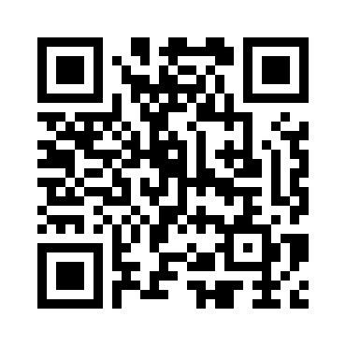
Got Feedback?
Scan this QR code to take the course survey!

Slide 130
Checkpoint Answers
Slide | Answer
30 | b) The Gaining REP - only the Gaining REP may initiate the Rescission process.
31 | True - providing any relevant information assists in the timely resolution of the MT.
32 | False - per PUC Subst. Rule 25.474(j), a customer has the right to rescind the terms of service without penalty or fee of any kind.
33 | c) 2 business days - once the TDSP has transitioned the MT to “Ready to Receive”.
51 | False - this is not a valid reject reason, the Losing CR should regain the ESI ID and execute the Current Occupant process.
52 | c) Either - is applicable and is dependent upon the Losing CR’s business practices.
53 | c) 12 days of MT submittal - Per the RMG 7.3.2.3.1 Reinstatement Date, the Losing REP shall submit the BDMVI no later than 12 days after submittal of the MarkeTrak.
54 | False - Generally speaking issuing a MVO on an active ESI will create a light out situation at the incorrect address. An Inadvertent Gain MT should be submitted to resolve the incorrect address.

Slide 131
Checkpoint Answers
Slide | Answer
70 | True - Any completed MVI/Switch or MVO transactions received after the initial transaction that caused the IAG will render the IAG regain process invalid.
71 | a) The best practice is for Losing CR’ to send their BDMVI’s as soon as the TDSP gives the ok to send the BDMI. With each passing day there is an increased risk of new transactions being sent on the impacted ESI ID.
72 | c) Using the MarkeTrak Rolodex tool to identify and reach out to escalation contacts within the non communicating CR’s organization.
98 | b) The Gaining REP – valid IAG & IAL MTs will only count toward the Gaining REP’s total
99 | False – Assigned REP #s will remain consistent for the market reporting
100 | e) All of the above – If all REPs work to drive efficiencies in their processes, the market will benefit

Slide 132
IAG Reduction
Market Challenge

Slide 133
Market Challenge – Q2 2015
Goals
Collectively, by the end of 2015, reduce IAGs by at least 25% from today’s volume
Speed up the resolution cycle = minimize the customer impact as much as possible

Slide 134
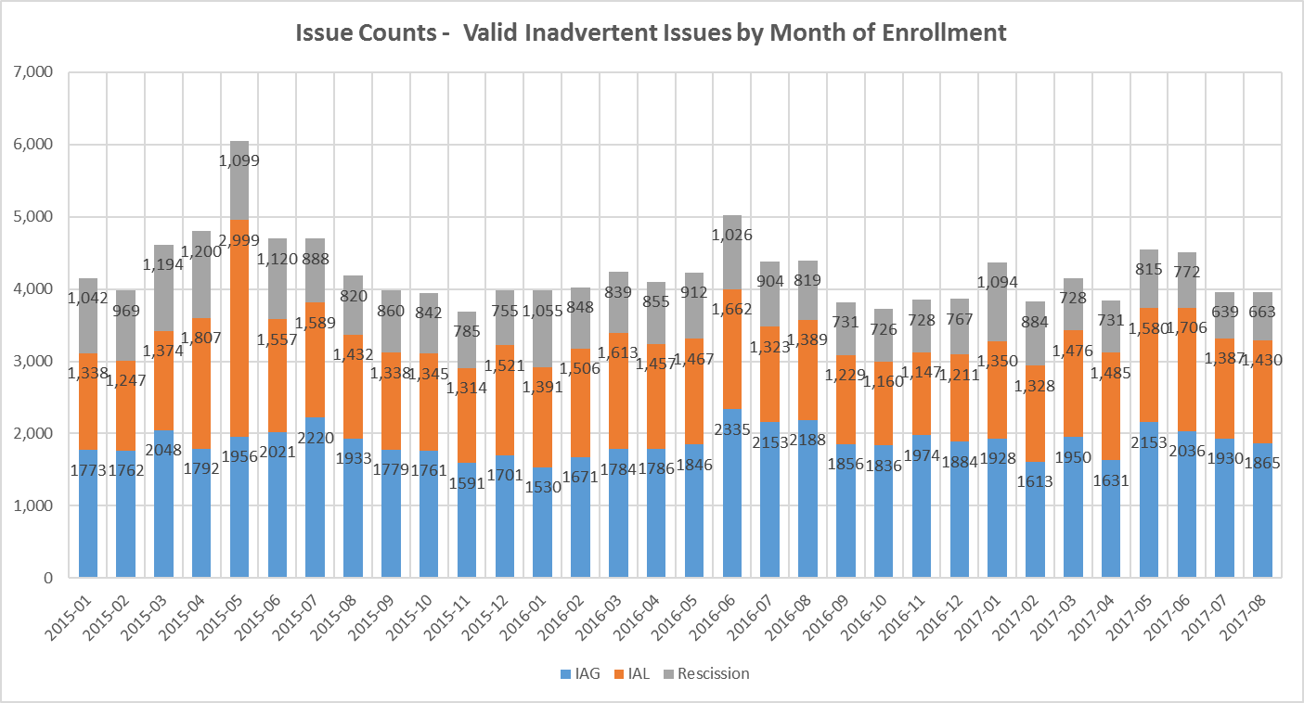
Did we achieve our goal?
Overall % Reduction from 2015 to 2016 = 6.62%
Overall % Reduction from 2016 to 2017 YTD = 7.80%
Volume of Enrollments = 0.5% increase
Volume of IAG/IAL/RESC = 6.0% decrease

Slide 135
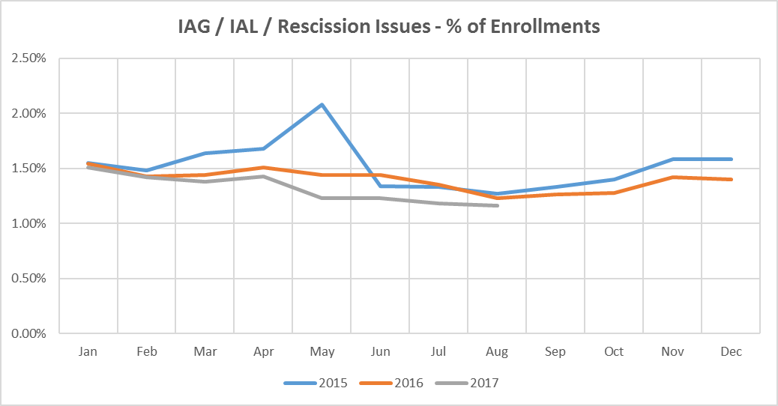
Did we achieve our goal?
 | Enrollments |  |  | IAG, IAL, Rescission
Year | SWI | MVI | Total | IAG | IAL | Rescission | IAG, IAL, Res Total | Overall %
2015 | 901,409 | 2,593,096 | 3,494,505 | 22,337 | 18,861 | 11,574 | 52,772 | 1.51%
2016 | 864,357 | 2,647,635 | 3,511,992 | 22,397 | 16,246 | 10,182 | 48,825 | 1.39%
2017 | 705,398 | 1,838,105 | 2,543,503 | 15,106 | 11,742 | 6,326 | 33,174 | 1.30%

Slide 136
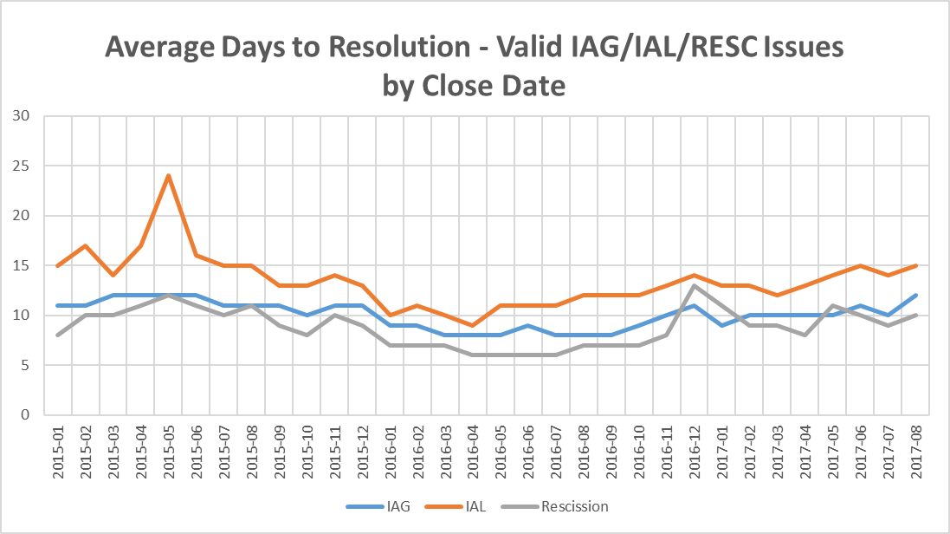
Did we achieve our goal?
Days to Resolution
Year | IAG | IAL | Rescission
2015 | 11 | 16 | 10
2016 | 9 | 11 | 7
2017 | 10 | 14 | 10
Overall improvement in timeliness from 2015 to 2016

Slide 137
What has changed?
The ERCOT market stakeholder process recommends changes to Market Rules and Operating Guides.
Retail Market Guide Revision Request (RMGRR) | Title | Approved Date | Description
RMGRR 139 | Date Change & Evaluation Window | 5/23/16 | Removal of the 1-day evaluation window for ERCOT and now allows for Date change (814_12) and cancel (814-08) transactions to be sent the day prior to a scheduled transaction
RMGRR 133 | Clarification of IAG Valid Reject Reasons | 9/21/15 | Removed ‘customer intent’ from the valid reject reasons for a Losing REP and clarified ‘customer intent’ for the Gaining CR
RMGRR 129 | Customer Rescission Timeline | 2/2/15 | Revised the timeline for the processing of Customer Rescissions from the normal IAG processing timeline to 2 Business Days for the Losing CR to ‘Agree’ followed by another 2 Business Days to submit a BDMVI once the TDSP is ‘Ready to Receive’
RMGRR 128 | Reinstate Critical Care Status after IAG | 12/22/14 | TDSP will restore a critical care status to an ESI that may have been removed due to an IAG
RMGRR 121 | Clarification of IAG Process | 2/17/14 | Clarified the valid reject reasons for both the Gaining CR and the Losing CR

Slide 138

Why is this important to the market?
These recommendations are opportunities to refine processes, seek efficiencies, and ultimately improve the customer experience.
REPs should be willing to be accountable to each other regarding IAGs, working together to continue to drive solutions to the market.
Reduce customer complaints
Address customer issues faster
Consume fewer back-office resources for REPS, TDSPs, ERCOT, & PUCT

Slide 139
How can we drive efficiency?
What can we all do to reduce the number of Inadvertent Gains/Losses in the market?
Analyzing why they occurred – trending, categorizing, and root causing
Execute techniques for preventing them going forward
Streamline management of MarkeTraks
Reporting to measure success

Slide 140
How can we drive efficiency? Analyzing
Analyzing why IAGs occurred …
Review the data and categorize root causes of the issue, such as:
Customer issue/error (wrong address- mailing vs service address)
Agent issue/error (wrong address- mailing vs service address)
System issue (order not processing)
Error by other REP (losses)
Back office error
Web portal error ( house meter/building service ESI ID vs apartment)
Each of these root causes may be further broken down and addressed accordingly:
  Coaching, coaching, coaching for agents who fail to comply with approved processes (issuance of MVOs to correct errors)
  Internal reporting identifying offending REPs and reaching out with opportunities to solution gaps in processes
  Education of agents on proper transactions

Slide 141
How can we drive efficiency? Execution
Execute techniques for preventing IAGs going forward …
Confirm service address via ERCOT, meter number, etc.
  Mailing address vs Service address vs 911 address confusion
  simply restating address prior to authorization of enrollment (Third Party Verification)
  ensure self-service web portals have proper validations (an apartment unit that may inadvertently enroll the house/building services meter)
Alerts on ESI IDs for which an IAG is in progress to ensure improper transactions do not occur to break IAG or create a lights out situation
Issuance of proper transaction – utilize a Cancel w/Approval MT, if applicable, in lieu of an IAG situation

Slide 142
How can we drive efficiency? Streamline
Streamline management of MarkeTraks …
Utilize customized MarkeTrak reporting features to organize “your buckets” into the following categories to allow for prioritization of your daily work such as:
  “ready to receive” – will display any MTs requiring BDMVIs
  “unexecuted” – gains – requiring closure
  “unexecuted” – losses – requiring closure
  “begin working” – gains
  “begin working” – losses
  Setting up personalized dashboard for multi-views

