Slide 1
NPRR864 – Discussion on Scaling Factor for Costs of Shorter Start Time Resources
David Maggio
February 13, 2018

Slide 2
Objective
Modify the costs of resources with cold start times less than or equal to 1 hour so that RUC will recommend those resources, when possible
Desired order:
Dispatch online resources
Commit fast-start resources
Commit non-fast-start resources
The cost of dispatching online resources creates a floor for scaling of fast-start resources
What scaling factor accomplishes this objective?

Slide 3
Costs as Seen by the RUC Optimization
Cost of dispatching online resources
Proxy Energy Offer Curves (EOCs) based on scaled Mitigated Offer Caps (MOCs)
Cost of committing offline resources
Startup cost
Cost of operating at LSL for minimum online time
Proxy EOC
Proxy EOCs are MOCs scaled by 0.1%

Slide 4
How RUC Selects a Resource (Simplistically)
When RUC has multiple options to resolve a violation, RUC selects resources based on:
Lowest total commitment cost, if there are multiple resources that can completely resolve the violation independently
Lowest average energy cost, if multiple resources are needed to resolve the violation
Average energy cost also defines the competition between committing offline resources and dispatching online resources

Slide 5
Basis for Analysis
Objective
Examine fleet to determine range of 0-LSL costs as seen by RUC for two Cold Start Duration categories:
“Fast Start” – less than or equal to 1 hour
“Slow Start” – greater than 1 hour
Determine scaling factor to influence RUC to prefer commitment of the “Fast Start” category.
Unique Resources in Study
Cold Start Duration | Count
<= 1 hour | 81
> 1 hour | 79

Slide 6
Basis for Analysis
Analysis Specifics
Took Sample of cost data from 48 hours between Jan2016 – Dec2017.
Identified Resource parameters and COP submissions that were valid just prior to the HRUC for the specific hour under consideration, where the specified hour was the first hour in the study period.
Resource Type not in ('CLR','NCLR','WIND','RENEW','PWRSTR','PVGR‘,’NUC’,’CLLIG’)
Resources with a status of “OFF”
Resources with cold start time greater than 10 hours were not considered.
Calculated cost for committing each unit at LSL for the minimum run time for each hour using
Method 1:
Using Offers, Verifiable Costs*150%, or Resource Category Generic Costs*150%, when appropriate, for “Slow Start” Resources
Verifiable Costs or Resource Category Generic Costs, when appropriate, for “Fast Start” Resources
Method 2:
Using only Verifiable Costs or Generic Costs, when appropriate, for all Resources

Slide 7
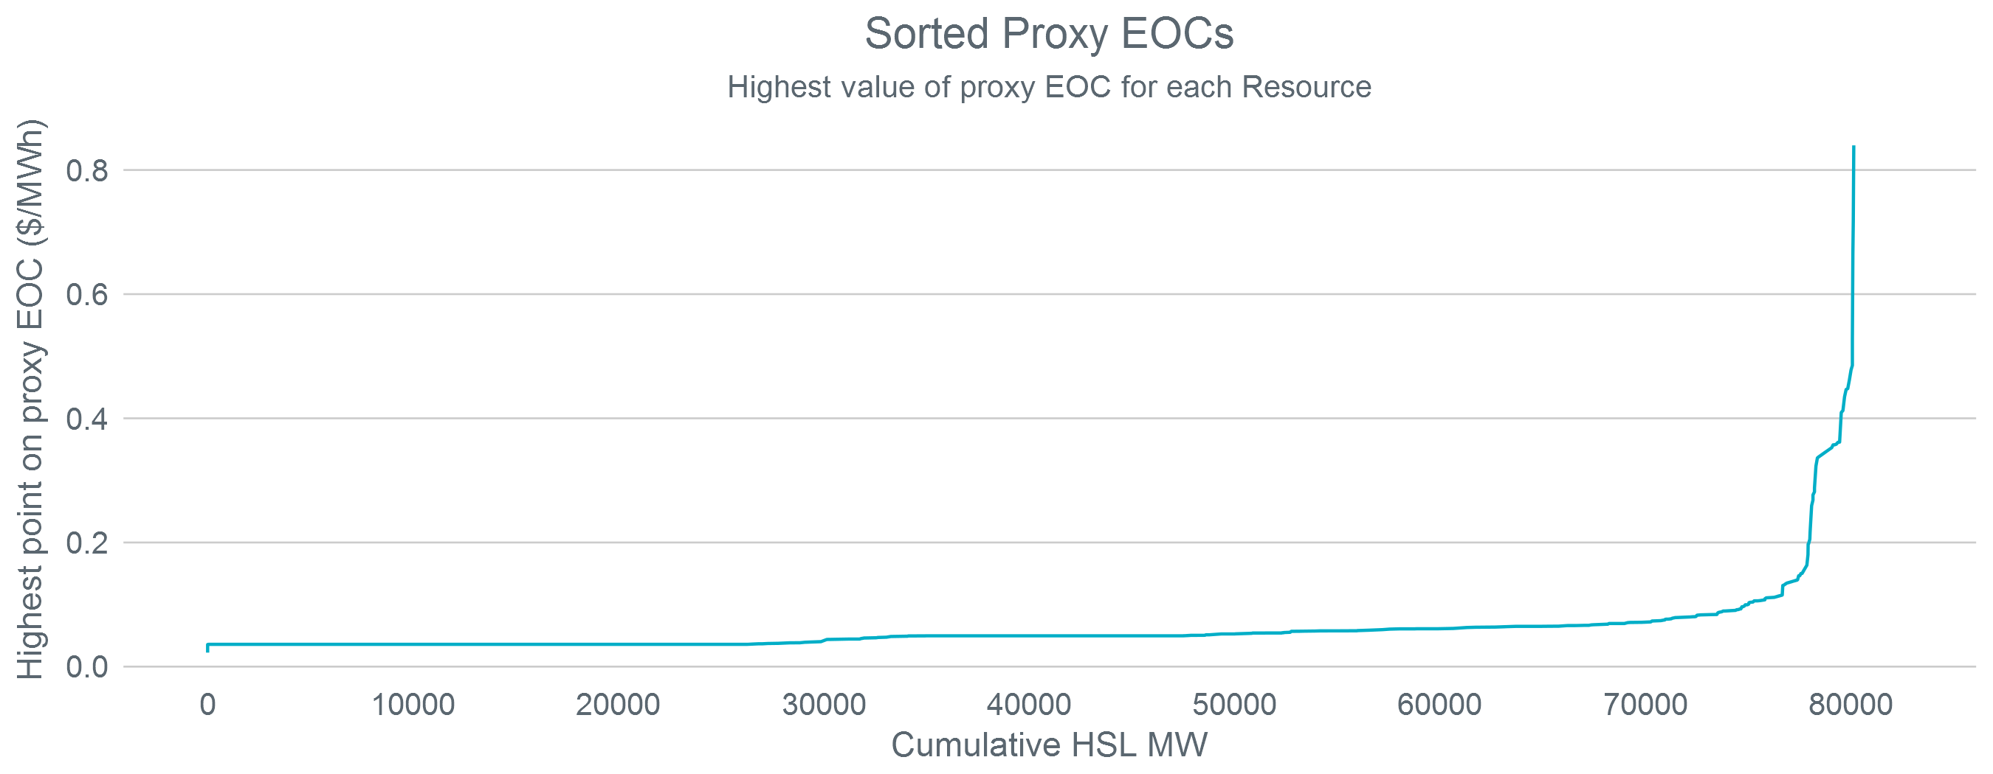
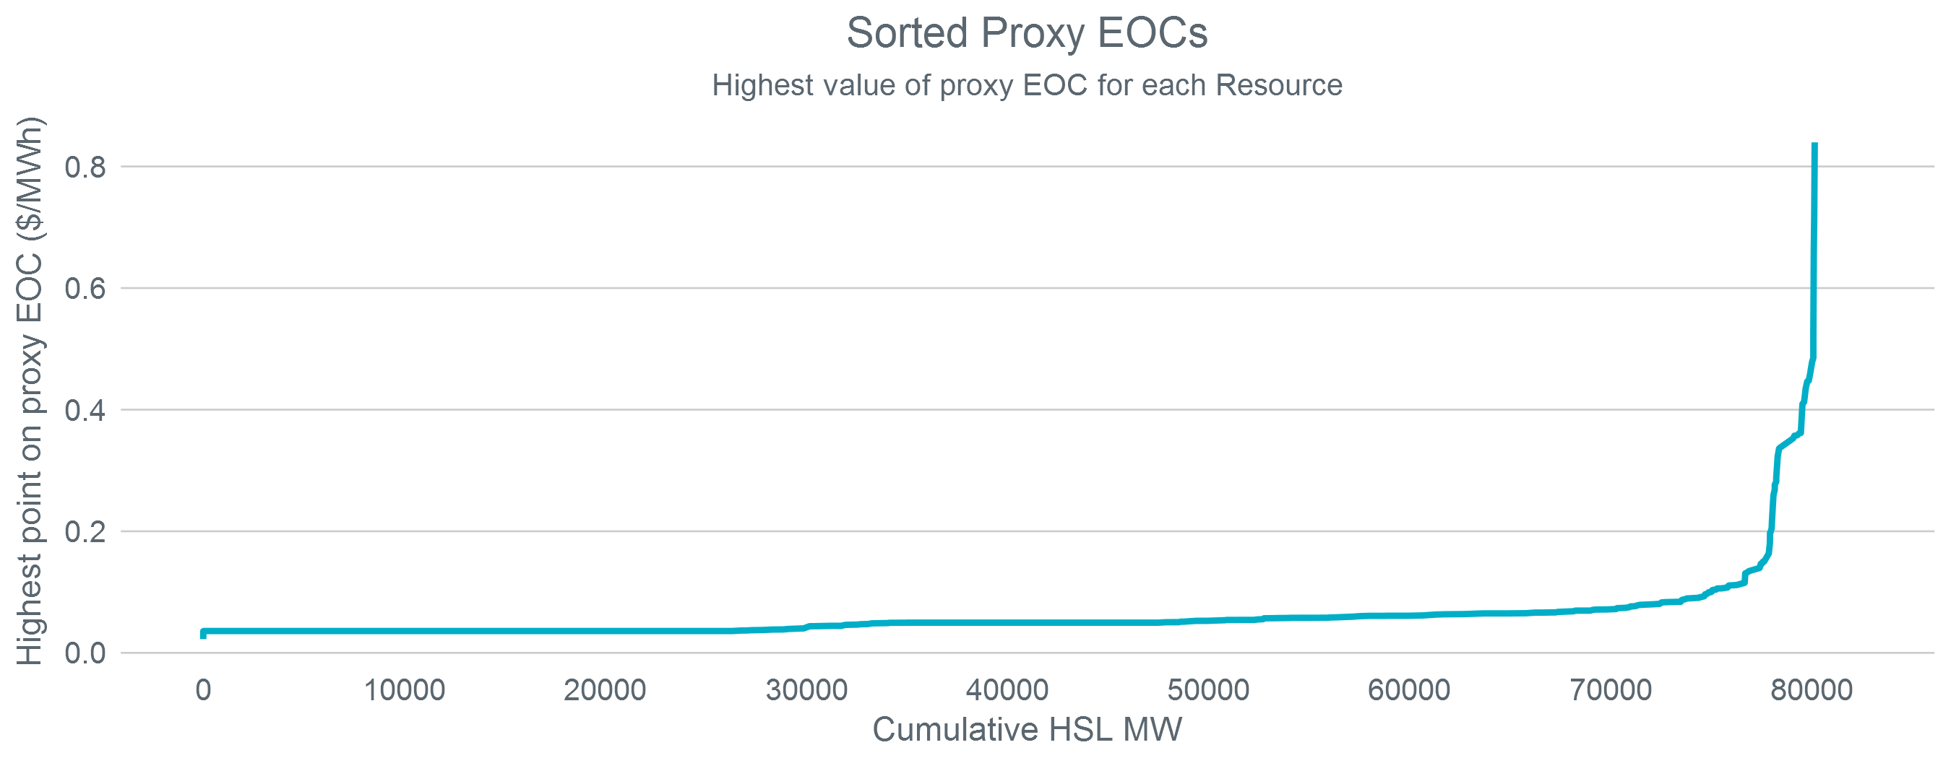
Cost of Dispatching Online Resources
The median proxy EOC is around $0.04/MWh
Proxy EOCs for QSGRs are in the range of $0.80/MWh

Slide 8
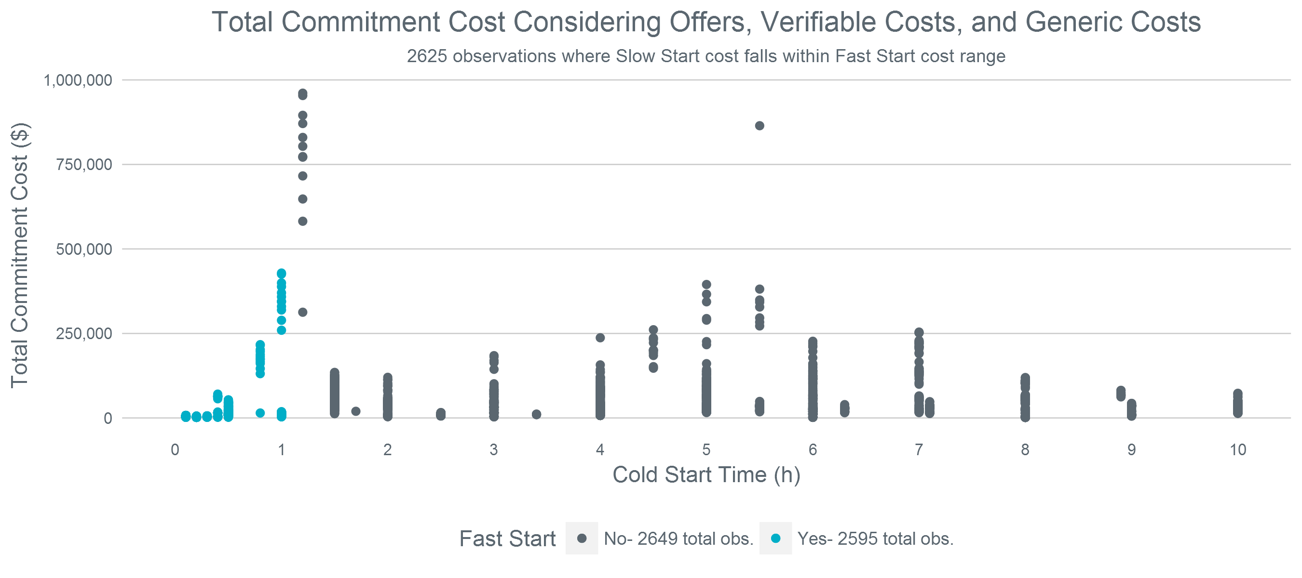
Total Commitment Cost
Per current NPRR 864 language, fast-start resources only use verifiable or generic costs

Slide 9
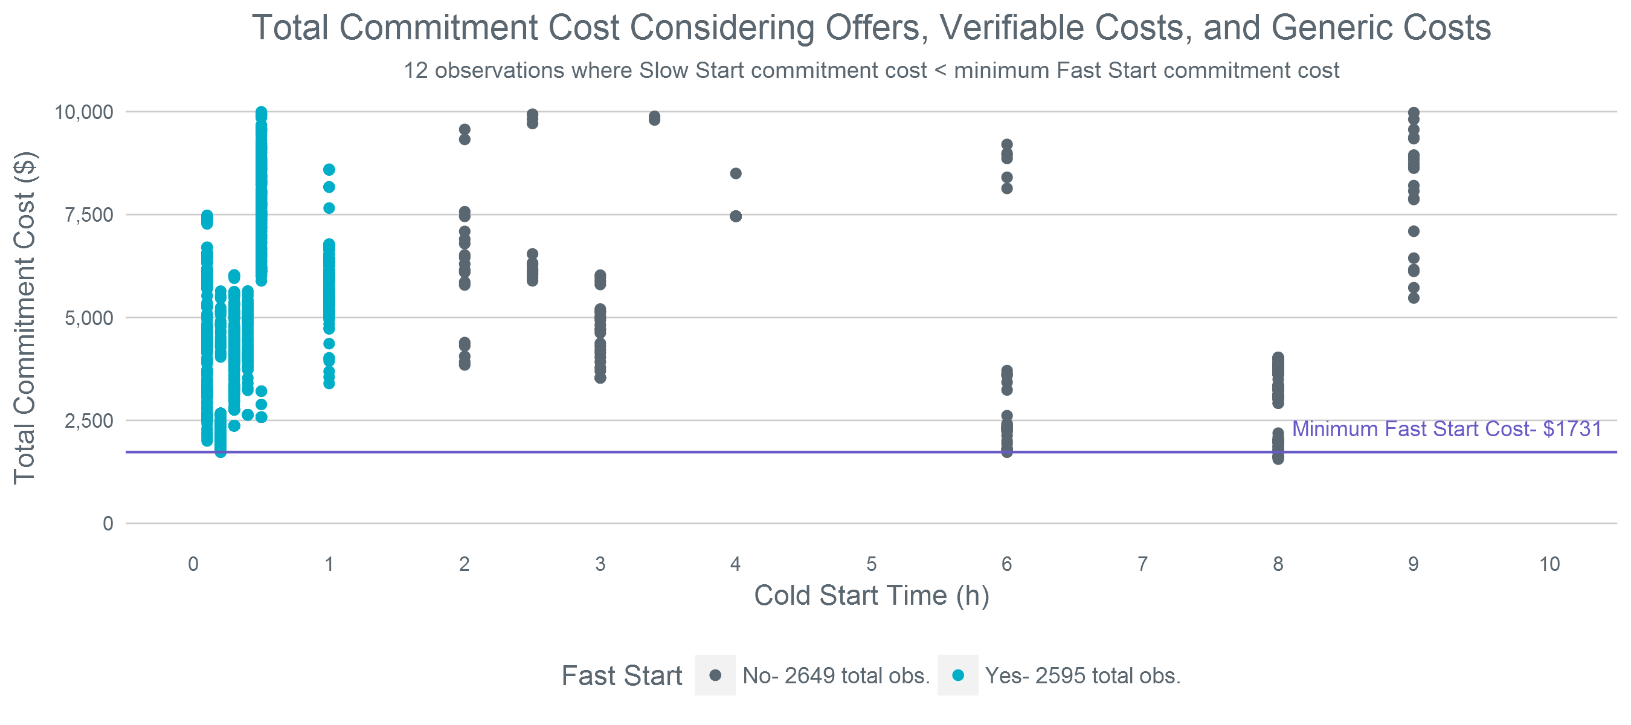
Total Commitment Cost - A Closer Look
Per current NPRR 864 language, fast-start resources only use verifiable or generic costs

Slide 10
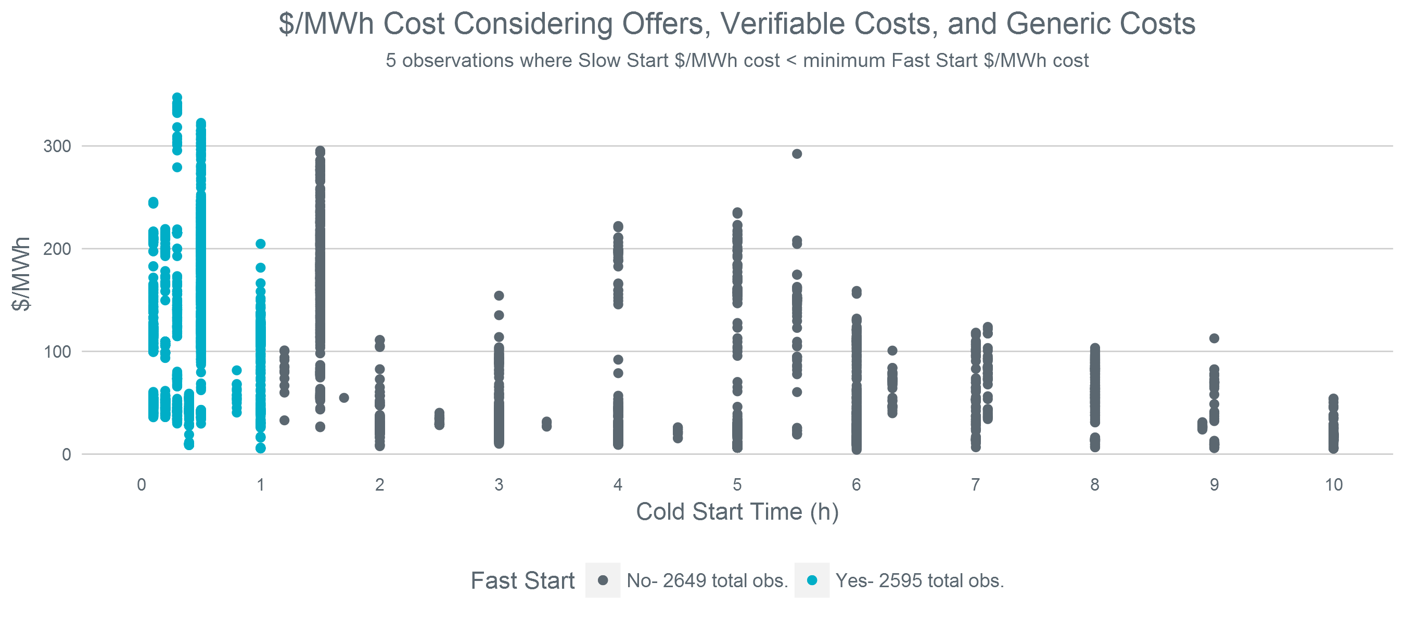
Average Energy Cost
Per current NPRR 864 language, fast-start resources only use verifiable or generic costs

Slide 11
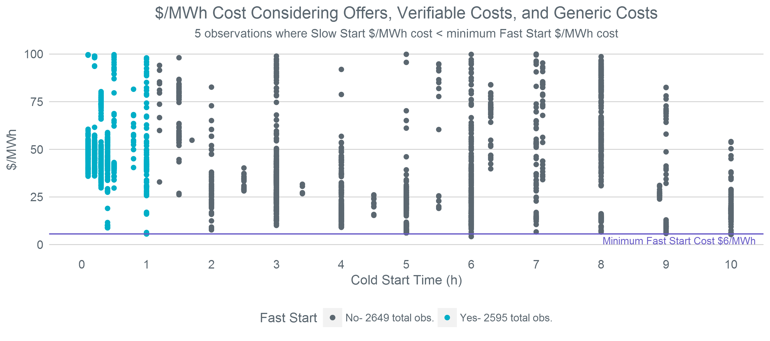
Average Energy Cost - A Closer Look
Per current NPRR 864 language, fast-start resources only use verifiable or generic costs

Slide 12
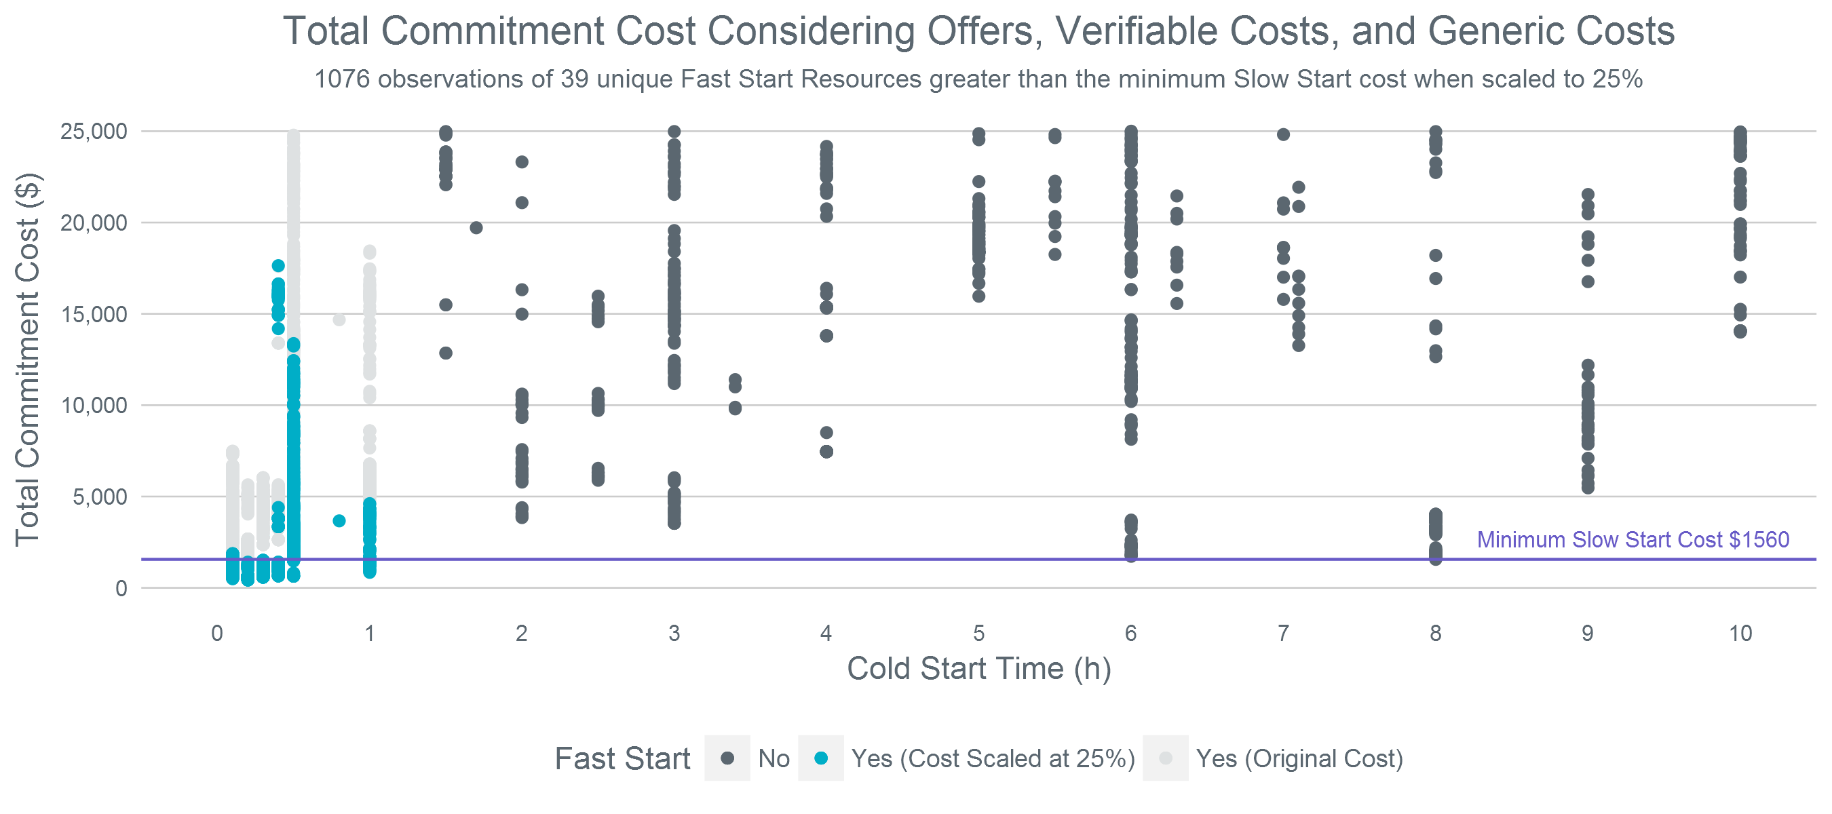
Total Commitment Cost – 25% Scaling
Per current NPRR 864 language, fast-start resources only use verifiable or generic costs

Slide 13
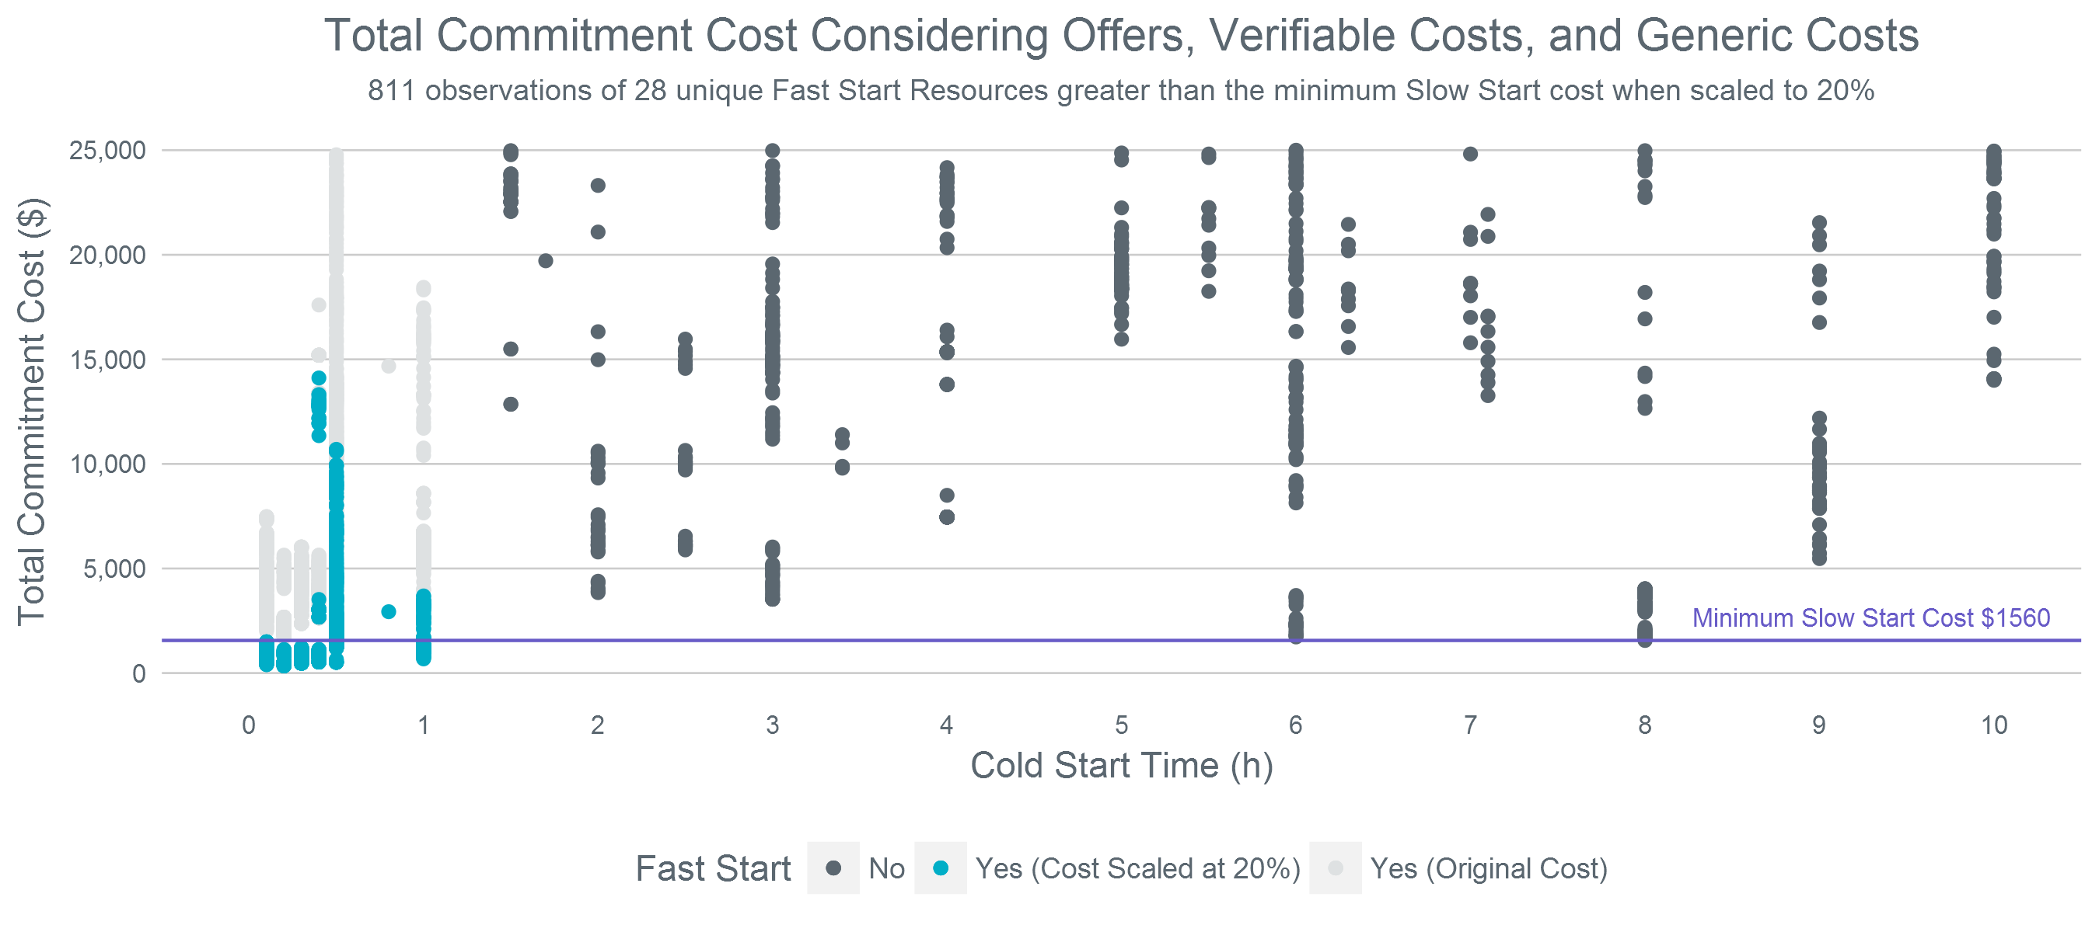
Total Commitment Cost – 20% Scaling
Per current NPRR 864 language, fast-start resources only use verifiable or generic costs

Slide 14
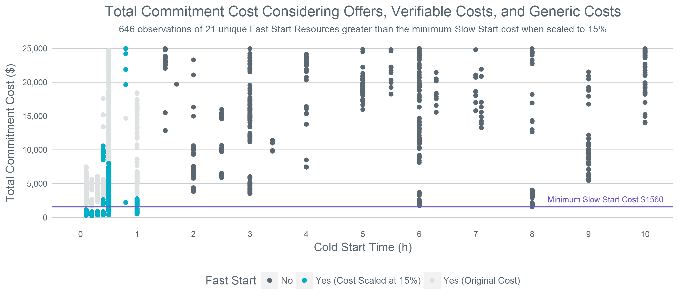
Total Commitment Cost – 15% Scaling
Per current NPRR 864 language, fast-start resources only use verifiable or generic costs

Slide 15
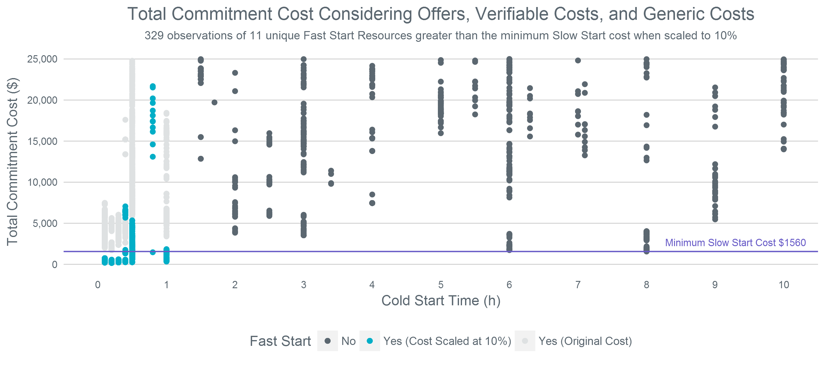
Total Commitment Cost – 10% Scaling
Per current NPRR 864 language, fast-start resources only use verifiable or generic costs

Slide 16
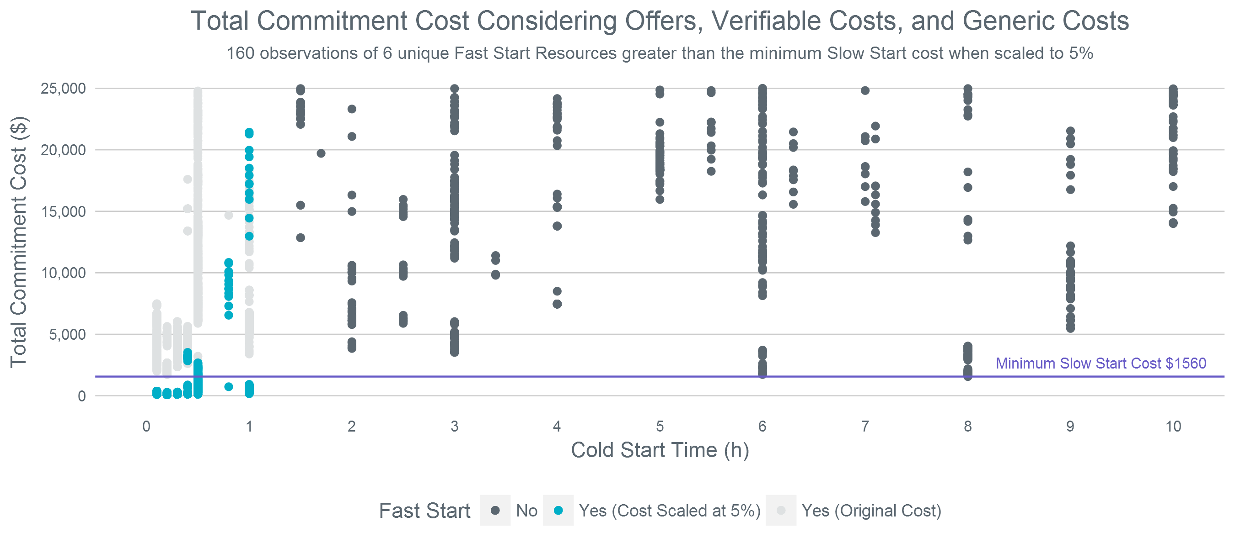
Total Commitment Cost – 5% Scaling
Per current NPRR 864 language, fast-start resources only use verifiable or generic costs

Slide 17
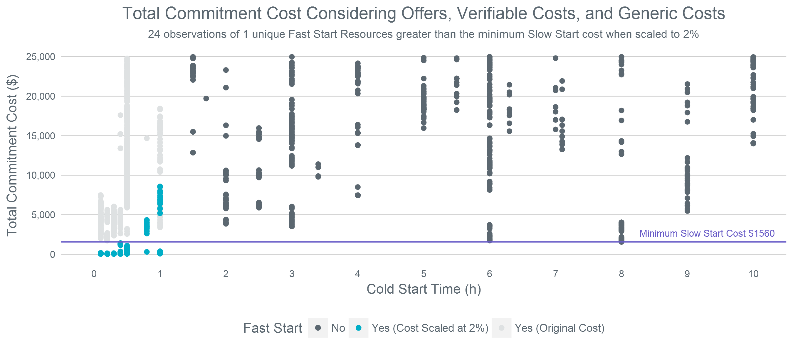
Total Commitment Cost – 2% Scaling
Per current NPRR 864 language, fast-start resources only use verifiable or generic costs

Slide 18
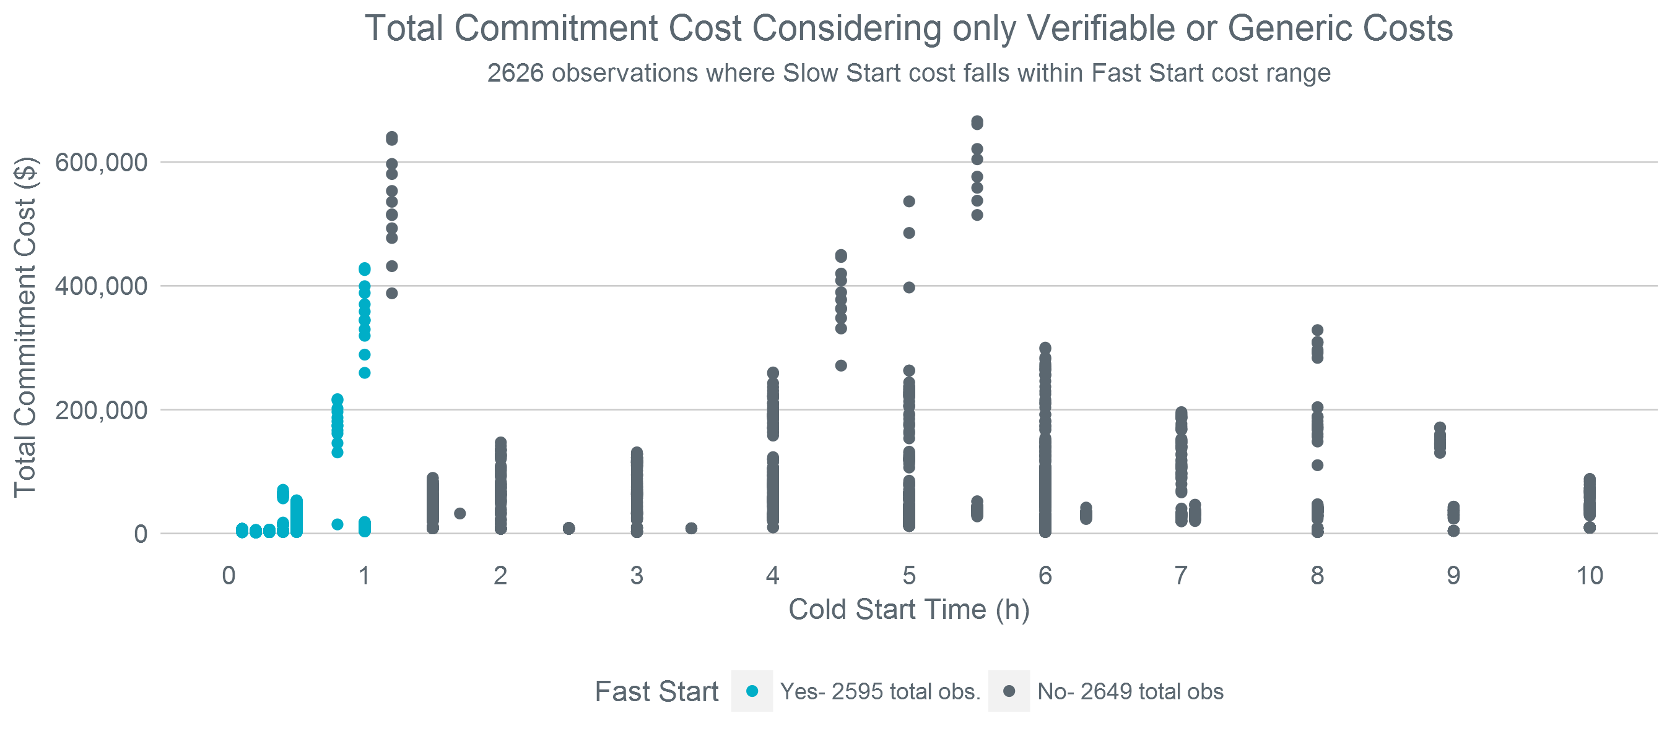
Total Commitment Cost – Removing Offer Logic
Both fast-start and non-fast-start resources use verifiable or generic costs

Slide 19
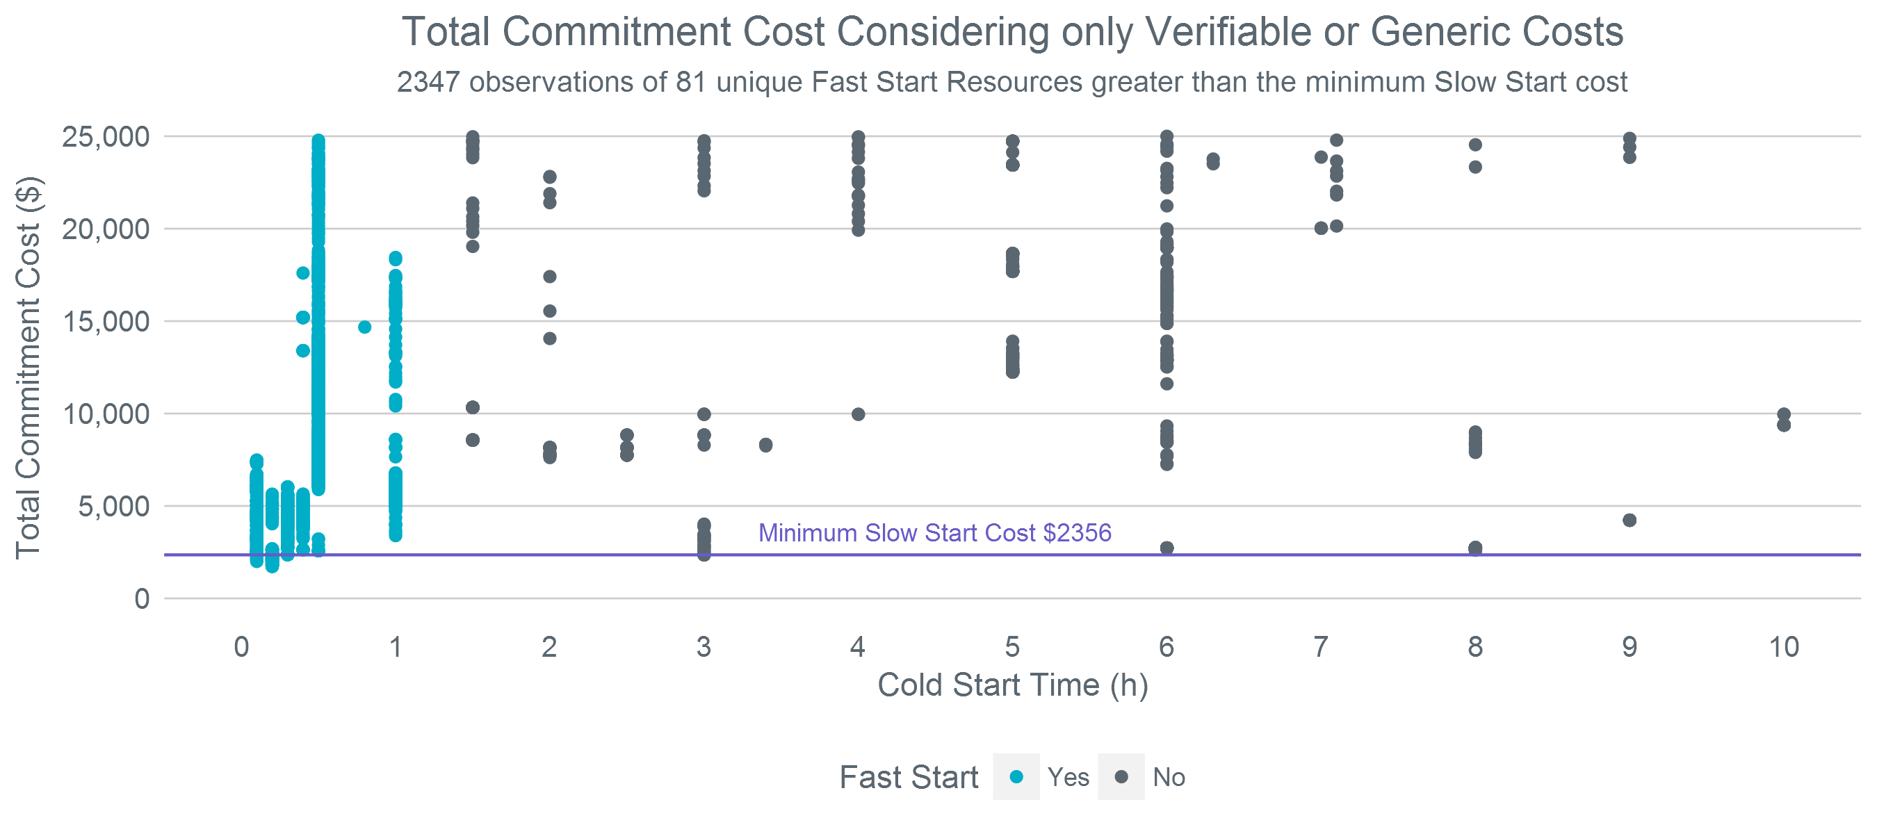
Total Commitment Cost – Removing Offer Logic – A Closer Look
Both fast-start and non-fast-start resources use verifiable or generic costs

Slide 20
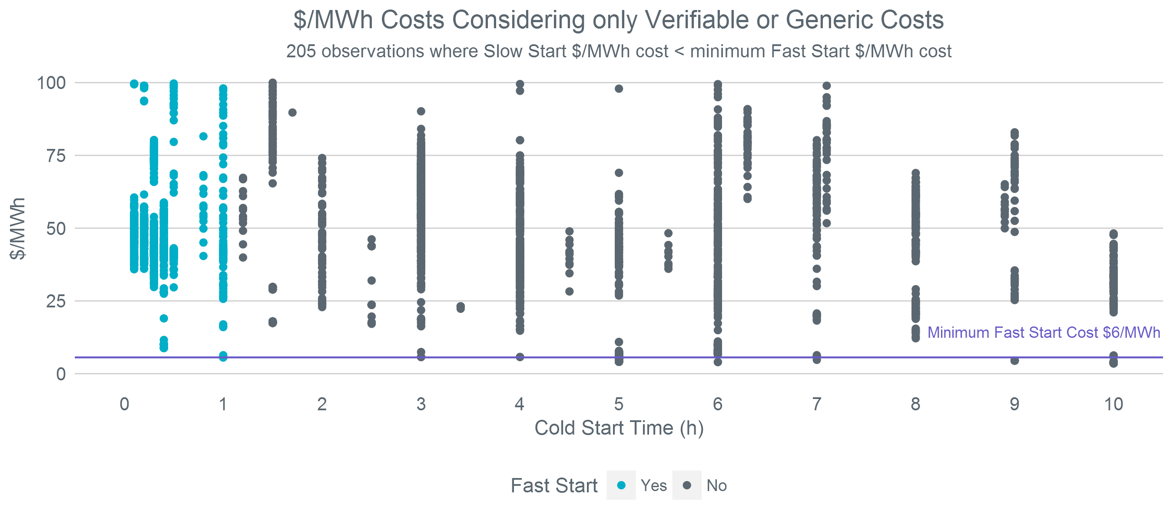
Average Energy Cost – Removing Offer Logic – A Closer Look
Both fast-start and non-fast-start resources use verifiable or generic costs

Slide 21
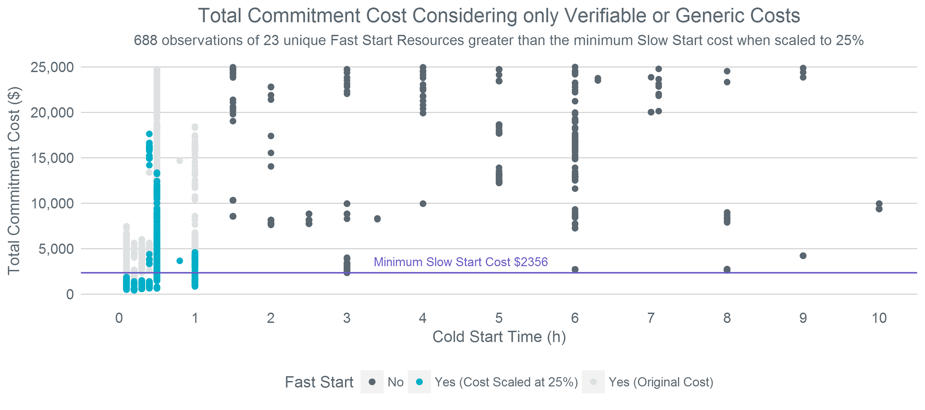
Total Commitment Cost – Removing Offer Logic – 25% Scaling
Both fast-start and non-fast-start resources use verifiable or generic costs

Slide 22
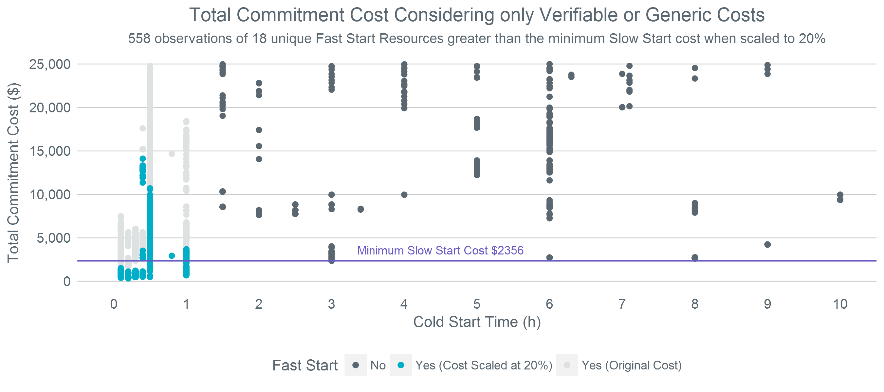
Total Commitment Cost – Removing Offer Logic – 20% Scaling
Both fast-start and non-fast-start resources use verifiable or generic costs

Slide 23
Total Commitment Cost – Removing Offer Logic – 15% Scaling
Both fast-start and non-fast-start resources use verifiable or generic costs

Slide 24
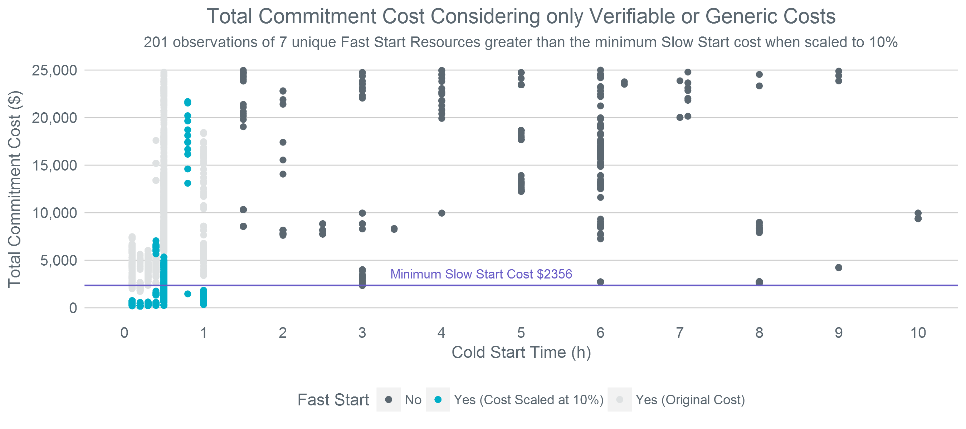
Total Commitment Cost – Removing Offer Logic – 10% Scaling
Both fast-start and non-fast-start resources use verifiable or generic costs

Slide 25
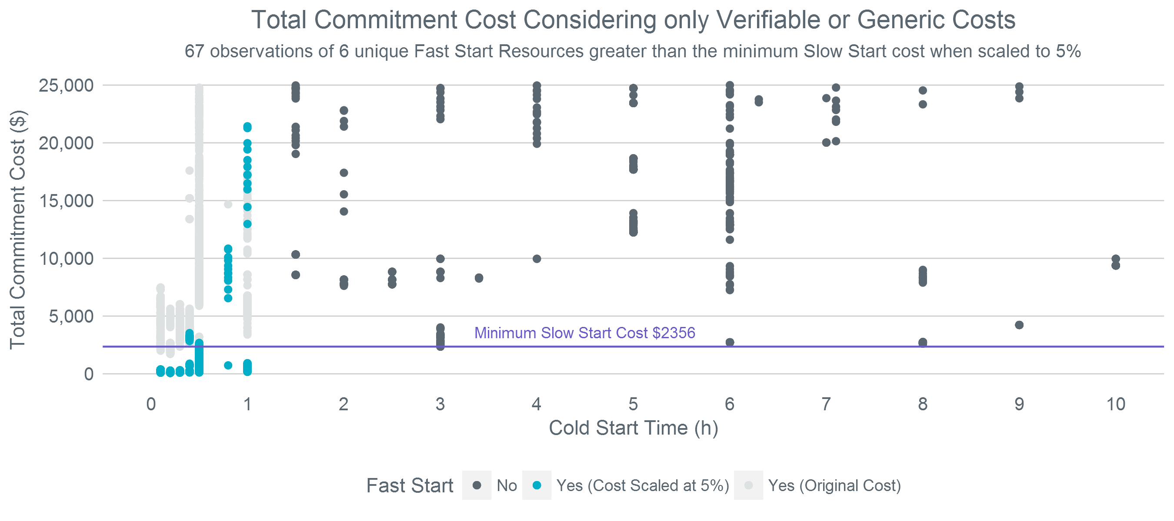
Total Commitment Cost – Removing Offer Logic – 5% Scaling
Both fast-start and non-fast-start resources use verifiable or generic costs

Slide 26
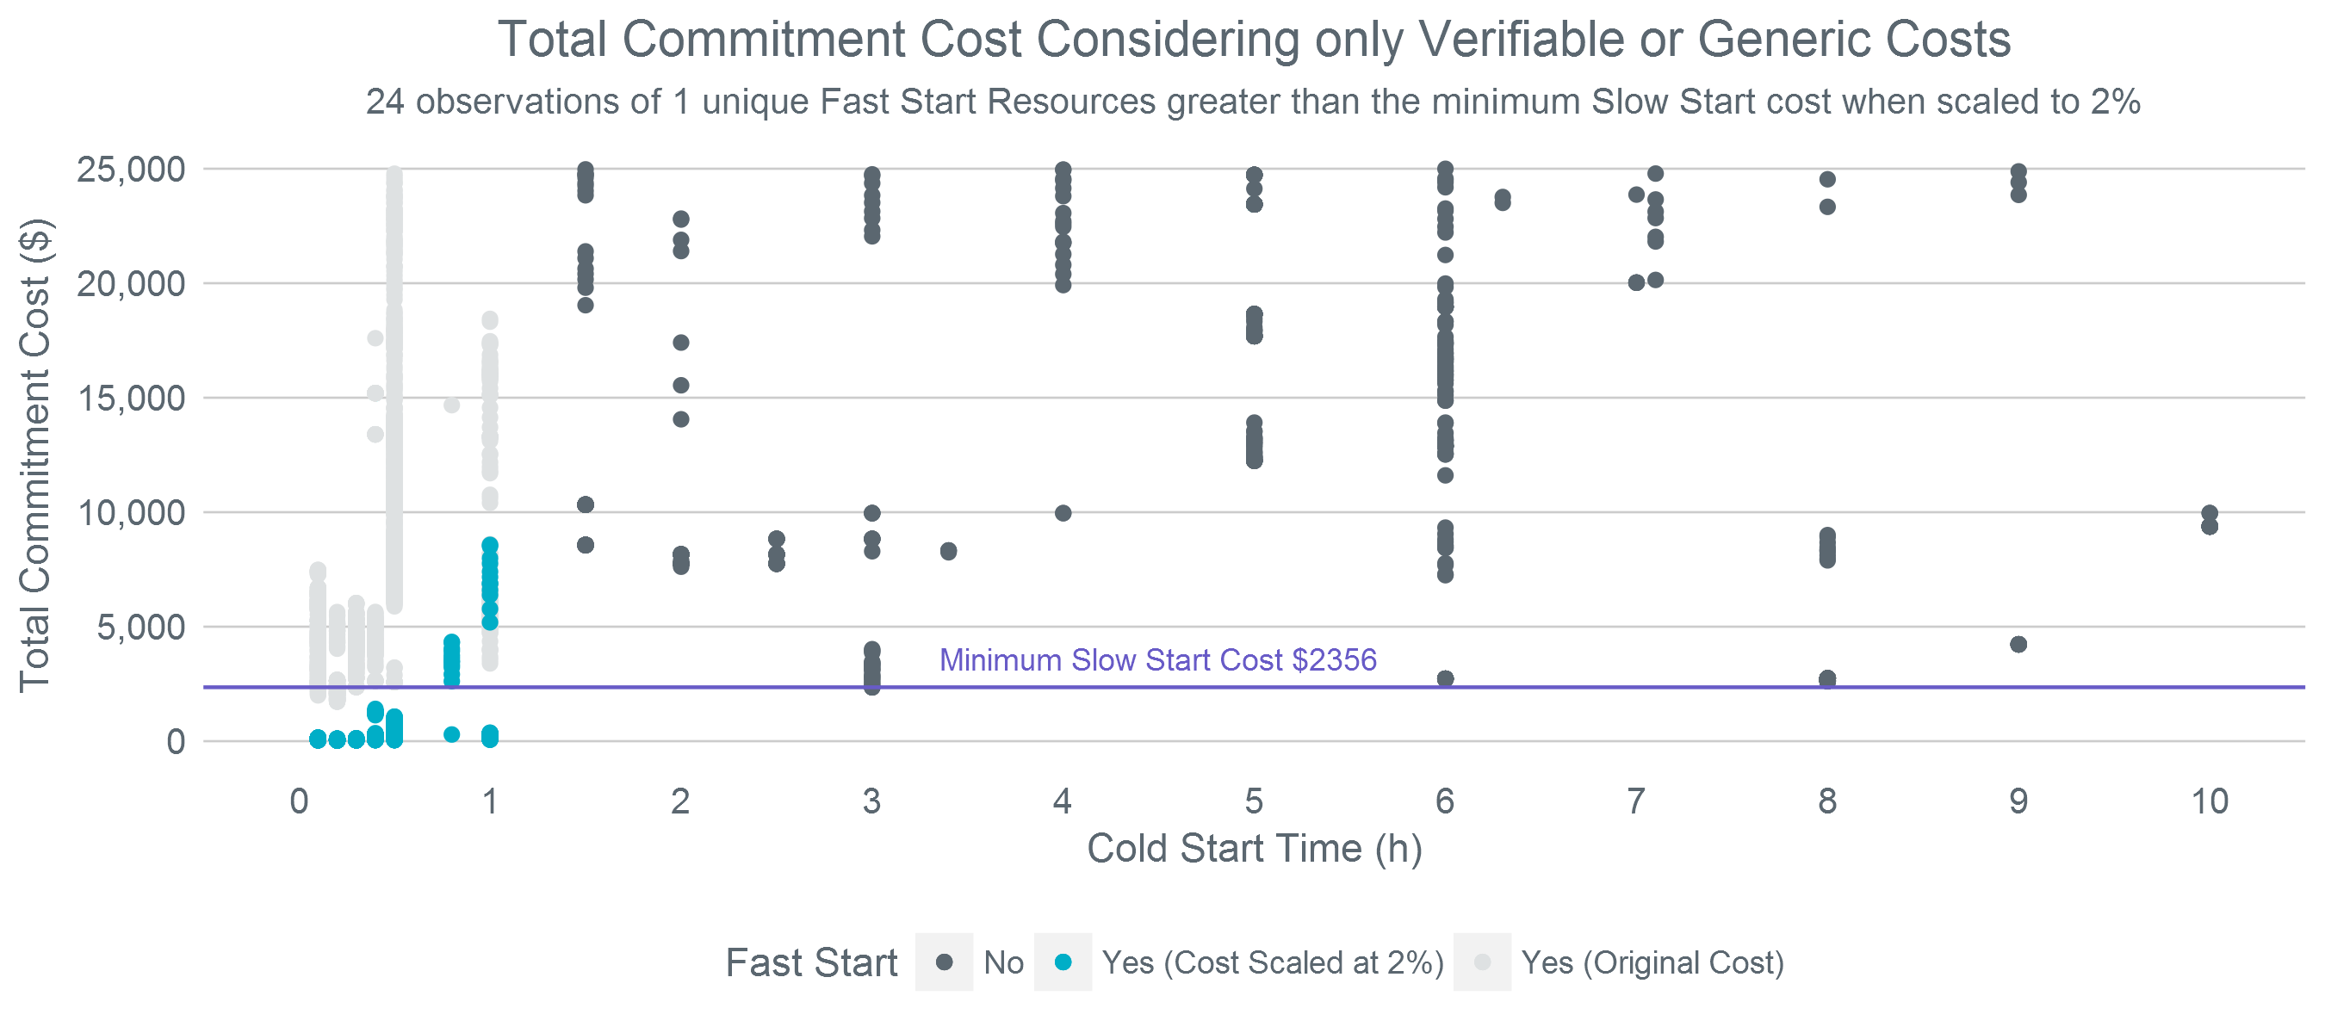
Total Commitment Cost – Removing Offer Logic – 2% Scaling
Both fast-start and non-fast-start resources use verifiable or generic costs

Slide 27
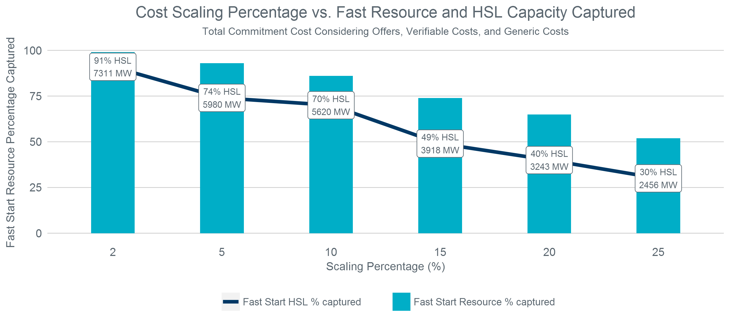
Result of Selected Scaling Values
Per current NPRR 864 language, fast-start resources only use verifiable or generic costs

Slide 28
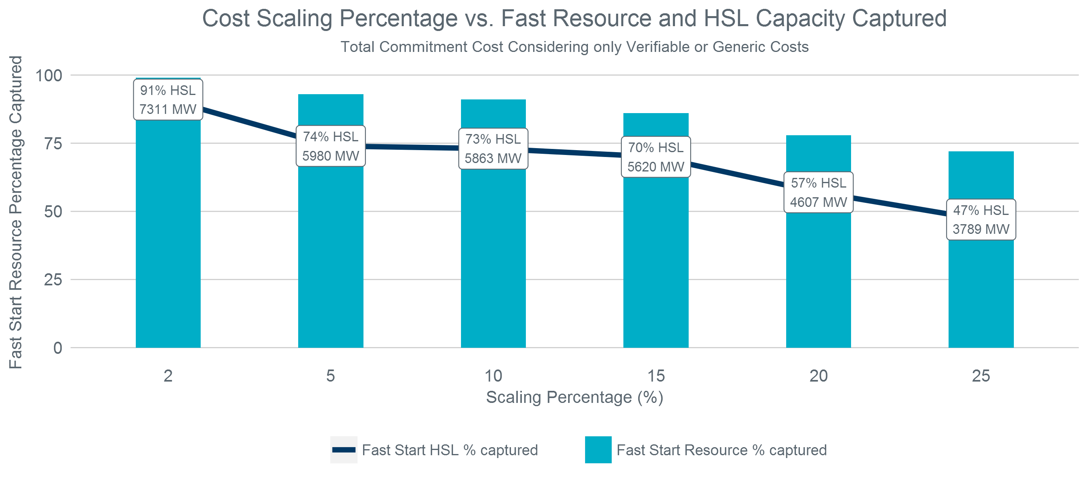
Result of Selected Scaling Values
Both fast-start and non-fast-start resources use verifiable or generic costs

Slide 29
Potential for Scaled Fast Start Costs Competing with Dispatch of Online Resources
A concern that needs to be considered is that scaling costs for fast-start Resources could result in the commitment of those Resources competing with the dispatch of other Resources already planned to be online
This would lead to more recommended commitments from the RUC engine and it could be unclear as to what was driving the recommendation.
A scaling of 15% should avoid this concern for the historical data but leaves little room for changes in natural gas prices
A scaling of 20% would allow for more fluctuation in natural gas prices
Less fast-start Resources would be lower cost than the lowest cost slow-start Resource, but fast-start Resources would be lower cost than most slow-start Resources

Slide 30
Next Steps
Discussion on whether or not to move away from using submitted offers for slow-start Resources
What additional analysis would be useful for future meetings?

