Slide 1
NPRR863, Creation of Primary Frequency Response Service Product
A Simple Alternative
Floyd J. Trefny
February 13, 2018

Slide 2
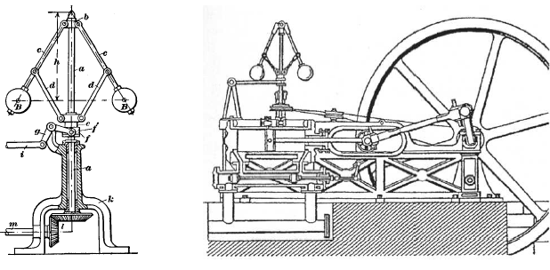
Generator Governors
A critical part of generation
plants since days of Edison
ERCOT is an island and has relied on generator governors as the “primary” frequency control device
Governors absolutely must be kept in service on all on-line generation units all the time
ERCOT’s Automatic Generation Control (AGC) is only a secondary control system

Slide 3
NPRR863 – A Bad Idea
Extremely costly to implement
Allows some on-line generators to operate without their governor(s) in service
Likely would cause a major system issue including potential blackout or system separation
System Operator and manual generator operator actions are too slow to manage some issues
Causes minimum Responsive Reserve to increase dramatically
Due to holding governor response capacity from the market; further reduces capacity allowed to serve load
Increases in reserve lowers energy costs for all generators

Slide 4
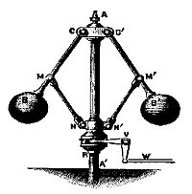
Primary Frequency Response
Use the current definition in Protocols
Require all synchronous Generators greater than 10 MW to keep their governors in service at all times
Strictly monitor the performance of each generation resource every time frequency deviation occurs greater than 0.1 Hz
Pay for performance to a Standard

Slide 5
Settlements
Pay all on-line synchronous Generators (greater than 10 MW) for each full hour based on a formula
Use MCPC for Responsive Reserve for each hour multiplied by a discount factor
The amount of PFR on an individual generator would be set at the tested frequency response that gives a 5% droop at 0.1Hz frequency deviation
Gen_{i} Payment = MCPC_{RRS} * Factor * PFR_{i}
where PFR_{i} is verified response at 0.1Hz

Slide 6
Setting the Factor
Factor would be the same for all generators greater than 10 MW
Factor would be set by the ERCOT Board once a year
Based to generally cover the costs of calibration, testing and operating with governors in service plus an incentive
ERCOT would have to predict the price of RRS for the next year
ERCOT would present their recommendations based on input from all Stakeholders
No true up based on actual RRS prices
ERCOT Board would not set a Factor that in ERCOT’s estimation would cause the total PFR payments to exceed $10M per year
Any overpayment from one year reduces next year Factor

Slide 7
Performance of PFR
ERCOT and the Performance Disturbance Compliance (PDC) group would review the actual performance of each generator for every frequency deviation greater than or equal to 0.1 Hz
Actual droop of each generator for each disturbance greater than 0.1 Hz would be calculated and posted for all stakeholders
Failure of any generator to respond appropriately would automatically stop payments for all future PFR payments
Payments would be restored following a future disturbance (greater than 0.1 Hz) where the generator passed
Egregious failures would claw-back all payments paid to an individual generator since the prior frequency deviation that the generator passed

