Slide 1
PWG
Discussion Annual Validation 2017
An investigative discussion into Residential Changes from Annual Validation 2017
Nikki Mckenna
ERCOT
2017

Slide 2
Investigative Process
Annual Validation algorithm for AMS changes was re-ran for 2015, 2016 and 2017.
Each AV has a three year period of look back (2015: 2015,2014 and 2013).
Only the winter months (January and February) are considered.
Process:
  Pull all the ESI ID’s in ERCOT
  Keep only those that are active
  Ensure they have 90% of monthly data for each of the 6 months looked at
  Calculate correlation of Average DB versus Daily Usage for each of the 6 months, changes as follows:
    ResLo to ResHi: 3 of 6 >=.6
    ResHi to ResLo: 6 of 6 <= .4

Slide 3
Investigative Process, cont.
Created a master database of all ESI ID’s and their Rsquare values for each of the AV Periods
  Master database was created using only CNP data
Looked at three different aspects:
  Flip Flops from year to year
  Verification of changes requested
  Weather

Slide 4
Flip Flops

Slide 5
Presentation regarding flip flops from two years ago was for AMS/IDR changes only.
To reiterate, it is not possible for IDR changes to flip flop in two consecutive years (2016 and 2017), however, an ESI ID can flop every two years (ex 2015 and 2017)
It is possible, although not common, for NIDR ESI IDs to change every year as the algorithm is different

Slide 6
AV 2016 to AV 2017
For AV 2017 there were a total of 43,505 changes for CNP Residential.
In comparing the change list sent to CNP for AV 2016 and AV2017, 6 ESI IDs were found on the list.
Each of the 6 ESI IDs NIDR’s which can potentially flip flop.

Slide 7
AV 2015 to AV 2017
For AV 2017 there were a total of 43,505 changes for CNP Residential.
In comparing the change list sent to CNP for AV 2015 and AV2017, 499 ESI IDs were found on the list.
Of the 499, 6 ESI ID’s were NIDR’s, leaving 493 ESI ID’s to be verified against the master rsquare database
ResLo to ResHi: 3 of 6 >=.6
ResHi to ResLo: 6 of 6 <= .4
Therefore, of the 43,505 requested change, 499 were ‘flip flops’, 499 out 43,505 is around .11% (a tenth of a penny)

Slide 8
Verification of Changes Requested

Slide 9
A random sample of 440 ESI IDs was selected from the AV 2017 change list.
*Sample was selected using proc survey select in SAS with a SRS method.
The ESI IDs in the sample were matched with their corresponding RSquare values in the master database created earlier.
The information was exported to Excel. Countif functions were used to count the RSquare values and compare to the change rules.
No exceptions were found
Two ESI ID’s did not have enough data and were still counted, 2 out of 440 is .45% of the data. Not a cause for concern.

Slide 10
Weather
Weather trends for the Coast weatherzone for January and February for AV periods for 2015, 2016 and 2017

Slide 11
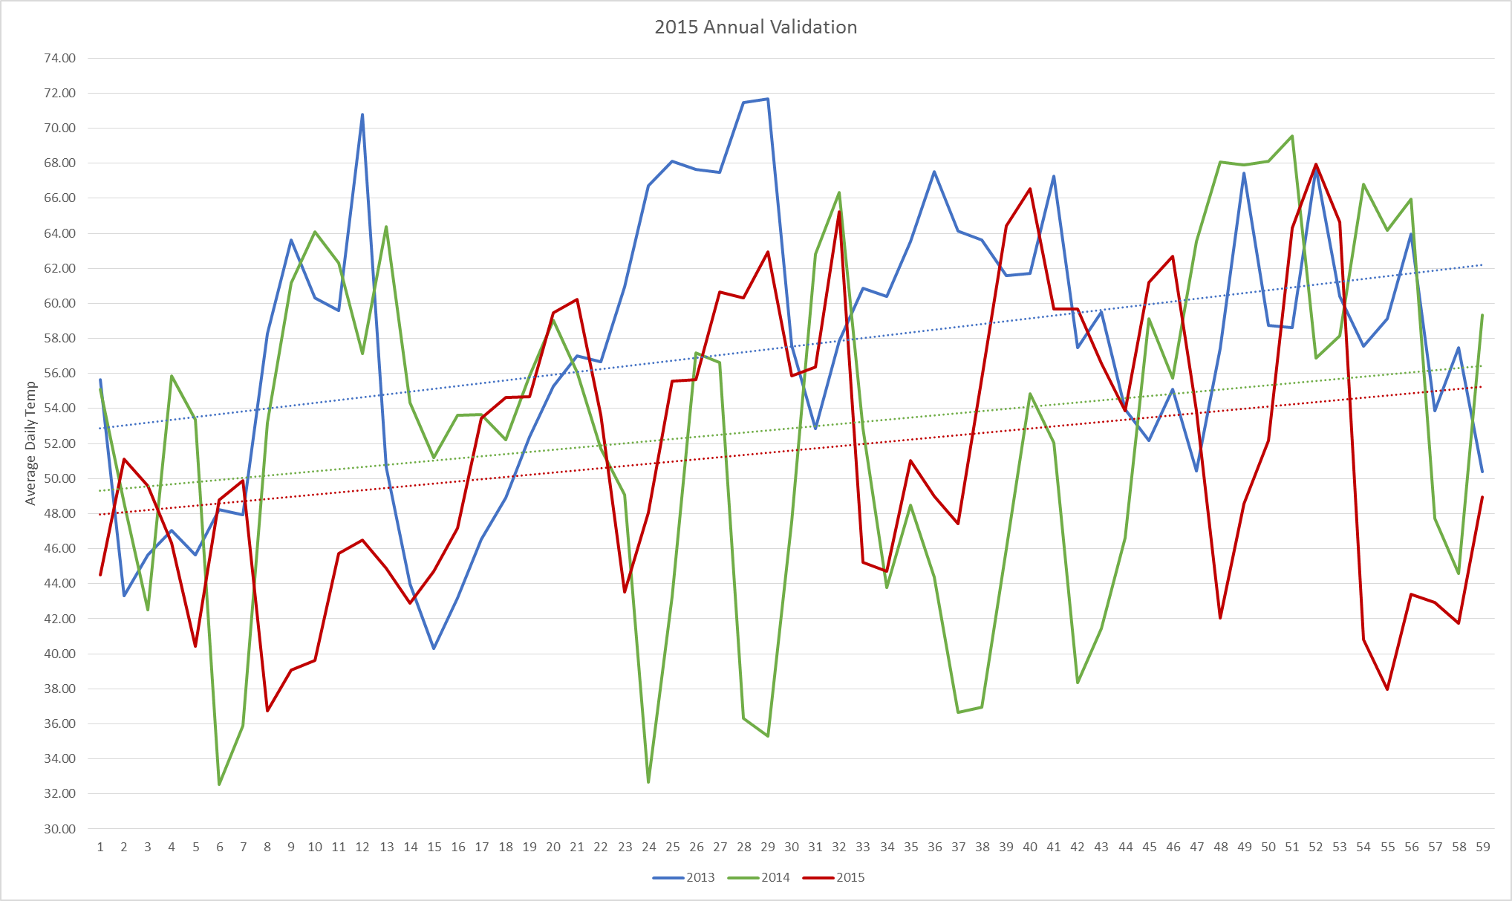
ResLo to ResHi: 78,656
ResHi to ResLo: 26,420
For the 2015 Annual Validation period, three winters were looked at: 2013, 2014 and 2015. As depicted in the graph to the left, it is safe to say those were three cool (cold) winters, thus it makes sense to have such a high number of changes to ResHi.
ResLo to ResHi: 3 of 6 >=.6
ResHi to ResLo: 6 of 6 <= .4

Slide 12
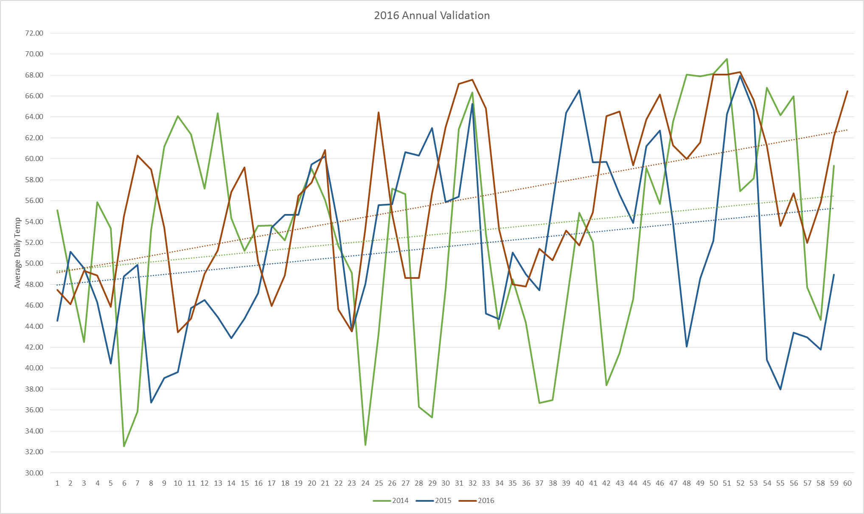
ResLo to ResHi: 21,089
ResHi to ResLo: 10,978
For the 2016 Annual Validation period, the 2013 winter is dropped off( the warmest of the last three winters) and 2016 is brought on and it is similar to the remaining two winters (2015 and 2014). Since the weather is similar, it is acceptable the correlation values would be similar, thus very few changes.
ResLo to ResHi: 3 of 6 >=.6
ResHi to ResLo: 6 of 6 <= .4

Slide 13
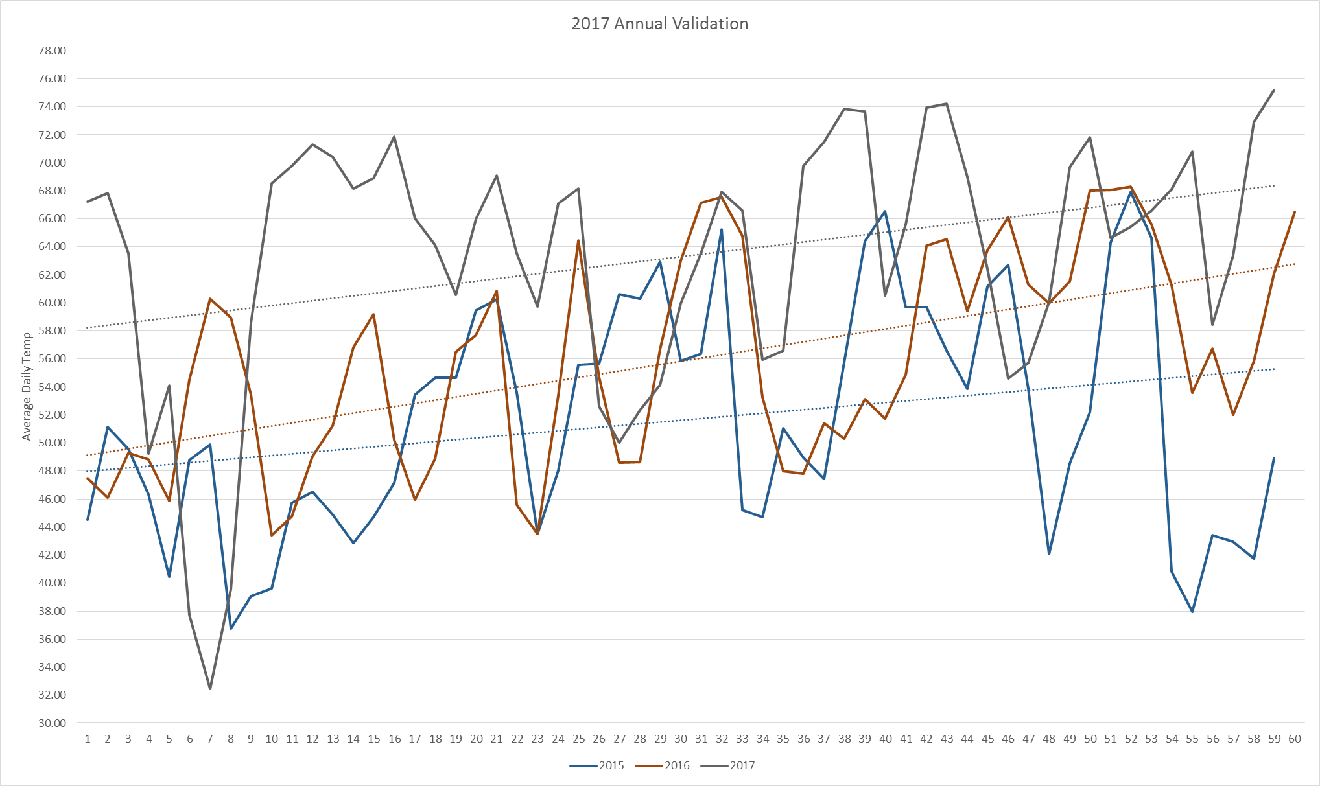
ResLo to ResHi: 15,734
ResHi to ResLo: 27,771
For the 2017 Annual Validation period, the 2014 winter dropped off and the 2017 winter came on, a very warm winter, thus adding many more observations with a low correlation.
ResLo to ResHi: 3 of 6 >=.6
ResHi to ResLo: 6 of 6 <= .4

Slide 14
Conclusions
Future Ideas
Once a RES Hi, always RES Hi
Change the RSquare Factors and/or the algorithm, days included based on temp
Only look at NIDR ESI IDs for Annual Validation
???
No significant flaws were found in the AMS/IDR algorithm for Residential Changes
Changes are highly dependent on type of winter

