Slide 1
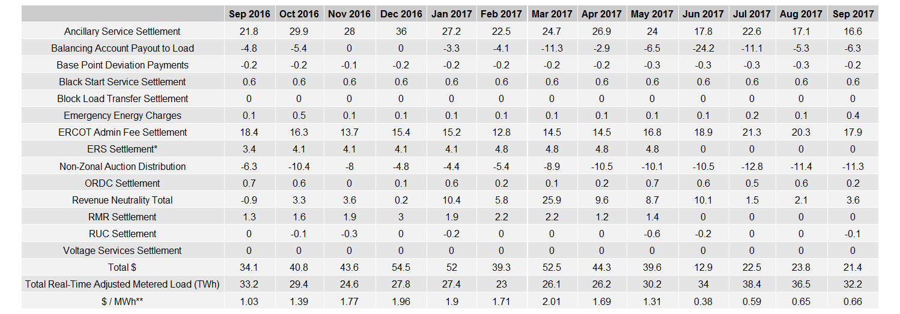
8.2(2)(g) Net Allocation to Load - Totals and $/MWh
NET ALLOCATION TO LOAD ($MM)
* The total ERS charges have been evenly allocated across the contract period.
** The $/MWh value as calculated per PR 8.2 (2) g

Slide 2
8.2(2)(g) Net Allocation to Load - Totals and $/MWh
ZONAL AUCTION REVENUE PER CONGESTION MANAGEMENT ZONE ($MM)
REAL-TIME ADJUSTED METERED LOAD BY CONGESTION MANAGEMENT ZONE (TWh)
$/MWh PER CONGESTION MANAGEMENT ZONE ($MM)

