Slide 1
Incremental Adjustment To Responsive Reserve Service Requirements
ERCOT Staff
QMWG
Feb 13, 2018

Slide 2
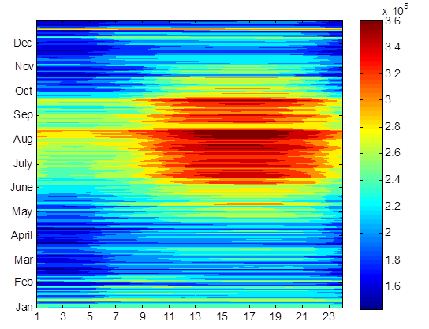
Responsive Reserve Service (RRS)
System Inertia 2016
RRS is procured to ensure sufficient capacity is available to respond to frequency excursions during unit trips.
To consistently meet BAL-003 Interconnection Frequency Response Obligation, ERCOT must plan not to activate UFLS for loss of 2750 MW of generation.
  UFLS relays will shed firm load if frequency drops to 59.3 Hz (5% of total ERCOT load).
  ERCOT plans to maintain frequency nadir at or above 59.4 Hz for loss of 2750 MW (0.1 Hz margin).
Responsive Reserve Requirements 2017

Slide 3
RRS Study Methodology
A set of recent cases at varying inertia levels are selected to to represent a wide range of expected future inertia conditions. Following assumptions are applied to each case/study,
    Model 1150 MW of PFR from Generation Resources.
      Generation mix when,
        Inertia < 250 GW·s: 30% Coal + 70% Gas
        Inertia ≥ 250 GW·s: 15% Coal + 85% Gas
    Load Resources providing RRS will trip at 59.7 Hz, with a delay of 0.416 s (relay delay = 0.333 s; breaker action = 0.083 s).
    Load damping factor was assumed to be 2% at the system level.
Trip 2750 MW of generation simultaneously and identify the amount of LR needed to maintain frequency at 59.4 Hz.

Slide 4
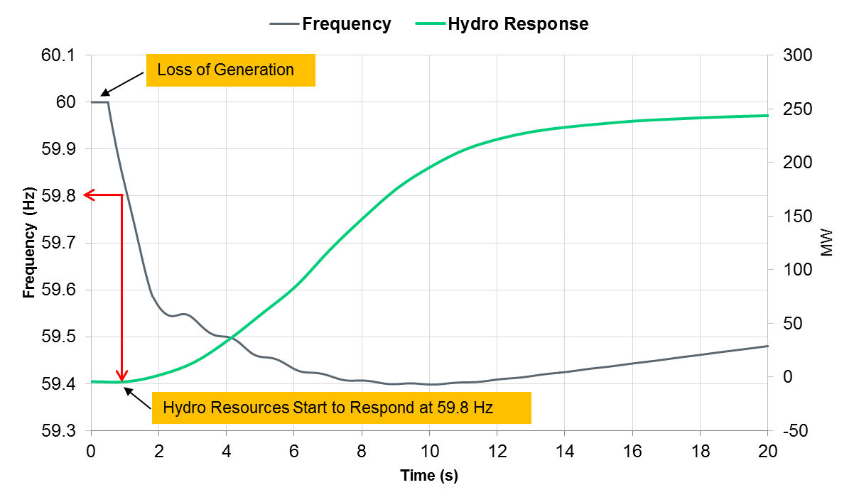
Hydro Response Characteristic
In Real Time, a portion of RRS is provided by Hydro resources operating in synchronous condenser mode via under-frequency relay action (i.e. not a typical governor response).
  Hydro resources provide response when frequency drops below 59.8 Hz, and are required to reach their HSL (equals their RRS responsibility) within 20 seconds after frequency trigger is met.

Slide 5
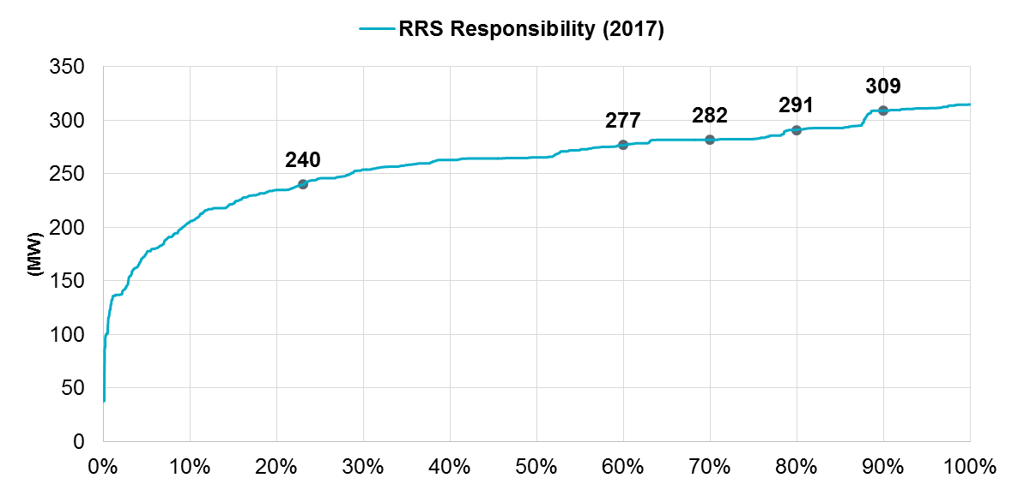
Discrepancy between RRS Study & Real Time Operations
These unique response characteristics of Hydro resources that operate under synchronous condenser fast response mode have not been included in previous studies to determine RRS requirement.
However, ~80% of the time Hydro Resources operating in synchronous condenser fast response mode carry more than 240 MW of RRS.

Slide 6
RRS Efficacy Study Methodology
To assess the efficacy of Hydro resources that provide RRS via synchronous condenser fast response mode, additional RRS studies were recently completed using updated cases at varying inertia levels.
In these studies for Hydro resources, models were created to mimic actual synchronous condenser fast response mode response.
  These models were benchmarked with actual plant level data (from seasonal RRS tests).

Slide 7
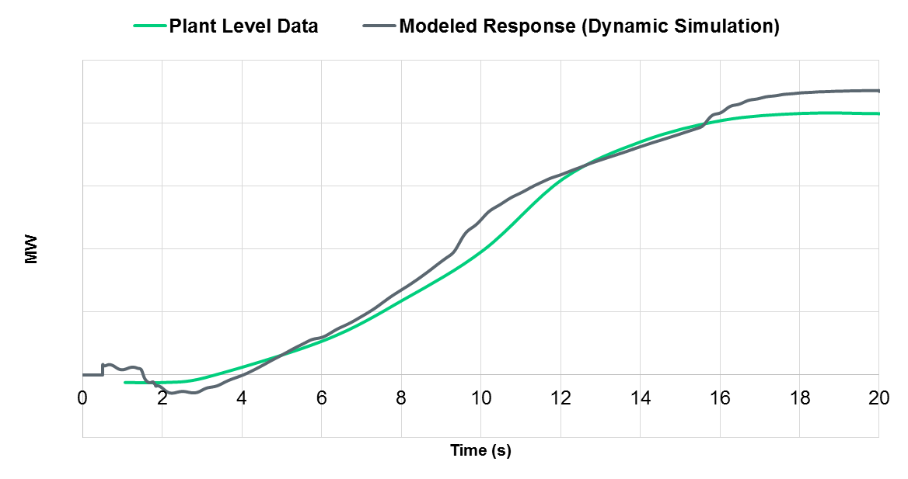
Hydro Model Benchmarking – Unit Level
Each Hydro unit’s response was benchmarked. Below is comparison for a particular Hydro resource’s response from the model created and its seasonal RRS test data.

Slide 8
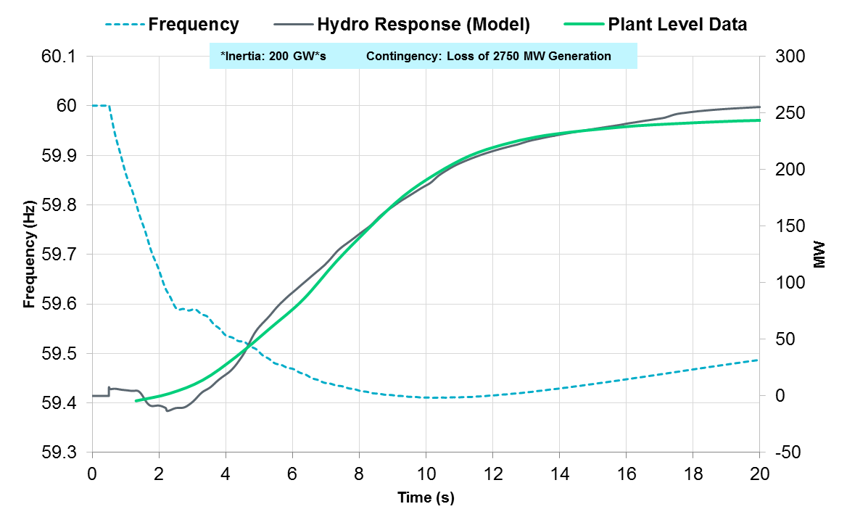
Hydro Model Benchmarking – System Level
Models were created for 11 Hydro resources (a total of 240 MW RRS).

Slide 9
RRS Efficacy Study Methodology
Once the Hydro response was benchmarked, additional studies were conducted at varying inertia levels.
Following assumptions were applied to each case/study,
    Model 240 MW of response from hydro resources operating in synchronous condenser mode using the benchmarked models and 910 MW of PFR from Generation Resources.
    All other assumptions were consistent with previous RRS studies.
Trip 2750 MW of generation simultaneously and identify the amount of LR needed to maintain frequency at 59.4 Hz.

Slide 10
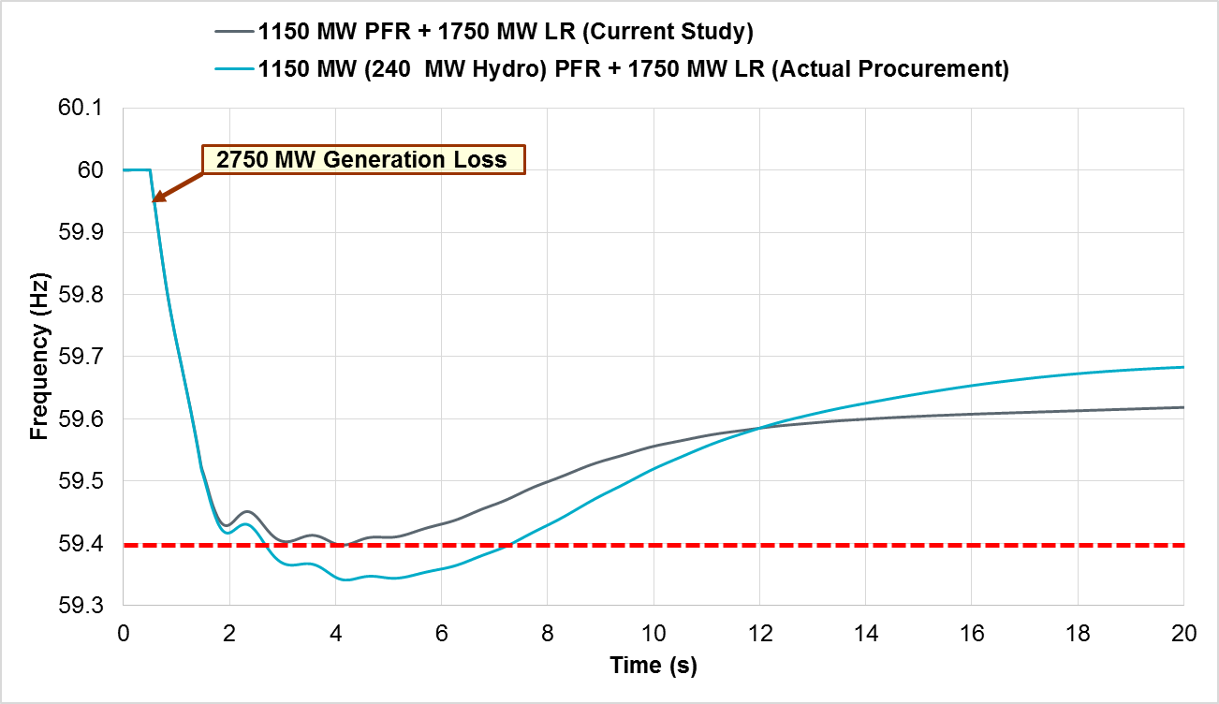
Low Inertia Condition (150 GW*s)

Slide 11
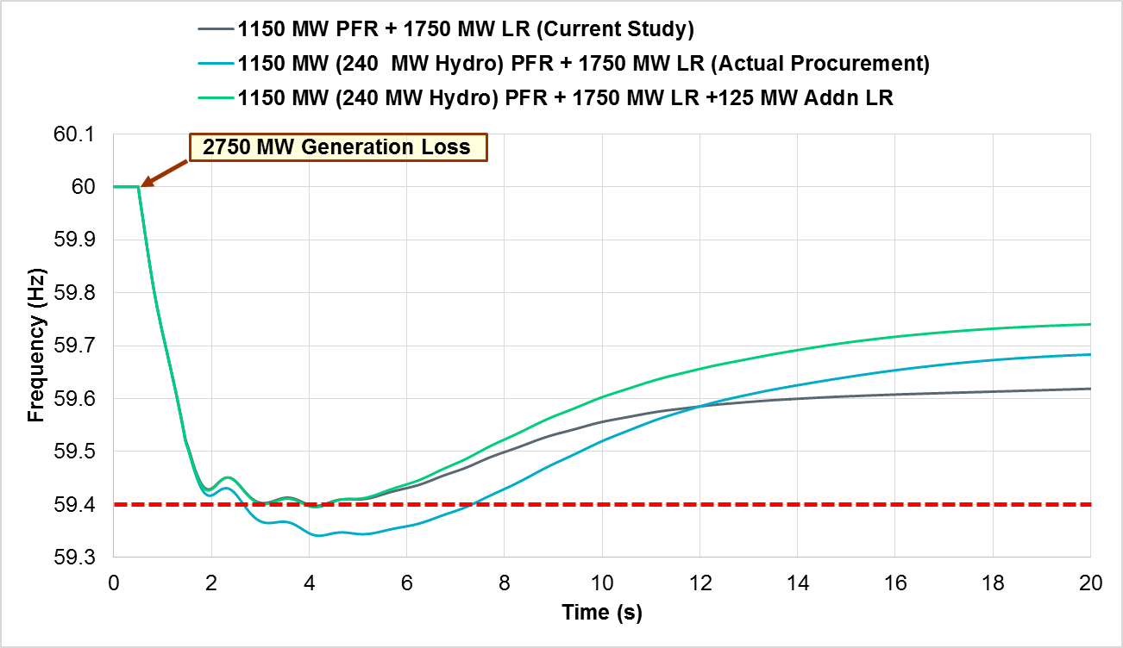
Increased RRS need in Low Inertia Condition (150 GW*s)
An additional 125 MW LR required to maintain C point at 59.40 Hz when 240 MW (out of 1150 MW) is provided by Hydro resources.

Slide 12
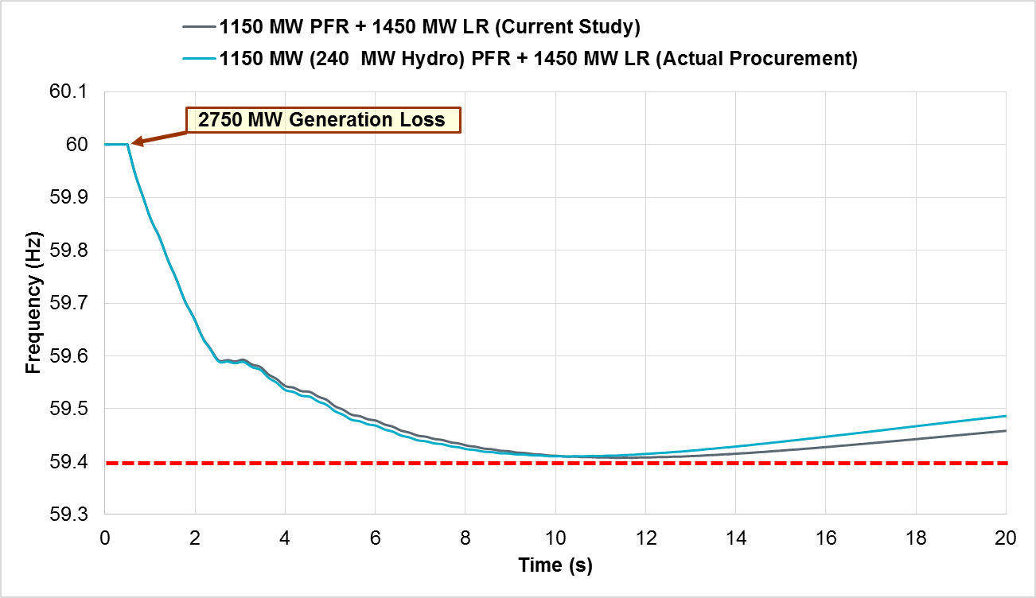
Mid Inertia Condition (260 GW*s)
No additional LR is required to maintain C point at 59.40 Hz when 240 MW (out of 1150 MW) is provided by Hydro resources.

Slide 13
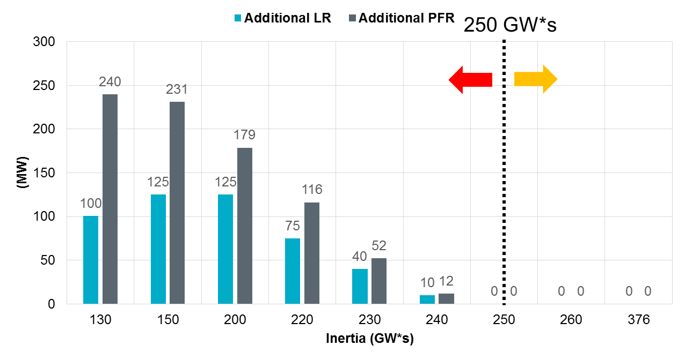
Impact on PFR
Chart below shows additional PFR needed OR additional LRs needed when 240 MW (out of 1150 MW) of RRS is provided by Hydro resources at varying system conditions (inertia levels).
Additional PFR = Additional LR × Equivalency Ratio

Slide 14
Additional RRS Needed – Pre-NPRR 815 (50% LR Limit)

Slide 15
Additional RRS Needed – Post-NPRR 815 (60% LR Limit)

Slide 16
Summary
  ERCOT increased minimum RRS requirements beginning Feb 1, 2018 for hours when inertia is expected to be below 250 GWs.
  Posted RRS requirements for Feb thru May 2018 have been updated. (Completed Jan 23, 2018)
  Upon NPRR 815 implementation, the minimum RRS quantities for the remainder of the year will be updated to reflect the 60% limit on RRS from Load Resources and the adjustments shown on the previous slide {Additional RRS Needed – NPRR 815 (60% Lim )}.

Slide 17
Divider Slide
Divider Slide (optional)
Discussion

