Slide 1
Non-Spin Price OD 1/17/18
Carrie Bivens
Manager, Forward Markets
February 13, 2018

Slide 2
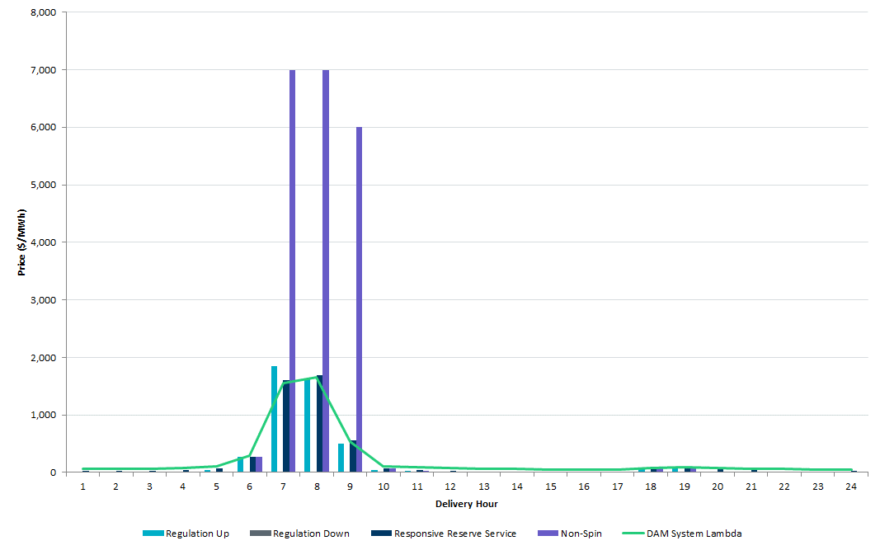
DAM Prices OD 1/17/18
Notes:
New winter peak demand record Jan 17 between 7 and 8 a.m. - 65,731 MW

Slide 3
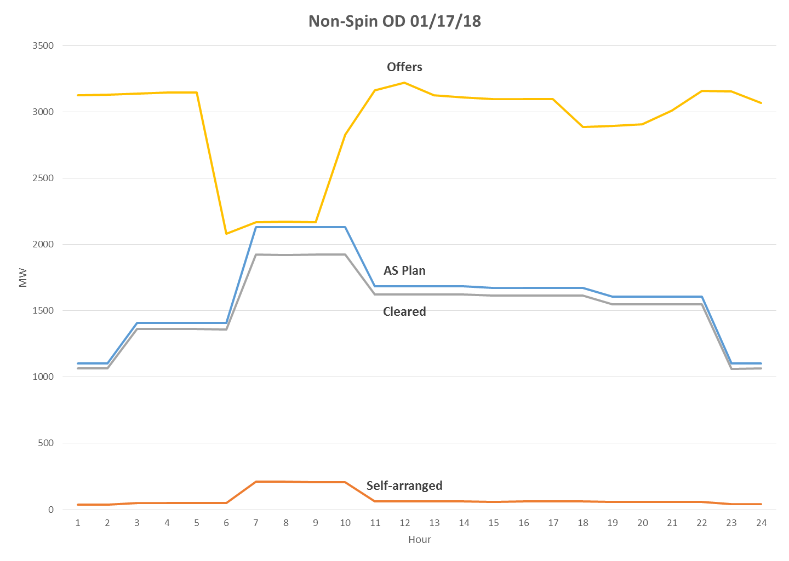
Requirement
Notes:
Reasons some MWs could not be awarded –
Offer quantity over limits (i.e. qty>HSL)
temporal constraints (i.e. OFFNS and not yet met min offline time)
awarded in higher configuration (this quantity double counts CCs)
Reduction in offers in morning mainly from OFFNS

Slide 4
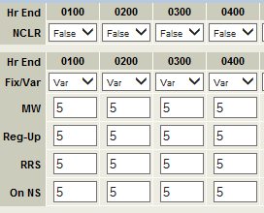
Further information
Recall that online reserves are linked – example:
There were 58 units that had RRS and/or RegUp offered in for the online services but no online Non-Spin (and are Non-Spin qualified)
Below table shows number of AS offer MWs this represents, with max combined cycle configuration used for CCs to avoid double counting
 | Online Reserve Offer MWs
Hour 7 | 2,333.6
Hour 8 | 2,333.8
Hour 9 | 2,342.8

Slide 5
Study results
A study was run, picking three units with high MW offers that had only RRS or RegUp offered for online services
Used the RegUp/RRS offer price to create an online Non-Spin offer. This added about 445 MW of available Non-Spin to DAM.
 | Original | Study | Change
Non-Spin Hour 7 | 7,000.00 | 2,002.55 | (4,997.45)
Hour 8 | 7,000.00 | 2,008.05 | (4,991.95)
Hour 9 | 6,000.00 | 722.22 | (5,277.78)
RRS Hour 7 | 1,604.81 | 2,000.00 | 395.19
Hour 8 | 1,694.63 | 2,008.05 | 313.42
Hour 9 | 558.20 | 722.22 | 164.02
RegUp Hour 7 | 1,852.46 | 2,002.55 | 150.09
Hour 8 | 1,629.24 | 1,679.25 | 50.01
Hour 9 | 502.88 | 552.53 | 49.65

