Slide 1
Power Balance Penalty Curve
Timeline of Changes
ERCOT
QMWG
February 13, 2018

Slide 2
Factors Considered: PBPC
The dominant factor in the ERCOT qualitative analysis relates to the use of Regulation Ancillary Service capacity in place of generation capacity provided by the market to resolve the SCED Power Balance constraint violation. ERCOT submits that the Power Balance Penalty Curve presented herein represents a reasonable balance between the loss of the Regulation Ancillary Service capacity used to achieve system power balance and the market value of the energy deployed from these Regulation Ancillary Service Generation Resources.

Slide 3
Factors Considered: PBPC
The factors considered by ERCOT in its qualitative analysis, include the following:
The amount of regulation that can be sacrificed without affecting reliability,
The PUCT defined System Wide Offer Cap (SWCAP),
The expected percentage of intervals with SCED Up Ramp scarcity,
The expected extent of Ancillary Service deployment by operators during intervals with capacity scarcity, and
The transmission constraint penalty values.

Slide 4
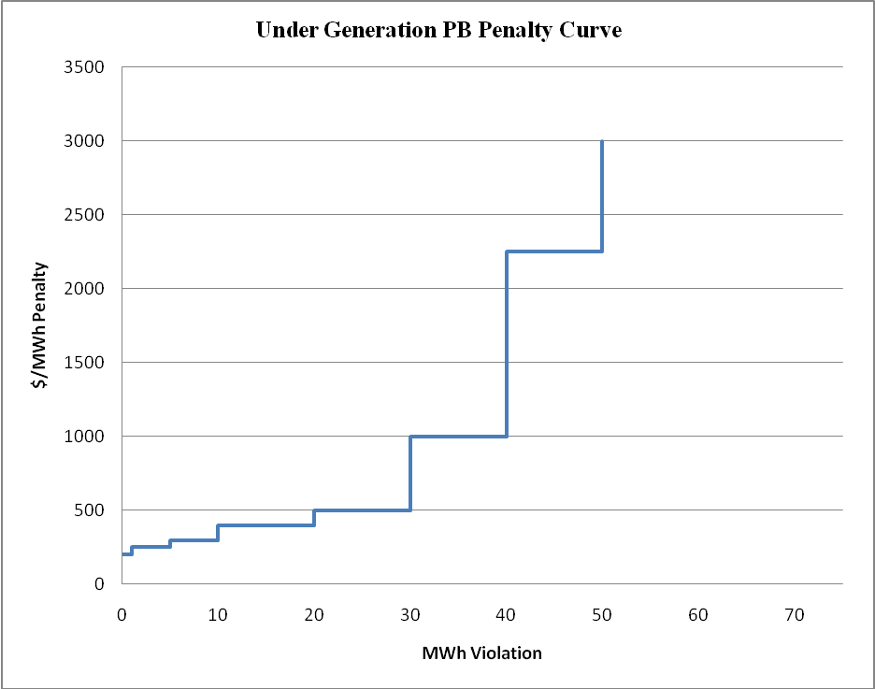
PBPC – December 2010 to July 31, 2012
Where:
MW violation | Violation <1 | 1 ≤ Violation < 5 | 5 ≤ Violation < 10 | 10 ≤ Violation < 20 | 20 ≤ Violation < 30 | 30 ≤ Violation < 40 | 40 ≤ Violation < 50 | 50 ≤ Violation < 100000
Price $/MWh | 200 | 250 | 300 | 400 | 500 | 1000 | 2250 | 3001

Slide 5
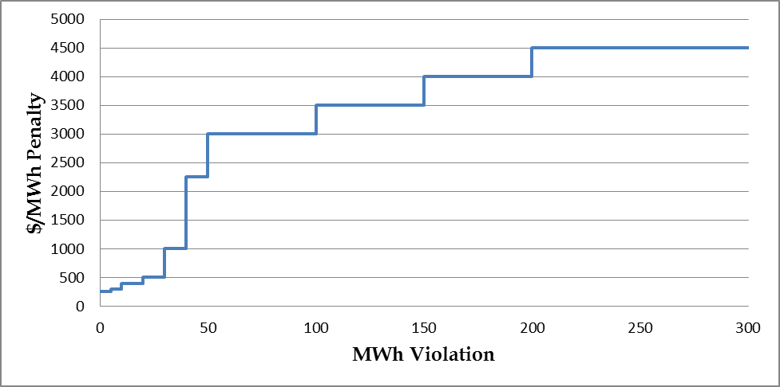
PBPC – August 1, 2012– May 31, 2013
MWh Violation | Price/MWh
≤ 5 | $250
5 < to ≤ 10 | $300
10 < to ≤ 20 | $400
20 < to ≤ 30 | $500
30 < to ≤ 40 | $1,000
40 < to ≤ 50 | $2,250
50 < to ≤ 100 | $3,000
100 < to ≤ 150 | $3,500
150 < to ≤ 200 | $4,000
200 or more | $4,501

Slide 6
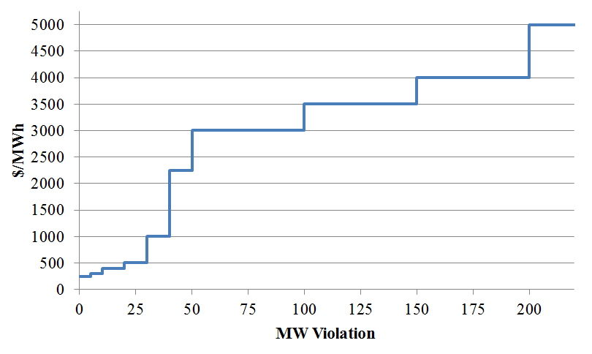
PBPC – June1, 2013 – May 31, 2014
MW Violation | Price/MWh
≤ 5 | $250
5 < to ≤ 10 | $300
10 < to ≤ 20 | $400
20 < to ≤ 30 | $500
30 < to ≤ 40 | $1,000
40 < to ≤ 50 | $2,250
50 < to ≤ 100 | $3,000
100 < to ≤ 150 | $3,500
150 < to ≤ 200 | $4,000
200 or more | $5,001

Slide 7
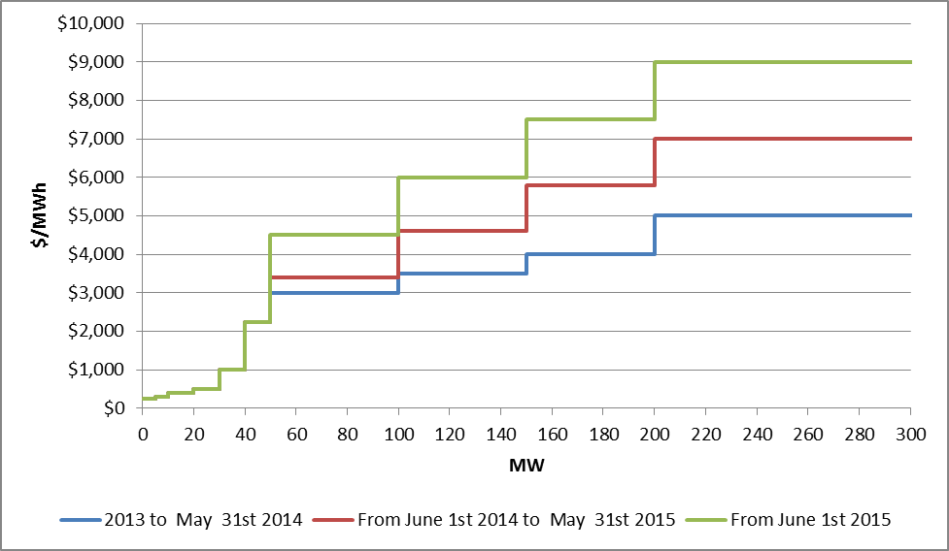
PBPC – June 1, 2014 – current
MW Violation | From June 1st 2014 to May 31st 2015 | From June 1st 2015
≤ 5 | $250 | $250
5 < to ≤ 10 | $300 | $300
10 < to ≤ 20 | $400 | $400
20 < to ≤ 30 | $500 | $500
30 < to ≤ 40 | $1,000 | $1,000
40 < to ≤ 50 | $2,250 | $2,250
50 < to ≤ 100 | $3,400 | $4,500
100 < to ≤ 150 | $4,600 | $6,000
150 < to ≤ 200 | $5,800 | $7,500
200 or more | $7,001 | $9,001

