Slide 1
Project Update and Summary of
Project Priority List (PPL) Activity
February 8, 2018

Slide 2
Project Update Agenda
Project Portfolio Update p. 3-8
Recent / Upcoming Project Implementations
Planned Project Starts
Now merged with Portfolio Report
2018 Release Targets
March Portfolio Report Preview
Priority/Rank Options for Revision Requests with Impacts
Appendix
Project Portfolio Gantt Chart p. 9-15
Location of Project Priority List (PPL): http://www.ercot.com/services/projects/index

Slide 3
Recent / Upcoming Project Implementations
2018 February Off-Cycle – 2/1/2018 Complete
NPRR846 – Allow Previously Committed ERS Resources to Participate in MRA Agreements and Other ERS Items
2018 February Release – 2/6/2018-2/8/2018 In Flight
NPRR659 – Discontinue RMR Cost Data Deviation Requests/Responses Rpt
NPRR683 – Revision to Available Credit Limit Calculation
NPRR743 – Revision to MCE to Have a Floor For Load Exposure
NPRR760 – Calculation of Exposure Variables For Days With No Activity
NPRR800 – Revisions to Credit Exposure Calculations to Use Electricity Futures Market Prices
NPRR810 – Applicability of RMR Incentive Factor on Reservation and Transportation Costs Associated with Firm Fuel Supplies
CMM Release 1a
Note: Projected Go-Live dates are subject to change. Please watch for market notices as the effective dates approach.

Slide 4
Approved Revision Requests “Not Started” – Planned to Start in Future Months
Revision Request | Target Start Date | Release Target | Cost Estimate | Author
SCR791 – Correction of 60-day SCED GRD Disclosure Report | Feb 2018 | 2018-R3 | $25k-$35k | MDWG
NPRR562 – Subsynchronous Resonance | Feb 2018 | 2018-R2 | $25k-$35k | ERCOT
NPRR817 – Create a Panhandle Hub | Mar 2018 | 2018-R5 | $150k-$200k | DC Energy
NPRR843 – Short-Term System Adequacy and AS Offer Disclosure Reports Additions | May 2018 | 2018-R5 | $70k-$90k | ERCOT
NPRR821 – Elimination of the CRR Deration Process for Resource Node to Hub or Load Zone CRRs | Jan 2019 | 2019-R3 | $30k-$50k | DC Energy
NPRR829 – Incorporate Real-Time Non-Modeled Telemetered Net Generation by Load Zone into the Estimate of RTL | Aug 2019 | 2020-R1 | $200k-$300k | Enchanted Rock
NPRR825 – Require ERCOT to Issue a DC Tie Curtailment Notice Prior to Curtailing any DC Tie Load | TBD | TBD | $200k-$300k | Rainbow Energy
Moved from January 2018 start
Create MIS link for posting of annual SSR topology-check report
Aging Items Report | Last Action | Status
NPRR664 – Fuel Index Price for Resource Definition and Real-Time Make-Whole Payments for Exceptional Fuel Cost Events | Board approved on 12/9/2014 | Pending submission / approval of alternate approach

Slide 5
2018 Release Targets – Board Approved NPRRs / SCRs / xGRRs
February 2/6 – 2/8 | April 4/3 – 4/5 | May 5/29 – 5/31 | August 8/7 – 8/9 | October 10/23 – 10/25 | December 12/11 – 12/13
NPRR659 NPRR683 NPRR743 NPRR760 NPRR800 NPRR810 PGRR042 NPRR846 | NPRR562(b) NPRR776 SCR792 | NPRR768 NPRR809(b) NPRR815 SCR791 | NPRR815 | NPRR817 NPRR843 | NPRR519 NPRR620 NPRR741 NPRR755 PGRR057 SCR789
8 | 3 | 4 | 0 | 2 | 6
E
E
E
E
E
E
NS
E
P
P
E
I
NS
NS
NS
E
E
E
E
E
I
CMM Release 1a
CMM Release 1b
1/1 & 2/1
4/7 – 4/8
(Retail)
6/2 – 6/3
(Retail)
8/11 – 8/12
(Retail)
10/27 – 10/28
(Retail)
12/15 – 12/16
(Retail)
1/1
2/1
TBD Items (and point at which they became “TBD”)
2014 | 2015 | 2016 | 2017
NPRR664 | None | SCR781 P | NPRR702 P, NPRR829, SCR777, NPRR831(b), NPRR749, NPRR833
Go-live dates can differ from Protocol effective dates – Please refer to market notices for more details
APPENDIX
Red Text: New additions and target release changes
Strike-Through Text: Previous target release changes
(a), (b), etc. indicates multiple phases
Project Status Codes
NS = Not Started
I = Initiation
P = Planning
E = Execution
H = On Hold
Release targets are subject to change
NPRR562(b) – Reporting/posting system changes
NPRR809(b) – Reporting/posting system changes
NPRR831(b) – CRR system changes

Slide 6
March Portfolio Report Preview
2017 Impact Analysis (IA) Review
Compare completed project cost/duration with original IA estimates
Follow-up on Impact Analysis Process Discussion
Potential IA format changes
Additional IA statistics

Slide 7
Priority / Rank Options for Revision Requests with Impacts
Options for…
Revision Request | Description | Priority | Rank | Comments
NPRR854 | NOIE TDSP Submittal of Meters with Bidirectional Flow Caused by Generation Interconnected at Distribution Voltage | 2018 | 2160 | Work into the 2018 project plan without disrupting in-flight projects
RRGRR015 | Additional Guidance for Transformer and Station Data | 2018 | 2150 | Work into the 2018 project plan without disrupting in-flight projects
RRGRR016 | Additional Guidance for Solar Data | 2018 | 2150 | Work into the 2018 project plan without disrupting in-flight projects
If both are approved, the plan is to bundle these into a single project
PPL Rank Information
Next available Rank in Business Strategy = 2150
Next available Rank in Regulatory = 190

Slide 8
Appendix
1/31/2018 Project Gantt
In-flight items sorted by Project End Date
“On Hold” projects listed separately
None at this time
“Not Started” items sorted by Project Start Date

Slide 9
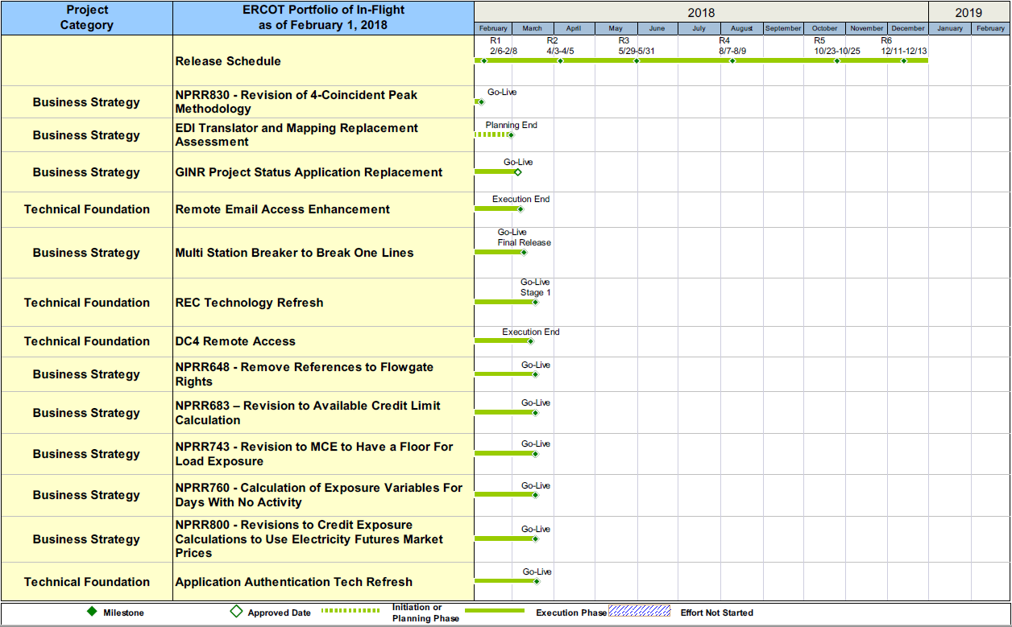
Project Portfolio Status – as of 1/31/2018

Slide 10
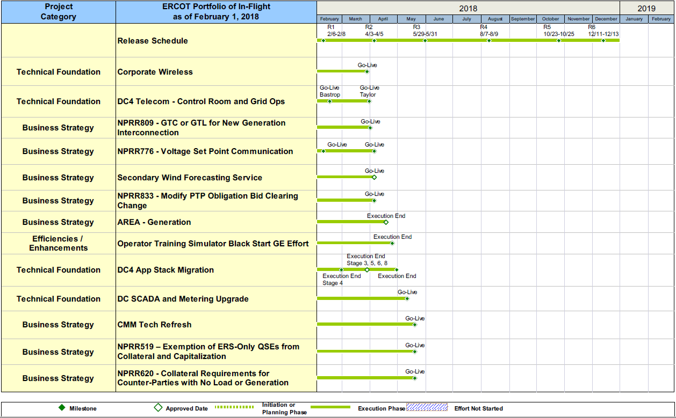
Project Portfolio Status – as of 1/31/2018

Slide 11
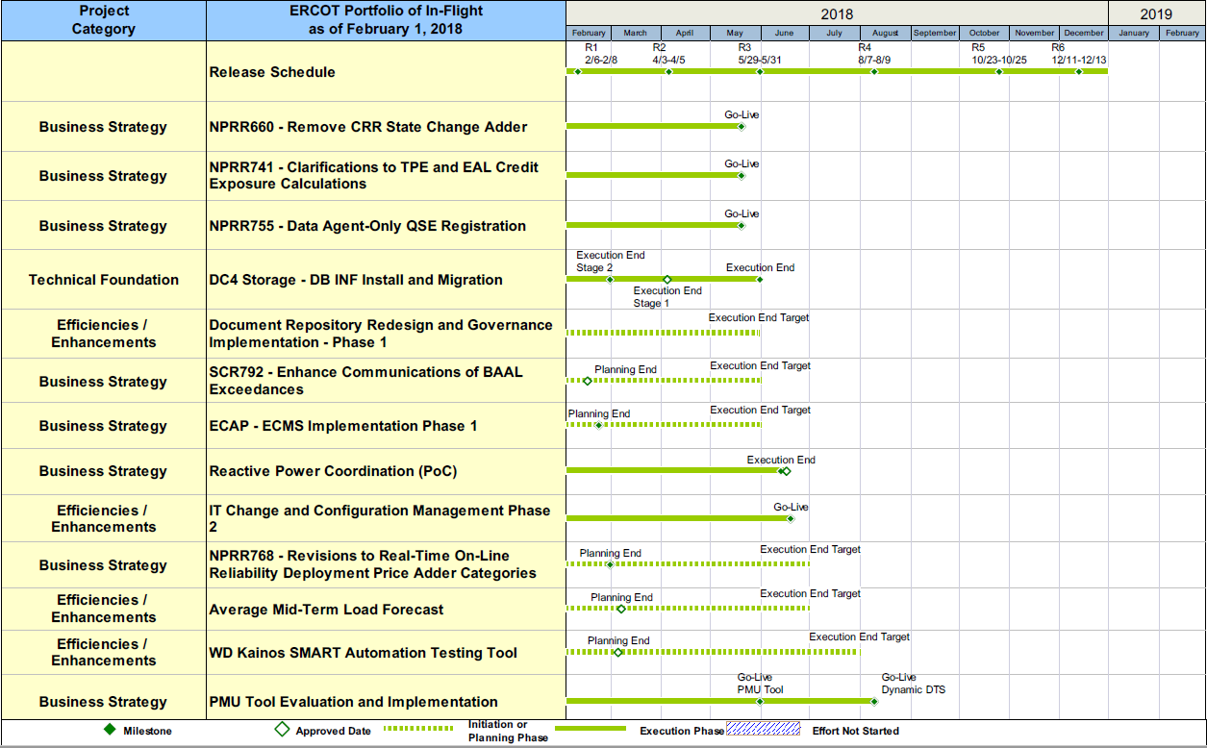
Project Portfolio Status – as of 1/31/2018

Slide 12
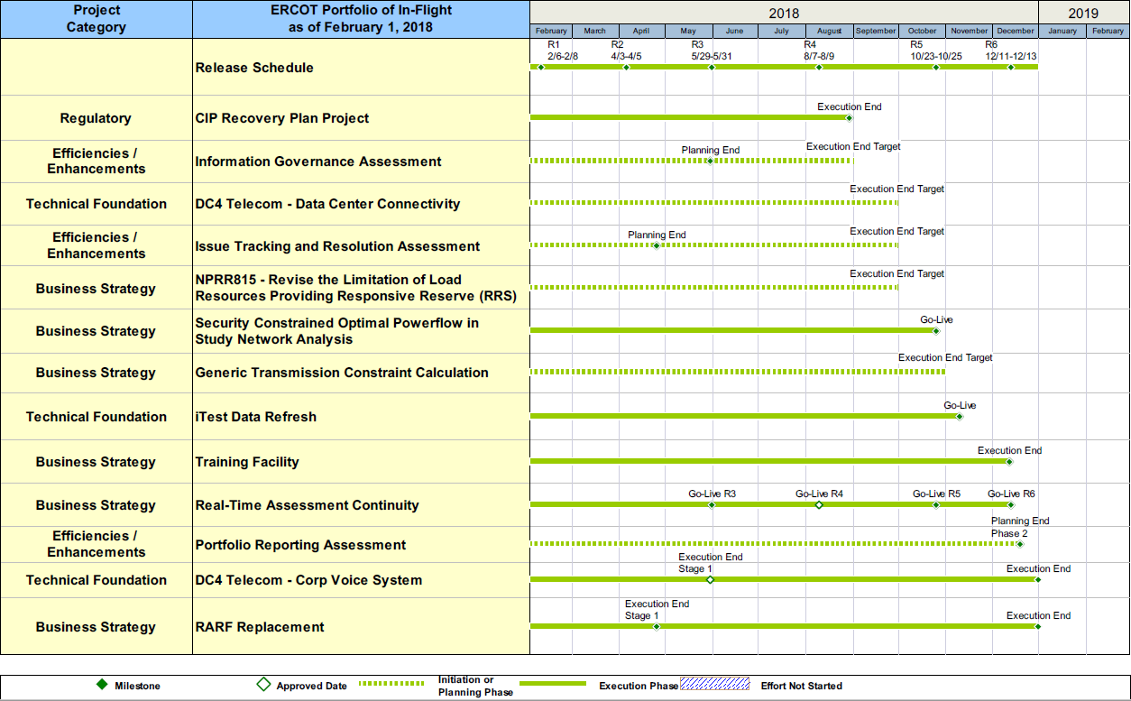
Project Portfolio Status – as of 1/31/2018

Slide 13
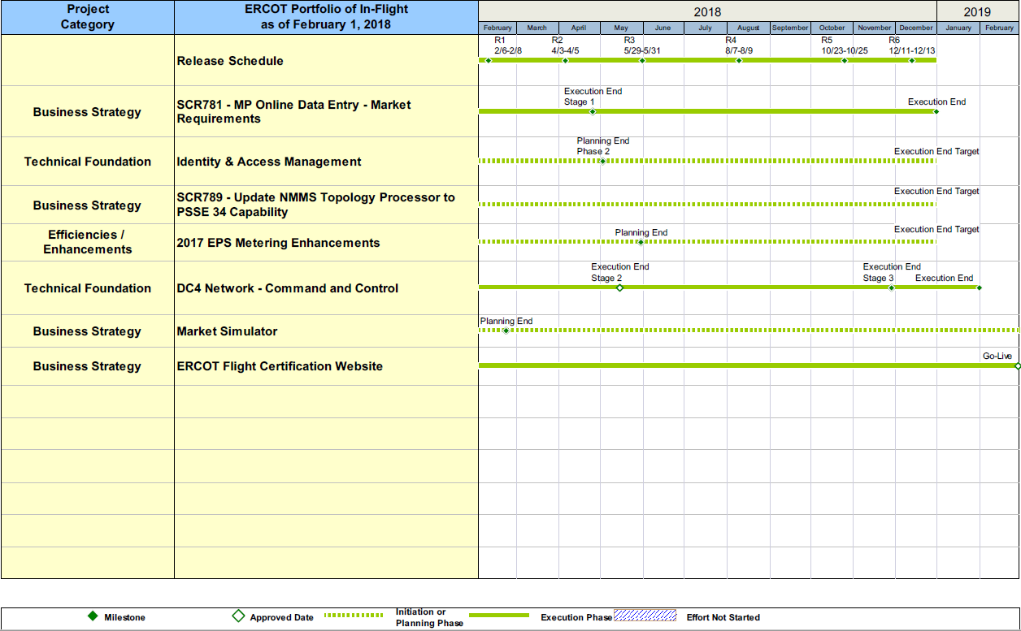
Project Portfolio Status – as of 1/31/2018

Slide 14
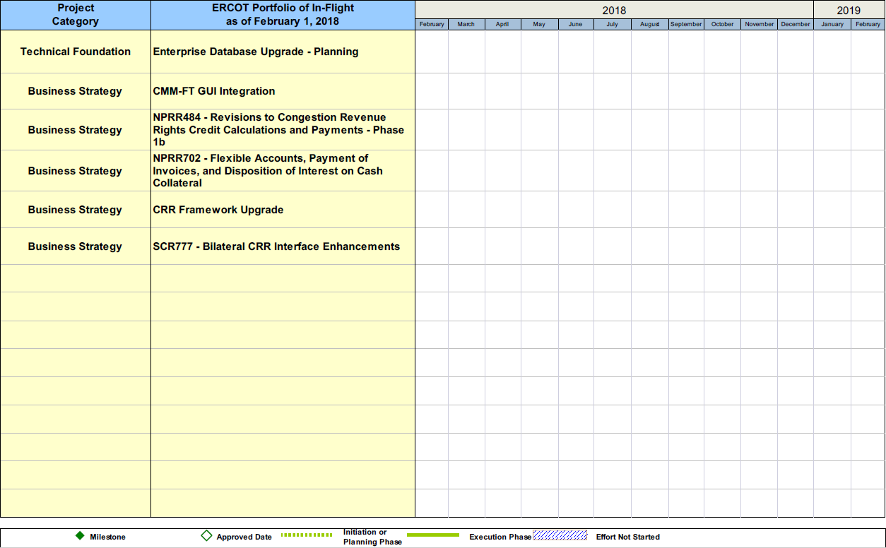
Project Portfolio Status – as of 1/31/2018

Slide 15
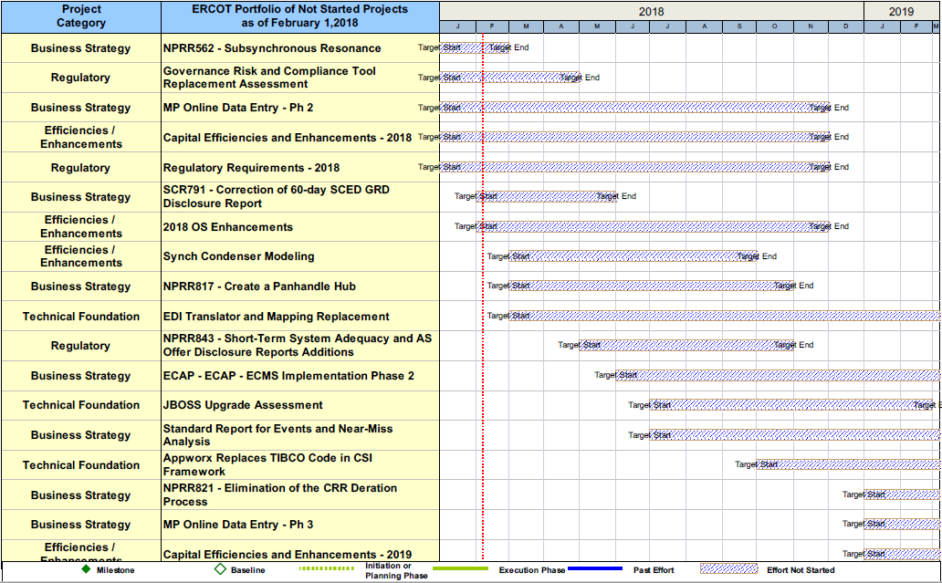
Project Portfolio Status – as of 1/31/2018

