Slide 1
ERCOT Retail Market Training Task Force
Update to RMS
Tuesday, February 6, 2018

Slide 2
RMTTF – 2017 Accomplishments Three 2 Day Training Sessions – Austin area, Dallas, Houston

Slide 3
RMTTF – 2017 Accomplishments - Continued
Marketrak Online Training Modules Completed
GUI Reporting
MarkeTrak Background Reporting
Emails and Notifications
MarkeTrak Online Modules modified to be consistent with Market changes included:
Inadvertent Gain
Cancel With/Without Approval
MarkeTrak Overview
Switch Hold
Revised instructor led presentations for Marketrak, Retail 101, IAG

Slide 4
2018 RMTTF Goals
Modify Marketrak Online Training Module series as needed to align with market revisions.
Develop and support Retail Market training materials for online modules and instructor led training.
Conduct Instructor led Retail training throughout the Market as directed.
Support ERCOT enhancements of the ERCOT Learning Management System (LMS)
Provide input and support for ERCOT Market Notifications and communications for training efforts
Continue development and launch of instructor led TxSET Overview training.
Assist ERCOT as needed in developing training materials for new ERCOT Flight Certification Website
Present instructor led comprehensive MarkeTrak training with emphasis on Inadvertent Gains.

Slide 5
Retail Training Scheduled for 2018
Schedule for Retail Training - 2018
AUSTIN | JANUARY | WebEx
TUESDAY | January 30th | RETAIL 101 | 9:00 – 4:00
WEDNESDAY | January 31st | INADVERTENT GAIN | 9:00 – 3:30
DALLAS | MAY | Oncor – Instructor Led
TUESDAY | May 1st | RETAIL 101 | 9:00 – 4:00
WEDNESDAY | May 2nd | MARKETRAK - IAG | 9:00 – 4:00
HOUSTON | SEPTEMBER | CenterPoint – Instructor Led
TUESDAY | September 25th | RETAIL 101 | 9:00 – 4:00
WEDNESDAY | September 26th | TxSET OVERVIEW | 9:00 – 4:00

Slide 6
MarkeTrak On-line Training Modules Available
Marketrak Overview
Switch Hold Removal
Cancel With/Without Approvals
Inadvertent Gains/Losses & Rescissions
Usage and Billing
Other D2D Subtypes
Bulk Insert
MarkeTrak Admin Functionality
Data Extract Variances (DEV) LSE Subtypes
Data Extract Variances (DEV) Non-LSE Subtypes
Emails and Notifications
Reporting – Background & GUI

Slide 7
MarkeTrak On-line Module Training via ERCOT Learning Management System
How many market participants have viewed the Online training modules*?
Which segment of the market do the viewers represent?
MT Module
# of Viewers
Market
# of Viewers
Segment
Overview
196
LSE/REP
302
Switch Hold
116
TDSP
157
Cancels
112
QSE
35
IAGs
141
Other
287
Usage & Billing
61
TOTAL
781
Day to Day
58
Bulk Insert
30
Admin
18
There have been 201 users YTD. Top modules viewed are Overview, Inadvertent Gain, and Cancel w/ Approval.
DEV LSE
14
DEV NonLSE
10
Email
17
Reporting
5
TOTAL
781
*Training taken via ERCOT LMS. Does not include training taken outside the LMS

Slide 8
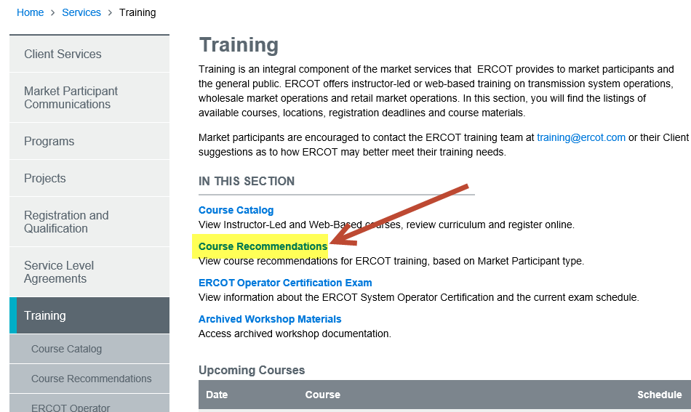
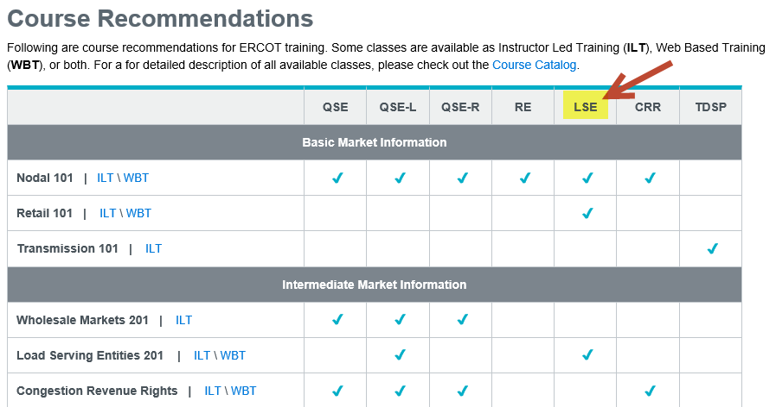
ERCOT Learning Management System – New Feature
The Training page of the ERCOT website has added a new page of Course Recommendations where you can view recommended courses for each Market Participant type.

Slide 9
Retail Market Training - Registration
How do I register for Training?
Go to the ERCOT Training Website at http://www.ercot.com/services/training/
Select the course you are interested in attending
On the ‘Schedule/Registration’ tab, select the ‘enroll online’ link under ‘Registration’ to register for the course.
If you find the course is not listed under the Web-based training…
Go to ERCOT Training Website as shown above
Select the ‘ERCOT Learning Management System’ (LMS) link in the upper right hand corner under RELATED CONTENT
If necessary, set up a log on
Once in LMS, follow drop downs for ‘web-based training’ and ‘retail market’. Available modules will appear
Select ‘start course’
Note! Most modules are able to be completed in less than 30 minutes.

Slide 10
Please join us for our Next RMTTF Meeting
March 1, 2018
9:30 AM
ERCOT MET Center

Slide 11
Thank you!

