Slide 1
January 2018 - Revenue Neutrality
Austin Rosel
ERCOT
February 7, 2018

Slide 2
High RENA
January had 3 simultaneous days of high RENA, January 16th – 18th.
All three days are in the top 10 highest RENA charges since go live.
During these days Texas was experiencing very low temperatures and set a new winter peak demand record on the 17th.
ERCOT experienced higher than average prices and volumes related to P2P Obligations.
ERCOT experienced increased DC Tie imports at higher prices.

Slide 3
RENA
LARTRNBILLAMT = (-1) * (RTEIBILLAMT + BLTBILLAMT + RTDCIMPBILLAMT + RTDCEXPBILLAMT + RTCCBILLAMT + RTOBLBILLAMT / 4 + RTOBLLOBILLAMT / 4)
Note: There was no BLTBILLAMT for these days

Slide 4
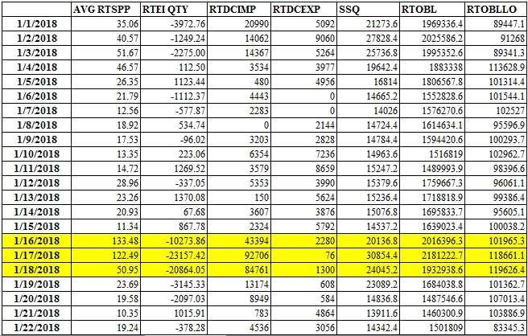
RENA Impact of Inputs

