Slide 1
Settlement Stability
2017 Q4 Update to COPS
Austin Covington
ERCOT
01/17/18

Slide 2
8.2(2)(c)(i) Track number of price changes
Reporting Period: 2017 Q4
Operating Day | # of Corrected Settlement Point Prices |  |  |  | # of Intervals Affected
 | DASPP | RTSPP | RTRMPR | ORDC Adders | DASPP | RTSPP | RTRMPR | ORDC Adders
- | - | - | - | - | - | - | - | -
Notes:
There were no price changes in Q4 2017.
The price changes reported on this slide display the price corrections that have been done after the Settlement Statement has posted for the Operating Day.

Slide 3

8.2(2)(c)(ii) Track number and types of disputes submitted
8.2(2)(c)(iii) Compliance with timeliness of response to disputes
100% of disputes resolved on a timely basis
Submitted but not resolved disputes may be:
Not started
Open
Rejected
Withdrawn

Slide 4
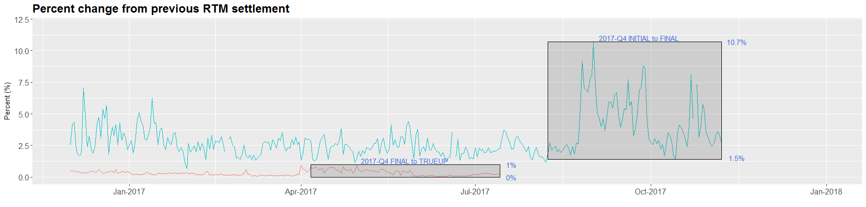
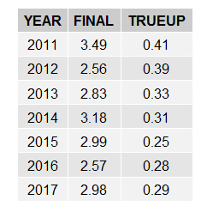
8.2(2)(c)(iv) Other Settlement metrics
NOTE: ERS Final settlement OD data is not represented in graph.
Average percent change

Slide 5
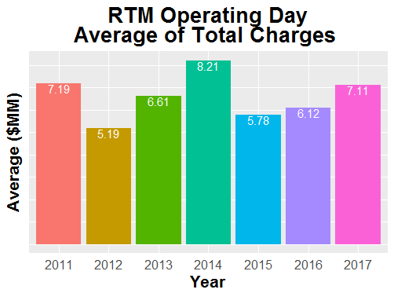
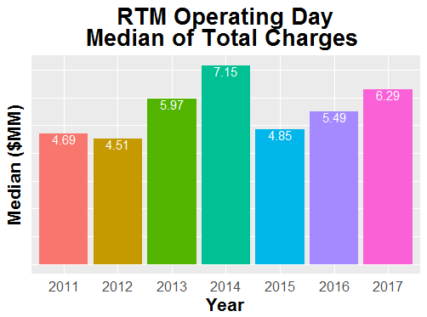
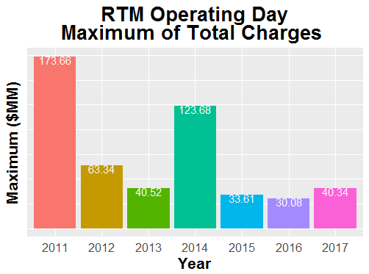
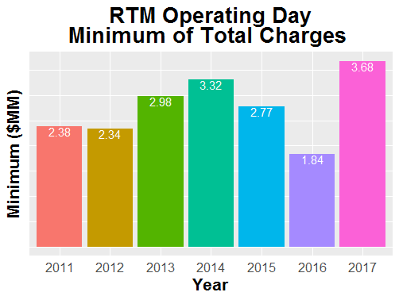
8.2(2)(c)(iv) Other Settlement metrics

Slide 6
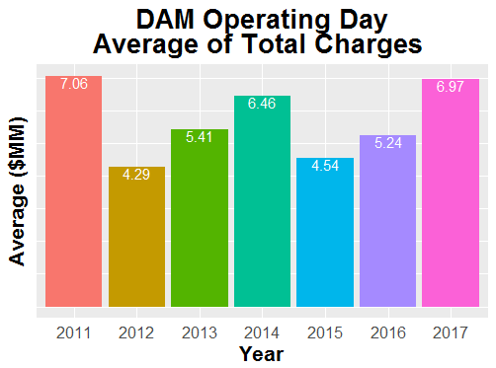
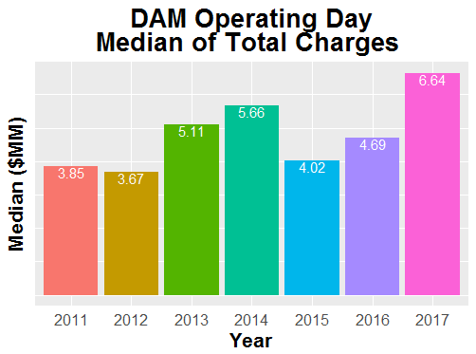
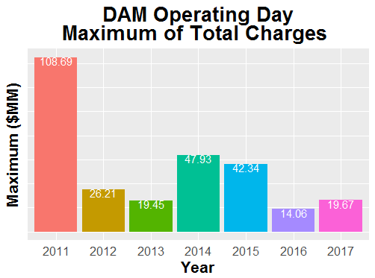
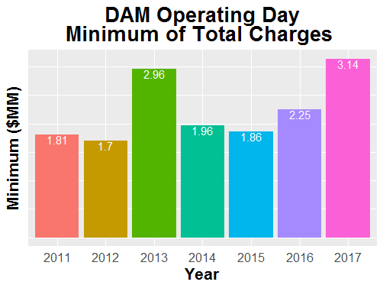
8.2(2)(c)(iv) Other Settlement metrics

Slide 7
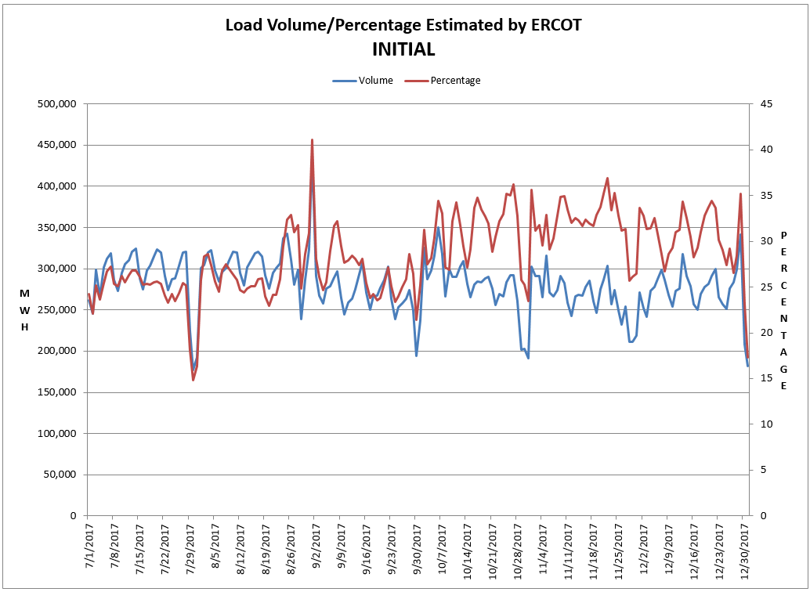
8.2(2)(c)(v) Availability of ESIID consumption data

Slide 8
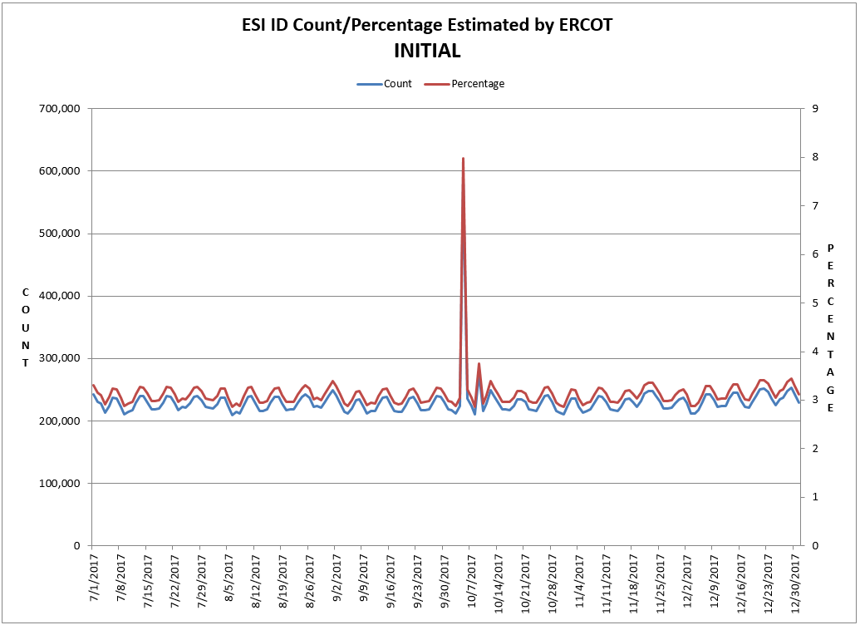
8.2(2)(c)(v) Availability of ESIID consumption data

Slide 9
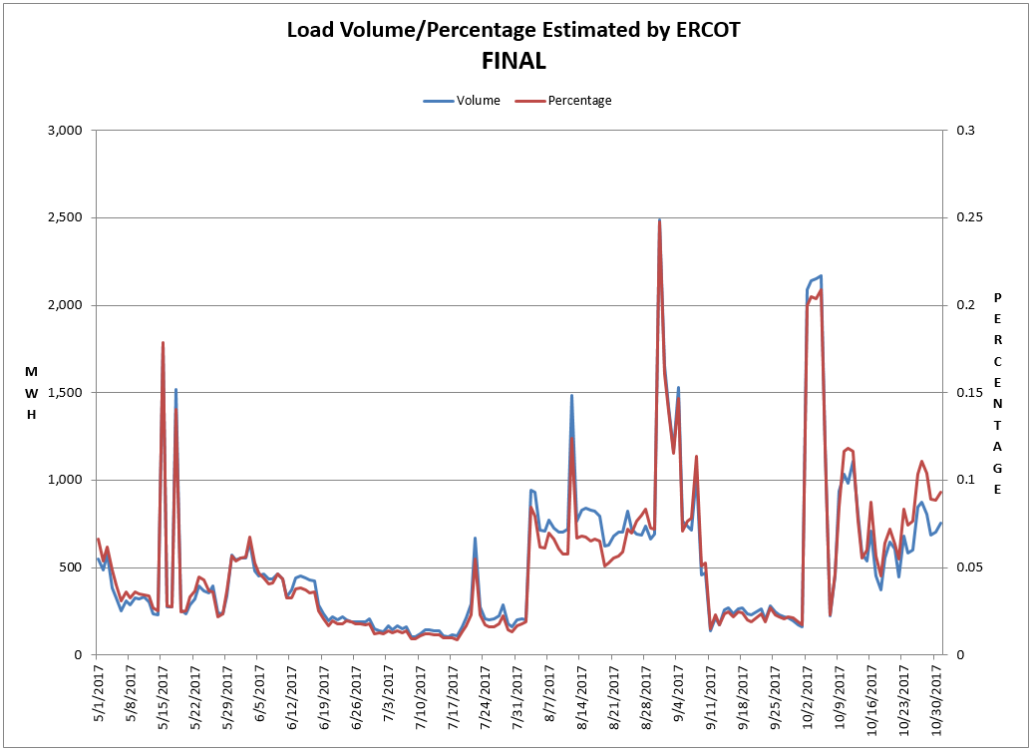
8.2(2)(c)(v) Availability of ESIID consumption data

Slide 10
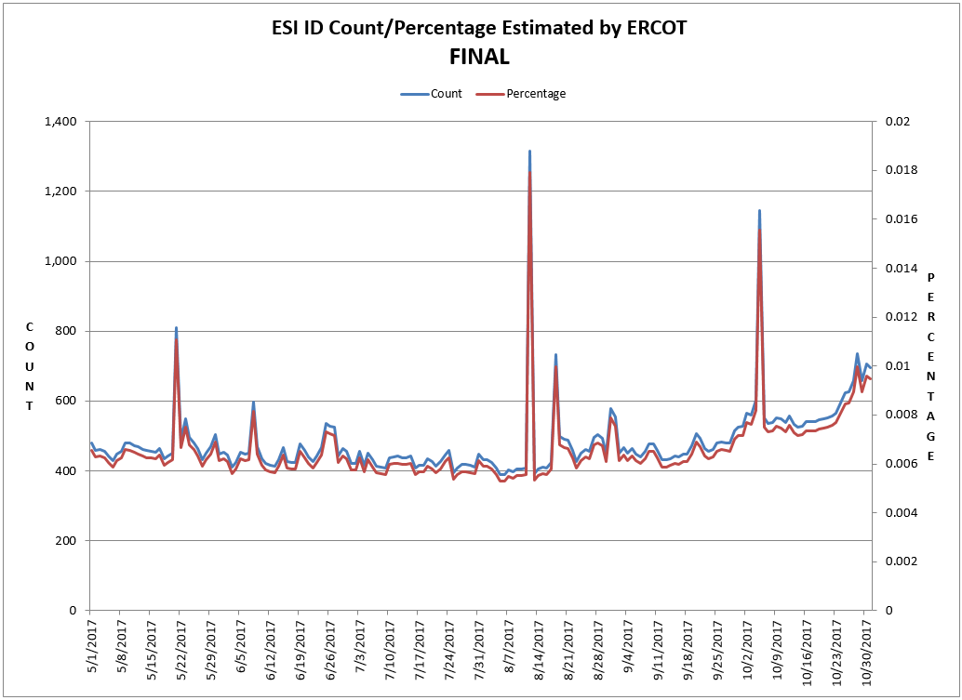
8.2(2)(c)(v) Availability of ESIID consumption data

Slide 11
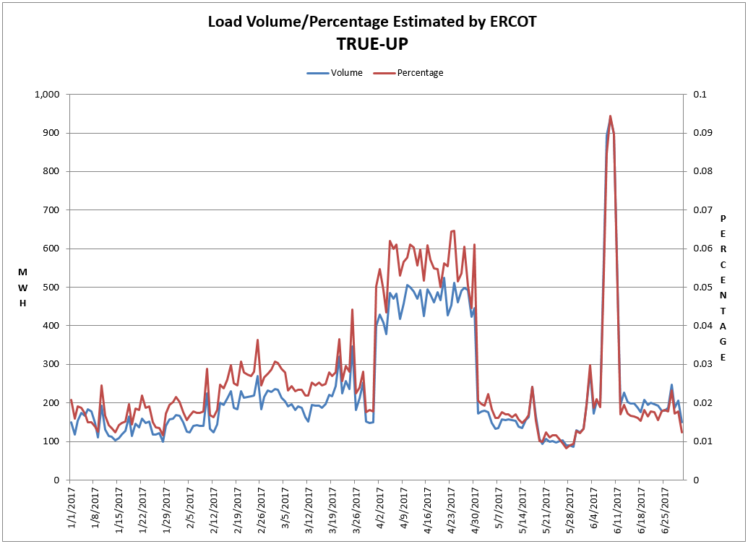
8.2(2)(c)(v) Availability of ESIID consumption data

Slide 12
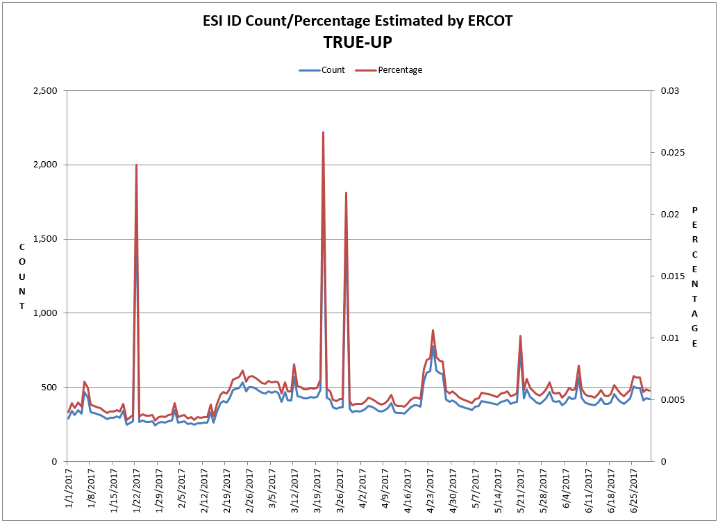
8.2(2)(c)(v) Availability of ESIID consumption data

Slide 13
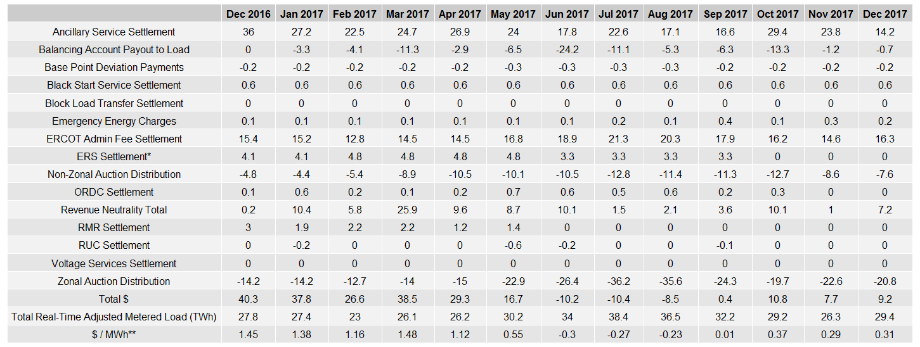
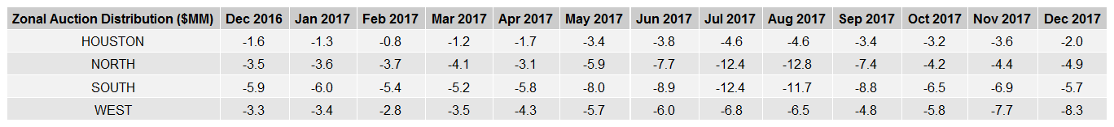
8.2(2)(g) Net Allocation to Load - Totals and $/MWh
NET ALLOCATION TO LOAD ($MM)
AUCTION REVENUE PER CONGESTION MANAGEMENT ZONE ($MM)
* The total ERS charges have been evenly allocated across the contract period.
** The $/MWh value as calculated per PR 8.2 (2) g

