Slide 1
Synchronous Inertial Response (SIR) Workshop
ERCOT Staff
Jan 24, 2018

Slide 2
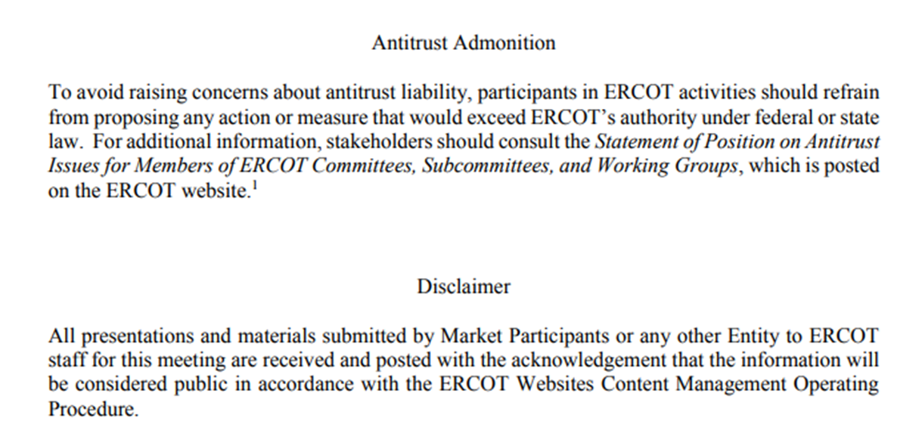
Antitrust Admonition

Slide 3
Inertia Background
Dan Woodfin
Sr. Director, System Operations
ERCOT
Synchronous Inertial Response (SIR) Workshop
Jan 24, 2018

Slide 4
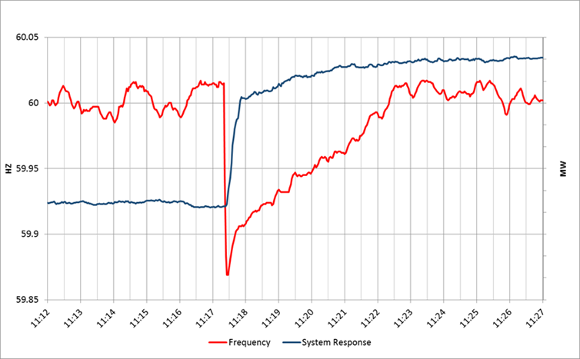
System Response following a Unit Trip

Slide 5
Inertia Background
Only synchronous machines provide inertia to the system
Everything else provides a response, but does not provide system inertia
The level of Inertia on the system is solely a function of the synchronously-connected machines online on the System and their characteristics
However, because the synchronously-connected machines that are online at a particular point in time are related to the load and wind generation on the system at that point in time, the system inertia may be correlated with the load and wind generation

Slide 6
Inertial Effect
Initial rate of change of frequency (RoCoF) prior to any resource response is solely a function of inertia

Slide 7
Inertial Effect
Slope of the RoCoF line changes due to resources’ response

Slide 8
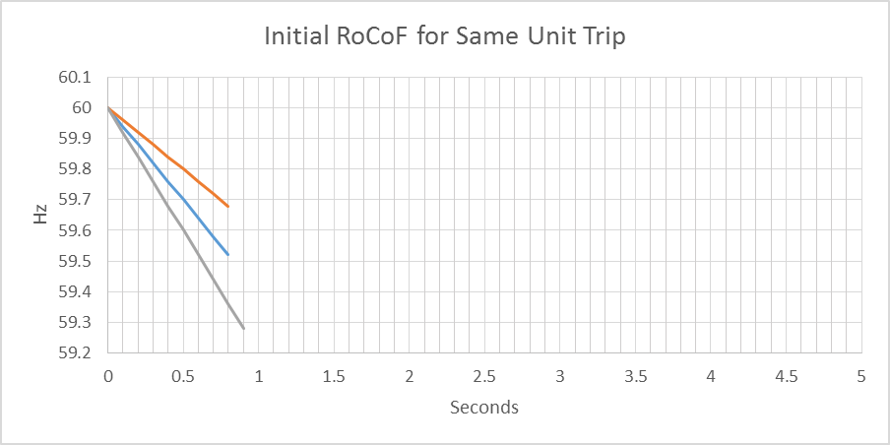
Inertial Effect
Higher Inertia
Lower Inertia

Slide 9
Frequency Response Times
Load Resources (LR) providing RRS have underfrequency relays that respond in about 0.5s after the frequency drops below the trigger level (currently 59.7Hz)
Governors of thermal generating units or Governor like response from curtailed renewable generating units begin to respond “immediately” but will take a few seconds to provide significant response (requires more steam or more combustion)

Slide 10
Response Time Definitions
Early – response is triggered earlier after the unit trip (e.g. a Resource that triggers at 59.8Hz would respond earlier than a Resource that triggers at 59.7Hz, all else equal)
Fast – response is delivered faster after the unit trip (e.g. a Resource that trips within 15 cycles is faster than one that trips within 30 cycles)

Slide 11
Design Criteria
Underfrequency Load Shed (UFLS) relays will shed firm load if frequency drops to 59.3 Hz (5% of total ERCOT load).
To consistently meet BAL-003 Interconnection Frequency Response Obligation, ERCOT must plan not to activate UFLS for the loss of 2750 MW of generation

Slide 12
Two Inertia Issues to be Considered
Must maintain at least a Critical Inertia Level that is based on the current operation practices and characteristics of frequency responsive resources
As inertia approaches critical level, RRS requirements increase exponentially
Will discuss these on next few slides

Slide 13
Critical Inertia Concept
The level of inertia which causes the frequency to drop below the UFLS trigger before the “fastest” resources can provide sufficient frequency response (for the two STP trip) is the “Critical Inertia”
0.4 Hz
0.5 s

Slide 14
Critical Inertia
Currently, the Critical Inertia Level for ERCOT appears to be around 100 GW-s (based on current operations and response characteristics of current resources)
  Simulation results have shown that below this level RoCoF is high enough that frequency would drop below 59.3 Hz for the two STP trip
  Simulation results have also shown wide-area voltage oscillations at inertia below this level; this is a separate but somewhat related issue as identified in the Panhandle region as weak grid

Slide 15
Technical Solutions to Maintain or Lower Critical Inertia
Bring synchronous units with sufficient inertia online
Lower the critical level of inertia by having “earlier” or “faster” frequency response resources
  Although these resources may not help with voltage oscillation issue if they do not also provide system strength
Change UFLS Setting
Others….

Slide 16
Discussion Outline for Today
Trends in Inertia – where are we currently & where are we headed.
Introduction to Long Term Stability Assessment Study’s high penetration scenario.
Current Practice for Monitoring & Maintaining Critical Inertia in Real Time.
RRS Study & other parameter changes and there impact on Critical Inertia.
How are other regions mitigating the critical inertia problem.
Discussion on potential solutions & next steps.

Slide 17
Discussion

Slide 18
Trends in Inertia
Pengwei Du, Julia Matevosjana
Staff
ERCOT
Synchronous Inertial Response (SIR) Workshop
Jan 24, 2018

Slide 19
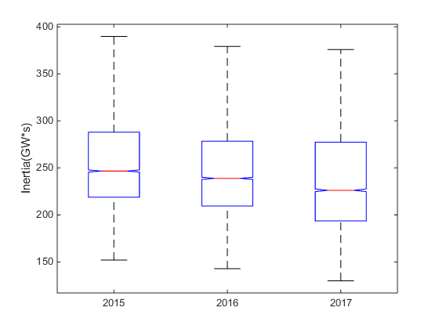
System Inertia
 | System Inertia (GW·s)
11/25/2015 02:00:00 | 152
04/10/2016 02:00:00 | 143
10/27/2017 3:00:00 | 130

Slide 20
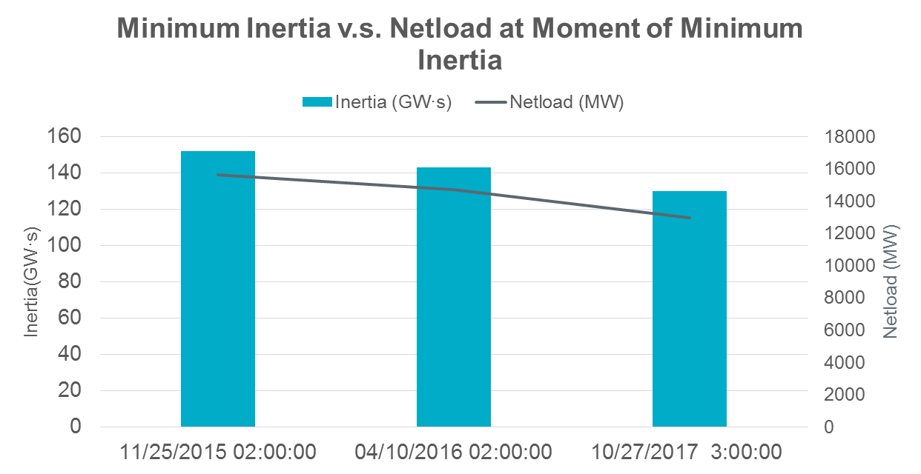
Minimum Inertia
 | System Inertia (GW·s) | Load (MW) | Wind Gen (MW) | Netload (MW)
11/25/2015 02:00:00 | 152 | 26607 | 10976 | 15631
04/10/2016 02:00:00 | 143 | 26801 | 12091 | 14710
10/27/2017 3:00:00 | 130 | 28228 | 15265 | 12963

Slide 21
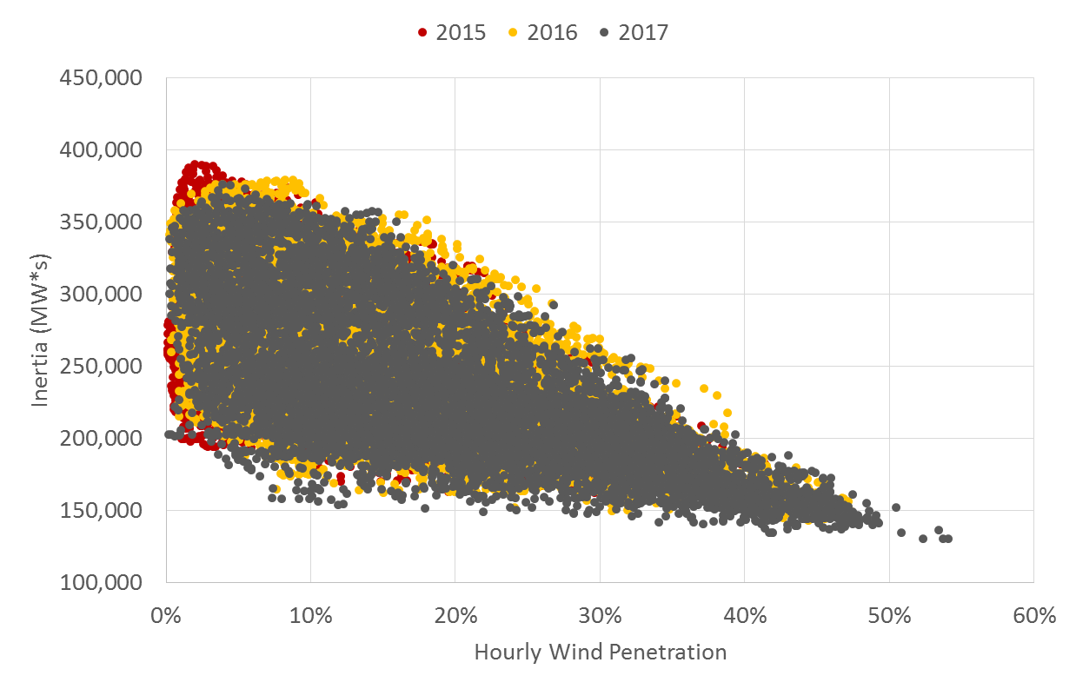
Correlation between Inertia and Wind Penetration (%)

Slide 22
Analysis of Future Base-Level Inertia
Critical inertia 100 GW·s
Private Use Networks, 32-40 GW·s
68-84 GW·s of base inertia
Min requirement for RRS from gen, 24-32 GW·s
Min 2 nuclear units,12 GW·s
At least 2 nuclear units are online at all times (based on 2013-2017 data) with 12 GW∙s of inertia;
There is a minimum requirement for frequency containment reserve RRS from generation. Based on five years of historic data between 2013-2017, the minimum inertia of generation units providing RRS was 24 GW∙s. Considering only the five year lowest inertia instances this number was 32 GW∙s;
Based on five years of historic data between 2013 – 2017, the minimum inertia from internal generation of Private Use Networks^{[1]} was 32 GW∙s. Using the five year lowest inertia instances this number was 40 GW∙s
About 300 MW also has to be reserved for Regulation (based on 2017 Regulation requirements at night time between Jan-Apr). However, it is possible that Regulation is carried by the same units that carry RRS and, therefore, Regulation requirements may not result in additional generation being committed.
^{[1]} Private Use Networks is an electric network connected to the ERCOT Transmission Grid that contains Load that is not directly metered by ERCOT (i.e., Load that is typically netted with internal generation). Even though this internal generation does not necessarily export power into ERCOT grid, it’s still synchronized with ERCOT system and contributes to total system inertia.

Slide 23
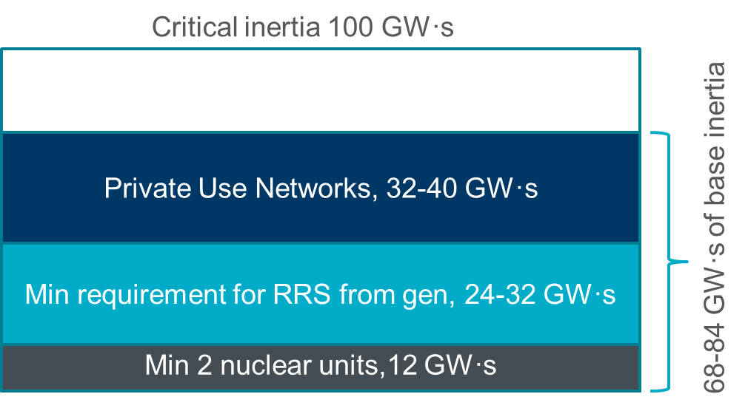

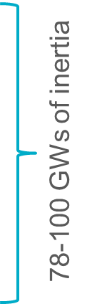
Analysis of Future Minimum Inertia
10-15 GW·s of additional inertia
Min net load in 2021, 10 GW
3 GW of additional generation needed
Gen from RRS units, ∼4500 MW
Min net load
served ∼7000 MW
Nuclear production, 2575 MW
At least 2 nuclear units are online at all times (based on 2013-2017 data) with 12 GW∙s of inertia;
There is a minimum requirement for frequency containment reserve RRS from generation. Based on five years of historic data between 2013-2017, the minimum inertia of generation units providing RRS was 24 GW∙s. Considering only the five year lowest inertia instances this number was 32 GW∙s;
Based on five years of historic data between 2013 – 2017, the minimum inertia from internal generation of Private Use Networks^{[1]} was 32 GW∙s. Using the five year lowest inertia instances this number was 40 GW∙s
About 300 MW also has to be reserved for Regulation (based on 2017 Regulation requirements at night time between Jan-Apr). However, it is possible that Regulation is carried by the same units that carry RRS and, therefore, Regulation requirements may not result in additional generation being committed.
^{[1]} Private Use Networks is an electric network connected to the ERCOT Transmission Grid that contains Load that is not directly metered by ERCOT (i.e., Load that is typically netted with internal generation). Even though this internal generation does not necessarily export power into ERCOT grid, it’s still synchronized with ERCOT system and contributes to total system inertia.

Slide 24
Summary
Minimum System inertia is trending downward as a result of decline in the netload.
Based of cursory studies it is estimated that the recent unit retirements will further contribute to the decreasing trend in the minimum system inertia in certain hours, conversely we expect to see a boost in system inertia in other hours.

Slide 25
Discussion

Slide 26
Dynamic Stability Assessment With High Penetration Of Renewable In ERCOT In 2031
LTSA Stability Study Overview
Shun Hsien Huang
Dynamic Studies
ERCOT
Synchronous Inertial Response (SIR) Workshop
Jan 24, 2018

Slide 27
Objective
Conduct a dynamic stability assessment of high renewable penetration in areas far from major load centers
To identify system challenges from a stability perspective and evaluate potential solutions
To facilitate communication and understanding of long-term system needs among stakeholders
Not intended to recommend specific upgrade projects

Slide 28
Study Scenario
ERCOT 2016 LTSA Year 2031 Current Trends is used as a reference to develop the dynamic stability study scenario for high penetration of renewable generation connected to the transmission grid
Initial Base Case Development (stressed system condition)
  Transmission Topology is consistent with ERCOT 2016 LTSA Year 2031 Current Trends
  System Load: 42.2 GW (includes self-serve load)
  Renewable Generation Dispatch: 27.8 GW (~66% of total load)
  System Inertia (from on-line synchronous generators) : 117 GW-sec (more units decommitted compared to 2016 LTSA)

Slide 29
Initial Base Case Overview
8,500
MW Flow Between Zones
Major Load (MW)
Load: 11,300
5,900
4,200
4,400
5,300
1,500
3,600
1,700
Load: 15,000
1,100
Case Parameter | Value
Load | 42.2 GW (includes PUNs)
Solar Output | 17 GW (90% Dispatch)
Wind Output | 11 GW (48% Dispatch)
W. TX Export | 15.5 GW (16 Major 345 kV Circuits)
Losses | 6%

Slide 30
Steady State (Load Flow) Observations
Large reactive losses due to the long distance and high power transfer from renewable generation to the load centers
Static reactive devices are required to maintain acceptable voltage response with tested contingencies

Slide 31
Flat Start Observations: No Disturbance Test
Numerical instability and low system strength challenges
Flat Start was obtained in the study area
Notes:
Unstable response in the PSS/e dynamic flat start simulation for an acceptable steady state power flow condition.
Condensers were added to improve the system strength to obtain acceptable dynamic flat start cases.

Slide 32
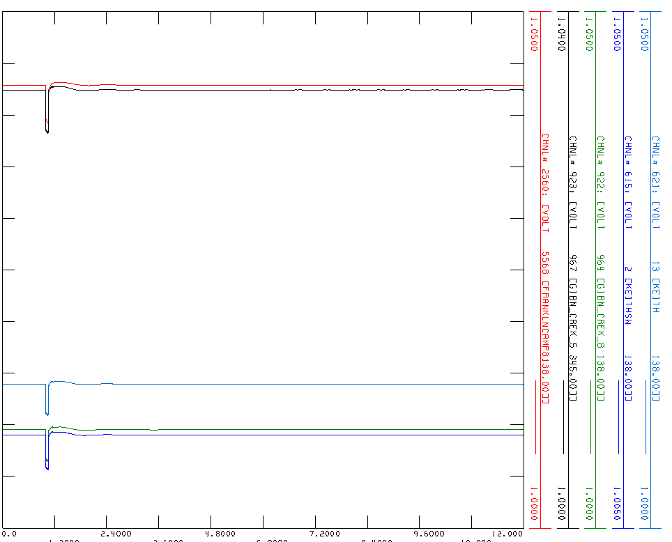
Flat Start Observations: Ring Down Test
Initial Ring Down Test
  Unacceptable
Synchronous condensers were added to obtain acceptable response
Notes:
Unstable response in the PSS/e dynamic flat start simulation for an acceptable steady state power flow condition.
Condensers were added to improve the system strength to obtain acceptable dynamic flat start cases.

Slide 33
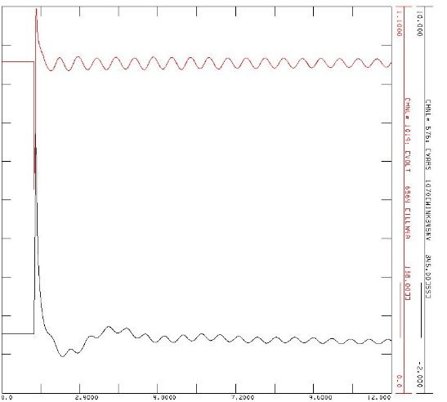
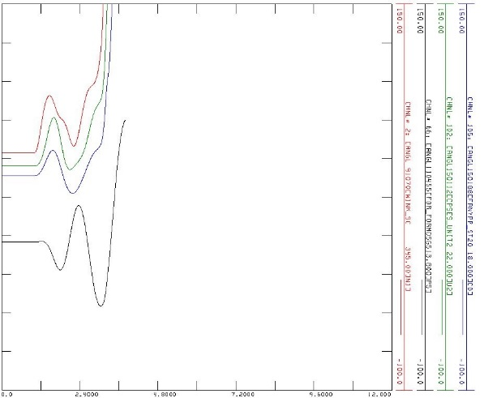
Dynamic Stability Assessment Observations
More condensers were added for the tested 345 kV outages
Unacceptable responses include:
Undamped Oscillations
Angular Instability and Voltage Collapse

Slide 34
Synchronous Condenser Observations
Provide system strength and reactive support
Subject to typical stability challenges, like angular stability and intra/inter area oscillations
Condensers only
Condensers + New Circuit

Slide 35
Preliminary Findings
Acceptable steady state condition may not guarantee stable response in normal operations
  Low system strength in the West, Far West, and Panhandle could cause controller instability
When considering synchronous condensers to provide voltage and strength support, system stability (e.g. intra/inter-area oscillation) must be checked
  Other upgrade options (e.g. adding new circuits) may be necessary to provide system improvement without introducing additional stability challenges

Slide 36
Discussion

Slide 37
Maintaining Critical Inertia
Nitika Mago
Operations Analysis
ERCOT
Synchronous Inertial Response (SIR) Workshop
Jan 24, 2018

Slide 38
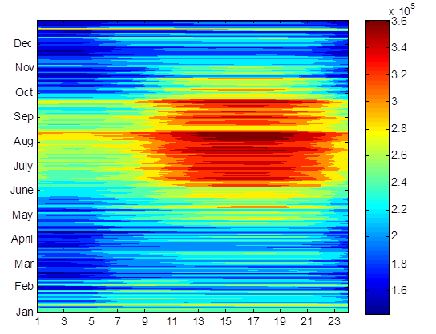
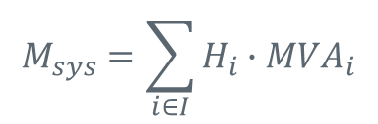
Inertia Monitoring
Inertia is being monitored in Real Time.
  The system inertia is calculated as
where I is the set of online synchronous generators or condensers,
MVA_{i} is MVA rating of on-line synchronous generator or synchronous condenser i, and
H_{i} is inertia constant for on-line generator or synchronous condenser i in a system (in seconds on machine MVA_{i})
$$M_{sys}=\sum_{i∈I}{H_{i}∙{MVA}_{i}}$$
System Inertia 2016

Slide 39
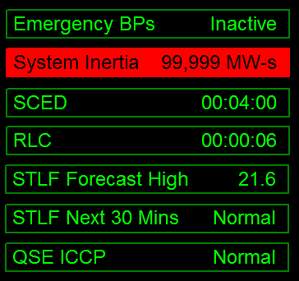
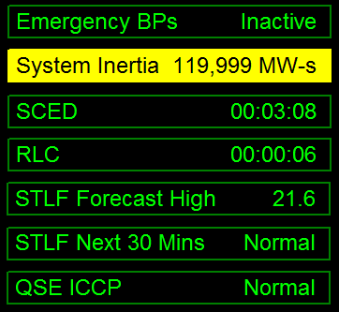
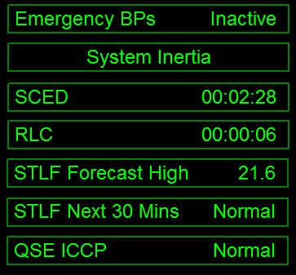
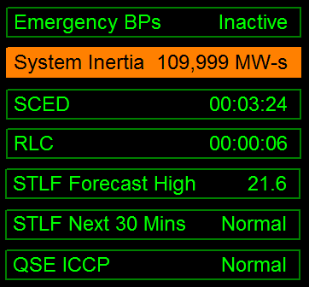
Maintaining Critical Inertia
Critical Inertia for ERCOT appears to be around 100 GW-s
Visual alarms are raised alarms when inertia gets close to critical
    120 GW*s >= Inertia Normal
    120 GW*s > Inertia >= 110 GW*s Yellow
    110 GW*s > Inertia >= 100 GW*s Orange
    100 GW*s < Inertia Red

Slide 40
Approach for Maintaining Critical Inertia
Monitor grid conditions closely when system inertia < 120 GW*s
Take Actions when system inertia < 105 GW*s
  Target increasing system inertia >= 105 GW*s
  Possible Actions
    Deploy Non-Spin from Offline Generation Resources (including Quick Start Generation Resource (QSGRs) that carry Non Spin)
    Deploy remaining Quick Starts (not carrying Non-Spin)
    RUC Generation Resource that can be turned on within one hour

Slide 41
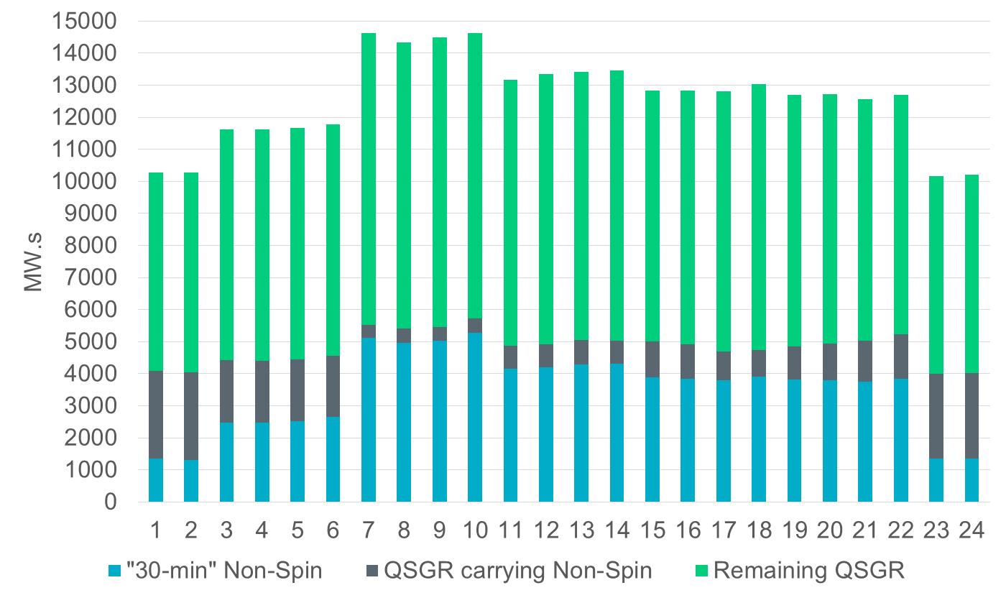
Winter – Potential Inertia Contributions

Slide 42
Spring – Potential Inertia Contributions

Slide 43
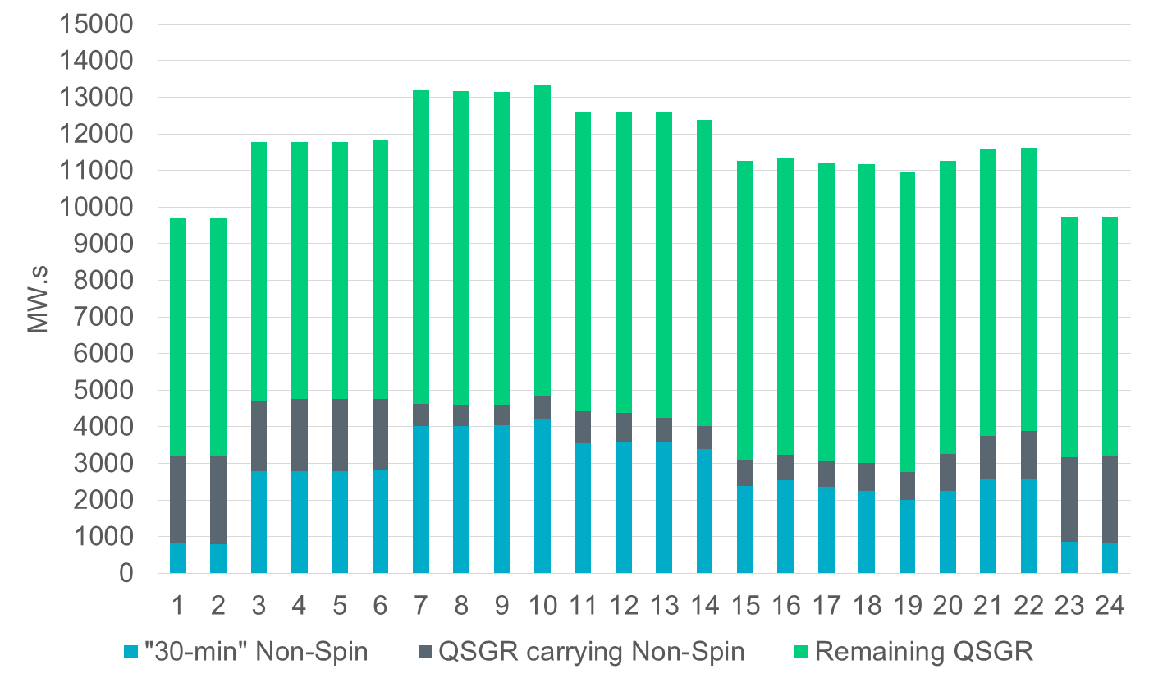
Summer – Potential Inertia Contributions

Slide 44
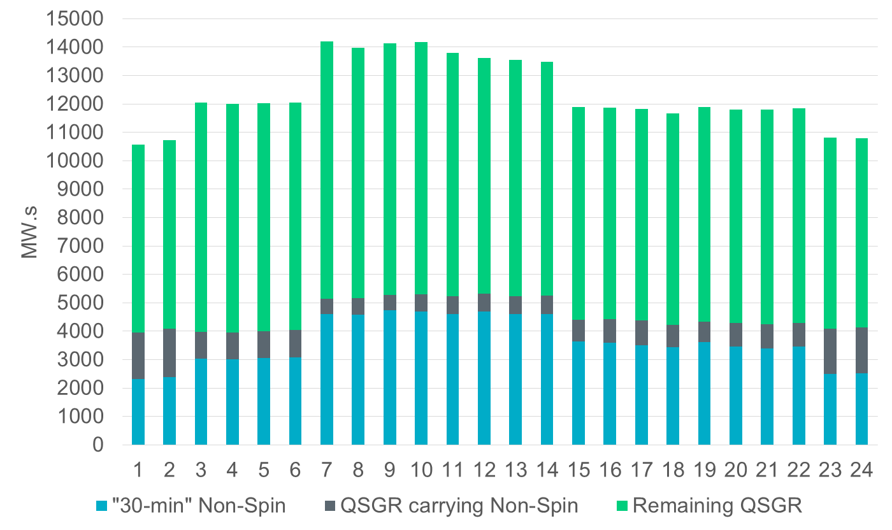
Fall – Potential Inertia Contributions

Slide 45
Approach for Maintaining Critical Inertia
Monitor grid conditions closely when system inertia < 120 GW*s
Take Actions when system inertia < 105 GW*s
  Target increasing system inertia >= 105 GW*s
  Possible Actions
    Deploy Non-Spin from Offline Generation Resources (including Quick Start Generation Resources (QSGRs) that carry Non Spin)
      Resources that have historically carried Offline Non-Spin can on an average provide ~4000 MW.s inertia increment.
    Deploy Quick Starts (not carrying Non-Spin)
      Quick Start resources that have historically not carried Non-Spin can on an average provide ~6000 MW.s inertia increment.
    RUC Generation Resource that can be turned on within one hour

Slide 46
Discussion

Slide 47
Impacts Of Parameter Changes On Critical Inertia
Sandip Sharma
Operations Planning
ERCOT
Synchronous Inertial Response (SIR) Workshop
Jan 24, 2018

Slide 48
Discussion Outline
Introduction to current RRS Study
Methodology to determine Critical Inertia
Parameter Changes and their impact on Critical Inertia
  Response Settings
  UFLS Settings
  Critical Contingencies

Slide 49
Responsive Reserve Service (RRS)
System Inertia 2016
RRS is procured to ensure sufficient capacity is available to respond to frequency excursions during unit trips.
To consistently meet BAL-003 Interconnection Frequency Response Obligation, ERCOT must plan not to activate UFLS for loss of 2750 MW of generation.
  UFLS relays will shed firm load if frequency drops to 59.3 Hz (5% of total ERCOT load).
  ERCOT plans to maintain frequency nadir at or above 59.4 Hz for loss of 2750 MW (0.1 Hz margin).
Responsive Reserve Requirements 2017

Slide 50
RRS Study Methodology
Select recent cases with varying inertia levels to represent a wide range of expected inertia conditions for future years.
The following assumptions are utilized in each study
  Model 1150 MW of PFR from Generation Resources.
    Generation mix when
      Inertia < 250 GW·s: 30% Coal + 70% Gas
      Inertia ≥ 250 GW·s: 15% Coal + 85% Gas
  Load Resources providing RRS will trip at 59.7 Hz, with a delay of 0.416 s (relay delay = 0.333 s; breaker action = 0.083 s)
  Load damping factor was assumed to be 2% at the system level
The following study methodology is followed for each case that is studied
  Trip 2750 MW of generation simultaneously. Identify the minimum amount of LRs required to ensure that frequency nadir remains at/or above 59.40 Hz.

Slide 51
Current RRS Table
 | Scenario 1 | Scenario 2 | Scenario 3 | Scenario 4 | Scenario 5 | Scenario 6 | Scenario 7 | Scenario 8 | Scenario 9 | Scenario 10 | Scenario 11 | Scenario 12
LR/PFR | 2.25:1 | 2.11:1 | 1.99:1 | 1.87:1 | 1.77:1 | 1.69:1 | 1.61:1 | 1.54:1 | 1.47:1 | 1.41:1 | 1.36:1 | 1.3:1
Inertia (GW∙s) | 130 | 140 | 150 | 160 | 170 | 180 | 190 | 200 | 210 | 220 | 230 | 240
PFR Req. (no LR) (MW) | 5246 | 4916 | 4620 | 4361 | 4132 | 3927 | 3743 | 3576 | 3424 | 3285 | 3157 | 3040
RRS 50% Lim (MW) | 3229 | 3162 | 3090 | 3039 | 2984 | 2920 | 2868 | 2815 | 2772 | 2726 | 2676 | 2643
RRS 60% Lim (MW) | 2998 | 2951 | 2898 | 2867 | 2835 | 2793 | 2760 | 2725 | 2697 | 2664 | 2626 | 2604
 | Scenario 13 | Scenario 14 | Scenario 15 | Scenario 16 | Scenario 17 | Scenario 18 | Scenario 19 | Scenario 20 | Scenario 21 | Scenario 22 | Scenario 23 | Scenario 24 | Scenario 25
LR/PFR | 1.26:1 | 1.22:1 | 1.17:1 | 1.14:1 | 1.1:1 | 1.07:1 | 1.04:1 | 1.01:1 | 1.00:1 | 1.00:1 | 1.00:1 | 1.00:1 | 1.00:1
Inertia (GW∙s) | 250 | 260 | 270 | 280 | 290 | 300 | 310 | 320 | 330 | 340 | 350 | 360 | 370
PFR Req. (no LR) (MW) | 2932 | 2831 | 2737 | 2650 | 2569 | 2492 | 2421 | 2353 | 2290 | 2230 | 2173 | 2119 | 2068
RRS 50% (MW) | 2594 | 2550 | 2523 | 2477 | 2446 | 2408 | 2373 | 2342 | 2290 | 2230 | 2173 | 2119 | 2068
RRS 60% (MW) | 2564 | 2528 | 2507 | 2466 | 2440 | 2405 | 2372 | 2341 | 2290 | 2230 | 2173 | 2119 | 2068
RRS 50% Lim (MW) - quantity is calculated with limit of 50% limit on LRs.
RRS 60% Lim (MW) - quantity is calculated using language approved in NPRR 815.
Red font in table above identifies study scenario where RRS needed < 2300 MW. 2300 MW floor will be used in RRS requirement determination.
Generation mix (CCs, Gas, SC, Coal, Steam) providing 1150 MW of PFR has been aligned with actual historic system operations.
Inertia < 250 GW·s: 30% Coal + 70% Rest. Inertia ≥ 250 GW·s: 15% Coal + 85% Rest

Slide 52
Critical Inertia Definition
Minimum level of system inertia that will ensure LRs will have sufficient time to respond before Frequency hits 59.3 Hz (UFLS threshold)
Tf > LRs Response time

Slide 53
Frequency Response (Initial Stage)
Inertia (GW.s)
376
358.5
340
324
307
290
260
224.3
190
184.3
153.6
140
108
59.7Hz
LR
59.3 Hz
UFLS

Slide 54
Critical Inertia Quantification Methodology

Slide 55

Current Critical Inertia for ERCOT
$$T=f \left(Inertia\right) =3×{10}^{−5}×{Inertia}^{2}+0.0016×Inertia+0.0048$$
Critical Inertia: 94 GW*s
LR Response Time
0.42s

Slide 56
Potential Parameter Changes
Faster Response
  25 Cycle Delay (0.42s) 15 Cycle Delay (0.25s)
0.42s
0.25s
68
94

Slide 57
Faster Response Impact
Critical Inertia | UFLS @59.3Hz
0.42s LR Response Time | 94 GW*s
0.25s LR Response Time
68 GW*s

Slide 58
Potential Parameter Changes
UFLS settings
  UFLS @ 59.3 Hz to UFLS @ 59.1 Hz

Slide 59
Automatic Firm Load Shedding @ ERCOT
2.6.1 (1) At least 25% of the ERCOT System Load that is not equipped with high-set under-frequency relays shall be equipped at all times with provisions for automatic under-frequency load shedding. The under-frequency relays shall be set to provide Load relief as follows:
Threshold | Load Relief
59.3 Hz | 5% of the ERCOT System Load (Total 5%)
58.9 Hz | An additional 10% of the ERCOT System Load (Total 15%)
58.5 Hz | An additional 10% of the ERCOT System Load (Total 25%)

Slide 60
Generators Under-frequency Protection @ ERCOT
2.6.2 (1) If under-frequency relays are installed, these relays shall be set such that the automatic removal of individual Generation Resources from the ERCOT System meets the following requirements:
Frequency Range | Delay to Trip
Above 59.4 Hz | No automatic tripping (Continuous operation)
Above 58.4 Hz up to And including 59.4 Hz | Not less than 9 minutes
Above 58.0 Hz up to And including 58.4 Hz | Not less than 30 seconds
Above 57.5 Hz up to And including 58.0 Hz | Not less than 2 seconds
57.5 Hz or below | No time delay required

Slide 61
Worldwide Comparison of UFLS Settings
 | Max (GW) | Min (GW) | Resource Contingency Criteria, under frequency MW | UFLS Frequency | UFLS Frequency on 60 Hz reference
Nordic TSOs | 70.00 | 25.00 | 1450 | 48.8 | 58.56
ERCOT | 69.86 | 24.17 | 2752 | 59.3 | 59.3
NG UK | 53.00 | 17.00 | 1000 | 49.2 | 59.04
Hydro Quebec | 39.00 | 15.00 | 1700 (but less @ low inertia) | 58.5 | 58.5
ESKOM | 35.00 | 19.00 | 930 | 49.2 | 59.04
Australia | 30.40 | 14.30 | 760 | 49 | 58.8
Eirgrid | 6.40 | 2.30 | 500 | 48.85 | 58.62
NZ Transpower North island | 4.50 | 1.70 | 572 | 47.8 | 57.36
NZ Transpower South island | 2.20 | 1.30 | 260 | 47.5 | 57
Rhodes | 0.191 | 0.03 | 26 | 49.4 | 59.28
Faroe Islands | 0.05 | 0.02 |  | 48.5 | 58.2
Source: ENTSO-E Report, Future System Inertia 2
Note this table reflects UFLS settings as of 2016 for the regions annotated. This data has been sorted by maximum load to aid comparison of the settings used by similar sized regions.

Slide 62
UFLS Setting Current vs. Analysis
5%
59.3 Hz
11%
59.1 Hz
58.9 Hz
10%
58.8 Hz
10 %
10%
58.5 Hz
58.5 Hz
4.7%
Current
Study

Slide 63
UFLS Setting Change
  UFLS @ 59.3 Hz UFLS @ 59.1 Hz
LR Response Time
0.42s
71
94

Slide 64
UFLS Change Impact
 | UFLS @59.3Hz | UFLS @59.1Hz
0.42s LR Response Time | 94 GW*s
71 GW*s

Slide 65
Faster Response & UFLS Change Impact
 | UFLS @59.3Hz | UFLS @59.1Hz
0.42s LR Response Time | 94 GW*s
0.25s LR Response Time | 68 GW*s
71 GW*s
52 GW*s

Slide 66
Potential Parameter Changes
Critical Contingencies

Slide 67
Summary
ERCOT’s Critical Inertia is sensitive to the parameters such as response characteristics of the LR’s that provide RRS, UFLS setting and even the level at which critical contingencies are dispatched.
Adopting one or more combinations of these can mitigate ERCOT’s Critical Inertia and widen ERCOT’s System Operating Limit.

Slide 68
Discussion

Slide 69
Lunch Break
Synchronous Inertial Response (SIR) Workshop
Jan 24, 2018

Slide 70
International Review of Inertia Related Challenges and Mitigation Measures
Julia Matevosjana
Resource Adequacy
ERCOT
Synchronous Inertial Response (SIR) Workshop
Jan 24, 2018

Slide 71
Systems Considering Inertia Issues
RCC – Resource Contingency Criteria, largest simultaneous generation trip
Source: Survey on Inertia Related Challenges and Mitigation Measures, presentation at Wind Integration Workshop 2017
Notes:
Resource Contingency Criteria :
• Largest category C loss‐of‐resource event (N‐2)
• Largest total generating plant with common voltage switchyard
• Largest loss of generation in the interconnection in the last 10 years

Slide 72
Systems Experiencing Inertia Decline, Comparison
350
Additional factors important for comparison:
Δf to UFLS
RoCoF protection settings
Other considerations (e.g. speed of reserves)
Source: Survey on Inertia Related Challenges and Mitigation Measures, presentation at Wind Integration Workshop 2017

Slide 73
Low Inertia Mitigation Options
Rotating mass
Control the Level of Inertia Online
Dynamic Assessment of Reserves
Based on Inertia Conditions
Lower UFLS trigger
Reserves
RCC
Keep frequency above UFLS
Reduce RCC
Faster Reserves
Based on: Survey on Inertia Related Challenges and Mitigation Measures, presentation at Wind Integration Workshop 2017

Slide 74
Nordic TSOs
Facts
Norway, Finland, Sweden and part of Denmark
Not interconnected synchronously with the rest of Europe
Peak demand 70 GW, 10% of capacity from wind and solar
Hydro-dominated system, inertia is low
Minimum inertia 125 GW·s
RCC=1450 MW (one nuclear unit)
Concerns
Slow PFR, time to UFLS is a concern
Mitigation measures
Monitoring system inertia in real time
Produces inertia forecasts for future years
Recognized low inertia is an issue but no solutions been developed yet.
Can use Fast Emergency Power Control on HVDC links in interim.

Slide 75
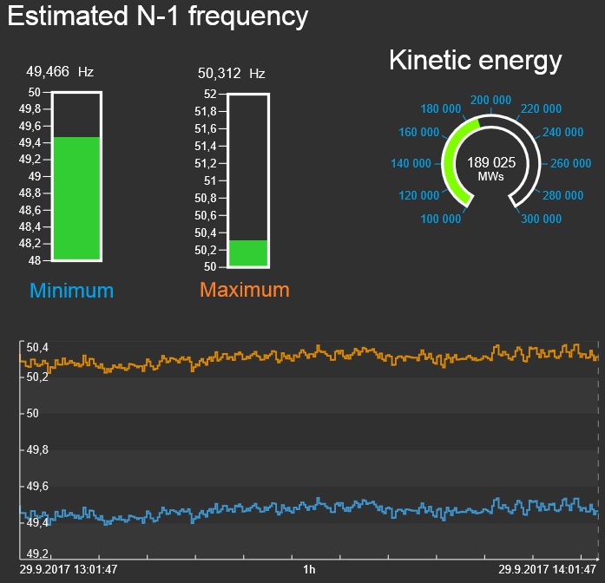
Nordic TSOs, Real-Time Inertia Monitoring Tool
Inertia estimation
Empirical regression model
List of possible
contingencies

Slide 76
South Australia
Facts
HVAC interconnector (650 MW), and HVDC interconnector (220 MW), to the rest of Australian system
Peak Demand 3 GW
35% capacity from wind and solar
Maximum instantaneous penetration 119%
Minimum inertia 2 GW·s
RCC=650 MW
Concerns
At RoCoF 1-3 Hz/s synchronous generation trips are possible
At RoCoF>3Hz/s UFLS can no longer operate properly
South Australia
Source: AEMO – EPRI Webcast Nov.2017

Slide 77
South Australia, Mitigation Measures
Near-term introduced:
Minimum required synchronous unit combinations online (for inertia and system strength)
Minimum* inertia threshold to be ensured by TSPs
Constraining RCC (HVDC import) to keep RoCoF<3Hz/s
Looking into:
Installing High Inertia Synchronous Condensers
Implementing inertia market for above the minimum* inertia levels
“Contingency” FFR with ∼1 s activation time to slow down RoCoF
“Emergency” FFR with ≤100 ms activation time (direct event detection, RAS)
More Distant Future:
Grid Forming (step change in technology capability)
* Minimum inertia is not intended to prevent UFLS but to avoid blackout in SA

Slide 78
National Grid UK
Facts
Scotland, Wales & England
Not synchronously interconnected with Ireland or the rest of Europe
HVDC links to Irelands (500 MW and 450 MW), France (2000 MW) and Netherlands (1000 MW)
Peak Demand 53 GW
>26 GW of wind and solar (most of it in distribution network)
Minimum inertia 135 GW·s
RCC=1000 MW (HVDC import)
Concerns
Loss-of-mains protection in the distribution networks uses RoCoF relays (used to trigger at 0.125 Hz/s). All distribution connected renewables were set to trip at RoCoF=0.125 Hz/s, changed to 1Hz/s for the plants installed after Aug. 2014. These considerations set the criteria for determining RCC limit.
Source: National Grid, System Operability Framework 2016

Slide 79
National Grid UK, Mitigation Measures
Near-term:
Monitors inertia online real time
RCC limited in real time by the operators to minimize the risk of high RoCoF 0.125 Hz/s - 1 Hz/s
Forecasts inertia < 12 hours ahead, derives largest loss that the system can withstand due to RoCoF considerations.
Post-fault inertia limit is set to 130 GW·s
Varies frequency containment reserve based on inertia and largest contingency
Introduced Enhanced Frequency Response Service (EFR): deliver 100% Active Power output within 1 second, sustain for 15 minutes
Working on:
Ongoing discussion about Grid Forming Capabilities to be included in Grid Code requirement
Sources: National Grid, System Operability Framework 2016

Slide 80
Hydro Quebec, Facts
Facts
Not synchronously interconnected with other systems
Peak Load 39 GW
7% of installed capacity is from wind generation
Minimum inertia 60 GW·s
Hydro-dominated, inertia is low
RCC=1700 MW (multiple units in a hydro power plant)
Concerns
Inertia is low, RCC is high, PFR is slow, time to UFLS is a concern
Mitigation
Limits largest contingency in real time based on inertia conditions
System operator performs real-time generation re-dispatch or increases the level of synchronous generation online to ensure the limit is not exceeded
Synthetic inertia requirement for all WGRs > 10 MW

Slide 81
Largest Resource Contingency Limit in HQ, 2007-2017
Notes:
FORMAT

Slide 82
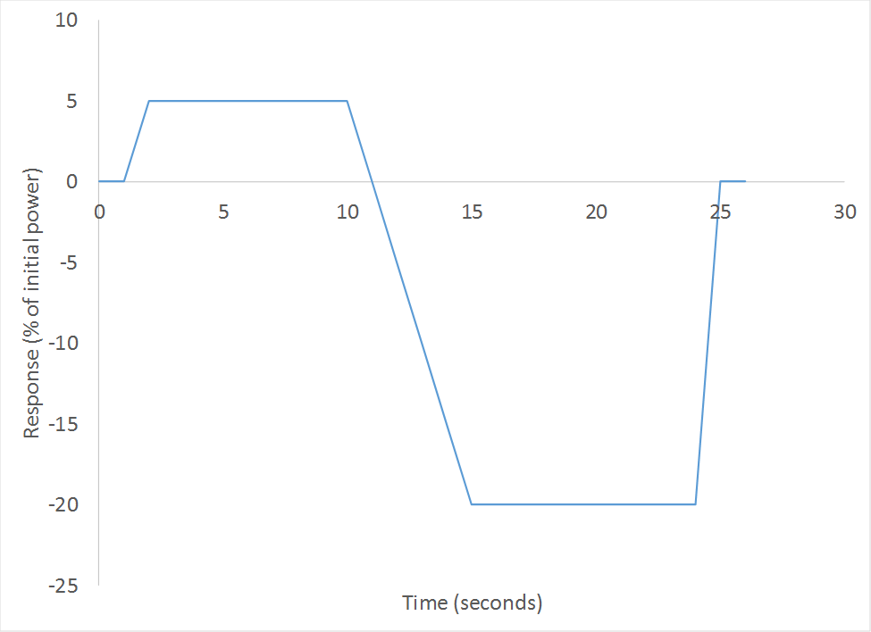
HQ Underfrequency control (Inertial Response)
Wind Generation Resources (>10 MW) during underfrequency conditions are required to provide momentary overproduction that limits the frequency drop after a major loss of generation.

Slide 83
EirGrid, Facts
Facts
Republic of Ireland and Northern Ireland
Not synchronously interconnected with other systems
HVDC links between Irelands and GB (500 MW and 450 MW)
Peak Load 6.4 GW
About 4 GW of non-synchronous generation
Minimum inertia 20 GW·s
RCC=500 MW (HVDC import)
Concerns
Lack of synchronizing torque,
RoCoF≥0.5 Hz/s will trip significant amounts of renewables
Low frequency nadir after large contingencies and
Low-voltage-induced frequency dips

Slide 84
EirGrid, Mitigation Measures
Limits instantaneous non-synchronous generation penetration (SNSP) to 60%
Trying to increase non-synchronous generation penetration to 75% while still maintaining RoCoF (0.5 Hz/s), using new AS
Monitors inertia in real time
Forecasts inertia in the DA reserve-constrained unit commitment tool; if forecasted inertia is < 20 GW·s, wind generation is constrained in real time.
Ensures inertia floor of 20 GW·s and minimum number of high inertia units in certain areas via the unit commitment process
Ensures < 0.5 Hz/s RoCoF for given operating conditions and largest possible contingency
Proposed 14 AS including synchronous inertia (already being remunerated for all generators providing SIR) and fast acting reserves (full response in ≥2 seconds)

Slide 85
Summary of Existing Low Inertia Mitigation Measures
Monitor inertia & possible contingencies in real time
Dynamic Assessment of Reserves based on inertia conditions and largest resource contingency
Limit RCC based on inertia conditions
Synchronous Condensers
Enforce minimum inertia limit
Inertia market/auction/payment for inertia
Synthetic inertia requirement
Faster Frequency Response, 0.5-1 second
Super Fast Frequency Response (through RAS) ≤ 0.1 seconds

Slide 86
Discussion

Slide 87
Open Discussion On Potential Solutions
Synchronous Inertial Response (SIR) Workshop
Jan 24, 2018

Slide 88
Short Term Options
Short Term = Approaches that can be undertaken without System changes.

Slide 89
Mid Term Options
Mid Term = Approaches that involve System Changes.

Slide 90
Long Term Options
Long Term = Approaches that involve significant system changes at ERCOT and MPs (such as new AS product)

Slide 91
Action Items
& Next Steps

