Slide 1
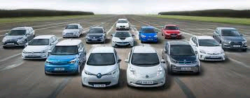

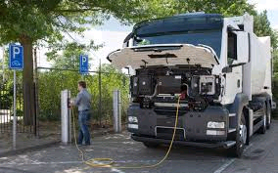
How will growth in Electric vehicles impact the Grid
Tom ‘ Smitty’ Smith for Public Citizen
Karl Popham – Austin Energy
Britta Gross- GM
Bill Kahn PACCAR ( Peterbilt)
Chris Nedler- Rocky Mountain Institute (RMI)
Questions

Slide 2
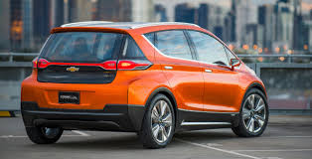
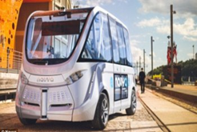


The coming of electric vehicles will change the electricity market as fast as renewable energy changed generation market
And the grid will change rapidly to supply mobile loads and storage
Now is the time to ask big questions
Or freak out later
Tom “Smitty” Smith for Public Citizen’s Texas office

Slide 3
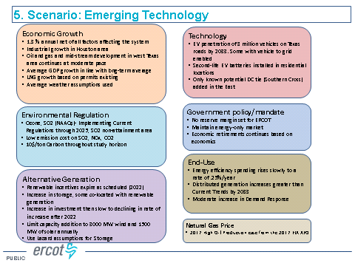
The 2018 LTSA predicts 3 million electric vehicles by 2030 –
--that seems too low to me

Slide 4
How Fast- How Many? are we at the tipping point?
Electric vehicles (EVs) will cost less than internal combustion engines (ICEs) between 2022 and 2025.
The majority of vehicles sold in the U.S. by 2029-2040 will be electric vehicles (EVs).
This will affect electric demand, create unique challenges of meeting mobile load and offer interesting opportunities for using vehicle batteries for storage.
Value streams for energy stored in vehicle batteries may include demand charge reduction, peak load reduction, energy arbitrage, price responsive opportunities, voltage support, and congestion management
Based on the data described below, we suggest ERCOT's Future Case should assume that between 2.5 and 12.6 million electric vehicles will be on the road in Texas in 2033
While these numbers seem large:
  In 2016 there were 24 million vehicle s for 28 million people or 1.8 vehicles per driver.
  It is estimated there will be 37 million Texans by 2035, 21 million drivers and there could be as many 38 million vehicles

Slide 5
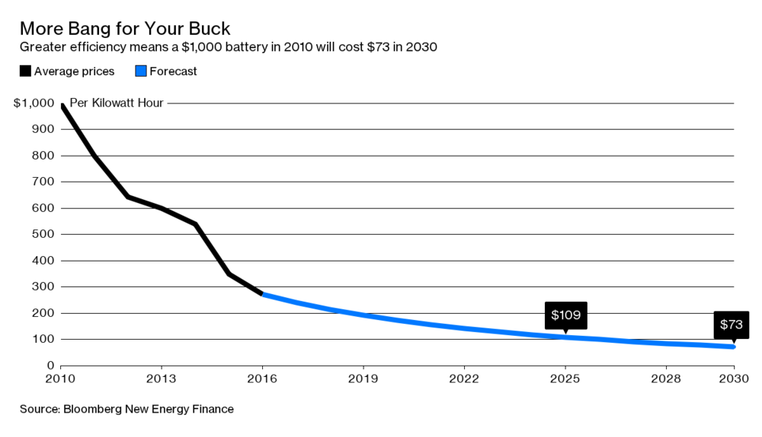
How fast?
,More than 90 per cent of all passenger vehicles in the U.S., Canada, Europe and other rich countries could be electric by 2040. Electric Cars May Rule the World’s Roads by 2040 National Geographic September 2017
Rethink X, an independent think tank, is even more bullish, saying most U.S. vehicles will be electric by 2030, just 13 years from now.
A November 2017 study by the Boston Consulting Group predicted Electrified Vehicles to Take Half of Global Auto Market by 2030
After 2025, falling battery prices and rising consumer demand based on TCO will drive rapidly increasing sales of all electrified vehicles, and especially BEVs. The adoption of electrified vehicles for shared mobility will accelerate because their higher mileage will result in more rapid payback of the investment.
Bloomberg New Energy Finance (BNEF) recently bumped up its estimate of the EV market share in 2040 from 35% of all new car sales to 54%:
  The EV revolution is going to hit the car market even harder and faster than BNEF predicted a year ago. EVs are on track to accelerate to 54% of new car sales by 2040. Tumbling battery prices mean that EVs will have lower lifetime costs, and will be cheaper to buy than internal combustion engine (ICE) cars in most countries by 2025-29.
  The real take-off for EVs will happen in the second half of the 2020’s due to plunging lithium-ion battery prices, which are set to fall by more than 70% by 2030.

Slide 6
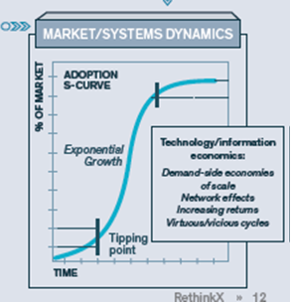
How fast?
EV sales could hit the rapid-growth part of the technology-adoption S-curve as soon as 2026, in the estimation of Bloomberg New Energy Finance
Based on how quickly horses and buggies disappeared in the early 1900’s-the transformation could occur in 15 years or less
Other 15 year technology changes
  Radio to TV
  Digital cameras
  Mobile phones
  Microwave ovens
  Mainframes to desktops and then to laptops and tablets
  renewable energy

Slide 7
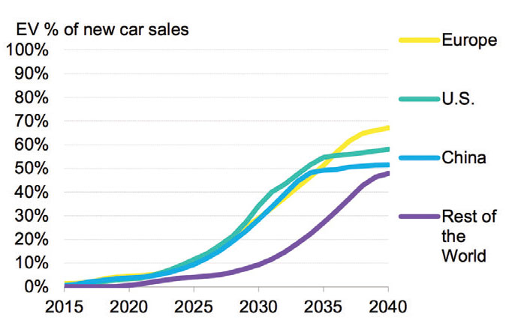
How many?
company | % sales | date
Bloomberg | 54% | 2040
Morgan Stanley | 50% | 2040
Electrix | 100% | 2035
Bernstein | 40% | 2037
Wood Mc Kenzie | 21% | 2035
Boston consulting Group | 50% | 2030
Mc Kenzie | 10-15% | 2030

Slide 8
The EV tide will turn without U.S. mandates or incentives
Seven countries have announced they are considering banning new fossil vehicle sales by 2040 or earlier. Norway will ban the sale of non-electric vehicles after 2025. India has said no new ICEs by 2030 . Governments in the UK., the Netherlands, and France have promised the same by 2040. Germany and China are committed and discussing similar dates. California has begun similar discussions and thirteen states usually follow their lead.
  Eight car manufacturers have upped the number of electric vehicles they plan to offer. Volvo has announced they are phasing out non- electrified vehicles beginning in 2019.
  Seven heavy-duty truck manufacturers are developing heavy-duty electric trucks and/or have announced new products.

Slide 9
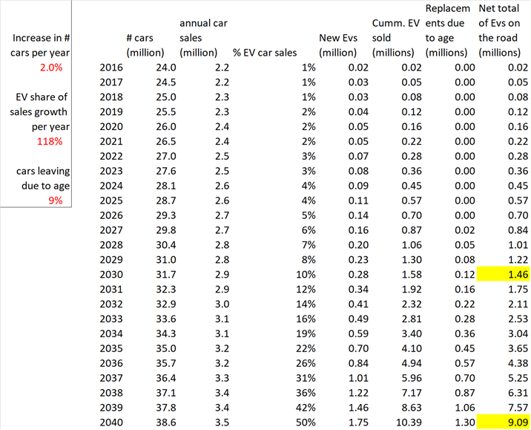
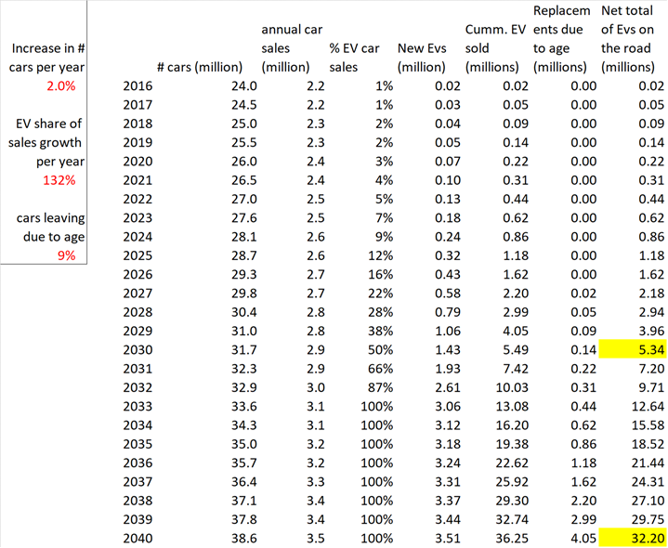
Projected number of Evs by 2033
Low 2.53 million vehicles
High 12.64 million vehicles

Slide 10
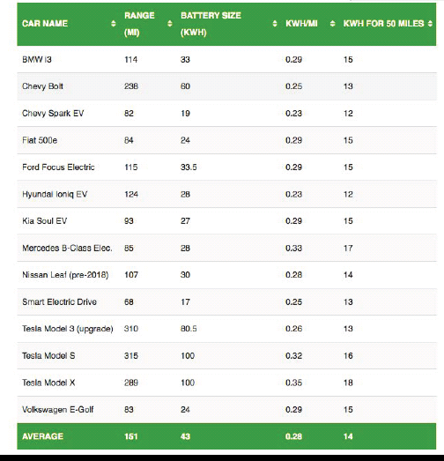
Estimated Light duty electric vehicle demand
VMT is expected to increase by 62 percent from 2010 to 2040 (based on the Texas SAM). Also, the plan states that population is expected to rise 61 percent
From 240.000 million miles to 388.000 million vehicles miles by 2040
EV miles: 2030: 18.000 (low) 53.400 (high)
2040: 91.000 (low) 322.000 (high)
https://static.tti.tamu.edu/tti.tamu.edu/documents/PRC-15-40-F.pdf
If we use a Bolt as a model –With 0.25 KWh per mile demand for 2030 and 2040 would be:
If Average Texan drives 44 miles per day X .28 KWh /mile =12.5 KWh
EV deployment could add
about 30% to load

Slide 11
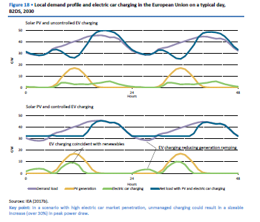
How will Evs affect demand
According to the International Energy Agency, unmanaged charging could result in an increase in peak power draw of roughly one-third.
However if charging is managed the additional generation required to meet the EV and PHEV increased demand drops to 1.5% of the total electricity demand by 2030 –
Global EV outlook 2017 © OECD/IEA 2017
Two million and counting pg. 42

Slide 12
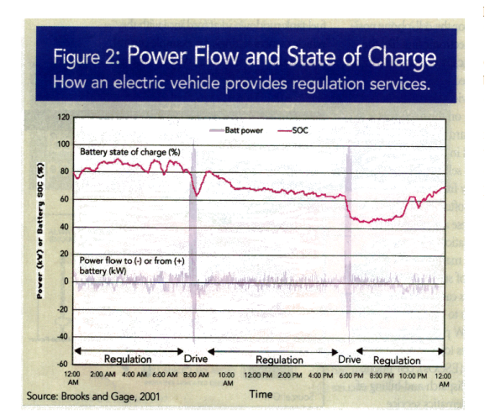
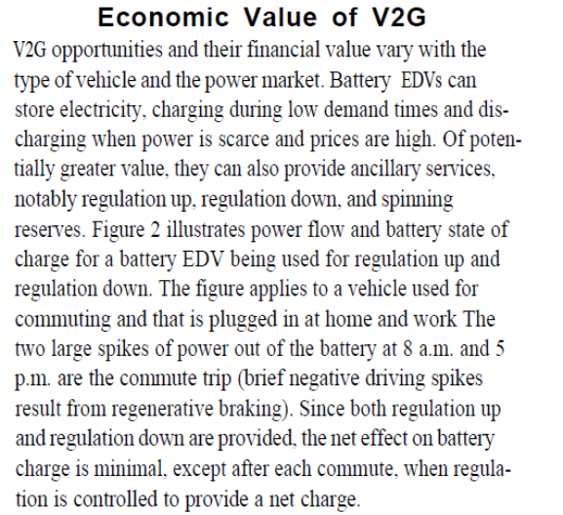
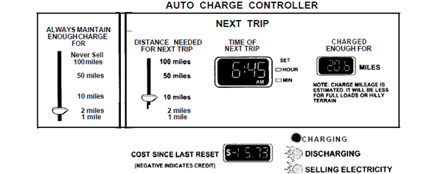
V2G can provide REG up and down services – with appropriate controls to assure the driver gets home

Slide 13
Policy questions that might lead to protocol revisions:
How do we assure that additional electric vehicles don’t add to peak load,
Will time-of-use rate structure alone do the job? Or do we need some sort of EV charging rates, controls or black out times?
What is the state of charging timing control technology in vehicles today –is it interactive?
How do we predict plug load? How much plug load should we assume for heavy duty vehicles?
How much additional charging infrastructure will we need?
How do we predict the likely percentage of use of fast chargers versus slower overnight charging systems?
How do we build adequate charging infrastructure ahead of demand?
How do we trace the vehicle load? Whose load is it? Does it get billed by the charging station or get billed back through the customers’ REP?
How do we value vehicle to grid energy? At time-of-use rate? As an ancillary service? Based on nodal price?
How do we aggregate and control stored energy from EVs into dispatchable energy
What kind of technology needs to be developed to trigger VTG battery discharge to help meet peak demand?
How does a vehicle owner signal availability for VTG dispatch?
What determines which vehicles get dispatched? Battery size, charge level? Proximity to load?

Slide 14
What we don’t know
How fast will heavy duty vehicles electrify?
What increased demand will occur due to HD vehicles recharging during the day
How will charging affect the grid?
  Will heavy duty busses and commercial vehicles recharge while waiting at corners or loading and unloading freight?
  Will we need to build MWs of capacity at major intersections and shopping centers to meet the demand for instant charging?
  Will roof top solar and storage become a solution to large EV demand? Will old vehicle batteries be used for energy storage ? and eliminate the need to build up the grid?
  Will vehicle batteries have a second life? Will new battery packs be so low cost as to eliminate that use of old vehicle batteries?
  Will VTG help with meeting peak demand at workplaces or commercial buildings?
  How will autonomous vehicles affect demand?

