Slide 1
Far West Texas Dynamic Reactive Devices
Presentation to ERCOT Regional Planning Group
at Jan 30, 2018 Meeting
Austin, TX – MET Center
Christopher Weldy, PE
christopher.weldy@oncor.com
Brent Kawakami, PE
brent.kawakami@oncor.com
When any portion of this presentation is used as a reference, please include attribution to Oncor Electric Delivery Company LLC (Oncor) and include the date of the presentation.
Plans are subject to change due to factors including, but not limited to, load, generation, engineering, system protection and system topology.

Slide 2
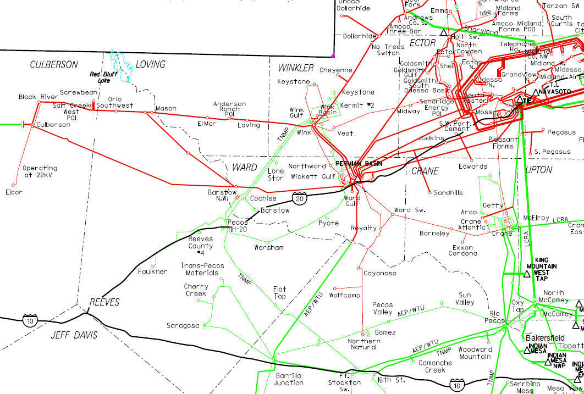
FAR WEST TEXAS PROJECT (PROPOSED)
345 kV LINE
345 kV AUTO
RIVERTON
MOSS
ODESSA EHV
Note: Future Yucca Drive – Culberson 138 kV Line shown. CCN granted in 2015.
Sand Lake
Yucca Dr
~
~
LYNX
BAKERSFIELD
SOLSTICE

Slide 3
FAR WEST TEXAS PROJECT (APPROVED)
345 kV LINE
345 kV AUTO
RIVERTON
MOSS
ODESSA EHV
Note: Future Yucca Drive – Culberson 138 kV Line shown. CCN granted in 2015.
Sand Lake
Yucca Dr
~
~
BAKERSFIELD
SOLSTICE
Notes:
ERCOT indicated that the approved project could serve up to 717 MW

Slide 4
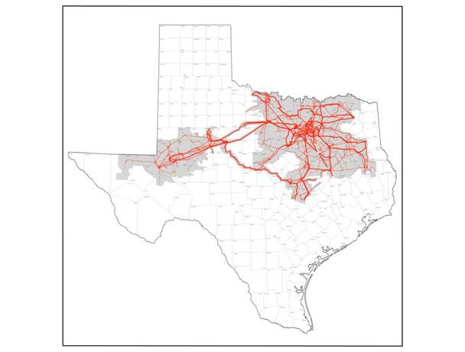
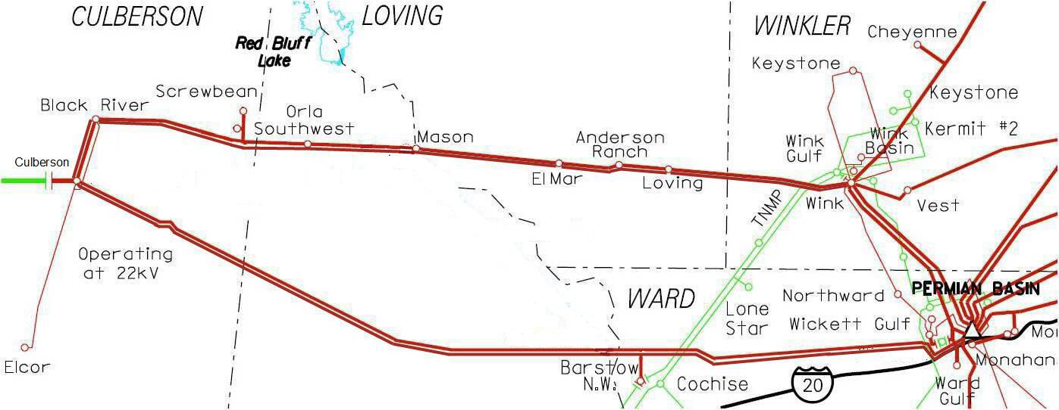
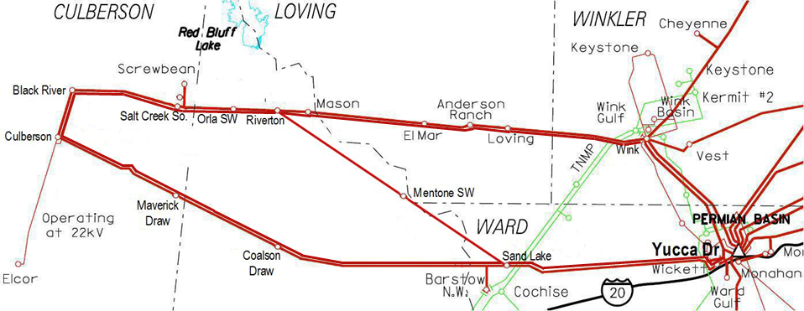
Culberson Loop Projected Load Growth
2018 | 2019 | 2020 | 2021 | 2022
484 MW | 647 MW | 734 MW | 762 MW | 790 MW
Notes:
- It should be noted the projections will vary from station to station by year, these are aggregate totals.
- More loads have been added since the date of the study
- The 2018 total is already greater than Oncor’s original FWTP submittal (425 MW) for 2021

Slide 5
ERCOT Far West Texas Project Additions
Option 1 - (917 MW)
New 345 kV line between Riverton – Sand Lake
345/138 kV autotransformer at Sand Lake
New 345 kV line between Sand Lake – Solstice (AEP)
Option 2 - (1037 MW)
New 345 kV line between Riverton – Sand Lake
345/138 kV autotransformer at Sand Lake
New 345 kV line between Sand Lake – Solstice (AEP)
200 MVAR Synchronous Condenser at Culberson
Notes:
Both options require longer lead time required to install 345 kV structures
Immediate reactive compensation needed
Approved project – 717 MW
Option 1 – 917 MW
Option 2 – 1037 MW

Slide 6
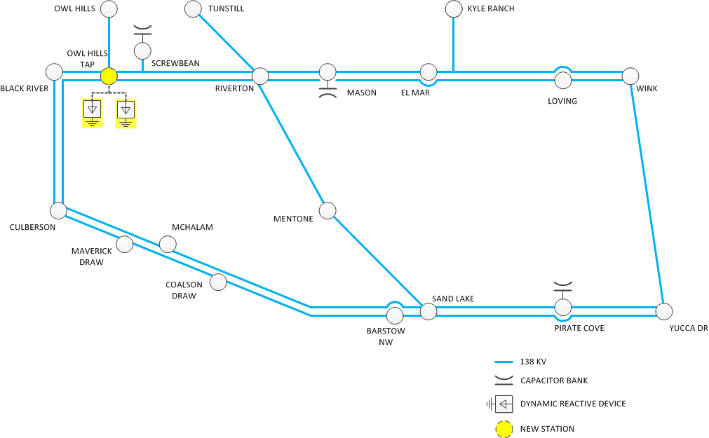
Project Description
New Owl Hills Tap 138 kV Sw. Sta.
Two 250 MVAR, 138 kV DRDs at the new sw. sta.
Certain P6 contingencies result in unsolved power flow with only one DRD
Estimated Cost: $86M

Slide 7
Base Case Analysis
Cases used
SSWG 2019SUM (October 2017)
DWG 2019SP (Spring 2017)
18 Contingencies with voltage collapse
14 Contingencies with low voltages along the Culberson Loop
Voltage collapse observed in dynamic simulations

Slide 8
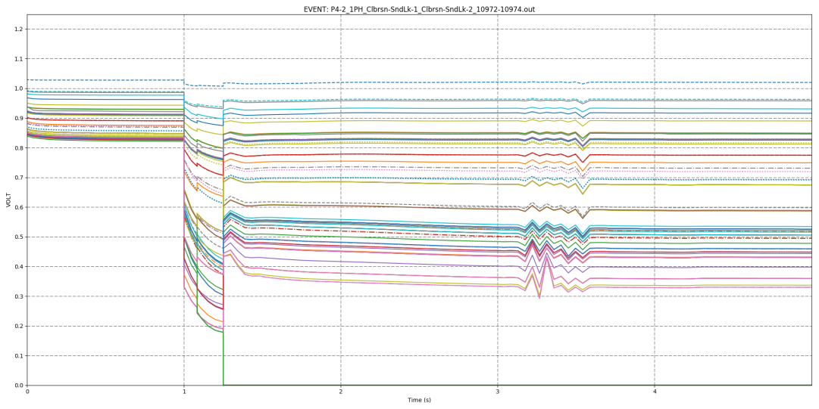
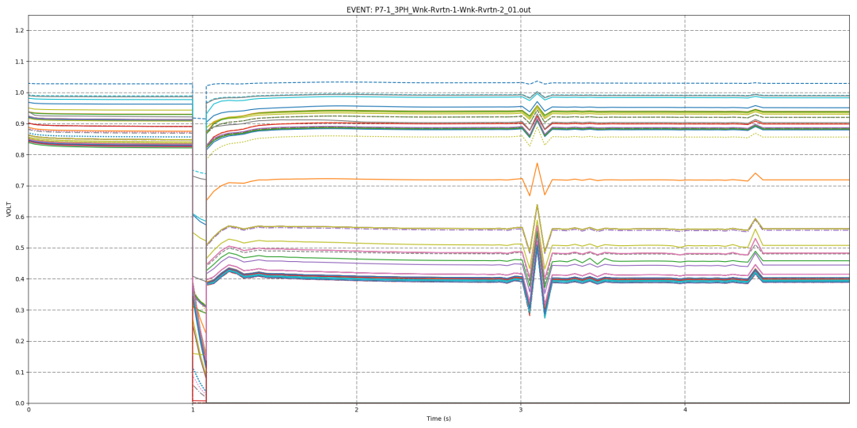
Dynamic Voltage Responses
P1.2, 3-PH Fault 1
P1.2, 3-PH Fault 2
P4.2, 1-PH Fault
P7.1, 3-PH Fault

Slide 9
Project Alternatives
Static VAR Compensator (SVC)
Provides rapid reactive power support
Impedance controlling device, $Q=V^{2}/X$
Static Synchronous Compensator (STATCOM)
Injects reactive current into the system
Current controlling device, $Q=I∗V$
Synchronous Condenser
Generates its own reactive power
Independent from system voltage
Device | Description | Estimate
SVC | Two (2) - 150 to +250 MVAR units | $56,500,000
STATCOM | Two (2) -/+ 250 MVAR units | $77,000,000
Synchronous Condenser | Two (2) -150/+250 MVAR units | $110,000,000

Slide 10
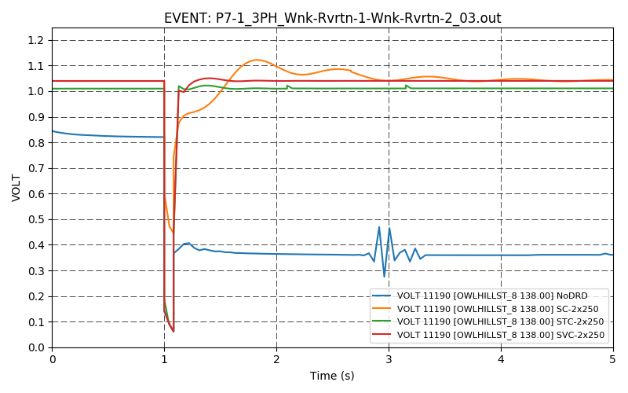
DRD Comparison
Culberson Loop Dynamic Voltage Response for a P7.1, 3-PH Fault

Slide 11
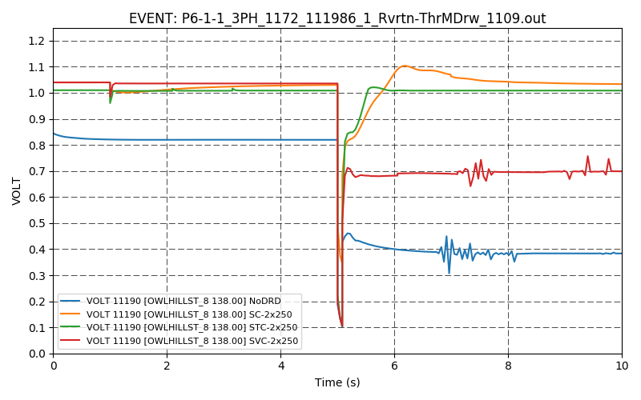
DRD Comparison (cont.)
Culberson Loop Dynamic Voltage Response for a P6.1, 3-PH Fault

Slide 12
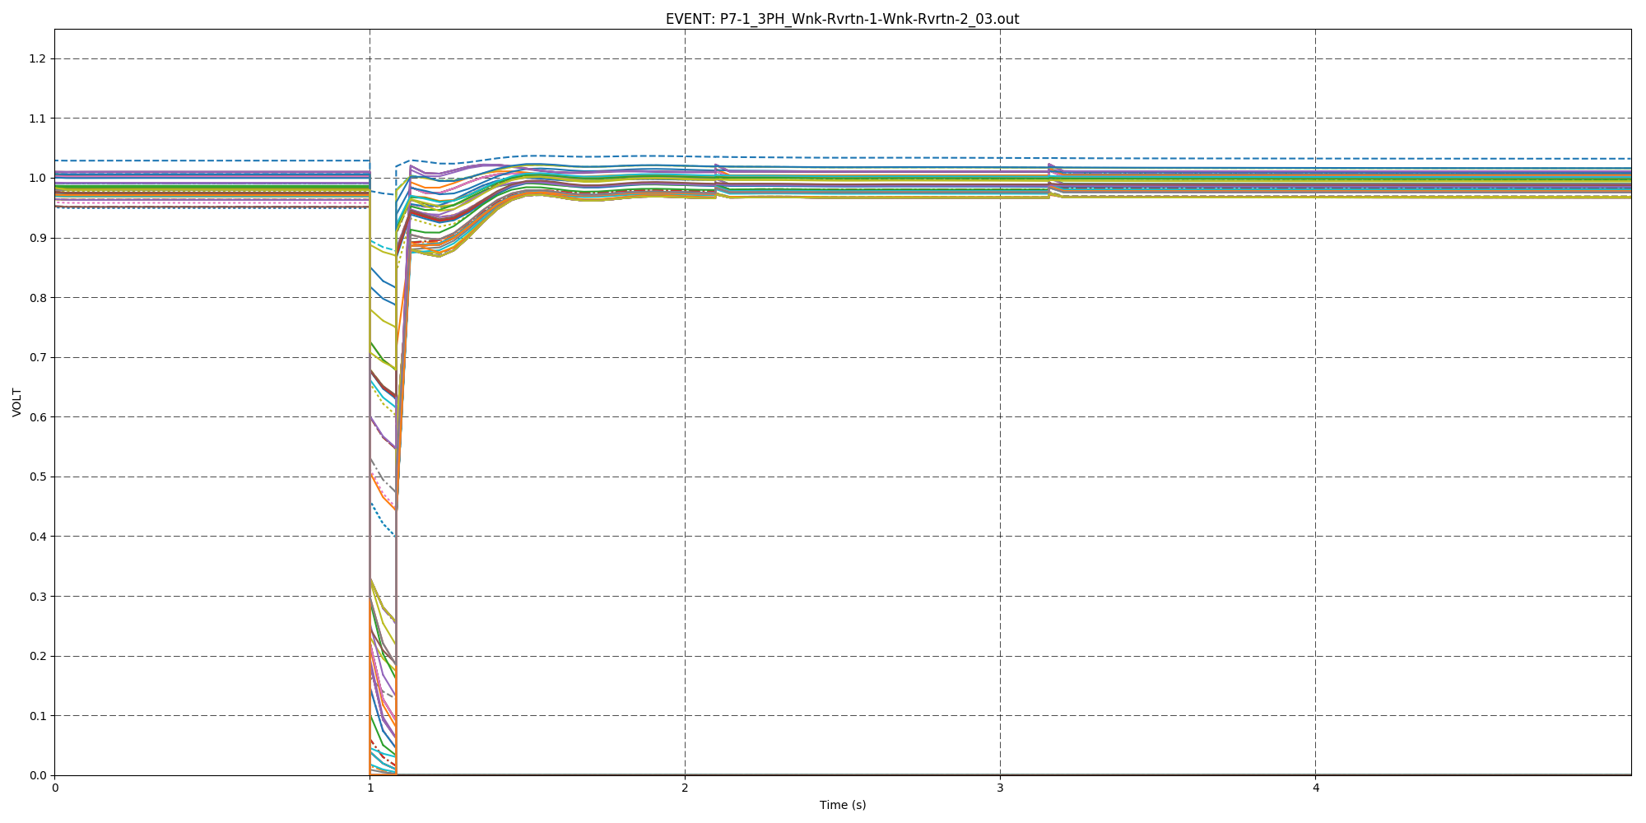
Final Recommendation
STATCOM technology recommended
SVCs inadequate for some contingencies
Synchronous Condensers exhibit oscillations, more expensive
Needs for DRDs remain after the 345 kV construction
Due to load growth and post-contingency operating conditions
Culberson Loop Dynamic Voltage Response for a P7.1, 3-PH Fault - STATCOMs

