Slide 1
ERCOT: EVs and Infrastructure
30 January, 2018
Britta K. Gross GM, Director Advanced Vehicle Commercialization Policy

Slide 2
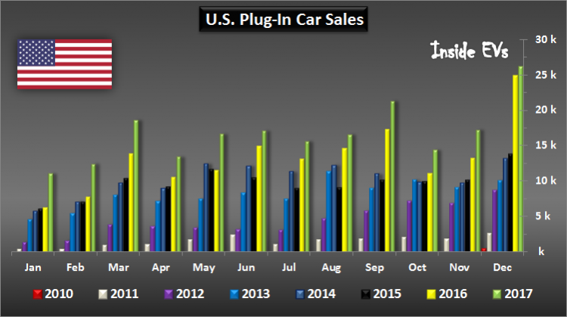
U.S. EV Market
764,500 PEVs in US
EV sales have risen YOY for 26 months
26% EV sales growth in 2017 over 2016
U.S. Plug-In Car Sales (data through December 2017) – insideEVs.com

Slide 3
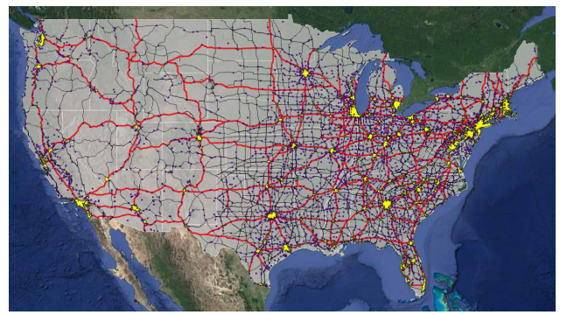
2030 EV Station and EVSE Estimates: Model Goals & Assumptions September 2017 NREL Report – National PEV Infrastructure Analysis
Goals:
Coverage: Enable long-distance driving and dispel range anxiety by providing a safety net of DCFC stations
Demand: 88% home charging supported by workplace and public L2 and DC charging to meet expected demand and maximize eVMT
Assumptions:
Assumes every PEV has access to a home charger
Highway: avg. 70 miles to a DC station
Community: < 3 miles to a DC station
15mil PEVs in 2030

Slide 4
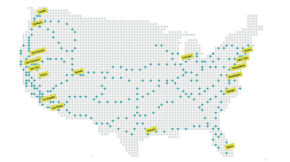
Electrify America (VW Settlement) – National Network Plans (2018-2019)

Slide 5
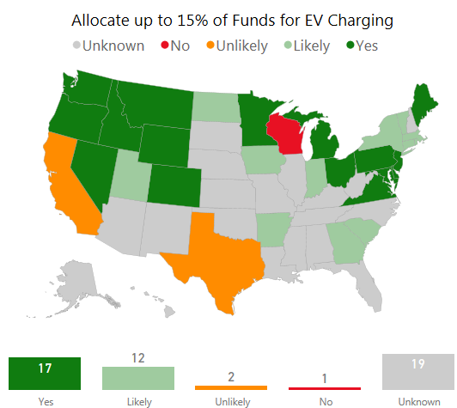
VW Appendix D: Current outlook of States funding EV Charging Infrastructure
Max 15% allowed for EV Infrastructure
All 50 states met the 12/1/17 deadline to file beneficiary status for the funds
To ensure funds are applied effectively, each state should develop a strategic infrastructure plan that considers highest-impact EV charging needs (e.g. DC corridors, MDU, workplace, key destinations)
Source: AtlasPolicy.com/EVhub

Slide 6
Utility engagement? Yes…
There is (almost) no business case today for public EV Infrastructure, so investment is lagging.
Consumers must see more infrastructure or they will not buy EVs.
The business case will improve over time – and the market will become more competitive.
But today … utilities need to:
1. Engage actively in public DC fast-charging, workplace and home charging
Most charging at home, so this is a way to reach all consumers (including those in multi-dwelling units)
Workplace charging is key to growing EV awareness and corporate relationships are key to utilities
A visible strategy of DC fast-chargers tells a big story to consumers and grows EV adoption among fence-sitters
2. Engage actively in PEV outreach and education
Utilities are trusted 3rd parties and operate at a local level – key for building awareness
The PEV market will not escape “niche” unless utilities (and regulators) get involved

Slide 7
EV Infrastructure – Where, What, Why Guidance
GM – BKGross
March 2017
 | Home |  | Work | Public |  |  | Commercial | Commuting | Road Trips
 | Single Family Home | Multi-Unit Dwelling | Workplace Charging | Short-dwell public | Mid-dwell public | Long-dwell public | Urban high-mileage applications | Urban-to-Urban Corridors | Long-distance Highway Corridors
Parking/ Charging description … e.g. | Overnight | Overnight … condos, apartments | Work shift | 1-2 hours … retail | 4-8 hours … parks, beaches | 1-X days … airports | High-use stations … “shared”, autonomous | (<200 miles) | (>200 miles)
Near-term | L1 or L2 (L2 recom’d) | Neighborhood L2 and DC (50kW) | L1 or L2 | L2 | L2 | L1 or L2 | High-speed DC 50-150kW (mega-stations) | High-speed DC 50-150kW | High-speed DC 150kW
Long-term | L1 or L2 (L2 recom’d) | L1 or L2 at Multi-Unit Dwelling | L1 or L2 | L2 | L2 | L1 or L2 | 150-320kW | 150-320kW | 150-320kW
Importance to Consumers | Where most charging is done | Need to grow EV market to these consumers | Where many consumers see EVs for the 1st time (EV Showcase) and most used charging after “home” | Nice perk (and retailers benefit from increased in-store dwell time) | Increases practicality of EVs (the number of places an EV can go) | Increases practicality of EVs (especially among early adopters/ professionals) | Enables commercial EV business cases (e.g. Lyft/Uber car-hailing services) | Increases practicality of EVs (especially among early adopters/ professionals) | Increases consumer confidence in EVs (perception of endless EV range)
R
R
R
R
R
R
Note, Professional installation of L1, L2 and DC is always recommended
Note, Future 150-350kW SAE fast-chargers will be backward compatible, allowing 50kW EVs to charge
R
Station redundancy is especially important

