Slide 1
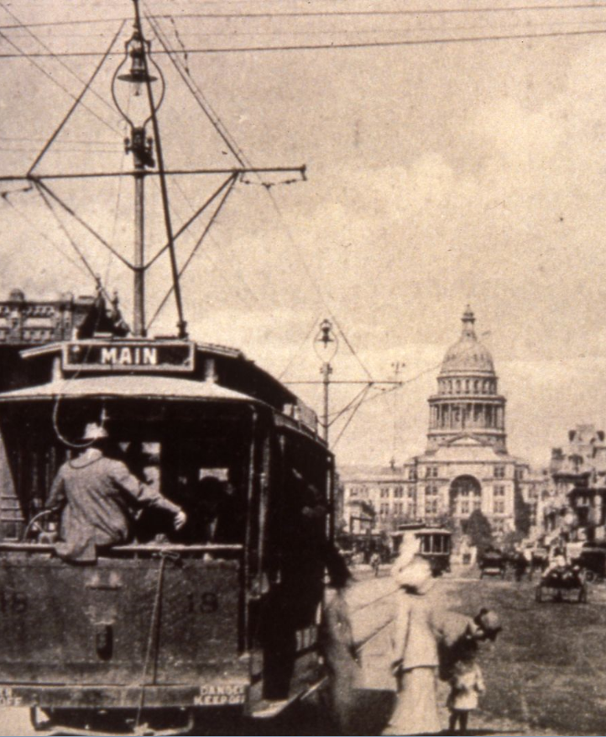
ERCOT: EVs and Infrastructure
Karl Popham
Electric Vehicles & Emerging Technologies
Austin Energy
Karl.popham@austinenergy.com
January 30th, 2018

Slide 2
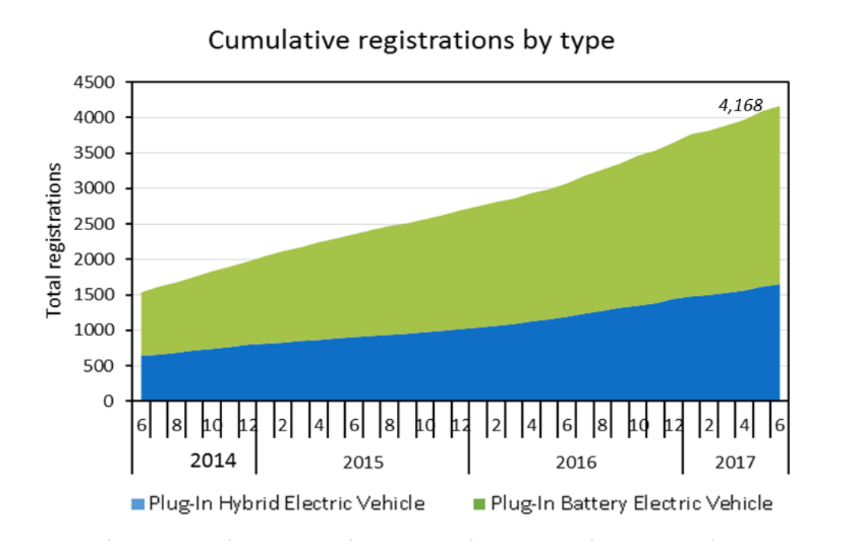
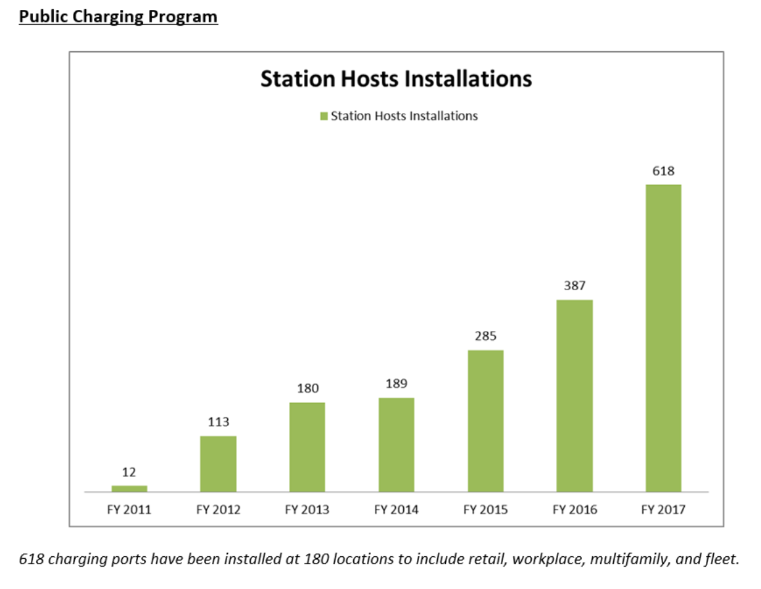
EV Program Metrics (Austin)
(Cumulative)
(Cumulative)

Slide 3
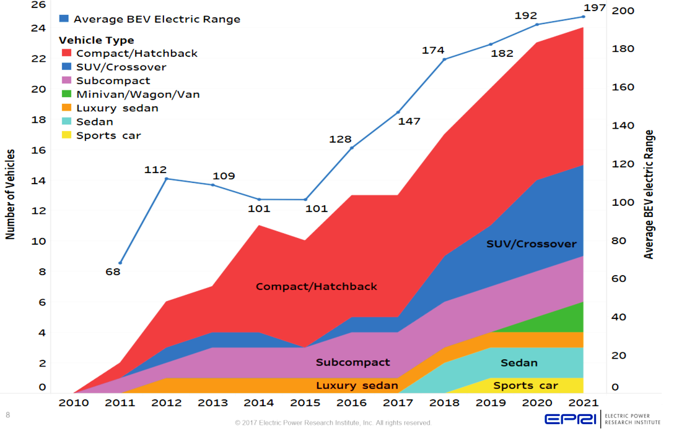
Batteries getting bigger | 60-80kWh
With increased range, one EV is moving to 10x the capacity of a single residential storage system.
Range in Miles

Slide 4
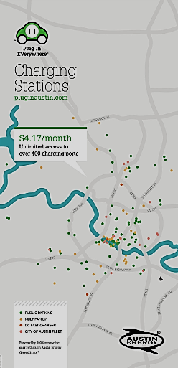
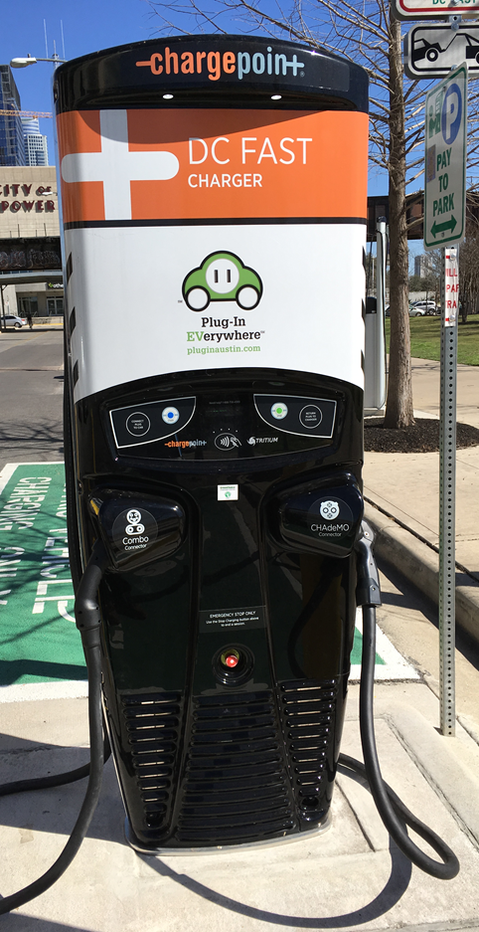
Public Charging & Rebates
600+
Ports
$4.17/mo or
$2.00/hr
100% Texas Wind

Slide 5
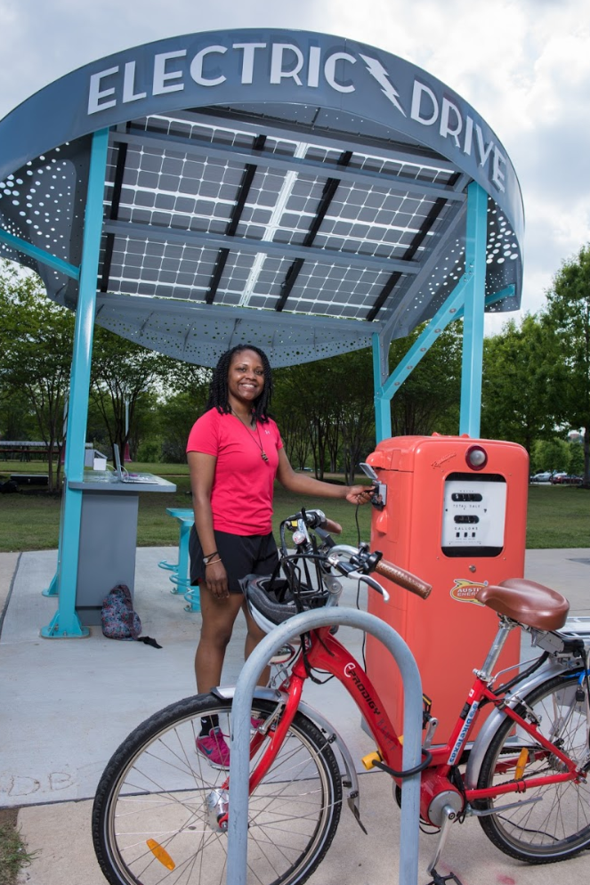
Marketing & Outreach
1st Place
Winner

Slide 6
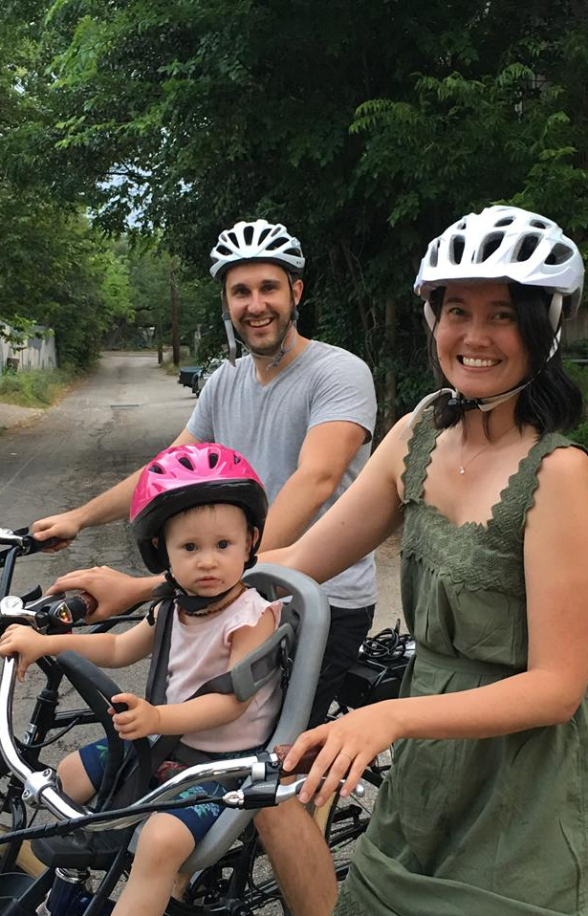
Fleet, Low-Income, TOU Rates

Slide 7
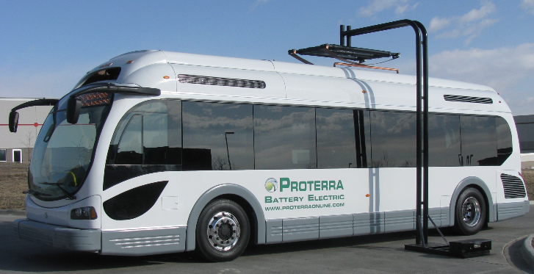
Shared & Electric Transit
Austin Energy is working with CapMetro to design a 3MW eBus fueling center in North Austin as they seek to deploy 30 electric buses by 2020.

Slide 8
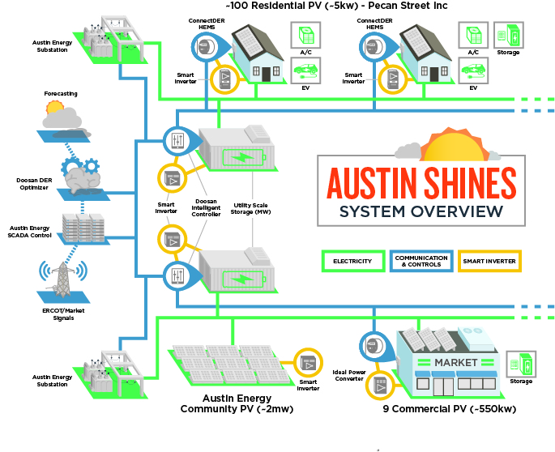
Holistic EV Grid Integration
Utility Scale Energy Storage + PV
Commercial Energy Storage + PV
Residential Energy Storage + PV
DER Management Platform
Illustrative

Slide 9
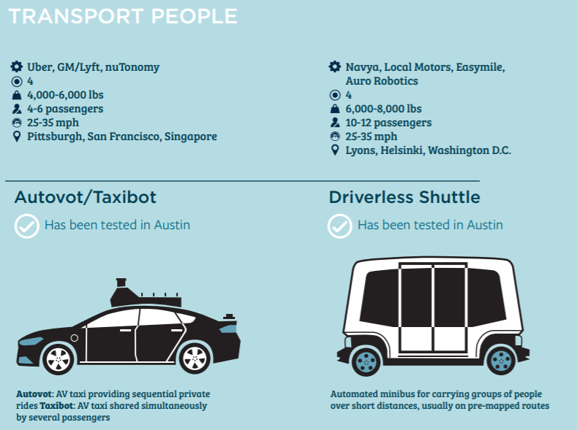
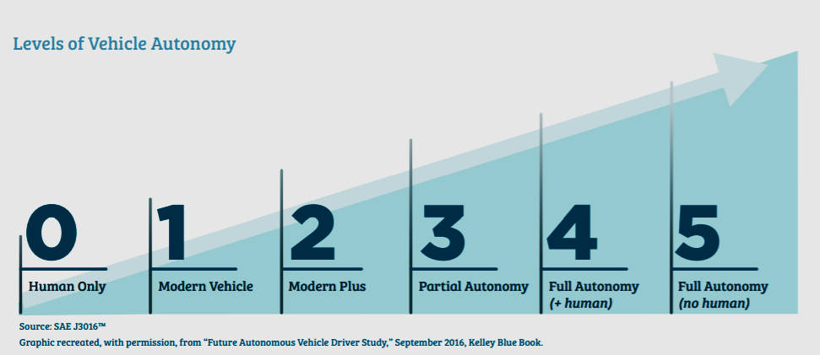
Shared, Electric & Autonomous
austintexas.gov/smartmobilityroadmap

