Slide 1
Load Forecast Review – 2018 RTP
Sandeep Borkar and Calvin Opheim

Slide 2
Agenda
Load review per PG 3.1.7
Next Steps

Slide 3
Load forecast (MW)
SSWG Load– Based on 17 SSWG cases dated 10/21/2017 less self-served load
90th percentile Load Forecast– less losses

Slide 4
Load forecast: 2018 RTP load level –less self-served and losses – preliminary (MW)

Slide 5
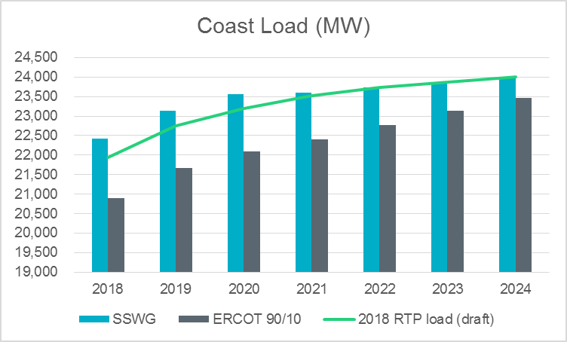
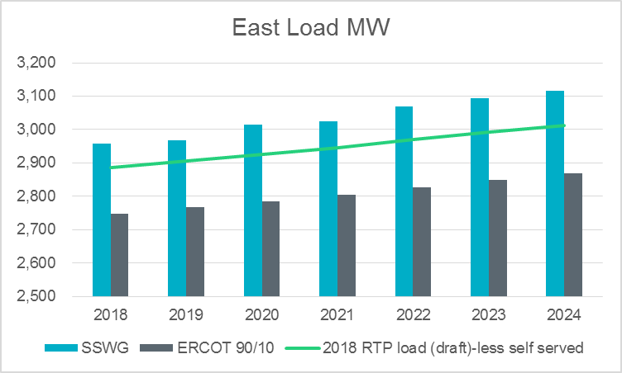
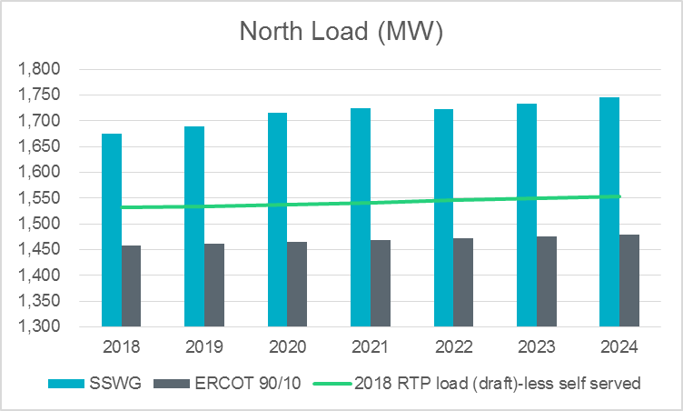
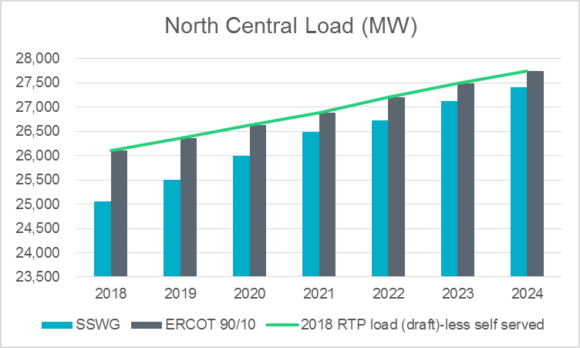
SSWG load v/s ERCOT 90/10 (less losses and self served)

Slide 6
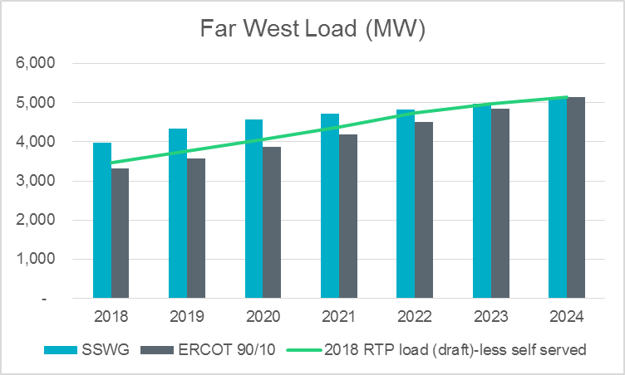
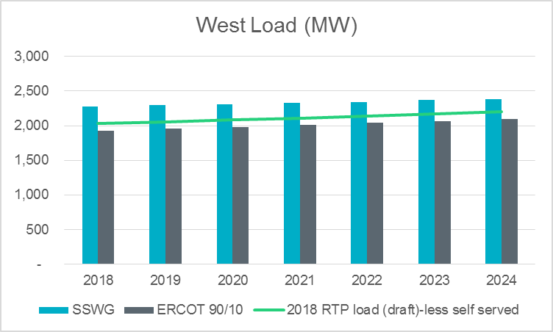
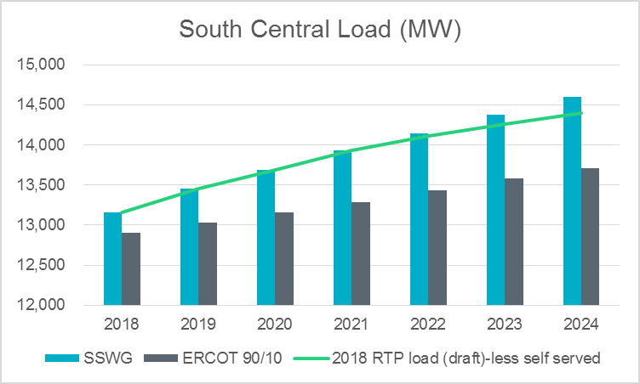
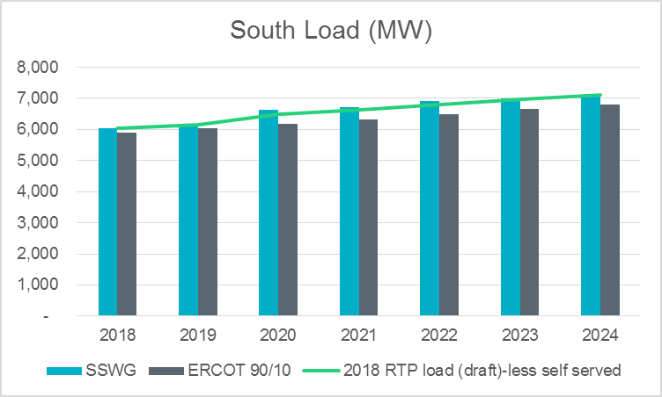
SSWG load v/s ERCOT 90/10 (less losses and self served)

Slide 7
2018 Load review
Preliminary start cases with the proposed load levels have been posted on MIS Secure (no case conditioning steps were applied)
  Grid>Regional Planning>Regional Transmission Planning>2018 Regional Transmission Plan Postings
TSPs are requested to review these and provide feedback on the initial draft
TSPs may choose to accept the load forecast, or
TSPs may choose to provide additional justification for cases where the proposed levels are not consistent with their expectations

Slide 8
Load review: Schedule
Key dates:
February 28, 2018: TSPs either approve or provide necessary documentation supporting additional loads. No response from TSP inferred as “No Comments”.
March 5, 2018: RTP loads finalized

Slide 9
Next steps
TPs and TOs to provide feedback on proposed load level (by February 28 2018)
Feedback provided to
  Calvin Opheim (Calvin.Opheim@ercot.com)
  Sandeep Borkar (Sandeep.Borkar@ercot.com)
ERCOT to complete Load Review and finalize RTP load levels (by March 5, 2018)

Slide 10
Questions
Sandeep Borkar
Sandeep.Borkar@ercot.com
512-248-6642
Calvin Opheim
Calvin.Opheim@ercot.com
512-248-3944

Slide 11
Appendix

Slide 12
References
PG 317 TAC presentation
  (http://www.ercot.com/content/wcm/key_documents_lists/107880/PG_317_LoadThreshold_rev.pptx)
PG 317 RPG presentation (Aug 2017)
  (http://www.ercot.com/content/wcm/key_documents_lists/108880/Load_Forecast_Review.pptx)

Slide 13
Bounded higher-of methodology (x=5%)

Slide 14
Load review process
Rationale:
Historic load growth
Committed load additions
Forecast methodology
Past forecast performance
Special circumstances
Other?
Preliminary RTP start cases will be shared to allow TDSPs to review the impact of load distribution on pockets within the weather zones.

Slide 15
Load forecast: 2018 RTP load level (with self-served) – preliminary (MW)

