Slide 1
Market Credit Working Group update to the Wholesale Market Subcommittee
Bill Barnes NRG, Chair
Josephine Wan AE, Vice Chair
02/28/2018

Slide 2
MCWG update to WMS
General Update
January 26th Joint MCWG/CWG Meeting
3 NPRRS reviewed for their credit impacts
861 NPRR Clarification of ERCOT’s Authority to Protect Its Jurisdictional Status
854 NPRR NOIE TDSP Submittal of Meters with Bidirectional Flow Caused by Generation Interconnected at Distribution Voltage
860 NPRR Day-Ahead Market (DAM) Clean-Up
All operational without any credit impact

Slide 3
MCWG update to WMS
2018 CWG/MCWG Officers
Ms. Spells thanked the group and the officers for their work in 2018 and informed the group that the following were re-elected as officers:
Donald Meek – CWG Chair
Loretto Martin – CWG Vice Chair
Bill Barnes – MCWG Chair
Josephine Wan – MCWG Vice Chair
ERCOT staff will submit to F&A and WMS committees for confirmation.
Review CWG Charter (vote)
Ian Haley at submitted a motion to reaffirmed CWG Charter for another year without change. Donald Meek seconded the motion. Motion passed.

Slide 4
MCWG update to WMS
Discuss NPRR850 Market Suspension and Restart
Many working groups have already reviewed and filed comments with ERCOT.
This NPRR is currently pending for PRS. It will be review by WMS and QMWG group.
The group will further review and discuss this NPRR in the next meeting.
Discuss CRR credit calculator concept
$10,365,293,555 excess collateral has been locked for 105 markets since NPRR484 was implemented in late 2012 that could have been used for other market activities.
Creating a CRR Credit Calculator would remove the need to manually calculate CRR credit requirements. Increasing Market Participant’s ability to accurately calculate posting requirements will eliminate excess collateral costs and should increase CRR values.
SCR submission form redline version has posted to ERCOT site
Numerous discussion in the group meeting between ERCOT staff and stakeholder

Slide 5
MCWG update to WMS
Discuss CRR credit calculator concept (Conti.)
The group agreed to remove the second last optional item in the SCR. In addition, the last optional item in the SCR will require to draft an NPRR prior to make the change in this SCR due to it is related to a credit report.
Ian Haley will do a clean SCR. Prior to the next meeting if ERCOT has not submit an NPRR then Luminant will file it.
ERCOT Updates
ERCOT Exposure Report
Ms. Papules at ERCOT presented an update of ERCOT credit exposure statistics for the months of November and December 2017.
Changes from October 2017 * to December 2017
Number of active Counter-Parties increased from 216 to 217.
Market-wide TPE decreased from 362 million to 350.8 million.
Excess Collateral increased from 1,573 million to 1,698 million.
TPE of Load and Generation category increased by $14 million and it decreased across all the other market segments for a net decrease in TPE.
Excess Collateral increased by $72 million for Load and Generation category and $58 million for traders.
Relatively low volatility in Real Time Prices during Nov-Dec compared to Sep-Oct.

Slide 6
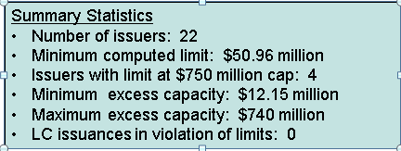
MCWG update to WMS
ERCOT Updates –(Conti.)
Letter of Credit Concentration Report
LC issuer limits are determined by the issuer rating and their Tangible net worth. In addition, each issuer is subject to an overall limit of $750M.
ERCOT computed the issuer limits and reviewed outstanding LCs as of 1/15/2018

Slide 7
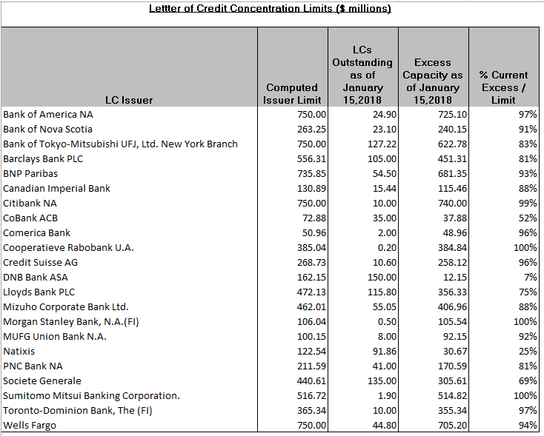
MCWG update to WMS
ERCOT presentation can be found at: http://ercot.com/calendar/2018/1/26/139402-CREDITWG-MCWG

Slide 8
MCWG update to WMS
ERCOT Updates –(Conti.)
Credit Update
Ms. Spells updated the group on recent developments.
Credit Items at February F&A
Review and Ratification of CWG Charter
Confirmation of CWG Chair and Vice Chair
Periodic Report on CWG Activity
Market Credit Risk Standard
February 7, 2018 Implementation of NPRR(s)/Phase 1A
683 Revision to Available Credit Limit Calculation
743 Revision to MCE to Have a Floor for Load Exposure
760 Calculation of Exposure Variables for Days With No Activity
800 Revisions to Credit Exposure Calculations to Use Electricity Futures Market Prices

Slide 9
MCWG update to WMS
ERCOT Updates –(Conti.)
Credit Training Workshop
ERCOT to provide a credit training workshop related to the implementation of Nodal Protocol Revision Requests (NPRRs) 683, 743, 760, and 800 on January 26, 2018 afternoon 1p.m. – 4p.m.
Discuss 2018 Goals
Ian Haley at Luminant submitted a motion to waive notice for the 2018 CWG Goals as this item is not for vote in this meeting. Donald Meek seconded it. Motion passed.
Ian Haley at Luminant submitted a motion to approve 2018 CWG draft Goals have now been approved. Donald Meek seconded it. Motion passed. Donald Meek will present the new goals in the next F&A meeting.

Slide 10
MCWG update to WMS
2018 Credit Working Group Goals
Review the implementation of NPRR800, the incorporation of a forward price curve-based methodology in collateral requirement calculations
Provide support to the ERCOT stakeholder process for Market Suspension and Restart (NPRR850)
Clarify the market’s risk tolerance/appetite level and provide regular updates on credit exposure to the ERCOT Board
Evaluate and quantify potential market risk under current credit rules and examine a framework for reviewing rules in flight
Explore potential usage of letter of credit/credit insurance
Pursue a calculator to allow market participants to calculate their requirements for CRR auctions

