Slide 1
Credit Exposure Update
Spoorthy Papudesi
Credit Work Group
ERCOT Public
January 17, 2018

Slide 2
Agenda
Inputs and assumptions
Observations
Exposure distributions
Appendix

Slide 3
Credit Exposure Update
Inputs and Assumptions:
  Only Active Counter-Parties are included
  Counter-Parties are classified by rating and market activity
  TPE and collateral balances used are averages for November and December 2017
  Counter-Parties that are subsidiaries of, or guaranteed by, rated entities are given the parent/guarantor’s rating, adjusted down one notch

Slide 4
Credit Exposure Update
Changes from October 2017 * to December 2017 *
Number of active Counter-Parties increased from 216 to 217.
Market-wide TPE decreased from 362 million to 350.8 million.
Excess Collateral increased from 1,573 million to 1,698 million.
TPE of Load and Generation category increased by $14 million and it decreased across all the other market segments for a net decrease in TPE.
Excess Collateral increased by $72 million for Load and Generation category and $58 million for traders.
Relatively low volatility in Real Time Prices during Nov-Dec compared to Sep-Oct.
  *Numbers presented are averages of Sep-Oct 2017 and Nov-Dec 2017

Slide 5
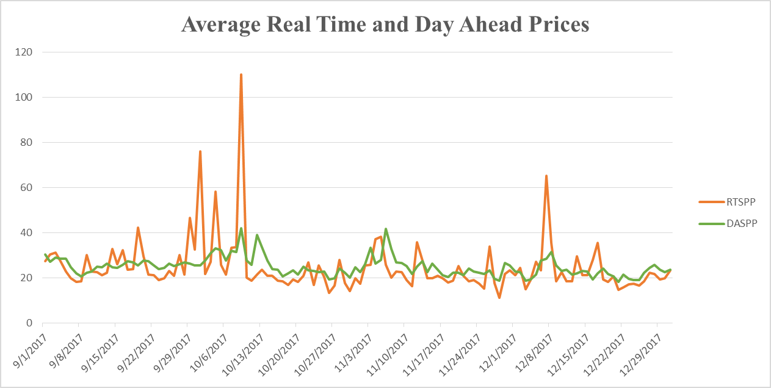
Credit Exposure Update

Slide 6
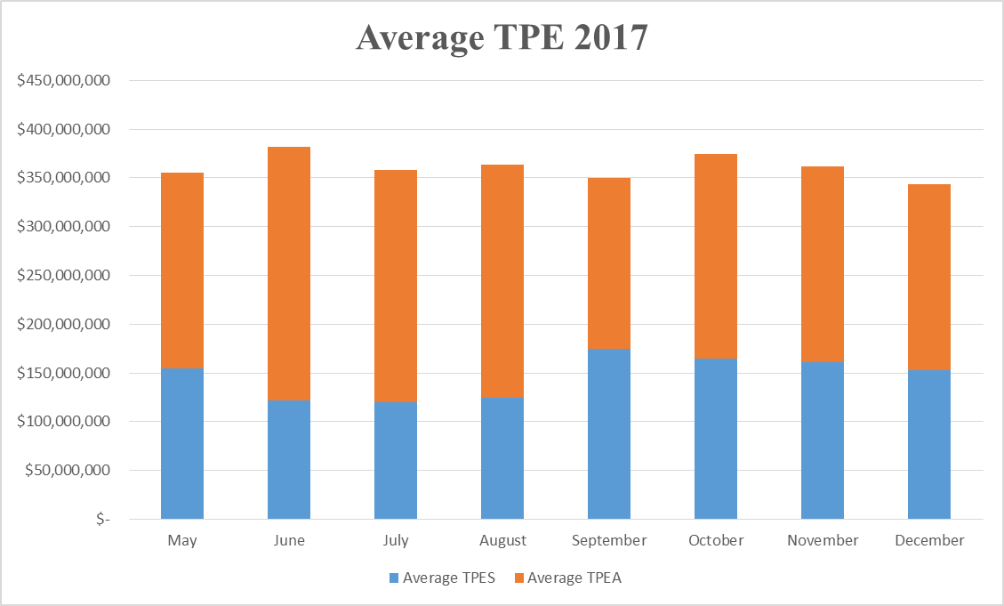
Credit Exposure Update

Slide 7
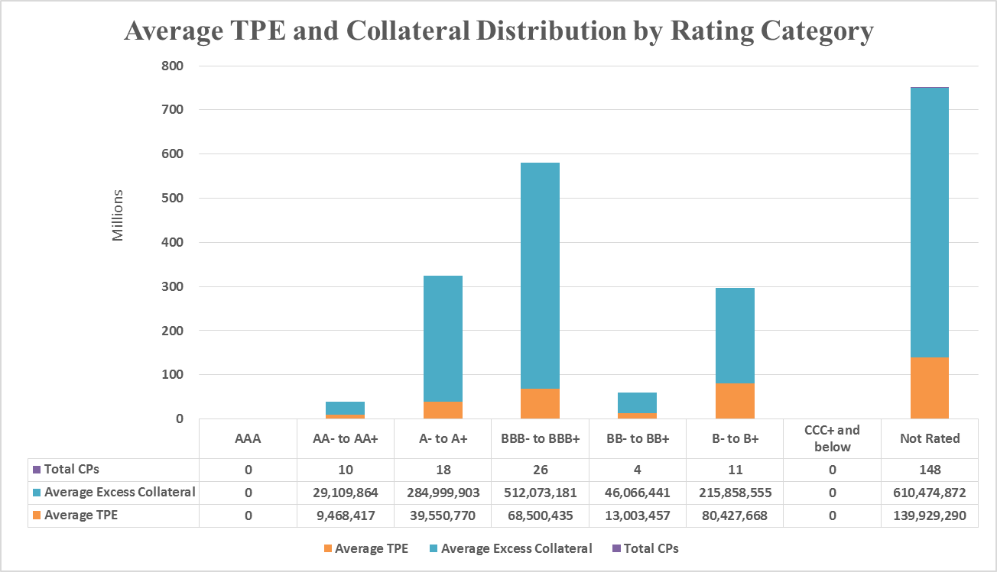
Credit Exposure Update

Slide 8
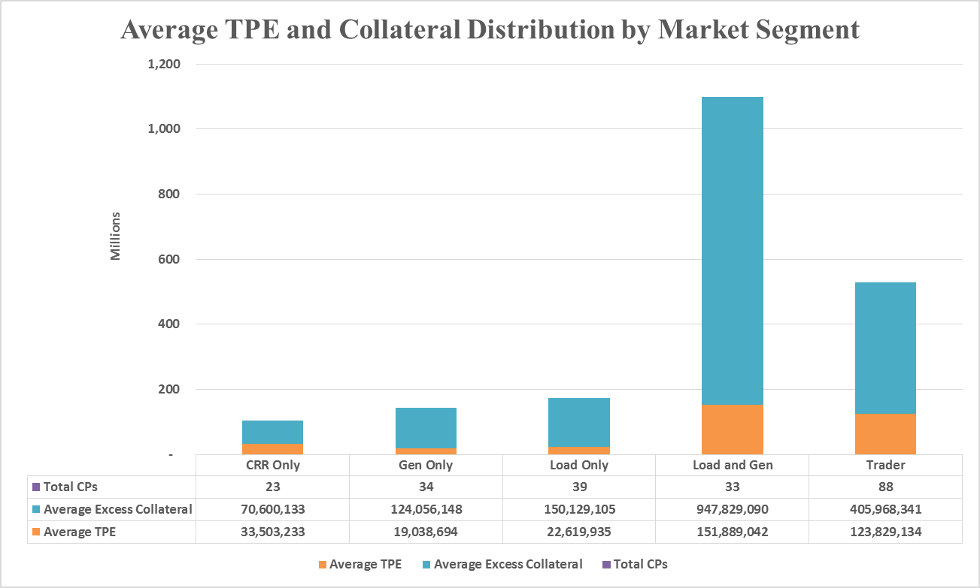
Credit Exposure Update

Slide 9
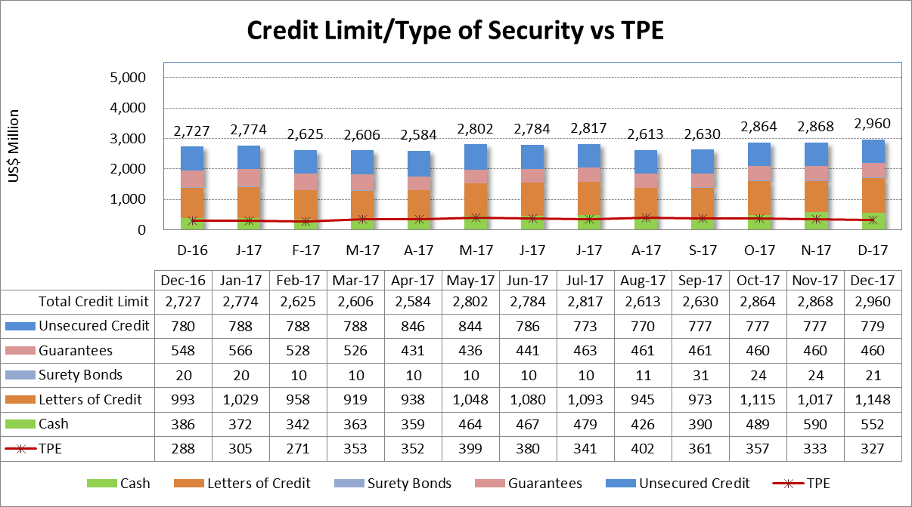
Credit Exposure Update

Slide 10
Credit Exposure Update
Appendix

Slide 11
Credit Exposure Update
Summary statistics by Market Segment

Slide 12
Credit Exposure Update
Summary statistics by Rating Group

Slide 13
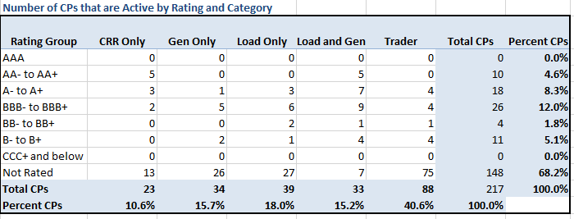
Credit Exposure Update
Active Counter-Parties distribution by rating and category

Slide 14
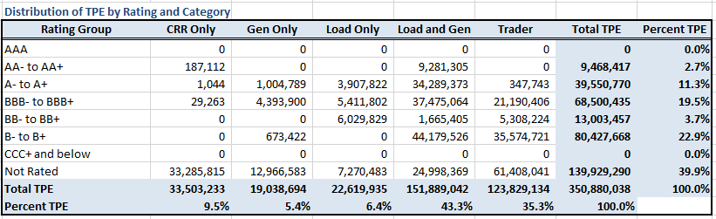
Credit Exposure Update
Average Total Potential Exposure distribution

Slide 15
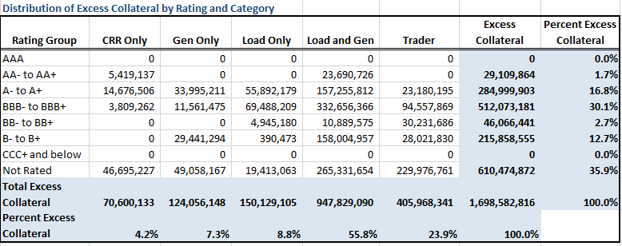
Credit Exposure Update
Average Excess Collateral distribution*
  *Excess Collateral is a voluntary disposition by Counterparty

Slide 16
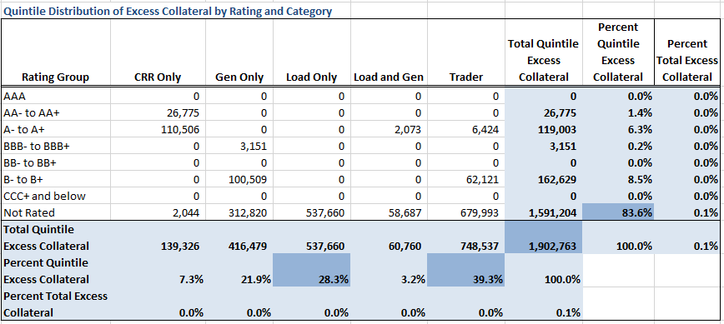
Credit Exposure Update
Average Excess Collateral distribution in the Bottom Quintile*
  *Excess Collateral is a voluntary disposition by Counterparty

Slide 17
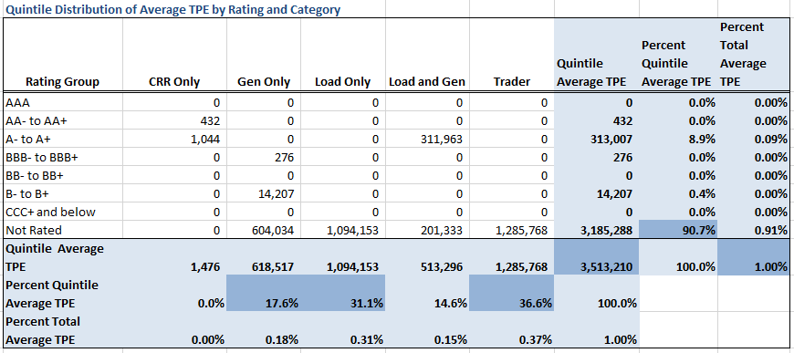
Credit Exposure Update
Average TPE distribution in the Bottom Quintile Based on Excess Collateral

Slide 18
Credit Exposure Update
Questions

