Slide 1
Southern Cross Planning Study
Flow Assumptions
PLWG
January 2018

Slide 2
PUCT Docket 46304 Order
Directive 5:
ERCOT shall study and determine how best to model the Southern Cross DC tie in its transmission planning cases, make any necessary revisions to its standards, guides, systems, and protocols as appropriate, and certify to the Commission when it has completed these actions.
Directive 6:
ERCOT shall study and determine what transmission upgrades, if any, are necessary to manage congestion resulting from power flows over the Southern Cross DC tie, make any necessary revisions to its standards, guides, systems, and protocols as appropriate, and certify to the Commission when it has completed these actions.

Slide 3
General Thoughts on Flow Assumptions
In general, the Southern Cross DC tie would be expected to export from ERCOT when prices in ERCOT are lower than in SERC
  Off-peak?
  High $0 generation output
In general, the Southern Cross DC tie would be expected to import to ERCOT when prices in ERCOT are higher than in SERC
  Peak?
  $9000/MWh cap in ERCOT
  Load diversity

Slide 4
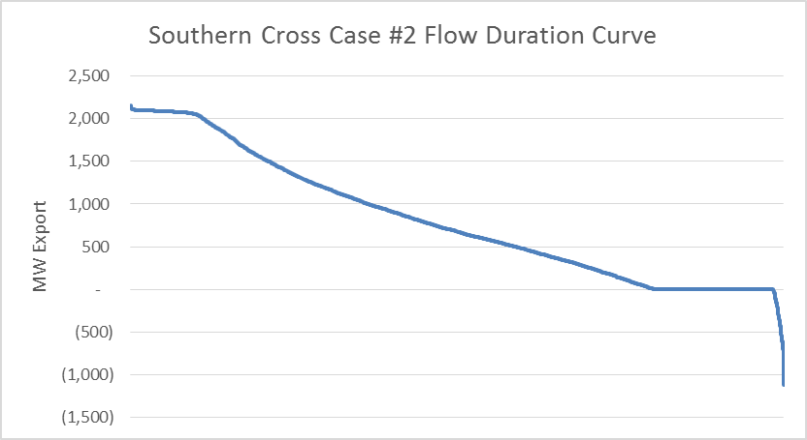
Hourly Flow Duration Curve (Case #2)
Case #2: ERCOT 2020 base case + 2GW wind + SCT DC Tie
  From Resero testimony on behalf of Southern Cross

Slide 5
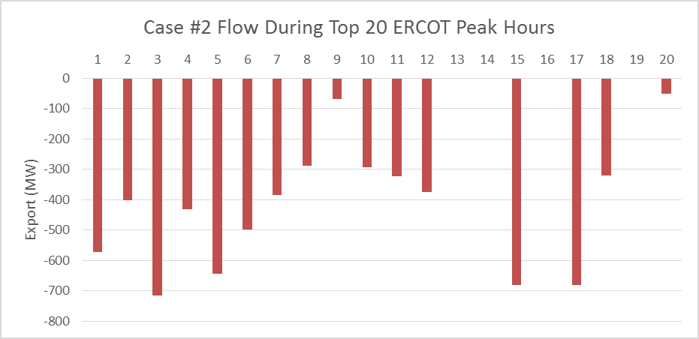
Top 20 Hours Summer Peak Data
Average Flow = 336 MW Import
Median Flow = 349 MW Import
Max Export = 0 MW
Max Import = 714 MW

Slide 6
For Discussion
SSWG/ DWG* | Summer Peak | 350 MW Import
 | All other | 2100 MW Export
RTP* | Summer Peak | 350 MW Import
 | Off Peak | 2100 MW Export
 | Economic | Procure consultant to provide dynamic-cost supply curve to be used in production cost simulation
Directive 6 Steady State | Summer Peak | 350 MW Import
 | HWLL | 2100 MW Export
Directive 6 Dynamic Stability | Summer Peak | 2000 MW Import/ 2100 MW Export
 | HWLL | 2000 MW Import/ 2100 MW Export
*Assumptions may be revised based on future analysis or actual operating data

