Slide 1
Unregistered Distributed Generation Report:
2017.Q3 and Q4 Update
Resource Adequacy
1/31/2018

Slide 2
2017 Q3 Unregistered Distributed Generation Report
Load Zone | 2017 Q3 Aggregate MW by Primary Fuel Type
 | SOLAR | WIND | OTHER RENEWABLE | OTHER NON-RENEWABLE | TOTAL
LZ_AEN | 14.52 | - | - | - | 14.52
LZ_CPS | 9.77 | - | 0.23 | - | 9.99
LZ_HOUSTON | 9.18 | 0.36 | 0.11 | 4.34 | 14.00
LZ_LCRA | 2.41 | - | 0.60 | - | 3.01
LZ_NORTH | 92.32 | 1.66 | - | 0.71 | 94.68
LZ_RAYBN | - | - | - | - | -
LZ_SOUTH | 14.32 | 0.68 | - | - | 15.00
LZ_WEST | 7.07 | 0.81 | - | 0.34 | 8.22
TOTAL | 149.59 | 3.52 | 0.94 | 5.39 | 159.43
Load Zone | 2017 Q2 → Q3 Change in Aggregate MW by Primary Fuel Type
 | SOLAR | WIND | OTHER RENEWABLE | OTHER NON-RENEWABLE | TOTAL
LZ_AEN | +0.14 | - | - | - | +0.14
LZ_CPS | +0.97 | - | - | - | +0.97
LZ_HOUSTON | +0.34 | - | - | - | +0.34
LZ_LCRA | +0.10 | - | +0.60 | - | +0.70
LZ_NORTH | +4.02 | - | - | - | +4.02
LZ_RAYBN | - | - | - | - | -
LZ_SOUTH | +0.79 | - | - | - | +0.79
LZ_WEST | +0.45 | - | - | - | +0.45
TOTAL | +6.81 | - | +0.60 | - | +7.41

Slide 3
2017 Q4 Unregistered Distributed Generation Report
Load Zone | 2017 Q4 Aggregate MW by Primary Fuel Type
 | SOLAR | WIND | OTHER RENEWABLE | OTHER NON-RENEWABLE | TOTAL
LZ_AEN | 16.07 | - | - | - | 16.07
LZ_CPS | 10.59 | - | 0.23 | - | 10.81
LZ_HOUSTON | 9.65 | 0.36 | 0.11 | 4.34 | 14.47
LZ_LCRA | 2.51 | - | 0.60 | - | 3.11
LZ_NORTH | 94.58 | 2.59 | - | 0.71 | 97.87
LZ_RAYBN | 0.85 | - | - | - | 0.85
LZ_SOUTH | 15.40 | 0.85 | - | - | 16.25
LZ_WEST | 7.38 | 0.84 | - | 0.34 | 8.56
TOTAL | 157.03 | 4.64 | 0.94 | 5.39 | 168.00
Load Zone | 2017 Q3 → Q4 Change in Aggregate MW by Primary Fuel Type
 | SOLAR | WIND | OTHER RENEWABLE | OTHER NON-RENEWABLE | TOTAL
LZ_AEN | +1.55 | - | - | - | +1.55
LZ_CPS | +0.82 | - | - | - | +0.82
LZ_HOUSTON | +0.47 | - | - | - | +0.47
LZ_LCRA | +0.10 | - | - | - | +0.10
LZ_NORTH | +2.26 | +0.92 | - | - | +3.19
LZ_RAYBN | +0.85 | - | - | - | +0.85
LZ_SOUTH | +1.09 | +0.17 | - | - | +1.25
LZ_WEST | +0.30 | +0.03 | - | - | +0.34
TOTAL | +7.44 | +1.12 | - | - | +8.57

Slide 4
Unregistered DG Growth: 2016-Q2* to 2017-Q4
* 2016-Q2 was the first report published after implementation of report changes per NPRR794/COPMGR044

Slide 5
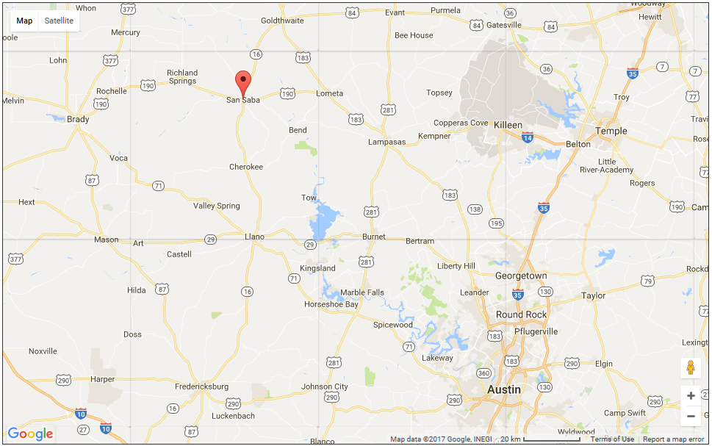
Unregistered DG Spotlight
During Q3, San Saba Pecan added four 150-kW biomass units that burn pecan shells to produce synthetic gas fuel

