Slide 1
Credit Management
NPRRs 683, 743, 760 & 800
ERCOT Credit
January 17, 2018

Slide 2
Protocol Disclaimer
Legal Disclaimers and Admonitions
This presentation provides a general overview of the Texas Nodal Market and is not intended to be a substitute for the ERCOT Protocols, as amended from time to time. If any conflict exists between this presentation and the ERCOT Protocols, the ERCOT Protocols shall control in all respects.
For more information, please visit:
http://www.ercot.com/mktrules/nprotocols/

Slide 3
Course Audience
This training is intended for personnel responsible for meeting ERCOT creditworthiness requirements at their companies and who have completed the Credit Management Workshop.
Includes companies registered as Qualified Scheduling Entities and CRR Account Holders

Slide 4
Workshop Objectives
Gain an understanding of….
Credit calculation changes related to implementation of Nodal Protocol Revision Requests (NPRRs):
  NPRR 683, Revision to Available Credit Limit Calculation
  NPRR743, Revision to MCE to Have a Floor for Load Exposure
  NPRR760, Calculation of Exposure Variables For Days With No Activity, and
  NPRR800, Revisions to Credit Exposure Calculations to Use Electricity Futures Market
  Prices
High Level Credit Calculations
Credit Report Changes

Slide 5
Workshop Outline
Introduction
Credit calculation changes related to:
  Available Credit Limit (ACL)
  Estimated Aggregate Liability (EAL)
    RFAF – Real-Time Forward Adjustment Factor
    DFAF – Day-Ahead Forward Adjustment Factor
  Minimum Current Exposure (MCE)
    1 Day Load Exposure
    RFAF – Real-Time Forward Adjustment Factor
    MAF - Market adjustment Factor
NPRR Overview
  683, 743, 760 and 800
Credit Report Changes
  Estimated Aggregate Liability (EAL) Summary Report
  Estimated Aggregate Liability (EAL) Detail Report
  Minimum Current Exposure (MCE) Summary Report
Q & A

Slide 6
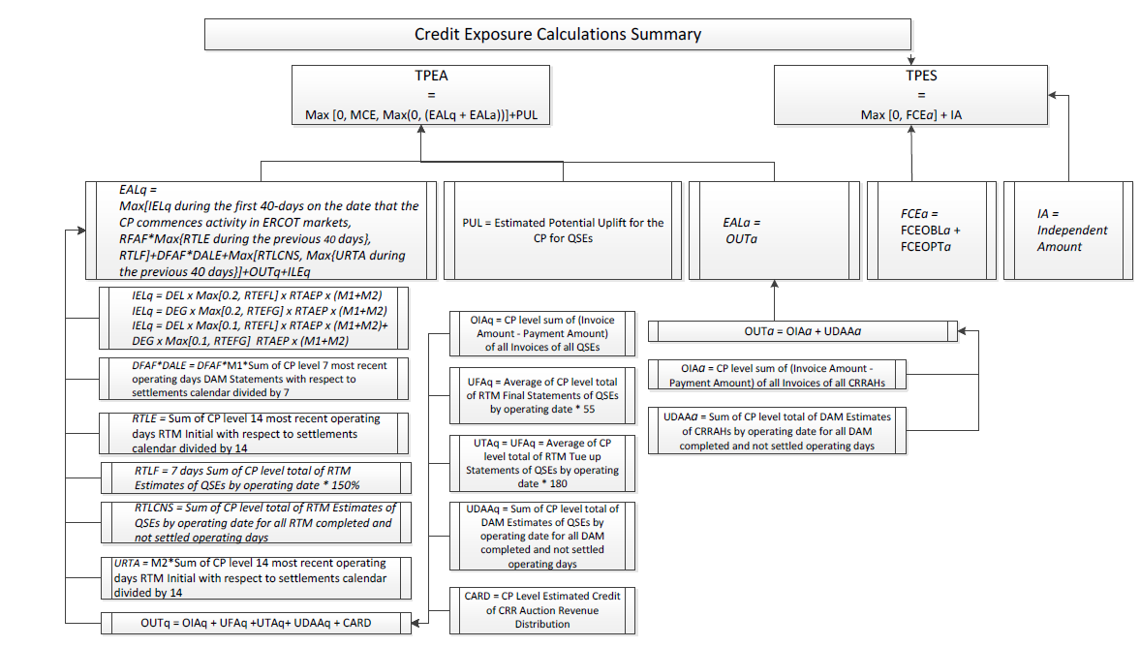
Credit Calculations - Summary

Slide 7
Credit Calculations – MCE

Slide 8
NPRR 683 - Overview
NPRR 683 Revision to Available Credit Limit Calculation
  NPRR 683 revises the calculation of Available Credit Limit for the CRR Auction (ACLC) and Available Credit Limit for the DAM (ACLD) by replacing the existing 10% discount with a 10% gross up of the Total Potential Exposure Any (TPEA) and the Total Potential Exposure Secured (TPES)
  Note: NPRR 683 does not impact calculation for additional collateral

Slide 9
NPRR 683
 | Available Credit Limit for the CRR Auction (ACLC) and an Available Credit Limit for the DAM (ACLD)
Current ACLC | Secured Financial Security – TPES – Net Positive Exposure for approved CRR Bilateral Trades – Maximum of 0 and TPEA minus the Unsecured Credit limit – Financial Security (guarantee agreement)
New ACLC | Secured Financial Security – 1.10 * TPES – Net Positive Exposure of approved CRR Bilateral Trades – Maximum of 0 and 1.10 * TPEA minus the Unsecured Credit Limit minus Financial (guarantee agreement)
Current ACLD | Unsecured Credit Limit + Financial Security + Remainder Collateral - TPEA
New ACLD | Unsecured Credit Limit + Financial Security + Remainder Collateral – 0.10 * TPES – 1.10 * TPEA

Slide 10
NPRR 683 Revision to Available Credit Limit Calculation
 | Credit Limit | TPEA | TPES | CRR Locked ACL | CRR ACL | ADJ CRR ACL | DAM ACL | ADJ DAM ACL
Current | 100,000,000 | 26,200,000 | 100 | 100,000 | 66,419,910 | 66,329,910 | 66,329,910 | 66,329,910
New | 100,000,000 | 28,820,000 | 110 | 100,000 | 71,179,890 | 71,179,890 | 71,079,890 | 71,079,890
Current | 100,000,000 | 51,000,000 | 100 | 100,000 | 44,099,910 | 44,099,910 | 44,009,910 | 44,009,910
New | 100,000,000 | 56,100,000 | 110 | 100,000 | 43,899,890 | 43,899,890 | 43,799,890 | 43,799,890

Slide 11
NPRR 760 - Overview
NPRR 760 Calculation of Exposure Variables For Days With No Activity
  NPRR 760 includes the Operating Days with zero activity in the calculation of RTLE, URTA, and DALE calculations.
  Currently, the Real-Time Liability Extrapolated (RTLE), the Unbilled Real-Time Amount (URTA), and Day-Ahead Liability Extrapolated (DALE) variables are based on the 14 (RTLE and URTA) or seven (DALE) most recent calendar days divided by the number of Real-Time Market (RTM) Initial Statements and Day Ahead Market (DAM) Statements generated for the Counter-Party in the same period.
  At this time, Operating Days with zero activity are not included in the above calculations when RTM Initial and DAM Statements are not generated for those Operating Days.

Slide 12
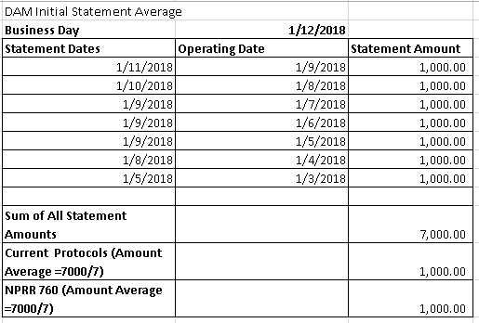
NPRR 760 - Calculation of Exposure Variables For Days With No Activity
Scenario 1: DAM Activity in ALL 7 Most Recent ODs*
* With respect to settlement calendar

Slide 13
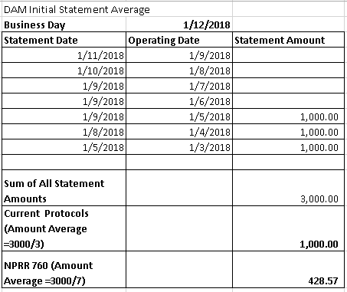
NPRR 760 - Calculation of Exposure Variables For Days With No Activity
Scenario 2: No DAM Activity in some of the most recent 7 ODs*
* With respect to settlement calendar

Slide 14
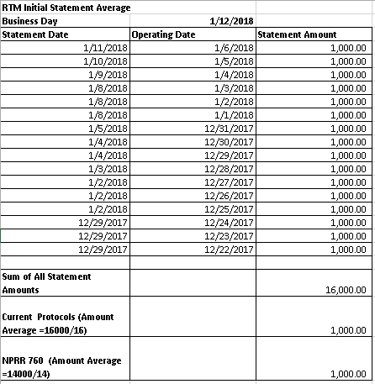
NPRR 760 - Calculation of Exposure Variables For Days With No Activity
Scenario 3: RTM Activity in ALL 14 Most Recent ODs*
* With respect to settlement calendar

Slide 15
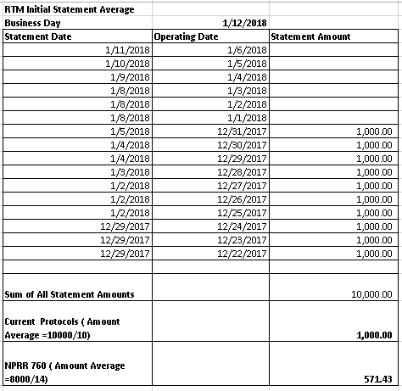
NPRR 760 - Calculation of Exposure Variables For Days With No Activity
Scenario 4: No RTM Activity in some of the most recent 14 ODs*
* With respect to settlement calendar

Slide 16
NPRR 743 - Overview
NPRR 743 Revision to MCE to Have a Floor for Load Exposure
  NPRR 743 revises the Minimum Current Exposure (MCE) calculation to maintain a floor for Load exposure because NPRR639, Correction to Minimum Current Exposure, provided a credit offset for bilateral hedges which resulted in minimal MCE collateral requirements in some instances.

Slide 17
NPRR 743 Revision to MCE to have A Floor for Load Exposure
NPRR743 revises the Minimum Current Exposure (MCE) calculation to maintain a floor for Load exposure.
Averaged over 14 days of Settlement Statements
Generation subject to 20% Net Unit Contingent Adjustment
  80% credit toward load
  20% outage risk
MCE | Current | New
Minimum Load |  | 1 day of exposure for Load
Load & Generation vs. Trade Position | 5 days of exposure for Load minus 5 days of exposure for Generation plus 5 days of bilateral exposure for Load or 2 days of bilateral exposure for other entities | 5 days of exposure for Load minus 5 days of exposure for Generation plus 5 days of bilateral exposure for Load or 2 days of bilateral exposure for other entities
Generation Outage Risk | 2 days of exposure @ 80% | 2 days of exposure @ 80%
Day-Ahead to Real-Time Risk | 1 day of Day Ahead Market (DAM) exposure | 1 day of Day Ahead Market (DAM) exposure

Slide 18
NPRR 800 - Overview
NPRR 800 Revisions to Credit Exposure Calculations to Use Electricity Futures Market Prices
  NPRR 800 revises the Real-Time Liability Extrapolated (RTLE) and Day-Ahead Liability Extrapolated (DALE) factors used in the Counter-Party Estimated Aggregate Liability (EAL) and Minimum Current Exposure (MCE) calculations to use electricity futures mark-to-market prices for estimating forward risk.
  The Real-Time Forward Adjustment Factor (RFAF) and Day-Ahead Forward Adjustment Factor (DFAF) for Real-Time Market (RTM) exposure and Day-Ahead Market (DAM) exposure are calculated using a ratio of futures average price to historic average price of a reference hub.

Slide 19
NPRR800, Revisions to Credit Exposure Calculations to Use Electricity Futures Market Prices
NPRR800 revises the Real-Time Liability Extrapolated (RTLE) and Day-Ahead Liability Extrapolated (DALE) factors used in the Counter-Party Estimated Aggregate Liability (EAL) and Minimum Current Exposure (MCE) calculations to use electricity futures mark-to-market prices for estimating forward risk.
MCE | Current: SAF* Higher Of {……} | New: RFAF*MAF* Higher Of {……}
Minimum Load |  | 1 day of exposure for Load
Load & Generation vs. Trade Position | 5 days of exposure for Load minus 5 days of exposure for Generation plus 5 days of bilateral exposure for Load or 2 days of bilateral exposure for other entities | 5 days of exposure for Load minus 5 days of exposure for Generation plus 5 days of bilateral exposure for Load or 2 days of bilateral exposure for other entities
Generation Outage Risk | 2 days of exposure @ 80% | 2 days of exposure @ 80%
Day-Ahead to Real-Time Risk | 1 day of Day Ahead Market (DAM) exposure | 1 day of Day Ahead Market (DAM) exposure

Slide 20
Credit Reports Changes
Estimated Aggregate Liability (EAL) Summary Report (EMIL ID NP16-665-SG, Report Id 13003):
Added RFAF*, DFAF* columns in the EALQ(EAL for QSEs) Summary section
Added RFAF*, DFAF* columns in the EALA(EAL for CRRAHs) Summary section
Added Forward Adjustment Factors Summary Report
Estimated Aggregate Liability (EAL) Detail Report (EMIL ID NP16-669-SG, Report Id 11179):
Added RFAF, DFAF columns, updated column name from Max(IEL, MAXRTLE, RTLF)+DALE to Max(IEL, RFAF*MAXRTLE, RTLF)+DFAF*DALE in the EAL for QSEs section
Added RFAF, DFAF columns in the EAL for QSEs section
Minimum Current Exposure (MCE) Summary Report (EMIL ID NP16-678-SG, Report Id 13092):
Added RFAF, MAF to MCE Operating Day Summary section column header
Added Exposure of Load($) column to MCE Operating Day Summary section
Added RFAF, MAF to MCE Summary section column header
Added Exposure of Load($) column to MCE Summary section
MIS link name "Future Credit Exposure for CRR PTP Obligations Portfolio Summary Report" will change to "Future Credit Exposure for CRR PTP Obligations (FCEOBL) Summary Report" (EMIL ID NP16-681-SG, Report ID 13106)
MIS link name "Future Credit Exposure for CRR PTP Options Portfolio Summary Report" will change to "Future Credit Exposure for CRR PTP Options (FCEOPT) Summary Report" (EMIL ID NP16-682-SG, Report ID 13107).

