Slide 1
NERC Acceptable Model List
Brad Woods
Reliability Services

Slide 2
Model Notification and List
NERC System Analysis Modeling Subcommittee (SAMS) was directed by the NERC Planning Committee (PC) to create a process to inform industry of obsolete models
SAMS consists of experts from all segments of the electricity industry
SAMS receives and reviews power systems modeling issues and background data from power system modeling subject matter experts (SME) and simulation tool users
SAMS performs analysis, if necessary
SAMS creates modeling notifications for unacceptable models and posts these notifications on the NERC SAMS website after approval
Unacceptable models are identified in the NERC Acceptable Model List which is posted on NERC SAMS website
SAMS accepts/reviews comments received from industry on notifications

Slide 3
Model Notification Examples
EX2000 Dynamics Component Model for Excitation Systems
Information received by SAMS indicated that the EX2000 dynamics model in the Siemens PTI PSS/E power system dynamics simulation program does not properly model the equipment that it is intended to represent. EX2000 is a General Electric (GE) excitation system for synchronous generators.
Gas Turbine Governor Modeling
The GAST, GAST2A, GASTWD, GFT8WD, and WESGOV models are simple representations of a turbine-governor control system, developed and introduced as early as the mid-1970s. These models are considered obsolete and should not be used for representing new generators and applicable existing generators.
Use of GENTPJ Generator Model
Testing in connection with NERC Reliability Standard MOD-026 has revealed that the GENSAL, GENROU, and GENTPF generator dynamic models may significantly underestimate the field current needed to support rated reactive power output of the generator and, consequently, could introduce significant error into simulations where reactive power support is an issue.

Slide 4
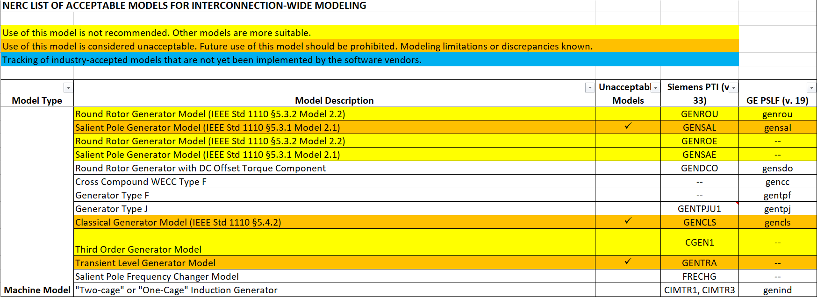
Model List

Slide 5
DWG Manual (ROS Approved 01/2018): Unacceptable Models
List of acceptable/unacceptable dynamic models are published on the NERC SAMS website.
Unacceptable models will not be accepted for new generator interconnections nor for dynamic model updates.
If a generation interconnection or dynamic model update has begun prior to a model being identified as unacceptable by the NERC SAMS, the model shall be allowed to be used in the dynamic flat start cases.
Unacceptable models that already exist in the ERCOT dynamic dataset shall be phased out through dynamic model updates including updates received via the NERC MOD-026-1 and MOD-027-1 processes.

Slide 6
Questions
?

