Slide 1
Incremental Adjustment To Responsive Reserve Service Requirements
ERCOT Staff
ROS
Feb 1, 2018

Slide 2
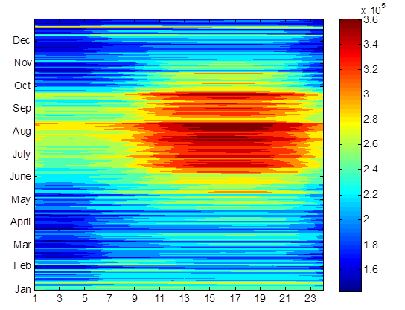
Responsive Reserve Service (RRS)
System Inertia 2016
RRS is procured to ensure sufficient capacity is available to respond to frequency excursions during unit trips.
To consistently meet BAL-003 Interconnection Frequency Response Obligation, ERCOT must plan not to activate UFLS for loss of 2750 MW of generation.
  UFLS relays will shed firm load if frequency drops to 59.3 Hz (5% of total ERCOT load).
  ERCOT plans to maintain frequency nadir at or above 59.4 Hz for loss of 2750 MW (0.1 Hz margin).
Responsive Reserve Requirements 2017

Slide 3
RRS Study Methodology
A set of recent cases at varying inertia levels are selected to to represent a wide range of expected future inertia conditions. Following assumptions are applied to each case/study,
    Model 1150 MW of PFR from Generation Resources.
      Generation mix when,
        Inertia < 250 GW·s: 30% Coal + 70% Gas
        Inertia ≥ 250 GW·s: 15% Coal + 85% Gas
    Load Resources providing RRS will trip at 59.7 Hz, with a delay of 0.416 s (relay delay = 0.333 s; breaker action = 0.083 s).
    Load damping factor was assumed to be 2% at the system level.
Trip 2750 MW of generation simultaneously and identify the amount of LR needed to maintain frequency at 59.4 Hz.

Slide 4
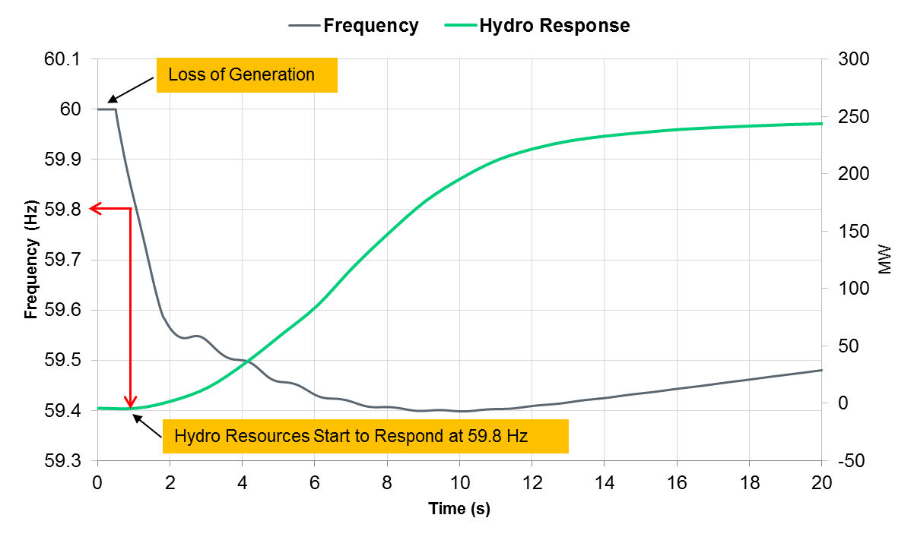
Hydro Response Characteristic
In Real Time, a portion of RRS is provided by Hydro resources operating in synchronous condenser mode via under-frequency relay action (i.e. not a typical governor response).
  Hydro resources provide response when frequency drops below 59.8 Hz, and are required to reach their HSL (equals their RRS responsibility) within 20 seconds after frequency trigger is met.

Slide 5
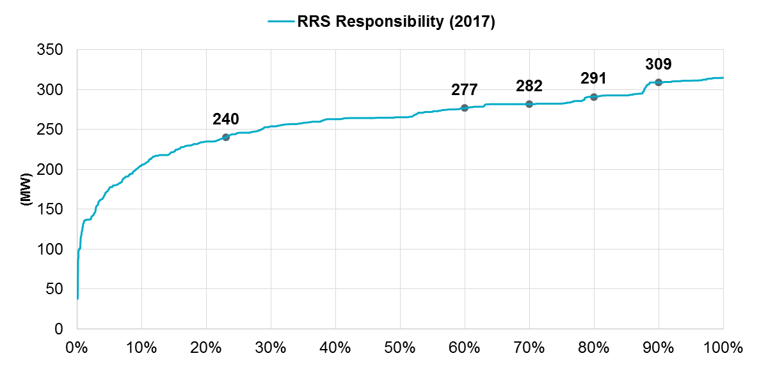
Discrepancy between RRS Study & Real Time Operations
These unique response characteristics of Hydro resources that operate under synchronous condenser fast response mode have not been included in previous studies to determine RRS requirement.
However, ~80% of the time Hydro Resources operating in synchronous condenser fast response mode carry more than 240 MW of RRS.

Slide 6
RRS Efficacy Study Methodology
To assess the efficacy of Hydro resources that provide RRS via synchronous condenser fast response mode, additional RRS studies were recently completed using updated cases at varying inertia levels.
In these studies for Hydro resources, models were created to mimic actual synchronous condenser fast response mode response.
  These models were benchmarked with actual plant level data (from seasonal RRS tests).

Slide 7
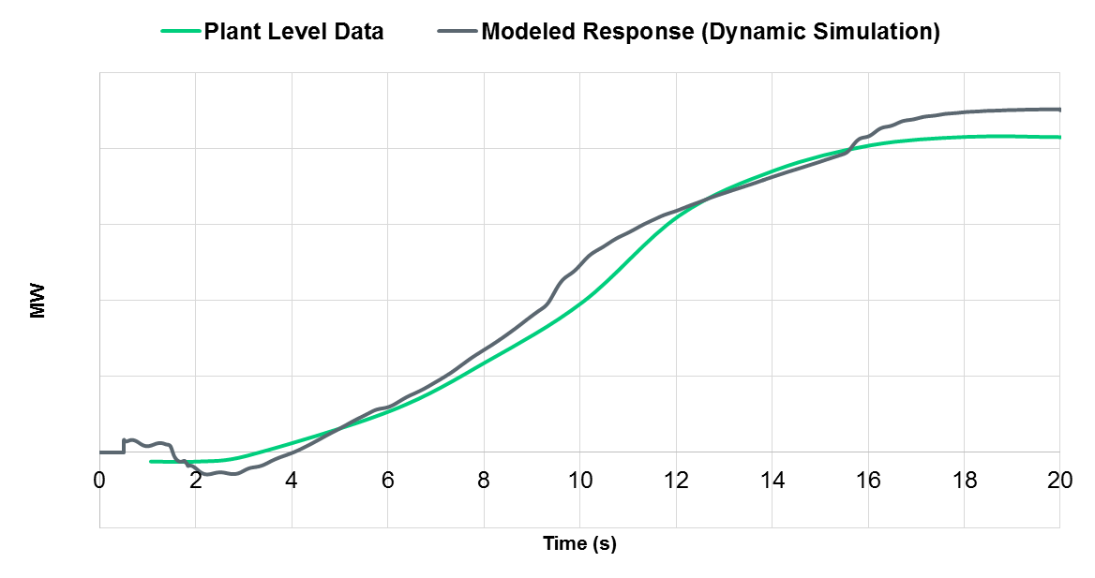
Hydro Model Benchmarking – Unit Level
Each Hydro unit’s response was benchmarked. Below is comparison for a particular Hydro resource’s response from the model created and its seasonal RRS test data.

Slide 8
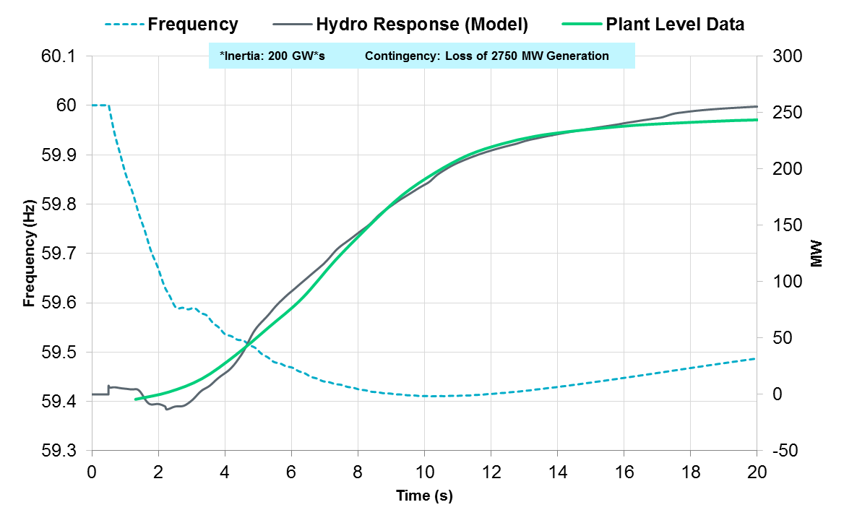
Hydro Model Benchmarking – System Level
Models were created for 11 Hydro resources (a total of 240 MW RRS).

Slide 9
RRS Efficacy Study Methodology
Once the Hydro response was benchmarked, additional studies were conducted at varying inertia levels.
Following assumptions were applied to each case/study,
    Model 240 MW of PFR from hydro resources operating in synchronous condenser mode using the benchmarked models and 910 MW of PFR from Generation Resources.
    All other assumptions were consistent with previous RRS studies.
Trip 2750 MW of generation simultaneously and identify the amount of LR needed to maintain frequency at 59.4 Hz.

Slide 10
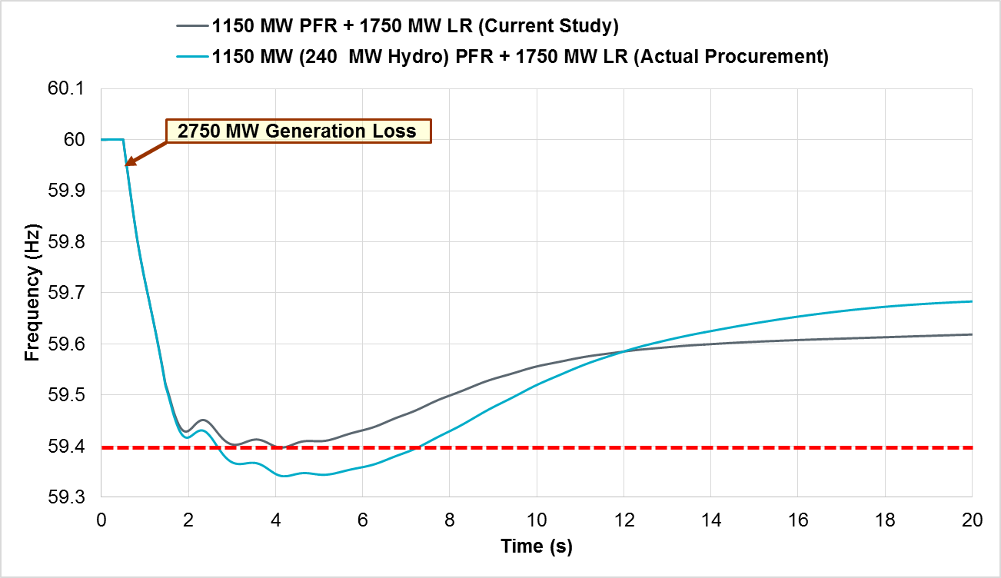
Low Inertia Condition (150 GW*s)

Slide 11
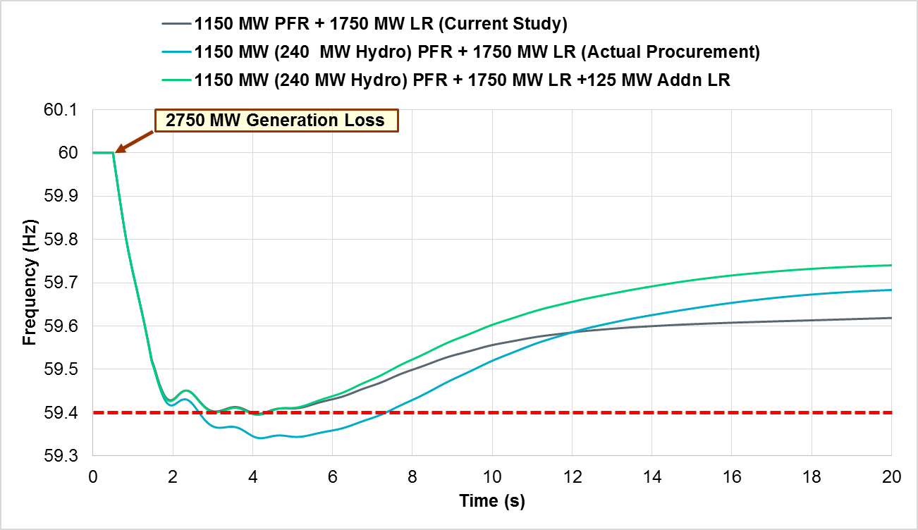
Increased RRS need in Low Inertia Condition (150 GW*s)
An additional 125 MW LR required to maintain C point at 59.40 Hz when 240 MW (out of 1150 MW) is provided by Hydro resources.

Slide 12
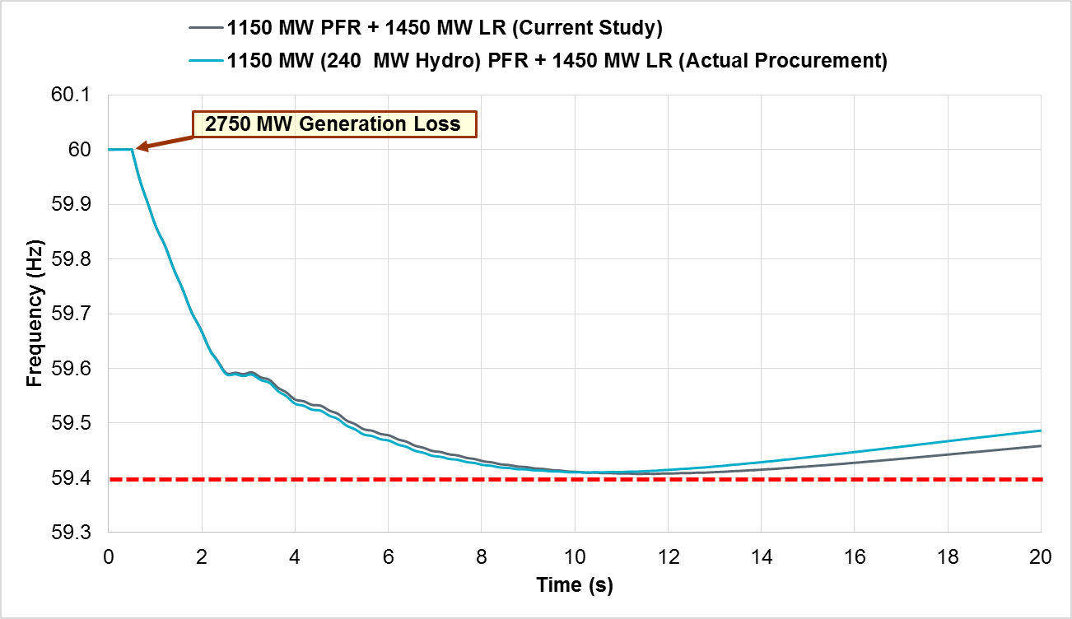
Mid Inertia Condition (260 GW*s)
No additional LR is required to maintain C point at 59.40 Hz when 240 MW (out of 1150 MW) is provided by Hydro resources.

Slide 13
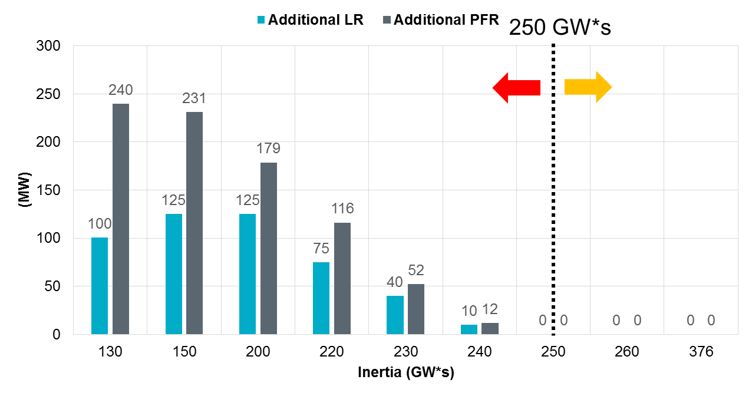
Hydro’s Impact on PFR
Chart below shows additional PFR needed OR additional LRs needed when 240 MW (out of 1150 MW) of RRS is provided by Hydro resources at varying system conditions (inertia levels).
Additional PFR = Additional LR × Equivalency Ratio

Slide 14
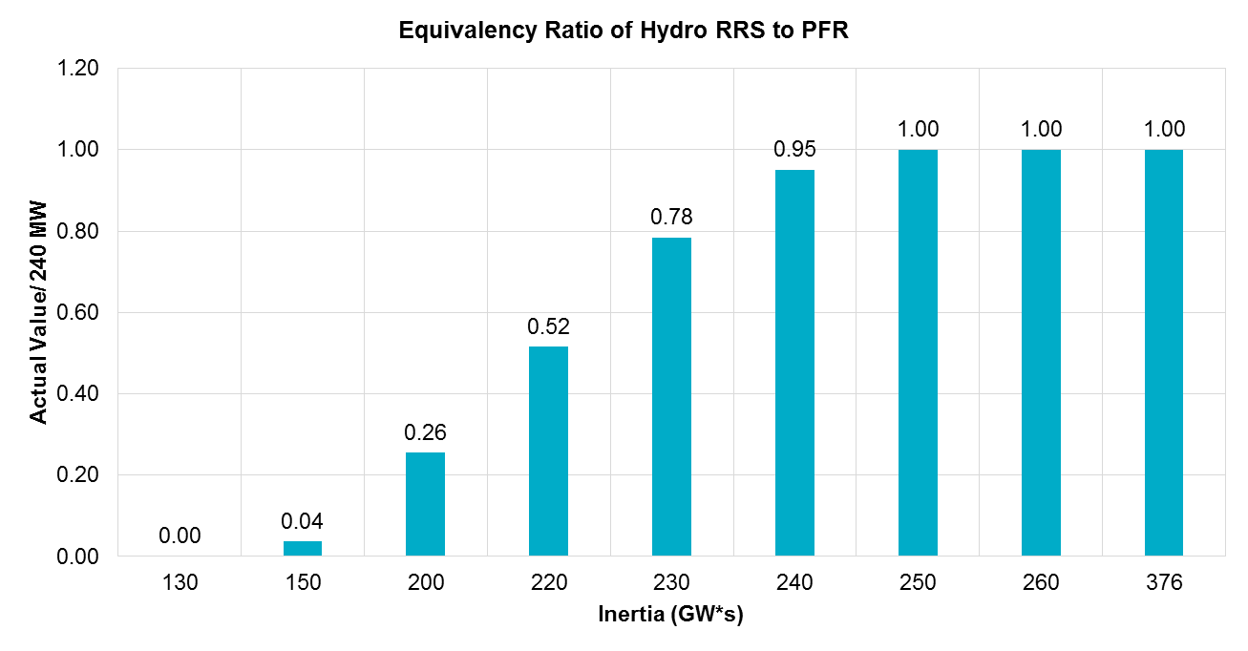
Actual Value of Hydro Providing RRS vs System Inertia
Chart below shows equivalency ratio of Hydro resources versus PFR at varying system conditions (inertia levels).

Slide 15
Summary
Efficacy studies show that with Hydro resources providing RRS in synchronous condenser mode, when;
  system inertia is at or above 250 GW.s, current RRS procurement quantities are sufficient.
  system inertia is below 250 GW.s, additional RRS will be needed to keep system frequency from falling below 59.40 Hz for a loss of 2750 MW.
Beginning Feb 1, 2018 ERCOT will procure additional quantities of RRS during hours when Hydro’s equivalency ratio is less than 1.
  Posted RRS requirements for Feb thru May 2018 will be updated. (Completed Jan 23, 2018)
  Post NPRR 815 implementation, these RRS quantities will be updated to reflect 60% limit on RRS from Load Resources.
RRS quantities for September through December, 2018 may be adjusted if an alternate solution is not implemented by that time.

Slide 16
Additional RRS Needed – Current Methodology (50% Lim)

Slide 17
Potential Longer Term Solutions
Continue to procure additional quantities of RRS during hours when Hydro’s equivalency ratio is less than 1.
Change DAM to include hydro’s equivalency ratio such that any shortfall in RRS/PFR is accounted for during procurement. Change settlement so that Hydro Resources providing RRS are paid the multiplication of the RRS MCPC, the Hydro Equivalency Ratio for the hour and the Awarded Quantity.
Modify performance capabilities of Hydro resources.
Consider comprehensive changes to Ancillary Service suite to align system needs and capabilities.

Slide 18
Divider Slide
Divider Slide (optional)
Discussion

