Slide 1
FIP + Fuel Adder
VS
Coal Prices
ERCOT
RCWG
Jan 23, 2018

Slide 2
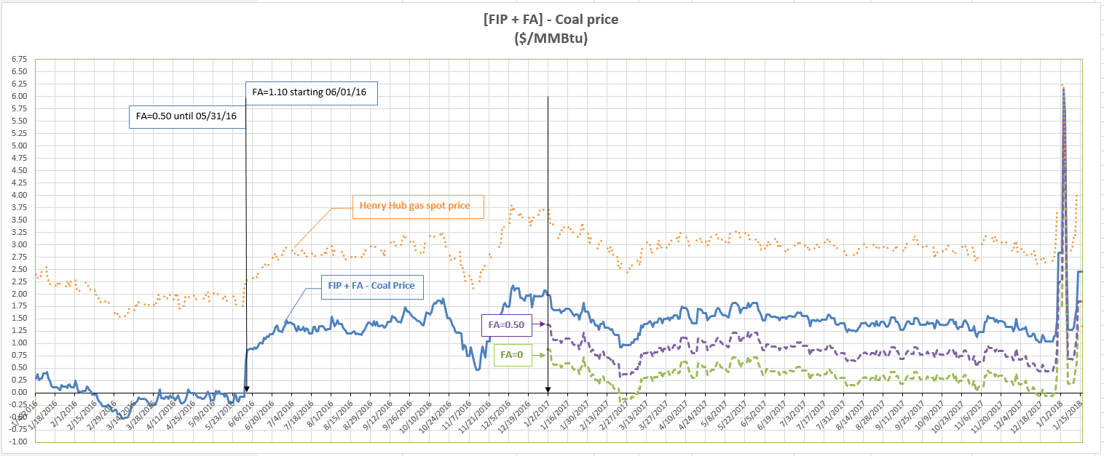
Price Comparison
Notes: FA refers to the fuel adder for Coal&Lignite plants
Coal price refers to coal 8800 delivered
Henry Hub gas spot price is used as a proxy for FIP

