Slide 1
SMT Update To AMWG
December 2017

Slide 2
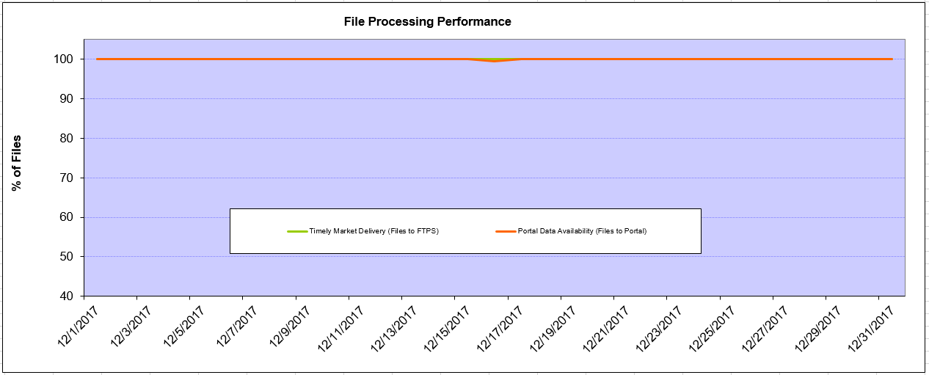
Monthly SMT Data Timelines AMWG CR 2014 002 End to End File Processing Completeness – Dec 2017
% Timely Market Delivery - % of files posted to market (FTPS) by 11:00pm out of # of files received by SMT by 11:00pm.
% Portal Data Availability - % of files loaded to the database for data availability on portal by 6:00am next day for the files received by 11:00pm
A LSE file includes usage data for up to 50,000 ESIIDs.
2

Slide 3
SMT API and FTPS Services Availability – Dec 2017
The service availability is measured as a percentage of number of minutes the service was available out of the total number of minutes in a month, excluding planned outages.
Observed Anomalies:
Mar-Apr 2015: SMT outage and subsequent recovery/catch-up impacted API availability. FTPS was available for most of the part except on 03/21-03/22 for 36 hours.
26 Jul 2015: Services were unavailable for 12 hours due to Flash storage issue
25 Jan 2016: Services were unavailable for 19 hours due to storage configuration issue
07 Mar 2016: API Services were unavailable for 7hours due to Oracle archiver issue.
12 Jul 2017: Due to network Outage FTP & API services are down for 20 minutes. FTPS & API availability is 99.95%.
Notes:
3

Slide 4
SMT Number of Accounts by Type AMWG CR 2014 009 – Dec 2017
Registered Users | ONC | CNP | AEPN | AEPC | TNMP | TOTAL
Active Residential Accounts | 67510 | 29845 | 1911 | 5969 | 4215 | 109450
Active Residential English Accounts | 67274 | 29626 | 1904 | 5840 | 4203 | 108847
Active Residential Spanish Accounts | 236 | 219 | 7 | 129 | 11 | 602
Non Active Residential Accounts | 26082 | 16927 | 1881 | 4251 | 1145 | 49781
Total Residential Accounts | 93592 | 46772 | 3792 | 10220 | 5360 | 159231
TDSP User | 349 | 28 | 10 | 18 | 1 | 406
TDSP Admin | 4 | 4 | 4 | 4 | 3 | 19
Small Business User | 97 | 47 | 1 | 1 | 3 | 149
Small Business Admin | 3146 | 1686 | 92 | 350 | 157 | 5598
Total Agreements (Includes Active and Pending) | 18665 | 3668 | 102 | 322 | 1350 | 24107
Energy Data Agreements (Includes Active and Pending) | 18665 | 3435 | 102 | 322 | 1350 | 23874
Han Device Agreements (Includes Active and Pending) | 0 | 232 | 0 | 0 | 0 | 232
Han Service Agreements (Includes Active and Pending) | 0 | 1 | 0 | 0 | 0 | 1
IN SMT
ESI IDs | 3570067 | 2486342 | 198346 | 869549 | 249967 | 7374271
Meters | 3514257 | 2486257 | 199182 | 870048 | 249353 | 7319097
HAN Devices | 3250 | 4177 | 134 | 266 | 31 | 7858
Acknowledgement | 0 | 0 | 0 | 0 | 0
Pending | 0 | 0 | 0 | 0 | 0
Meter Ready | 3 | 0 | 37 | 91 | 19
Provisioned | 3247 | 4177 | 97 | 175 | 12
HAN Messages (MTD) | 0 | 0 | 0 | 0 | 0 | 0
HAN Messages (YTD) | 0 | 0 | 0 | 0 | 0 | 0
HAN Messages (Cumulative) | 608 | 7412 | 0 | 0 | 0 | 8020
Simple Text Messages | 166 | 2934 | 0 | 0 | 0
Load Control Messages | 192 | 2658 | 0 | 0 | 0
Pricing Messages | 173 | 56 | 0 | 0 | 0
Cancellation Messages | 77 | 1764 | 0 | 0 | 0
Supplemental – (Friends)
Total Agreements | 1944 | 1524 | 82 | 107 | 68 | 3725
Accepted Agreements | 808 | 590 | 36 | 32 | 23 | 1489
Pending Agreements | 8 | 2 | 0 | 2 | 0 | 12
Revoked Agreements | 339 | 296 | 11 | 8 | 7 | 661
Expired Agreements | 749 | 604 | 33 | 65 | 38 | 1489
Terminated Agreements | 40 | 32 | 2 | 0 | 0 | 74
 | TDSPs | REP | Small Business | Regulatory | Third Party
Registered Entities | 5 | 122 | 5409 | 2 | 175
Registered Users | 406 | 883 | 149 | 8 | 27
Registered Admins | 19 | 185 | 5431 | 3 | 161
HAN Messages Sent By | 578 | 7418

Slide 5
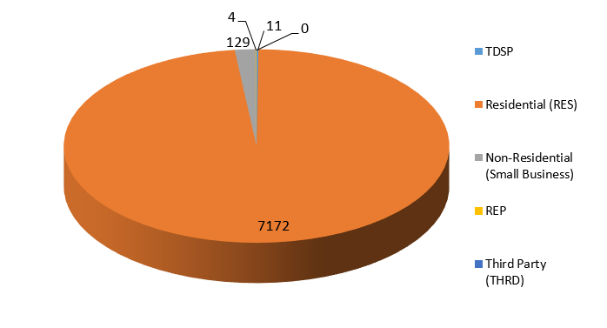
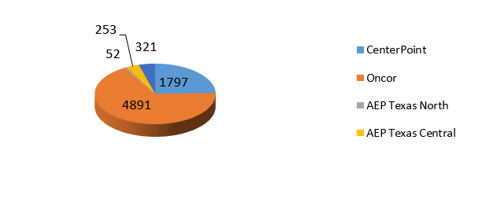
SMT ODR Details – Dec 2017
Total ODR Requests TDSP wise statistics:
Total ODR Requests User type statistics:

