Slide 1
Overview of RTP Cascading Outage Analysis
Yong Cheng
Transmission Planning Assessment

Slide 2
ERCOT - Regional Transmission Planning (Planning Assessment for 2 to 6 Year Future System Conditions)
Case Building
Other Reliability Studies
Sensitivity analysis
Short circuit study
Initial start cases, and contingency list ready
Long-lead time equipment study
Report and Posting
Multiple element outage and cascading analysis
Set 1 (P1, P7),
Set 2 (P2, P4, P5) contingency analysis for the base cases
Set 3 (P3: G-1+N-1, part of P6: X-1+N-1) contingency analysis for the base cases
Economic case preparation and analysis

Slide 3
System Cascading – NERC Requirement
Definition in NERC’s Glossary of Terms
“The uncontrolled successive loss of system elements triggered by an incident at any location. Cascading results in widespread electric service interruption that cannot be restrained from sequentially spreading beyond an area predetermined by studies.”
Requirements in NERC TPL-001-4 (Transmission System Planning Performance Requirement)
Table Steady State & Stability Performance Planning Events of the TPL does not allow any cascading under Planning events (P1 through P7)
R3.5 and R4.5 requires evaluation of possible actions for potential cascading caused by extreme events

Slide 4
Cascade analysis in RTP
Any contingency event defined in the TPL-001-4 standards where a non-consequential load shed is an acceptable corrective action plan will be screened further for potential cascade conditions
ERCOT performs the initial screen as well as detailed cascade analysis
This analysis is conducted on the base case and sensitivity cases

Slide 5
Cascading Analysis –Cases and Contingencies
Study cases:
Secure summer peak cases (Year 2, Year 5 and Year 6)
Secure off-peak cases (Year 3)
For cascading analysis, ERCOT studies the following NERC contingencies for cascading analysis
P2.2 (HV- Bus section fault), P2.3 (HV- Internal failure of non-bus tie breaker), P2.4 (Internal failure of bus tie breaker), P4 (HV - Fault plus stuck breaker), P4.6 (EHV – Fault plus a stuck bus-tie breaker), P5 (HV - Fault plus relay failure to operate), P6 (N-1-1 with system adjustment);
EE1 (N-1-1 without system adjustment), EE2 (Local area events affecting the Transmission System), EE3 (Wide area events affecting the Transmission System based on System topology such as loss of two generating stations)

Slide 6
Cascading Analysis – Methodology
Methodology
Equipment trip settings:
Relay loadability limits for transmission facilities identified by TSPs. If not available, the lower of 115% of emergency rating or 150% of normal rating
Generator over and under voltage relays identified by Generator Owners
Buses with UVLS protection schemes where voltages go below the under voltage triggering level
Monitored Elements:
All Transmission Elements connected at the BES level were monitored according to the ERCOT System Operating Limit Methodology for Planning and Operations Horizon

Slide 7
Cascading Analysis – Procedure
General Study Procedure
Following a initiating contingency event, the study will trip elements if the post contingent voltages and branch flows exceed the relay trigger limits and re-solve power flow.
The study will continue to trip elements until the cascade analysis terminating condition is reached.
The study will determine the accumulated load loss as a result of a system cascade

Slide 8
Cascading Analysis – Criteria(Screening Study)
Screening criteria: An initiating contingency event is identified to be a ‘potential’ cascade event if
The accumulated load loss is greater than 6% of the total initial system load,
The power flow does not converge - which may be a result of a potential voltage collapse condition, subject to additional confirmation, OR
The number of cascade levels exceeds user-defined tiers
A contingency causing potential cascade event will be studied in detail to determine if the event leads to an actual cascade condition

Slide 9
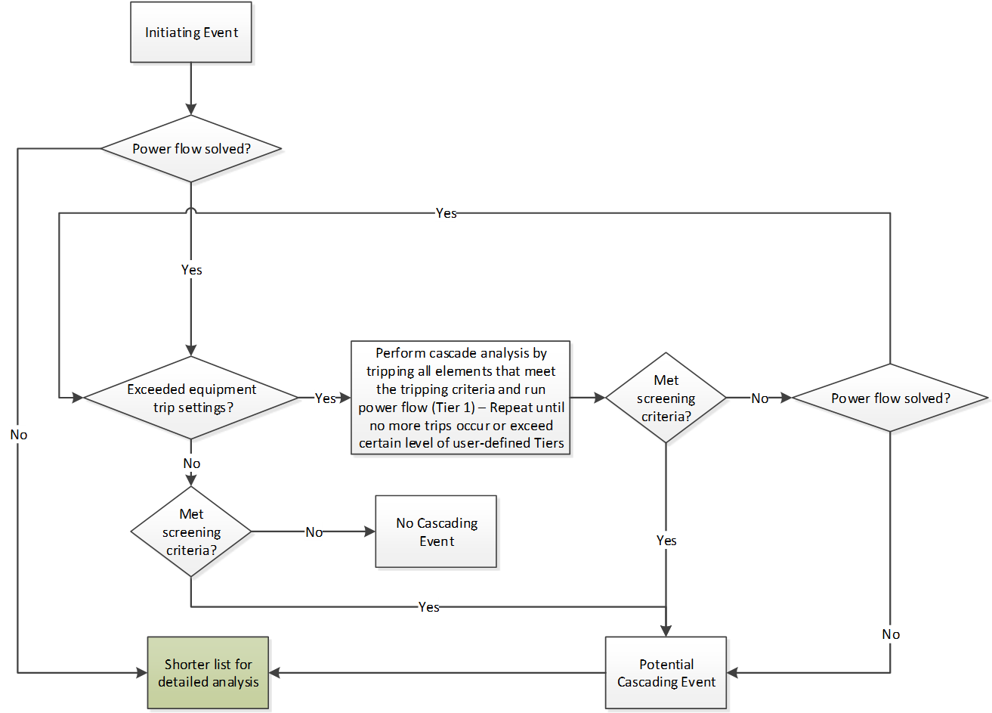
Flow Chart for Screening Study

Slide 10
Cascading Analysis – Criteria (Detailed Study and Mitigation Plan)
Criteria for potential system cascading:
Power flow fails to converge following the event
The accumulated amount of total load loss is greater than 6% of the total initial system load
Criteria to development of mitigation plan:
Amount of load shedding to prevent cascading
For an N-1-1 (P6) type events: More than 100 MW load shedding if the total load shed required after the first contingency, but prior to the second contingency
For other events such as N-2 (EE1): More than 300 MW load shedding
The likelihood of the event is also considered to determine necessity of mitigation project

Slide 11
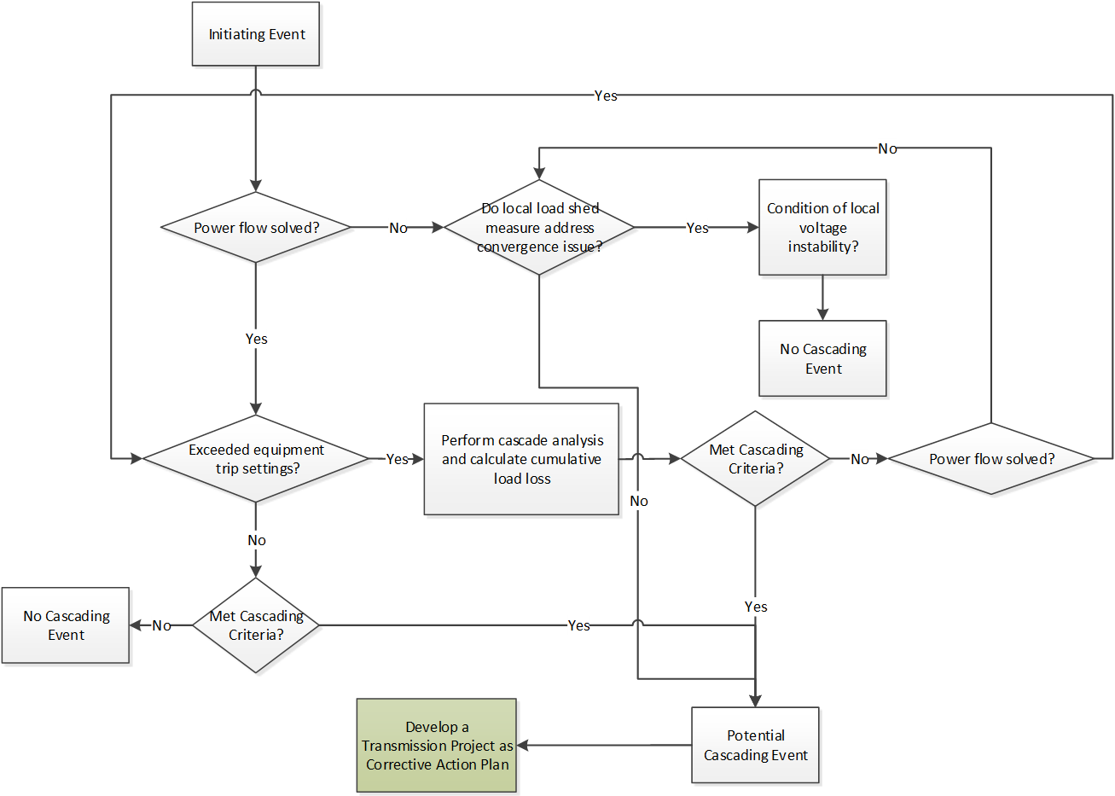
Flow Chart for Detailed Analysis

Slide 12
Cascading Analysis – Tool
Tools Used for Cascading Analysis:
Potential Cascading Modes (PCM)
Purpose: screening study and load shedding analysis
Company: V&R Energy System Research
PowerWorld Simulator
Purpose: Detailed analysis of the select contingencies
Company: PowerWorld Corporation

Slide 13
References
NERC TPL-001-4 Standard
2017 Regional Transmission Plan Report
System Operating Limit Methodology for Planning and Operations Horizon

Slide 14
Question
Yong Cheng
Yong.cheng@ercot.com

