Slide 1
DER Mapping Proposal
January 2018

Slide 2
ERCOT’s goals for DER Mapping
Improve situational awareness of registered DG activity that could affect the bulk power grid
At increased levels of penetration, DERs will impact ERCOT’s planning and operations
  Errors in Load Distribution Factors
  Contingency analysis
  Congestion management
  Outages and restoration
  Load forecasting
  State Estimator
See: DER Reliability White Paper from March 22, 2017:
  http://www.ercot.com/calendar/2017/5/25/107863-TAC
DER Mapping is a required step in providing LMP pricing to DER. This is discussed in the “ERCOT Concept Paper on Distributed Energy Resources in the ERCOT Region”.

Slide 3
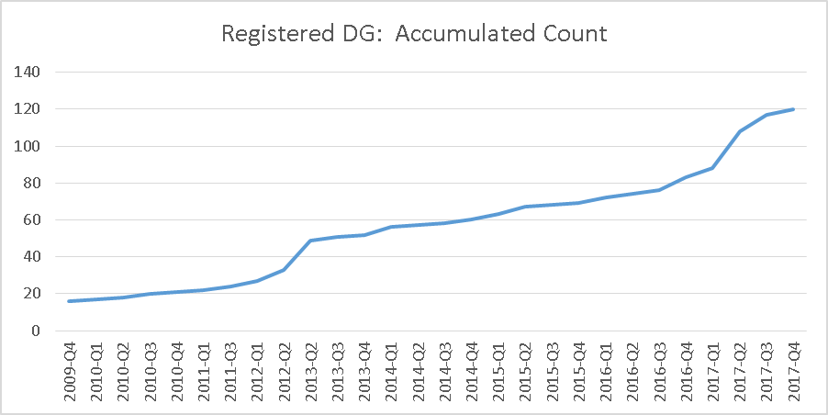
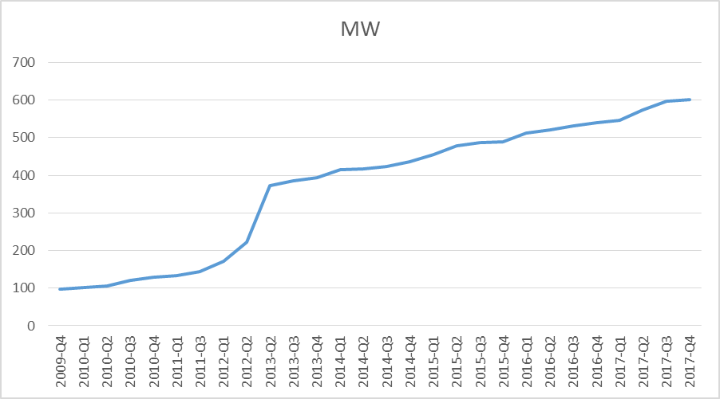
Trend lines for Registered DG (4Q09-Nov 17)
120 Registered DG units on the system; 37 new so far in 2017
600 MW of Registered DG now on the system
Notes:
1 more added since slide was drafted

Slide 4
What’s involved in Registered DG Mapping
Mapping is not the same as Modeling
  Distribution system modeling is the responsibility of the Distribution Service Providers (DSPs)
  Modeling involves gathering, generating and maintaining distribution system information (impedances, switches, etc.) – a compilation of TSP, DSP and Resource data
ERCOT intends to map registered DGs and no intention of modeling the distribution system
Mapping is associating registered DG with its appropriate Common Information Model Load (CIM Load) in the Network Operations Model
  CIM Loads are modeling constructs developed by Transmission Service Providers (TSPs)
Note* Distribution connected Load Resources have been providing CIM load mapping information in a similar way via RARF submissions.

Slide 5
Which DGs require mapping?
ERCOT proposes to map Registered Distributed Generation (Registered DGs) to their appropriate CIM Loads
  Registration with ERCOT is required for DG >1 MW
  There are 120 registered DG units on the system as of Nov. 2017
  A small percentage of registered DG are less than 1 MW.
Note*
In the ERCOT reliability whitepaper ERCOT discusses the concept of accumulations or clusters of smaller (unregistered) DGs.
In local areas these accumulations may start to resemble larger Registered DGs
  This is a potential long-term issue, not on the agenda today

Slide 6
Where does this stand?
TDSPs, TSPs and DSPs have been helpful in providing mapping data to ERCOT for current Registered DGs
ERCOT has mapped most of the current fleet of Registered DGs to their appropriate CIM Loads in the model
  Data was provided bilaterally via email following ERCOT requests
Goal of today’s roundtable discussion: identify best process for mapping going forward
  Agree on framework to formalize the process

Slide 7
“Mapping” Roadmap- Near Term Proposal
Establish Mapping process
DSP
Communication to establish CIM load location
TSP
establish IA and metering
Resource Entity
ERCOT
ERCOT process
RARF Submittal
ERCOT submits CAMR
ERCOT NMMS group to execute
RARF submittal to follow Load Resource process and include information required for mapping resource to correct CIM load

Slide 8
“Mapping” Proposal
Transmission model and Mapping Example.
CIM Load is the telemetered value that is typically brought in from the high side of the substation transformer
Mapping associates Registered DG under a CIM load that consists of:
Loads
Registered DG
Controllable Load Resources
Non-Controllable Load Resources
This approach mirrors the Load Resource process which is manageable for lower volumes of mapping

Slide 9
“Mapping” Roadmap- Mid Term Proposal (future)
Moving to an on-line registration tool which handles the mapping of Registered DG
establish IA and metering
DSP
Resource Entity
On-Line registration tool for DG
CAMR process
TSP/ERCOT NMMS group to execute NOMCR
Submittal would require Resource Entity to select CIM load using the registration tool.

Slide 10
Until the rules are Written and Implemented…
ERCOT to complete the mapping based on the provided information.
ERCOT modify RARF to include CIM load and process DG RARFs
  NPRR section 3.10
  RRGRR add existing field to DG RARF
Annual Survey for verification to TDSPs of registered DG mapping
  PGRR insert annual survey to TSP under ALDR section

