Slide 1
Operations Training Working Group
Meeting Notes
Mark Spinner
Chairman
1/9/2018

Slide 2
Winter Storm Drill
Completed Winter Storm Drill. CEHs for the Winter Storm Drill have been administered.
ERCOT’s biennial Winter Storm Drill was executed successfully with four major objectives:
Test ERCOT System Operations, QSE’s and TO’s serving the ERCOT region for their ability to recognize the current state of the system, given a set of conditions;
Given a sequence of events, test appropriate response to changing system conditions;
As warranted by system conditions, test communication of information with relevant personnel;
Test demonstration of proper three-part communication.

Slide 3
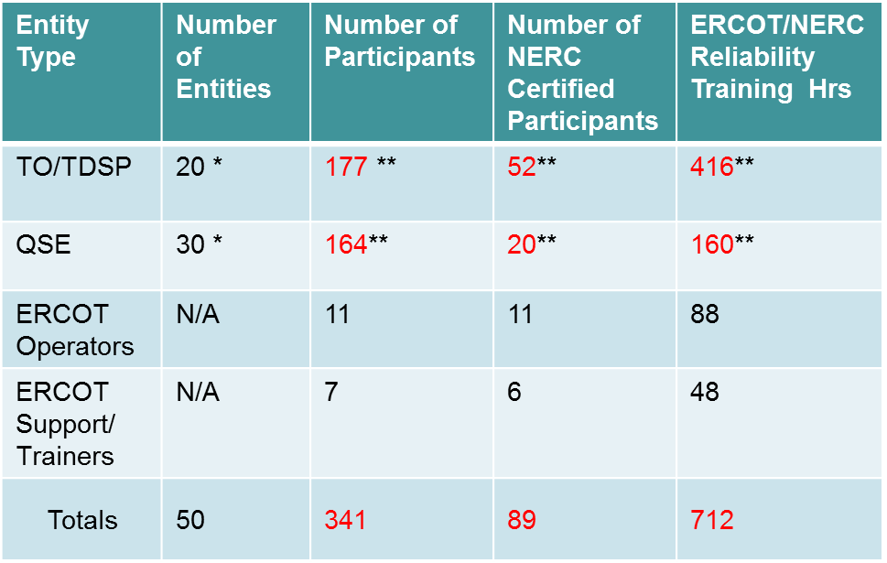
Winter Storm Drill Participants

Slide 4
Drill Scenario
The drill included simulations such as;
High winds and icing shutting down wind units
Control transmitters freezing causing a loss of fossil generation
Galloping conductors tripping lines
Gas curtailments causing loss of some generation and reduced output of others.
Boiler tube leaks
Loss of other transmission elements not necessarily related to the storm for the purpose of achieving EEA 1, 2 and 3 conditions.

Slide 5
Winter Storm Drill Comments
ERCOT experienced issues several issues with the Consortium system during Day 1 hotline calls forcing ERCOT operators to make some individual hotline calls to participants.
The original script timelines which were sent out with the market notice did not match with the Day 1 timeline.
Overall, the MMAP refresher received much praise for timeliness.

Slide 6
Winter Storm Drill Comments
The ERCOT Operators had favorable response to the simulation. They stated that it was important to them to step through the procedures, take actions and see the impacts.
One operator stated that he failed to predict PRC response to deployment actions of load resources done to restore frequency and it was important that he understand that impact.

Slide 7
Winter Storm Drill Comments
Overall the Market Participant Operators stated it was a good exercise and simulation to test our response to real-world events.
The also stated it was an excellent simulation of real system emergency conditions.
There were some problems programming events in the simulator.
Request to have a little more detail on the timeline of weather events

Slide 8
Winter Storm Comments
Although majority of participants expressed value using MMAP for this type of simulation, suggestions were received in areas for enhancement:
Alarm log for TO’s to view individual lines as they go out
State Estimator tool in the MMAP
MMAP default to showing de-energized lines and wall board colors
Would like more time committed to learning Macomber Map.

Slide 9
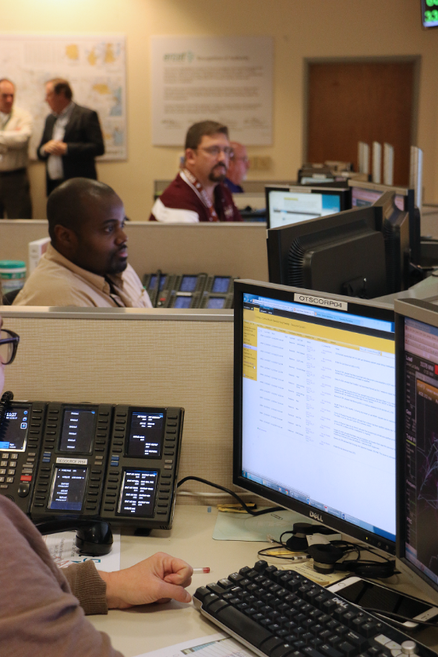
Grid Ex IV
Completed Grid Ex IV Nov 15 – 16, 2017
GridEx is a biennial exercise designed to simulate a cyber/physical attack on electric and other critical infrastructures across North America.

Slide 10
Grid Ex IV
Included simulated cyber & physical events in our Operator Training Simulator (OTS) and including Market Participants
Included Cyber Proving Grounds / Test Bed
Server and Workstations representative of our environment

Slide 11
Grid Ex IV Participants
AEP Austin Energy
Avangrid Calpine
City of Garland CPS Energy – TO/QSE
Duke Energy LCRA – TO / QSE
Formosa MP2 Energy
NRG ONCOR
TNMP
Sharyland Utilities
Rayburn Electric Cooperative

Slide 12
Drill Scenario
Day 1 Simulation included:
Some unrelated generator and line trips.
Gas Company reported that a pumping station had been attacked
Several physical attacks occurred to transmission elements which included cutting down trees in the ROW.
Attacks on generators included a UAV attack on the fuel at coal plant
A car was rammed into the gas supply of a combined cycle plant.

Slide 13
Drill Scenario
Day 1 Simulation included:
An attack on a Transmission Operator Back up control center, where a car was abandoned with flammable materials and ignited.
Cyber attacks included a software update conducted on generator control systems causing some generators to become uncontrollable and required manual tripping.

Slide 14
Drill Scenario
Day 2 Simulation included:
Structures collapsed due to explosives
Trees cut in Right of Ways
Fires set in Right of Ways
Insulators shot out
Linemen shot at
Generators still impacted by gas curtailments
UAV attacks
A cyber attack impacted the ICCP link for a Transmission Operator which impacts the ERCOT’s EMS.

Slide 15
Grid Ex IV Comments
Overall the Exercise was a success
There were many instances of great teamwork and collaborative troubleshooting.
Market Participants and ERCOT Operators showed they were extremely skilled, in fact the teams had to be sabotaged to slow them down so the full effect of the event could play out. They adapted quickly to changing conditions.

Slide 16
Grid Ex IV Comments
A more extensive documentation of events will ensure that all players are identified and allow the players to fully explore incident to the logical conclusion. This will allow for:
Better indications to prevent an undesired outcomes
Ensure equipment requirements met for operation, troubleshooting and recovery
Better identification of communication requirements and tools
Ensure planners have clear roles
Improve coordination and minimize deviations from the MSEL.

Slide 17
Grid Ex IV Comments
Simulator case was not fully groomed, which required instructors to perform switching which was misidentified as cyber-attacks.
Due to limited size and technology of wall display, operators were tipped off to some events due to the changes in the display
Some Modeled elements have incorrect ownership
MMAP does not default to showing de-energized lines and wall display colors
MMAP does not have logging capability so the Operators can see the events for their system.

Slide 18
2018 Black Start Training
Schedule
Pilot :(Primer) Generator/Transmission System Dynamics (10 CEH) – January 8-9, 2018 and Black Start and Restoration Course (19 CEHs) – January 9th – 11th
Session 1: (Primer) Generator/Transmission System Dynamics (10 CEHs) – January 29th – 30th and Black Start/Restoration Course (19 CEHs) January 30th – February 1st
Session 2: (Primer) Generator/Transmission System Dynamics (10 CEHs) – February 5th – 6th and Black Start/Restoration Course (19 CEHs) – February 6th – 8th

Slide 19
2018 Black Start Training
Schedule
Session 3: (Primer) Generator/Transmission System Dynamics (10 CEHs) – February 12th – 13th and Black Start/Restoration Course (19 CEHs) – February 13th – 15th
Session 4: (Primer) Generator/Transmission System Dynamics (10 CEHs) – February 19th – 20th and Black Start/Restoration Course (19 CEHs) – February 20th – 22nd
Session 5: (Primer) Generator/Transmission System Dynamics (10 CEHs) – February 26th – 27th and Black Start/Restoration Course (19 CEHs) – February 27th – March 1st

Slide 20
2018 Black Start Training
Schedule
Session 6: (Primer) Generator/Transmission System Dynamics (10 CEHs) – March 5th – 6th and Black Start/Restoration Course (19 CEHs) – March 6th – 8th
Inclement Weather Session: (Primer) Generator/Transmission System Dynamics (10 CEHs) – March 12th – 13th and Black Start/Restoration Course (19 CEHs) – March 13th – 15th

Slide 21
2018 Operator Training Seminar (OTS)
Theme: Generators, Markets and Transmission, Working Together to Ensure Reliability
Topics (Length 18 hours, 16 CEHs)
CEO Introduction (Bill Magness / ERCOT)
Extreme Natural Events (1 CEH) (Kristi Hobbs / ERCOT)
Hurricane Harvey (3 CEH)
Hurricane Harvey Weatherman Perspective (Chris Coleman) (50 min)
Hurricane Harvey Centerpoint Perspective (30 min)
Hurricane Harvey AEP Perspective (Joe Pina) (30 min)
Hurricane Harvey NRG Perspective (Kevin Matt) (30 min)
Hurricane Harvey ERCOT Perspective (Aaron Ballew, Jerry Gaddy, Jimmy Hartmann (30 min)

Slide 22
2018 Operator Training Seminar (OTS)
Topics (Length 18 hours, 16 CEHs)
Resource Integration Impacts(1 CEH) (John Bernecker / ERCOT)
Operating Reserve and Reliability Deployment Price Adders (1 CEH) (David Maggio / ERCOT)
Grid Scale Renewables(1 CEH) (Nitika Mago / ERCOT)
Trends in Markets and Policy (1 CEH) (Paul Wattles / ERCOT)
Distributed Energy Resources (DER) / Demand Response (1 CEH) (Clayton Stice / ERCOT)
Reliability Unit Commitment Process (1 CEH)(Agee Springer / ERCOT)

Slide 23
2018 Operator Training Seminar (OTS)
Topics (Length 18 hours, 16 CEHs)
Improving Resiliency (1 CEH)(John Adams / ERCOT)
Loss of SCADA, EMS, or LCC (1 CEH) (Dave Penney / TRE, Mark Henry / TRE)
Coordinated Voltage Control (Voltage set point control) (1 CEH) (Stephen Solis / ERCOT)
Human Performance Improvement (1 CEH) (Brian Legg / ERCOT)
Physical and Cyber Security (1 CEH) (Joshua Aldridge / ERCOT)
Australian Black Out Event (1 CEH) (Alex Lee / ERCOT)

Slide 24
2018 Operator Training Seminar (OTS)
Schedule
Pilot – January 23rd – 25th
Session 1 – March 27th – 29th
Session 2 – April 3rd – 5th
Session 3 – April 10th – 12th
Session 4 – April 17th – 19th
Session 5 April 24th – 26th
Session 6 May 1st – 3rd

Slide 25
2019 Black Start Training
Schedule
Pilot: February 25th (Generation and Transmission Dynamics) and February 26th – 28th (Black Start and Restoration Training)
Week 1: March 18th (Generation and Transmission Dynamics) and March 19th – 21st (Black Start and Restoration Training)
Week 2: March 25th (Generation and Transmission Dynamics) and March 26th – 28th (Black Start and Restoration Training)
Week 3: April 1st (Generation and Transmission Dynamics) and April 2nd – 4th (Black Start and Restoration Training)

Slide 26
2019 Black Start Training
Schedule
Week 4: April 8th (Generation and Transmission Dynamics) and April 9th – 11th (Black Start and Restoration Training)
Week 5: April 15th (Generation and Transmission Dynamics) and April 16th – 18th (Black Start and Restoration Training)
Week 6: April 22nd (Generation and Transmission Dynamics) and April 23rd – 25th (Black Start and Restoration Training)
Inclement Weather Week: April 29th (G and T Dynamics) and April 30th – May 2nd (Black Start and Restoration Training)

Slide 27
2019 Operator Training Seminar
Start thinking about topics
Schedule
Pilot: August 13th – 15th
Week 1: October 15th – 17th
Week 2: October 22nd – 24th
Week 3: October 29th – 31st
Week 4: November 5th – 7th
Week 5: November 12th – 14th
Week 6: November 19th – 21st

Slide 28
New Business
New Chair and Vice Chair
New Training Building Construction has begun.
ERCOT’s Manager, Operations Training; Mark Spinner would like to visit all Market Participant’s control room / training facilities and meet with the Control Room Management and Training Department to obtain input on how ERCOT can assist your training program.

Slide 29
New Business
Black Start Seating Criteria
It was identified there should be some criteria for selecting who gets first chance at seats during Black Start training.
Software solution not available and manual methods are complex and time consuming.
New Training Building additional space may offer respite for a time.
Two solutions were suggested:
Early Registration limited to only operators, then open registration for everyone else. Have all required Market Participants update the required number of seats.
Draft NOGGR for ERCOT Nodal Operating Guide Section 1.5 Operational Training to clearly state who shall attend and correct other issues with the section.

Slide 30
Next Meeting
February None (Black Start Training)
March 8 (1 pm) TCC 1, Rm 252 / WebEx (after Black Start Week 6)
April 12 (1 pm) TCC 1, Rm 253 / WebEx (after OTS Week 3)
May 9 (1 pm) TCC 1, Rm 253 Trainer Development
May 10 (9 am) TCC 1, Rm 253 / WebEx
June 14 (9 am) TCC 1, Rm 252 / WebEx
July 12 (9 am) TCC 1, Rm 253 / WebEx

Slide 31
Next Meeting
August 9 (9 am) TCC 1, Rm 253 / WebEx
Sept 12 (1 pm) TCC 1, Rm 253 Trainer Development
Sept 13 (9 am) TCC 1, Rm 253 / Web Ex
Oct 11 (9 am) TCC 1, Rm 253 / WebEx
Nov 8 (9 am) TCC 1, Rm 252 / WebEx
Dec 13 (9 am) TCC 1, Rm 253 / WebEx

