Slide 1
PDCWG Report to ROS
Chair: Percy Galliguez, Brazos Electric Power Cooperative, Inc.
Vice Chair: Lei Ye, Austin Energy
ROS
January 11, 2018

Slide 2
Report Overview & Notes
Report Overview
  Meeting Minutes
  BAL-001-TRE-1 FMEs & IMFR
    4 FME in the month of November
  Frequency Control Report

Slide 3
Meeting Minutes
PDCWG Meeting 12/13/17
  Southern Cross DC Tie Transmission Project-Directive 8 ERCOT White Paper Draft
  NPRR Draft RRS Limit
  Regulation & Frequency Control Reports
  BAL-001-TRE-001 Discussion
    Directives ROS Assigned
  NOGRR Proposal(MOD-026-1 Alignment)
    NOGRR Proposal/Review Status
  Chair and Vice-Chair Selection

Slide 4
Frequency Measurable Events Performance

Slide 5
Frequency Measurable Events
There was 4 FMEs in November
  11/6/2017 09:08:22
    Loss of 550 MW(IMFR=1038MW/0.1Hz)
    Interconnection Frequency Response:
    10 of 49(0 of 36 RRS providers) Evaluated Generation Resources had less than 75% of their expected Initial Primary Frequency Response.
    7 of 49(0 of 36 RRS providers) Evaluated Generation Resources had less than 75% of their expected Sustained Primary Frequency Response.
  11/13/2017 15:16:13
    Loss of 692 MW(IMFR=733MW/0.1Hz)
    Interconnection Frequency Response:
    5 of 35(1 of 36 RRS providers) Evaluated Generation Resources had less than 75% of their expected Initial Primary Frequency Response.
    4 of 35(0 of 36 RRS providers) Evaluated Generation Resources had less than 75% of their expected Sustained Primary Frequency Response.

Slide 6
Frequency Measurable Events
  11/18/2017 02:30:36
    Loss of 474 MW(IMFR=817MW/0.1Hz)
    Interconnection Frequency Response:
    14 of 41(0 of 31 RRS providers) Evaluated Generation Resources had less than 75% of their expected Initial Primary Frequency Response.
    13 of 41(1 of 31 RRS providers) Evaluated Generation Resources had less than 75% of their expected Sustained Primary Frequency Response.
  11/25/2017 20:24:34
    Loss of 1219 MW(IMFR=1033MW/0.1Hz)
    Interconnection Frequency Response:
    5 of 37(1 of 33 RRS providers) Evaluated Generation Resources had less than 75% of their expected Initial Primary Frequency Response.
    7 of 37(1 of 33 RRS providers) Evaluated Generation Resources had less than 75% of their expected Sustained Primary Frequency Response.

Slide 7
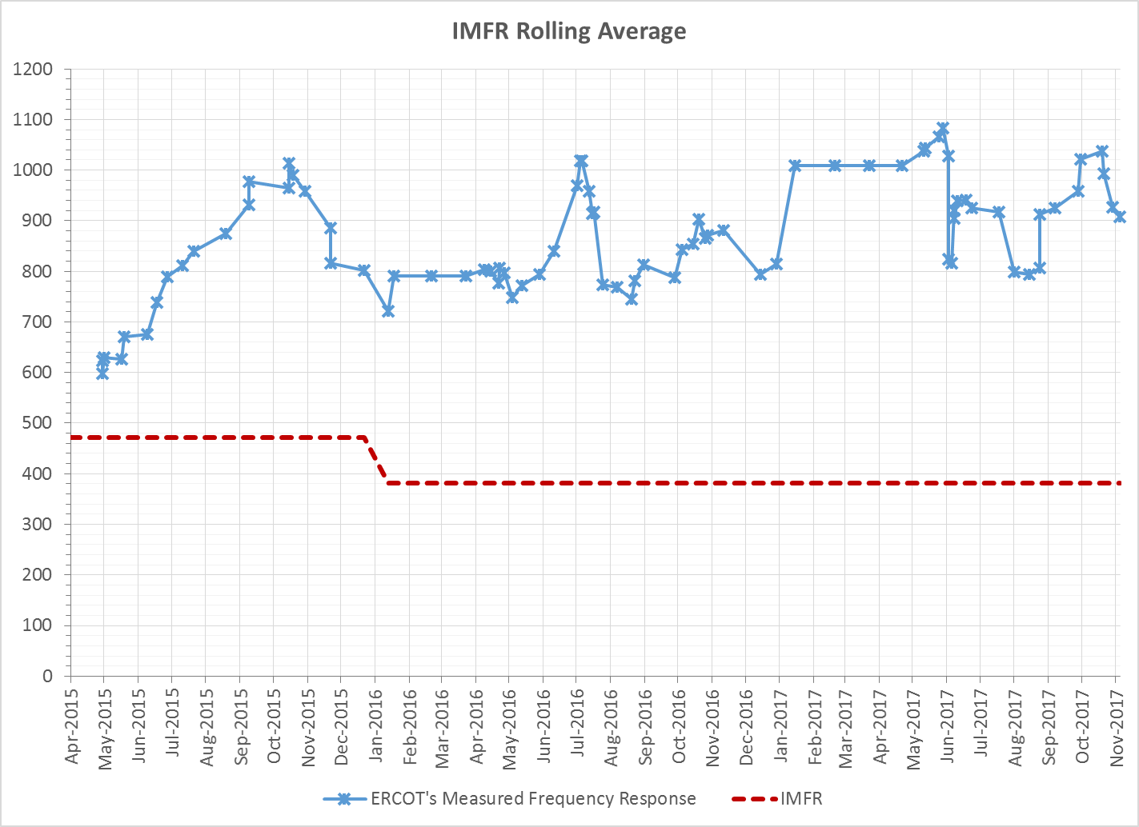
Interconnection Minimum Frequency Response (IMFR) Performance
IMFR Performance currently 907.27 MW/0.1Hz

Slide 8
Frequency Control Report
November 2017

Slide 9
BAAL Exceedances & Violations
There were 2 BAAL exceedances
  November 25th 2017
    FME at 20:24:34
    Loss of 1219 MW
    Less than 59.91 for 2 minutes

Slide 10
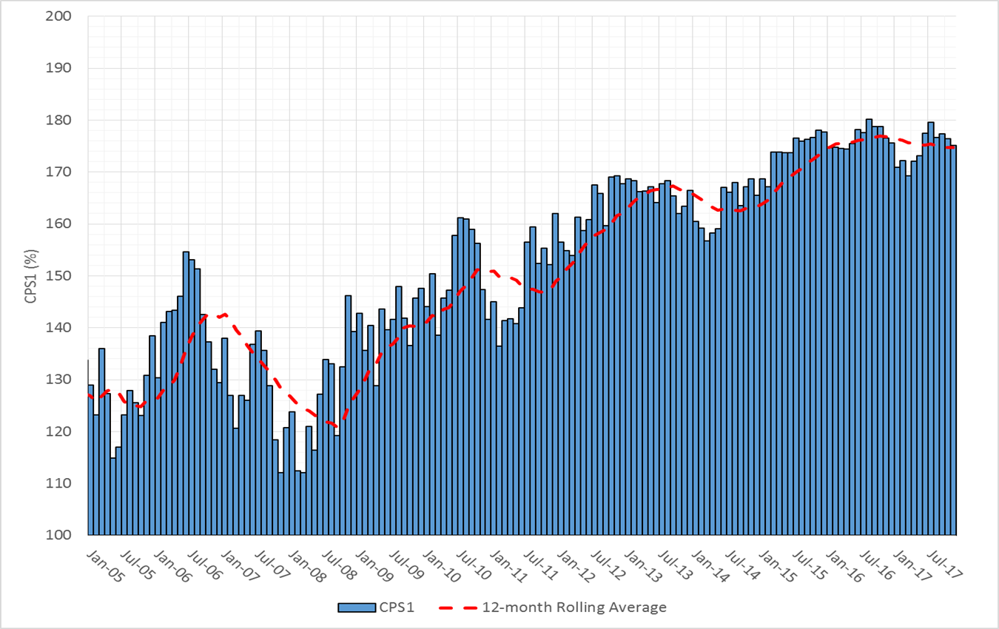
12-10Month Rolling Average CPS1
Current 12-Month Rolling Average: 174.65%

Slide 11
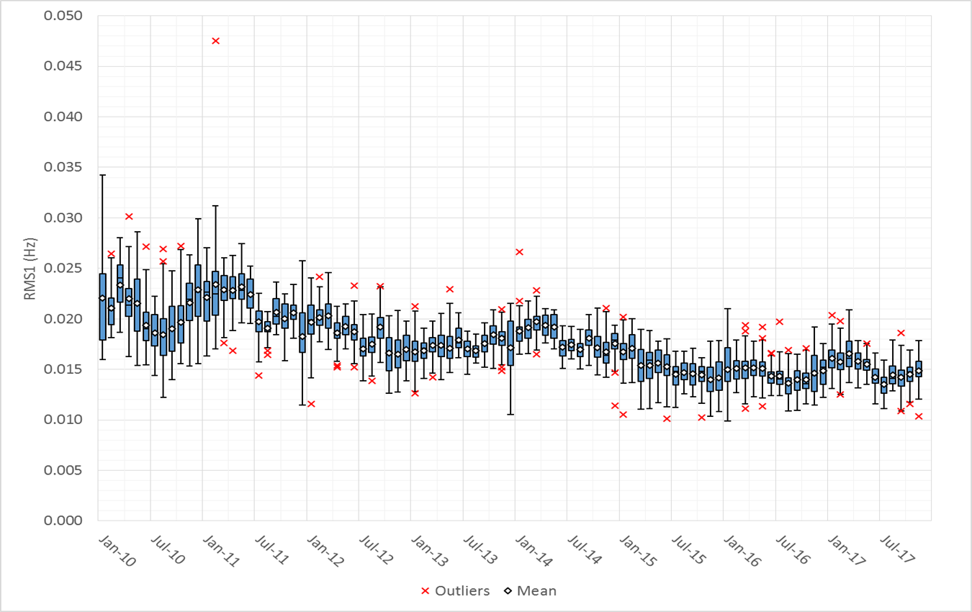
Daily RMS1 of ERCOT Frequency by Month

Slide 12
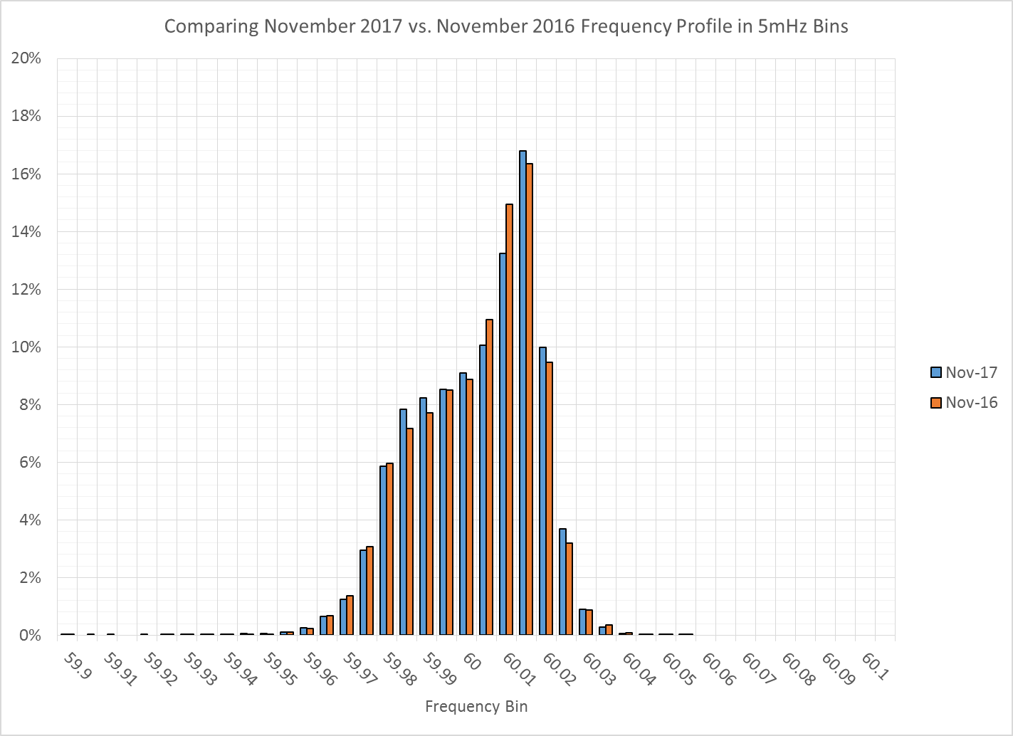
Frequency Profile Comparison

Slide 13
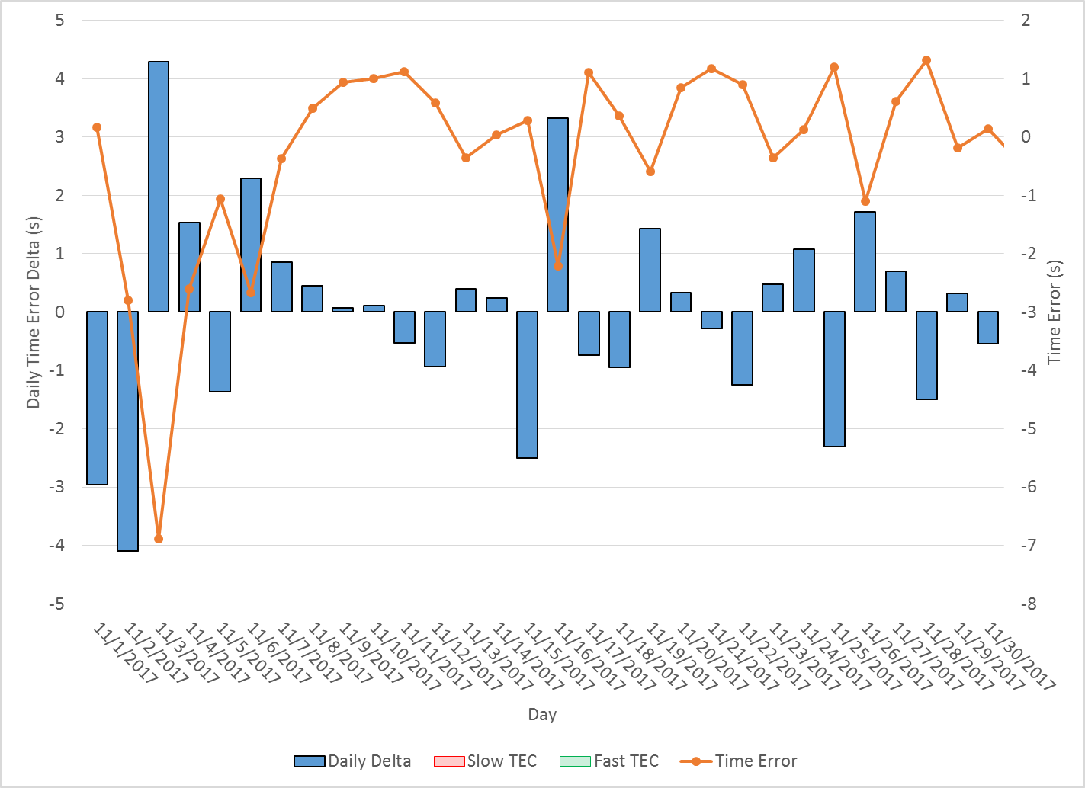
ERCOT Daily Time Error
Notes:
Overall Slow for the 19th and 20th. Fast for the 22nd
Weather Forecast Error
19th
~950 MW under forecast
20th
~740 MW under forecast
22nd
~2000 MW over forecast
23rd
~300 MW over forecast

Slide 14
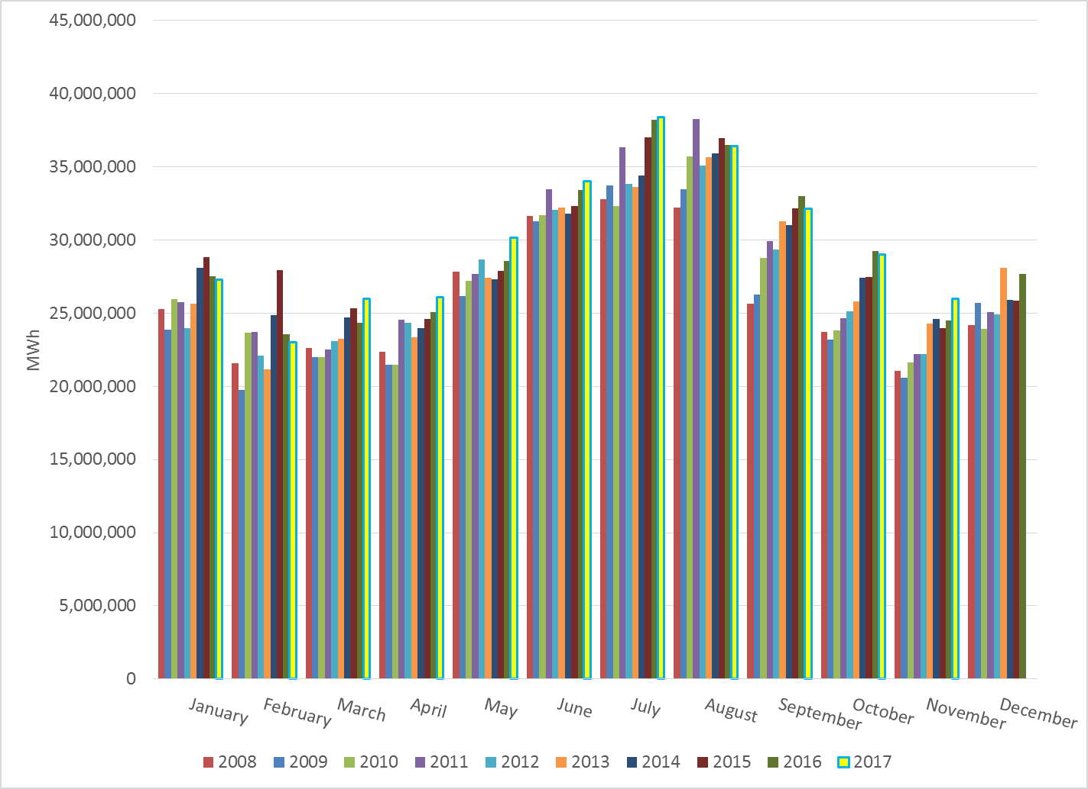
Total Energy

Slide 15
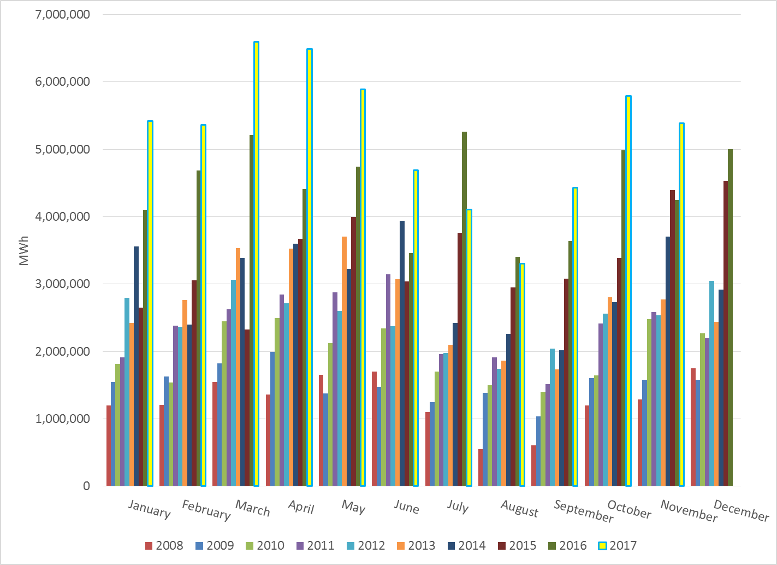
Total Energy from Wind Generation

Slide 16
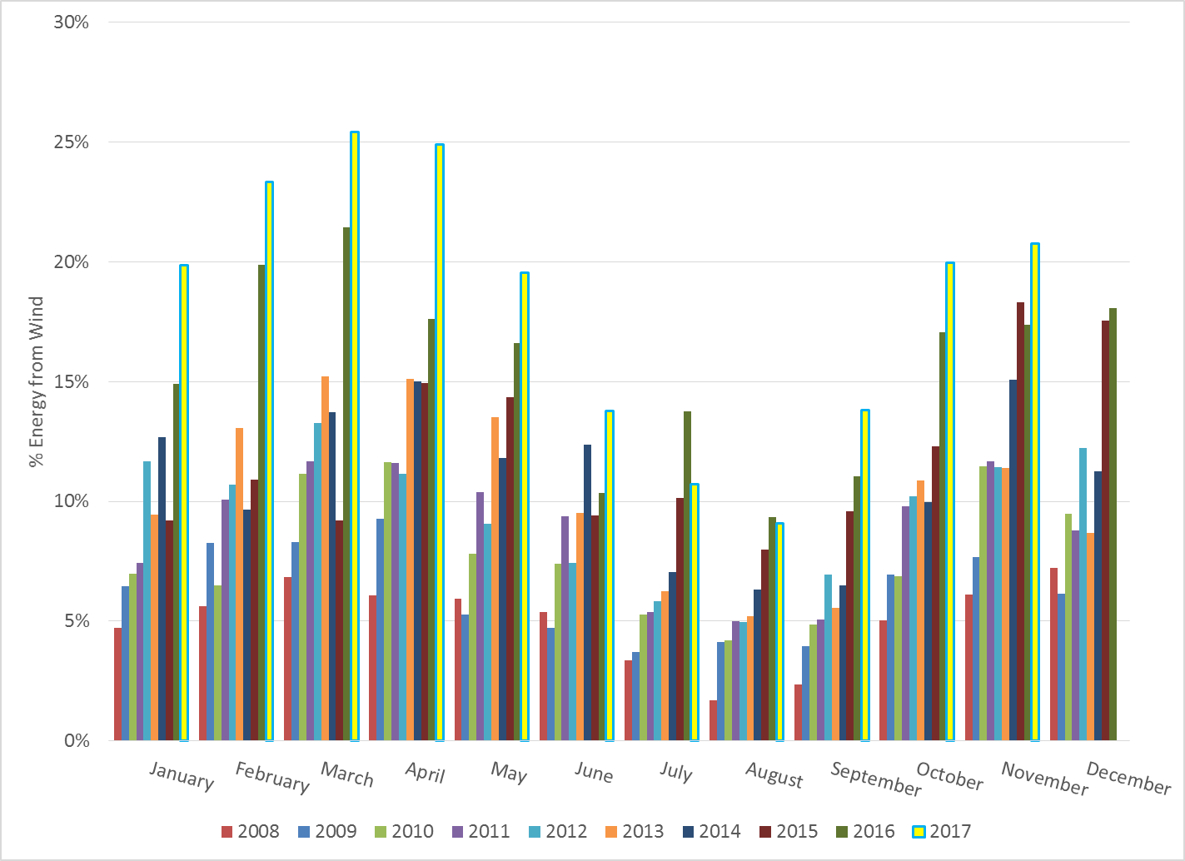
% Energy from Wind Generation

Slide 17
Questions?

