Slide 1
ERCOT
Retail Market Training
Task Force
Update to RMS
Tuesday, January 9, 2018

Slide 2
Retail Training Instructor Led Classes – Proposed for 2018
Proposed Schedule for Retail Training - 2018
AUSTIN | JANUARY | WebEx Only
Tue | January 30th | RETAIL 101 | 9:00 – 4:00
Wed | January 31st | INADVERTENT GAIN TRAINING | 9:00 – 3:30
DALLAS | MAY | Oncor Offices
Tue | May 1st | RETAIL 101 | 9:00 – 4:00
Wed | May 2nd | TxSET TRAINING - tentative | 9:00 – 4:00
HOUSTON | SEPTEMBER | CenterPoint Offices
Tue | September 25th | RETAIL 101 | 9:00 – 4:00
Wed | September 26th | TxSET TRAINING | 9:00 – 4:00

Slide 3
MarkeTrak On-line Training Modules Available
  Marketrak Overview - refreshed
  Switch Hold Removal - refreshed
  Cancel With/Without Approvals - updated
  Inadvertent Gains/Losses & Rescissions - refreshed
  Usage and Billing - refreshed
  Other D2D Subtypes – refresh in progress
  Bulk Insert
  MarkeTrak Admin Functionality
  Data Extract Variances (DEV) LSE Subtypes
  Data Extract Variances (DEV) Non-LSE Subtypes
  Emails and Notifications
  Reporting – Background & GUI

Slide 4
MarkeTrak On-line Module Training via
ERCOT Learning Management System
How many market participants have viewed the Online training modules*?
Which segment of the market do the viewers represent?
There have been 179 users YTD. Top modules viewed are Overview, Inadvertent Gain, and Cancel w/ Approval.
*Training taken via ERCOT LMS. Does not include training taken outside the LMS

Slide 5
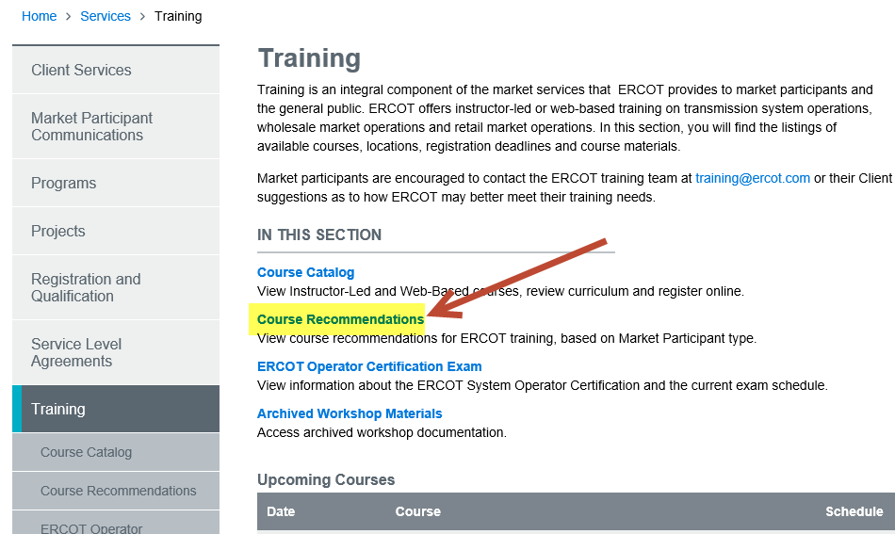
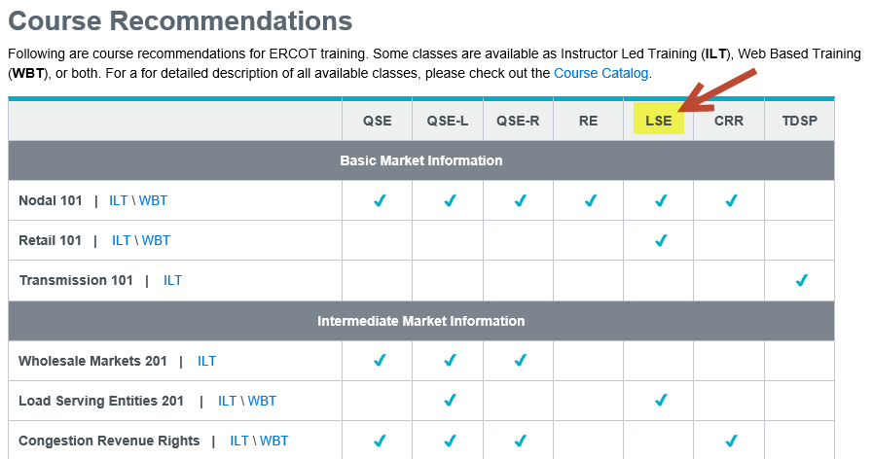
ERCOT Learning Management System – New Feature
The Training page of the ERCOT website has added a new page of Course Recommendations where you can view recommended courses for each Market Participant type.

Slide 6
MarkeTrak On-line Training Module Series
How do I register for Training?
Go to the ERCOT Training Website at http://www.ercot.com/services/training/
Select the course you are interested in attending
On the ‘Schedule/Registration’ tab, select the ‘enroll online’ link under ‘Registration’ to register for the course.
If you find the course is not listed under the Web-based training…
Go to ERCOT Training Website as shown above
Select the ‘ERCOT Learning Management System’ (LMS) link in the upper right hand corner under RELATED CONTENT
If necessary, set up a log on
Once in LMS, follow drop downs for ‘web-based training’ and ‘retail market’. Available modules will appear
Select ‘start course’
Note! Most modules are able to be completed in less than 30 minutes.

Slide 7
Please join us for our Next RMTTF Meeting
January 11, 2018
9:30 AM
ERCOT MET Center

Slide 8
Thank you!

