Slide 1
Commercial Operation Impacts
from Hurricane Harvey
David Maggio
Manager, Market Analysis & Validation
Pam Shaw
Analyst, Market Operations
WMS
ERCOT Public
January 10, 2018

Slide 2
Key Observations
Despite the impacts of Hurricane Harvey, commercial operations and market outcomes stayed fairly stable and were within a normal range during the storm.
The rain and lower temperatures resulted in a significant reduction in demand both regionally and system-wide.
This lessened the impacts of Resource and transmission equipment outages.
There was some divergence in congestion between the Day-Ahead and Real-Time Markets (DAM and RTM).
There are limitations, but there could be some room for improving this alignment during extreme conditions.

Slide 3
Hurricane Harvey path

Slide 4
Impact on System-Wide Demand

Slide 5
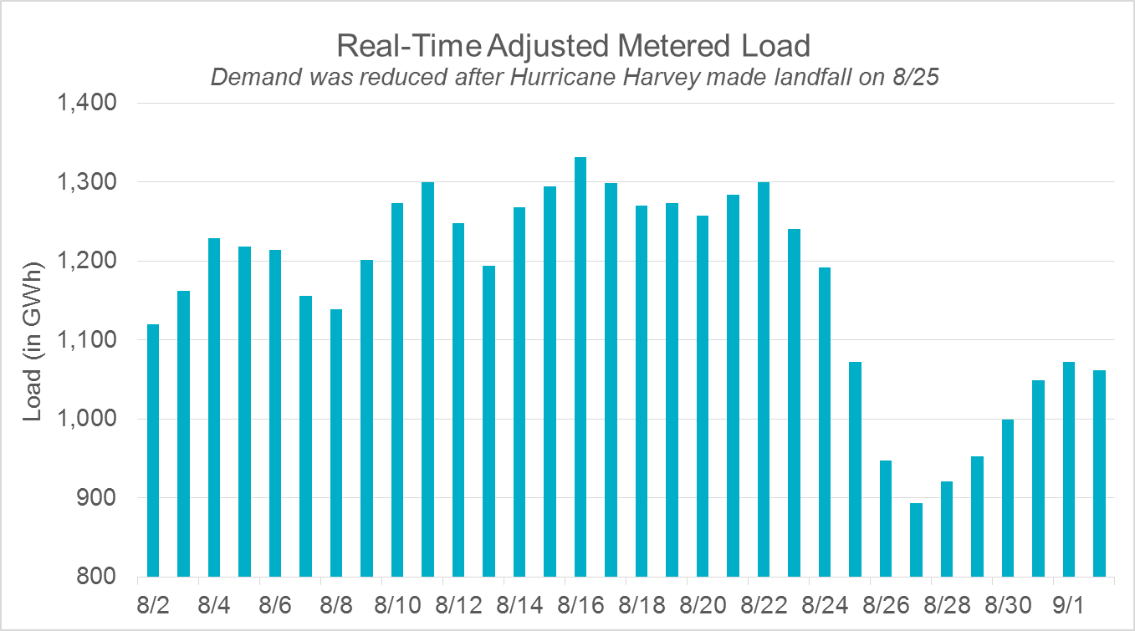
Impact on System-Wide Demand

Slide 6
System-Wide Pricing Impacts

Slide 7
System-Wide Pricing Impacts

Slide 8
Load Resource Availability
Although Responsive Reserve Service (RRS) prices stayed within a normal range, there was a noticeable decrease in RRS offers from Non-Controllable Load Resources in the days after the storm.

Slide 9
ERS Capacity Availability
~2,300 (out of 8,800) ERS participants were located in hurricane impacted areas.
350 had day-long service interruptions accounting for ~20 MW of ERS capacity reduction.
The estimated premise-level reduction in load of ERS participants in hurricane impacted areas was 80 MW starting on August 25 and reached a high of 200 MW on August 29.
Still observing 50-100 MW as of the end of September
Doesn’t necessarily indicate a reduction in the MW of service available

Slide 10
Communication of Meter Data
There was an increase in communication failures experienced in the aftermath of Harvey.
As a baseline, communication failures for a typical Operating Day are generally less than 3%.
ERCOT and TDSPs worked together to gather datasets for settlement

Slide 11
Real-Time and DAM Congestion
There was congestion during this period that resulted in higher prices in individual zones.
There was a discrepancy between RTM and DAM congestion rent in the South Load Zone during this period.
Similar constraints in both markets but different magnitudes for different days

Slide 12
Load Zone Pricing Impacts

Slide 13
Expected Demand in the Coastal Weather Zone

Slide 14
Load Distribution Factors (LDF)
There was significant LDF mismatch in the Coastal and Southern Weather Zones, relative to typical performance.
Current process typically results in a 3 day difference between the source data and the Operating Day for which it’s used
E.g., using data from 8/28 for 8/31
Limited ability to improve performance during extreme events like Harvey

Slide 15
Questions?

